Slide 1
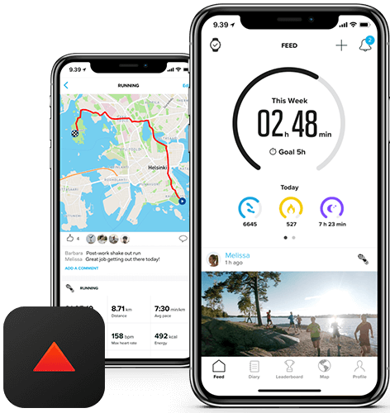


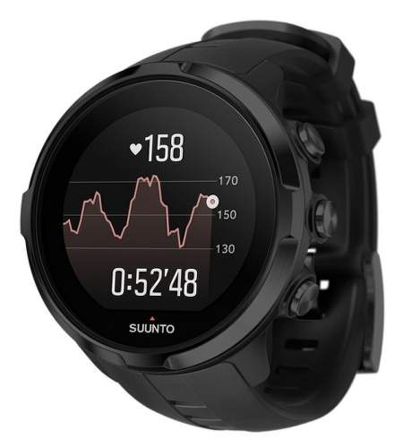

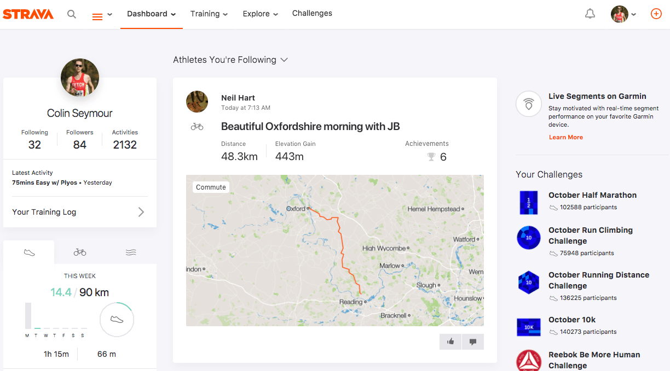



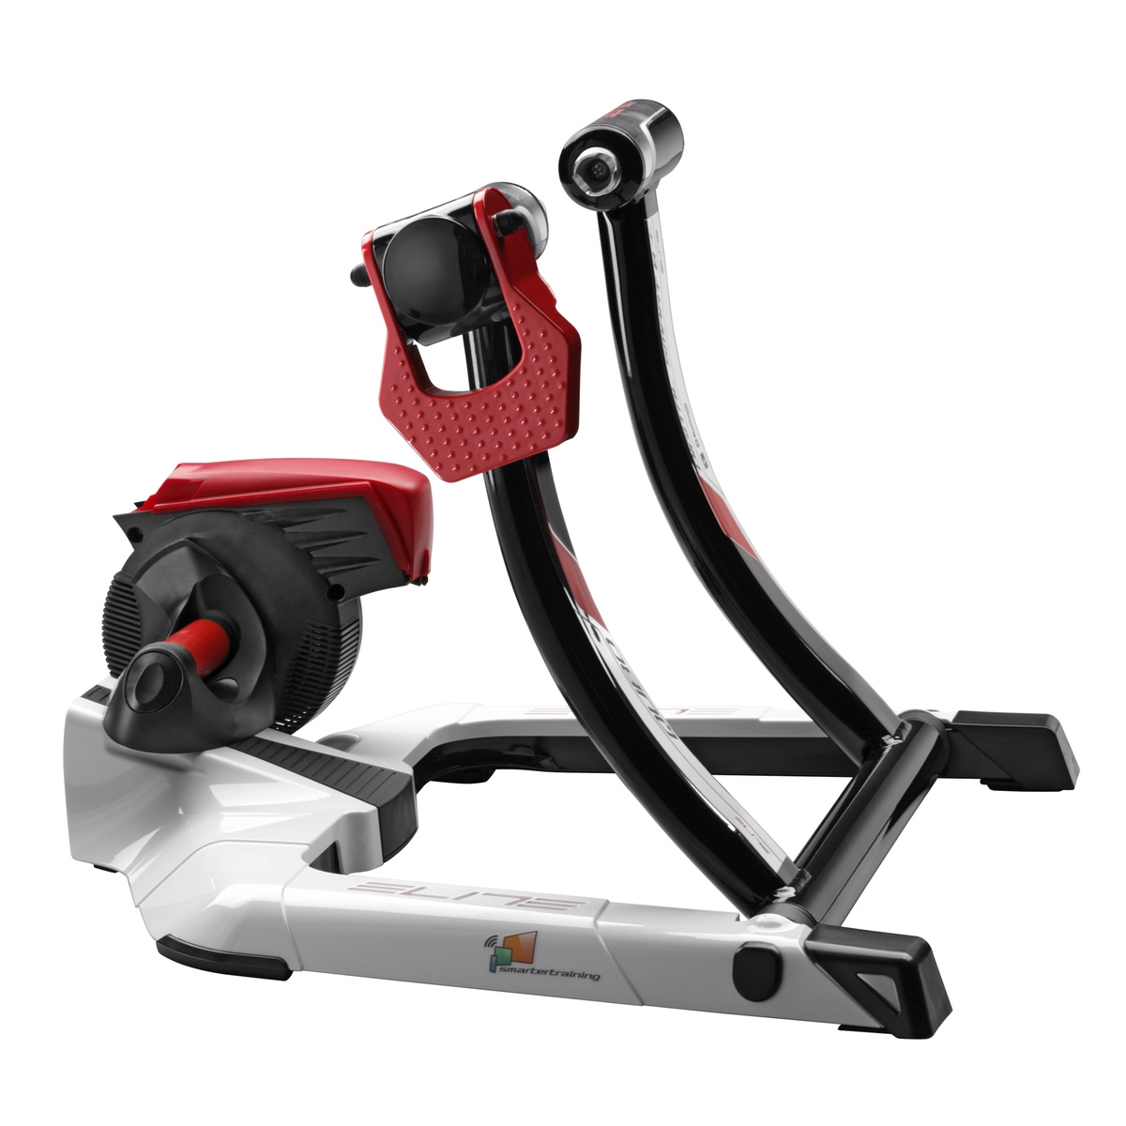
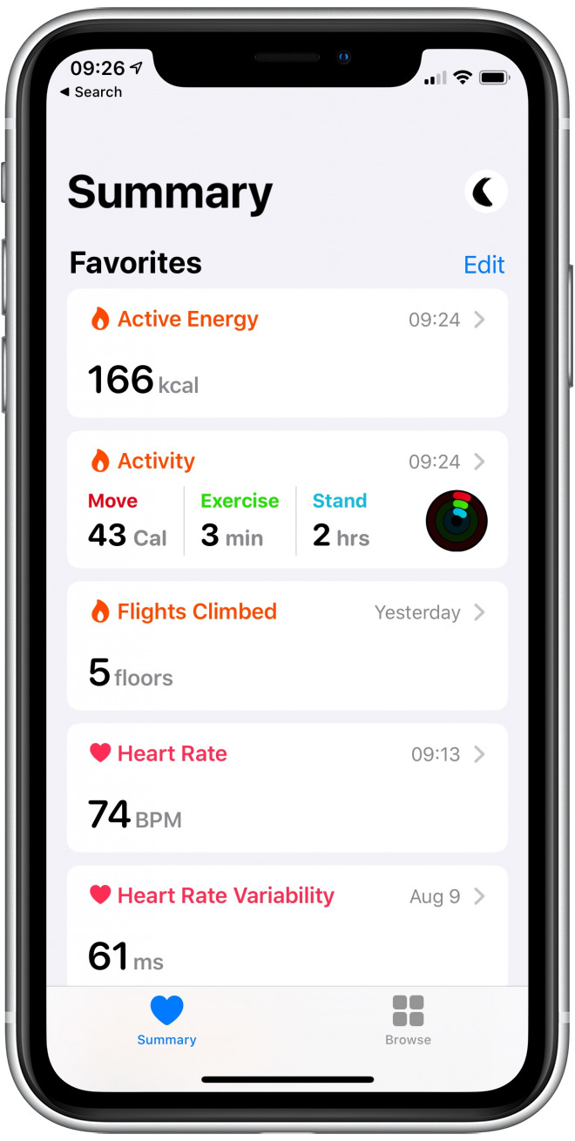

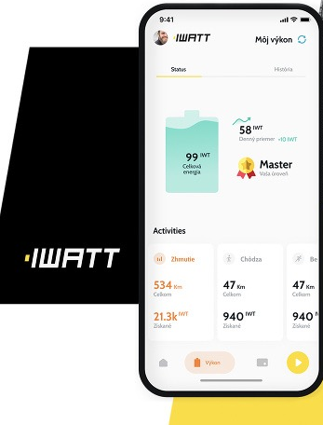




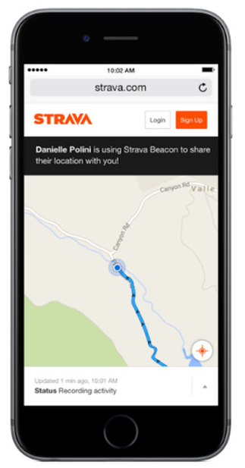
Track/Measure
Export as
FIT file
AirDrop
Upload
activity
Profile/Settings/
Save to Apple Health
SUUNTO
SPARTAN SPORT HR
SUUNTO APP
iOS
HEALTH APP iOS
Elite Qubo
Digital Smart B+
sync
iWatt APP iOS
ELAH BT003
STRAVA APP iOS

Slide 2



