Slide 1
Argument for the Women
Team 7
Female faculty earns less money than the male faculty: across all ranks, and across all salary ranges
Not only does female faculty earn less, a larger percentage of women also enjoy less pay raise than men!

Slide 2
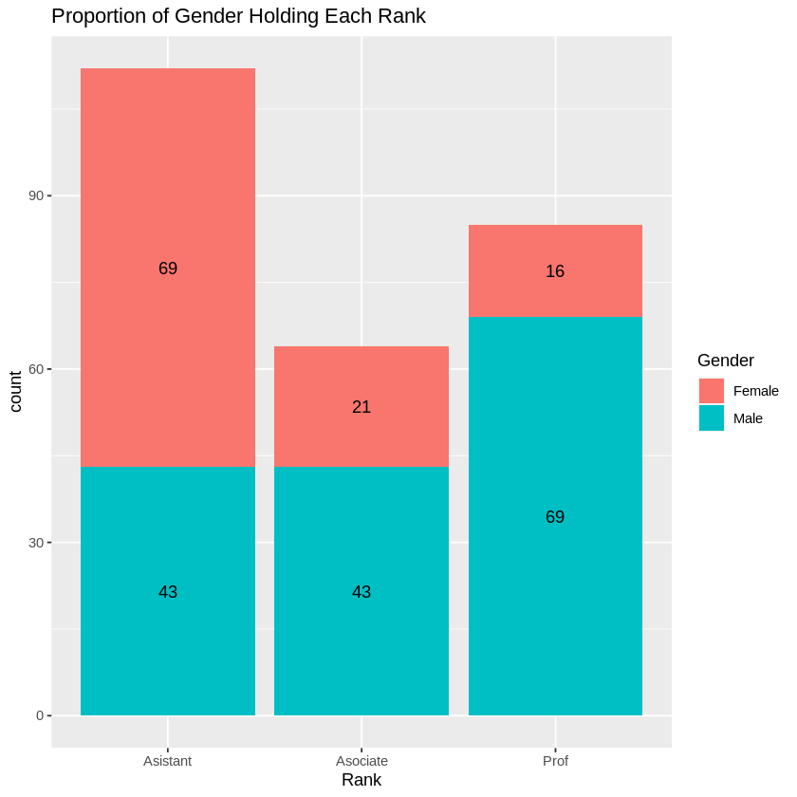
Overview
Overall, there are more women in lower ranks as compared to the men.
Females are less likely to be full profs, and more likely to be assistant profs.
Additionally, we found that the total number of men employed is 1.5 times that of women.
Brandon Ho

Slide 3
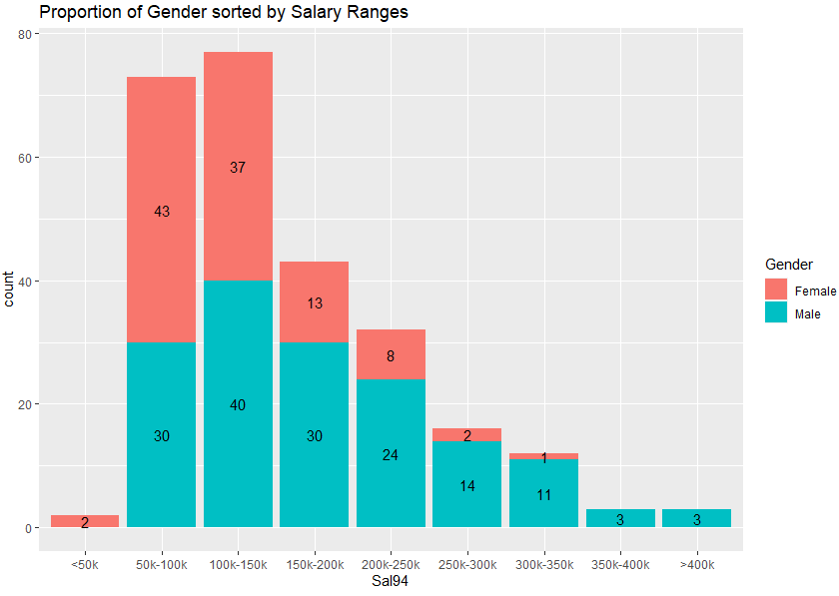
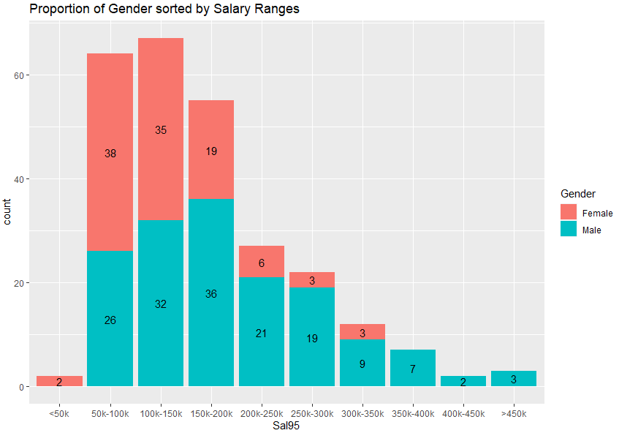
Argument 1: Female faculty earns less across all salary ranges
Females dominate the lower salary ranges while male salaries are more evenly spread
Moreover, the top earners are only males for both 1994 and 1995
Specifically, 77% (1994) and 89% (1995) of females earn less than $200k, while only 64% (1994) & 61% (1995) of males earn less than $200k
Julian Chung

Slide 4
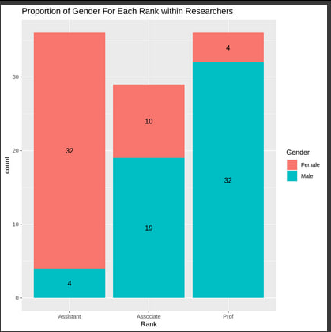
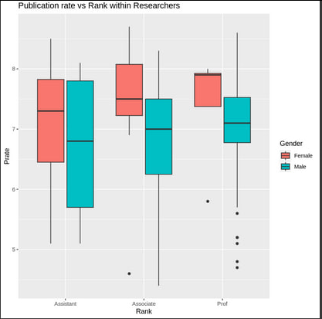
Zooming in: Female researchers are stuck in lower ranks
Across researchers, disproportionate number of females in the lower ranks
Taking publication rate as a key performance indicator, females in each rank consistently outperform their male colleagues but are not fairly promoted
Wang Rui Xian

Slide 5
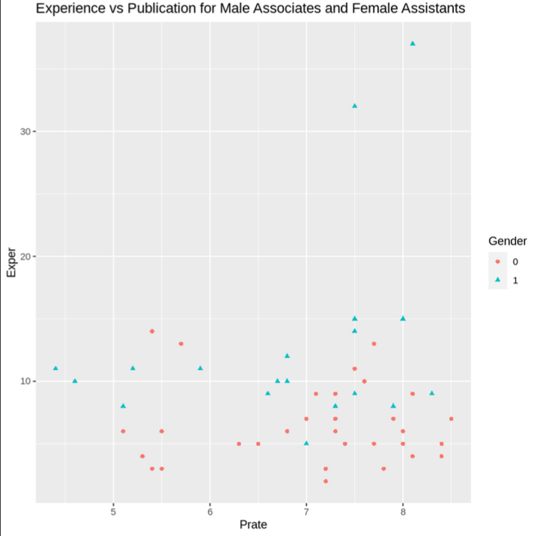
Zooming in: Female researchers are stuck in lower ranks
We cross-examine key metrics between female assistant researchers and male associate researchers
Females assistant researchers on average have higher publication rate, and similar experience to male associate researchers
Wang Rui Xian

Slide 6
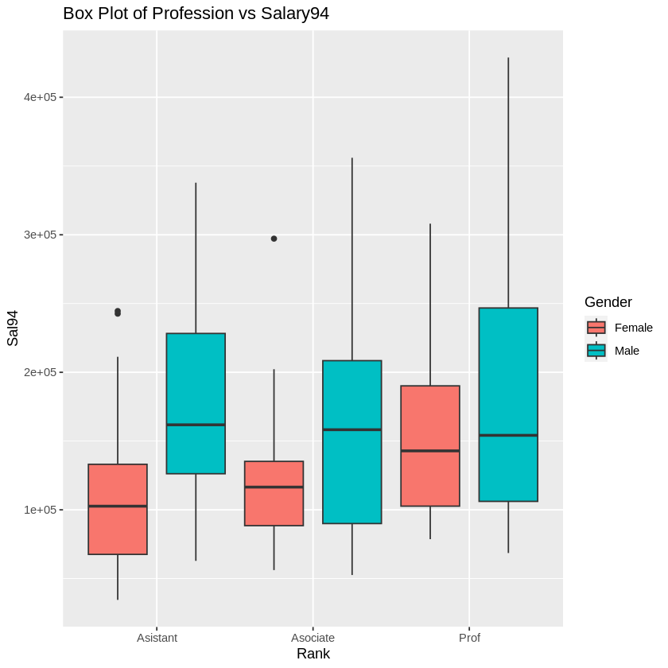

Female faculty earns less across and between all ranks
Looking at the median when comparing across the same ranks, the female faculty is earning less than the male faculty. 2 interesting points:
Lower rankings seems to have it worst: the female assistant outlier samples barely surpass the 3rd quartile of male assistants.
An interesting “pattern” is that the median of the higher ranking female faculty is struggling to beat the median of the lower ranking male faculty. (e.g female median prof vs male media associate).
The range of salary distribution is also much narrower for the female faculty (length from top whisker to bottom whisker). All this is the same even when including both the academic year 94 and 95.
How Rui Yang

Slide 7
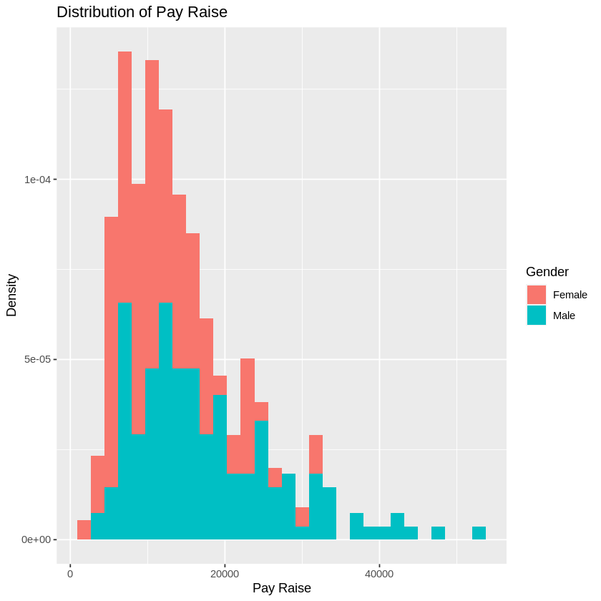
Argument 2: Female faculty pay raise is less than male faculty
The graphs of both the female and male faculty are right-skewed and the peaks are actually roughly the same, but this is seemingly deceptive.
The graph of the male faculty follows a fatter & longer-tailed distribution -> meaning we see a bigger proportion of male faculty having a disproportionately higher pay raise than the female faculty.
The male faculty seems to enjoy a higher pay raise than the female faculty. This further worsens the gender pay gap!
How Rui Yang

Slide 8
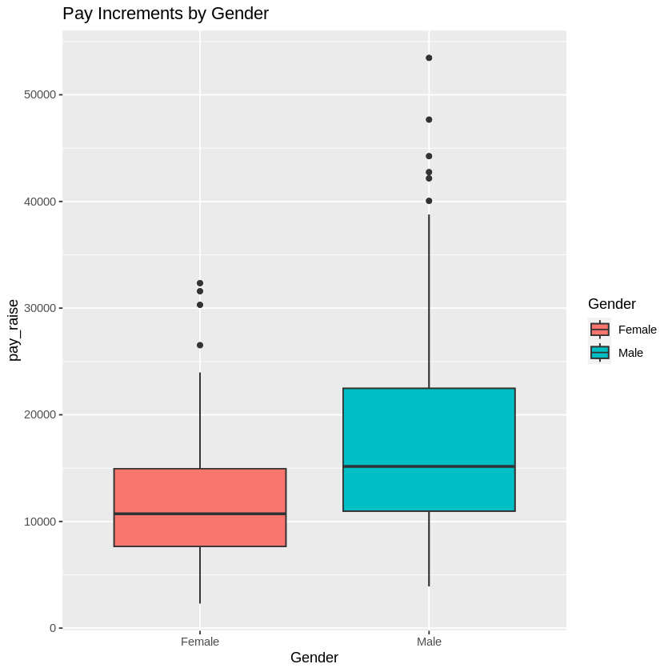
The boxplot further proves it
Although the peaks were roughly the same in the previous graph, this graph shows that…
The female faculty median is basically at the 1st quartile of the male faculty => most of the female faculty is just getting a lower raise!
How Rui Yang

