Slide 1
RDBMS & Oracle SQL

Slide 2
Agenda
Introduction to Database
Data Manipulation Language
Normalization
Transaction Control Language
Data Control Language
Data Query Language
Data Definition Language
Single & Multiple Row Functions

Slide 3
Agenda
Set operations in SQL
Joins in SQL
SubQueries in SQL

Slide 4
Introduction to Databases

Slide 5
Objectives
The objective of this session is to make participants understand the Database Concepts and enable to design the Database Schema

Slide 6
Contents
Database Fundamentals
Database Views and Users
Data Models
Normalization
Notes:
Internet - a global network of computer networks that use standard protocols to exchange information, the largest network of computer networks.
World Wide Web - the network of HTML files stored on Web servers and interlinked with hyperlinks, thereby creating a "web" of interlinked files
URL - the address of a Web page consist of (Protocols, Hostname and DNS, IP Address, Port number)
Domain Name - names used in URL's and corresponding to one or more IP addresses. Domain names always carry a suffix, the top-level domain name such as com or edu. Domain names in a URL are case sensitive
Web server - a computer connected to the Internet that provides electronic files to other computers.
Browser - a software application used to access the World Wide Web and view web pages
HTTP - the protocol computers use to transmit Web documents between computers, identified by the prefix "http://" of the URL
ISP - companies that sell access to the Internet to other users.

Slide 7
Introduction to Database
DB - A set of inter-related data
MS - A software that manages the data
SCHEMA - A set of tables and relationships, which meet a specific need
ENDUSER TOOLS
DBMS
DATA
END USER
END USER
APPLICATIONS

Slide 8
Database Administrator
Is a database architect who is responsible for design and implementation of new databases.
Manages the database centrally
Decides on the type of data, internal structures and their relationships
Ensures the security of the database
Controls access to the data through the user codes and passwords
Can restrict the views or operations that the users can perform on the database.

Slide 9
Characteristics of DBMS
Control of Data Redundancy
Same data is stored at number of places
DBMS helps in removing redundancies by providing means of integration.
Sharing of Data
DBMS allow many applications to share the data.
Maintenance of Integrity
Refers to the correctness, consistency and interrelationship of data with respect to the application, which uses the data.

Slide 10
Characteristics of DBMS
Support for Transaction Control and Recovery
DBMS ensures that updates take place physically after a logical transaction is complete.
Data Independence
In DBMS, the application programs are transparent to the physical organization and access techniques.
Availability of Productivity Tools
Tools like query language, screen and report painter and other 4GL tools are available.

Slide 11
Characteristics of DBMS
Control over Security
DBMS provide tools by which the DBA can ensure security of the database.
Hardware Independence
Most DBMS are available across hardware platforms and operating systems.

Slide 12
Levels of Abstraction
Conceptual Level :-the overall integrated structural organization of the database
Physical Level :- the information about how the database is actually stored in the disk.
View / External Level :- the user view of the database. Different for different user based on application requirement.

Slide 13
The Data Model
Data model defines the range of data structures supported and the availability of data handling languages
It is a collection of conceptual tools to describe:
Data
Data relationships
Constraints
There are different data models:
Hierarchical Model
Network Model
Relational Model
Notes:
What is A Data Model
A data model is a conceptual representation of the data structures that are required by a database. The data structures include the data objects, the associations between data objects, and the rules which govern operations on the objects. As the name implies, the data model focuses on what data is required and how it should be organized rather than what operations will be performed on the data. To use a common analogy, the data model is equivalent to an architect's building plans.
A data model is independent of hardware or software constraints. Rather than try to represent the data as a database would see it, the data model focuses on representing the data as the user sees it in the "real world". It serves as a bridge between the concepts that make up real-world events and processes and the physical representation of those concepts in a database.

Slide 14
Contd…
What is A Data Model
A conceptual representation of the data structures that are required by a database.
The data structures include the data objects, the associations between data objects, and the rules which govern operations on the objects.
The data model focuses on what data is required and how it should be organized rather than what operations will be performed on the data.
The data model is equivalent to an architect's building plans.
A data model is independent of hardware or software constraints
The data model focuses on representing the data as the user sees it in the "real world".
It serves as a bridge between the concepts that make up real-world events and processes and the physical representation of those concepts in a database.

Slide 15
Contd…
Why is Data Modeling Important?
To make sure that the all data objects required by the database are completely and accurately represented.
Because the data model uses easily understood notations and natural language , it can be reviewed and verified as correct by the end-users.

Slide 16
Contd…
The data model is also detailed enough to be used by the database developers to use as a "blueprint" for building the physical database. The information contained in the data model will be used to define the relational tables, primary and foreign keys, stored procedures, and triggers. A poorly designed database will require more time in the long-term. Without careful planning you may create a database that omits data required to create critical reports, produces results that are incorrect or inconsistent, and is unable to accommodate changes in the user's requirements.

Slide 17
Hierarchical Structure
In this model data is represented by simple tree structure
Relationships between entities are represented as parent-child.
Many-to-many relationships are not allowed.
Parents and children are tied together by links called "pointers"
Root
Level 1
Child
Level 1
Child
Level 2
Child
Level 2
Child
Level 2
Child
Level 2
Child

Slide 18
The Hierarchical Model
Consider a student course - marks database
In the hierarchical model a student can register for many courses and gets marks for each course.
A parent can have many children
A child cannot have more than one parent
No child can exist without its parent
Scode
Sname
S1
A
Scode
Sname
Ccode
Cname
Marks
S2
B
C1
Physics
65
Ccode
Cname
Marks
C2
Chemistry
78
C3
Maths
83
C3
Maths
83
C4
Biology
85
C4
Biology
85

Slide 19
Possibilities in Hierarchical Model
INSERT
Insertion of Dummy student required to introduce a new course.
DELETE
Deleting a student- the only one to take the course deletes course information.
UPDATE
To change the course name of one course, the whole database has to be searched, this may result in data inconsistency.

Slide 20
The Network Model
Network model solves the problem of data redundancy by representing relationships in terms of sets rather than hierarchy
A record occurrence may have any number of immediate superiors
Network model supports many-to-many relationships

Slide 21
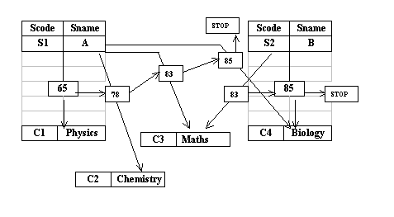
The Network Model
The student and course records are linked together through a marks record
No restrictions on number of parents
Record type can have number of parent and child record types
It is more complex than the hierarchical model because of links
Is a superset of the hierarchical model

Slide 22
Possibilities in Network Model
INSERT
Inserting a course record or student record poses no problems as they can exist without any connectors till a student takes the course.
DELETE
Deleting any record automatically adjusts the chain
UPDATE
Update can be done only to a particular child record

Slide 23
The Relational Model
The Relational Model developed out of the work done by Dr. E. F. Codd at IBM in the late 1960s who was looking for ways to solve the problems with the existing models.
At the core of the relational model is the concept of a table (also called a relation) in which all data is stored.
Each table is made up of records (horizontal rows also known as tuples) and fields (vertical columns also known as attributes).
Examples of RDBMS are Oracle, Informix, and Sybase.

Slide 24
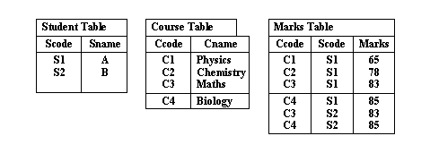
The Relational Model
Because of lack of linkages relational model is easier to understand and implement.

Slide 25
Possibilities in Relational Model
INSERT
Inserting a course record or student record poses no problems because tables are separate
DELETE
Deleting any record affects only a particular table
UPDATE
Update can be done only to a particular table

Slide 26
Relational DBMS
Examples of Relational Tables
DEPT table
Deptno Dname Loc
10 Accounting New York
20 Research Dallas
30 Sales Chicago ß 'row' or 'tuple'
40 Operations Boston
á
'column' or 'attribute'
EMPLOYEE table
Empno Empname Job Mgr Deptno
7369 Smith Clerk 7902 20
7499 Allen Salesman 7839 30
7566 Jones Manager 7839 20
7839 King President 10
7902 Ford Analyst 7566 20

Slide 27
Properties of Relational Data Structures
Tables must satisfy the following properties to be classified as relational.
Entries of attributes are single valued
Entries of attribute are of the same kind.
No two rows are identical
The order of attributes is unimportant
The order of rows is unimportant
Every column can be uniquely identified.

Slide 28
Data Integrity
Data integrity is the assurance that data is consistent, correct, and accessible
Entity Integrity:
Entity integrity ensures that no records are duplicated and that no attributes that make up the primary key are NULL
It is one of the properties necessary to ensure the consistency of the database.
Foreign Key and Referential Integrity
The referential integrity rule : If a foreign key in table A refers to the primary key in table B, then every value of the foreign key in table A must be null or must be available in table B

Slide 29
Data Integrity (Cont…)
Unique Constraint:
A unique constraint is a single field or combination of fields that uniquely defines a tuple/row
Unique constraints ensure that every value in the specified key is unique
A table can have any number of unique constraints, with at most one unique constraint defined as a primary key
A unique constraint can contain NULL value.

Slide 30
Data Integrity (Cont…)
DEPT table
Deptno Dname Loc
10 Accounting New York
Research Dallas
EMPLOYEE table
Empno Empname Job Mgr Deptno
7369 Smith Clerk 7902 20
7499 Allen Salesman 7839 30
Column Constraints : Specify restrictions on the values a column can take

Slide 31
Normalization

Slide 32
Normalization
is a technique for designing relational database tables
minimize duplication of information
safeguard the database against certain types of problems

Slide 33
Contd…
Process of efficiently organizing data in a database
Goals of the normalization process:
eliminate redundant data
ensure data dependencies make sense
reduces the amount of space a database consumed
ensures that data is logically stored.
Notes:
Definition:
Normalization is the process of modifying a data model or database design so that the resulting entities or tables are in normal form
OR
It is a process of reducing a complex data structure into its simplest and most stable structure. In general, the process entails the removal of redundant attributes, keys, and relationships from a conceptual data model.

Slide 34
Problems with Unnormalized Database
can suffer from logical inconsistencies of various types and from anomalies involving data operations.
UPDATE ANOMALY
INSERTION ANOMALY
DELETION ANOMALY

Slide 35
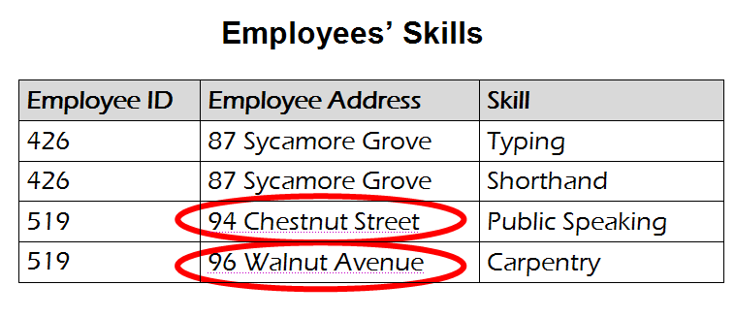
Example: UPDATE ANOMALY
An update anomaly. Employee 519 is shown as
having different addresses on different records

Slide 36
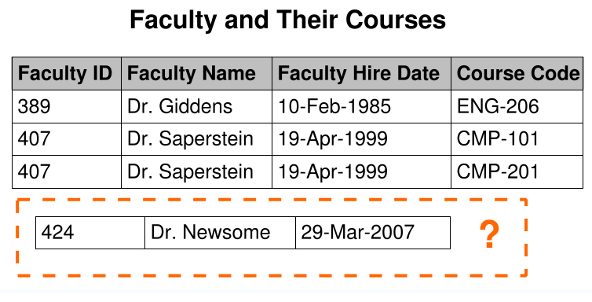
Example: INSERTION ANOMALY
An insertion anomaly. Until the new faculty member is assigned
to teach at least one course, his details cannot be recorded.

Slide 37
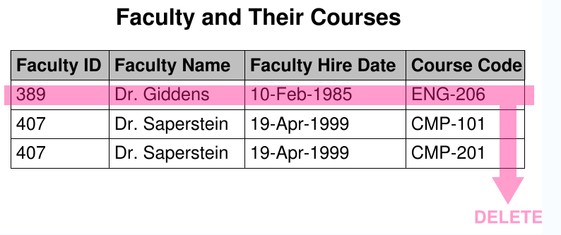
Example: DELETION ANOMALY
A deletion anomaly. All information about Dr. Giddens is lost when
he temporarily ceases to be assigned to any courses

Slide 38
Background to normalization:
Functional dependency
Trivial functional dependency
Transitive dependency
Multivalued dependency
Join dependency
Super key
Candidate key
Non-prime attribute
Primary key

Slide 39
Purpose of the Normalization
no duplication of data
2. no unnecessary data stored within a Database.
3. All the attributes (columns) of a table are completely dependent on the primary key of a table only and not on any other attribute.

Slide 40
Properties of Normalization:
Two important properties of Normalization:
a. Lossless Join Property
b. Dependency Preservation Property

Slide 41
Normal forms (abbrev. NF)
provides criteria for determining a table's degree of vulnerability to logical inconsistencies and anomalies.
The higher the NF applicable to a table, the less vulnerable it is to inconsistencies and anomalies

Slide 42
Normal Forms – Anomalies and Data Redundancies
A number of NF have been defined for classifying relations.
has associated with the relation.
Are used to ensure the various types of anomalies and inconsistencies

Slide 43
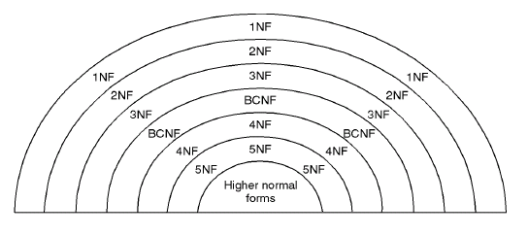
Relationship between Normal Forms

Slide 44
Unnormalized Relation
A table that contains one or more repeating groups.
To create an unnormalized table transform the data from the information source (e.g. form) into table format with columns and rows.

Slide 45

Unnormalized relation contains non atomic values
Below unnormalized table shows the preferences that student registers for various classes
Each row may contain non-atomic values

Slide 46
First Normal Form (1NF)
Eliminate Repeating Groups - Make a separate table for each set of related attributes, and give each table a primary key.
1NF requires that the values in each column of a table are atomic. By atomic we mean that there are no sets of values within a column.

Slide 47
Contd…
A table is in first normal form (1NF) if and only if it faithfully represents a relation.
a table with a unique key and without any nullable columns is in 1NF

Slide 48
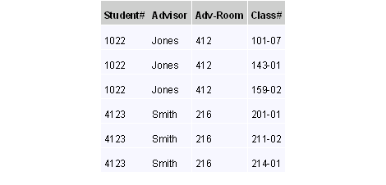
Example of First Normal form
unnormalized data is normalized to 1NF

Slide 49
Second Normal Form (2NF)
Is based on the concept of Full Functional Dependency.
A relation R is in 2NF if and only if it is in 1NF and every non-key attribute is fully functionally dependent on the primary key of the relation R.

Slide 50
Rules for 2NF
A table in 1NF is also in 2NF form if the values in every column are functionally or transitively dependent on the complete primary key
For every relation with a single data item making up the primary key, this rule should always be true. For those with the composite key examine every column and ask whether its value depends on the whole of the composite key or just some part of it
Remove those that depend only on part of the key to a new relation with that part as the primary key
Notes:
(1): The Second Normal Form involves the idea of Functional Dependency.
Functional Dependency : Attribute B has a functional dependency on attribute A if, for each value of attribute A, there is exactly one value of attribute B. Example, in a Employee table, Employee Address has a functional dependency on Employee ID, because a particular Employee ID value corresponds to one and only one Employee Address value. (Note that the reverse need not be true: several employees could live at the same address and therefore one Employee Address value could correspond to more than one Employee ID. Employee ID is therefore not functionally dependent on Employee Address.) An attribute may be functionally dependent either on a single attribute or on a combination of attributes. It is not possible to determine the extent to which a design is normalized without understanding what functional dependencies apply to the attributes within its tables; understanding this, in turn, requires knowledge of the problem domain. For example, an Employer may require certain employees to split their time between two locations, such as New York City and London, and therefore want to allow Employees to have more than one Employee Address. In this case, Employee Address would no longer be functionally dependent on Employee ID.
Full Functional Dependency : In some cases, a column may not be functionally dependent on a single column but functionally dependent on a group of columns. B is 'fully functionally dependent' on A if it is dependent on all of A, not on any part of A. Example, {Employee Address} has a functional dependency on {Employee ID, Skill}, but not a full functional dependency, for it is also dependent on {Employee ID}.
Transitive dependency: A transitive dependency is an indirect functional dependency, one in which A→C only by virtue of A→B and B→C. Example, Salary-scale depends on Grade and Grade is dependent on Emp-code. This means that Salary-scale is transitively dependent on Emp-code.

Slide 51
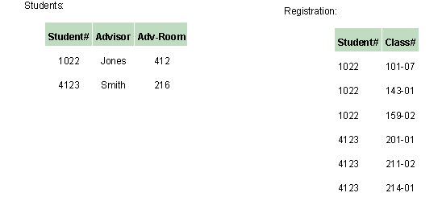
Example of 2NF form
The below two tables demonstrate 2NF.
Note the multiple Class# values for each Student# value in the above table. Class# is not functionally dependent on Student# (primary key), so this relationship is not in 2NF.

Slide 52
Example for 2nf
Let’s consider relation Emp_proj has the following structures with the following FDs:
Emp_Proj (SSN, Pnumber, Hours, Ename, Pname, Plocation)
SSN -> Ename
Pnumber -> {Pname, Plocation}
{SSN,Pnumber} -> Hours
{SSN,Pnumber} -> Ename

Slide 53
Contd…
In the above set of FDs for the relation Emp_Proj the attribute Ename is partially dependent on {SSN,Pnumber} because SSN􀃆Ename also holds. Therefore Ename is not fully functionally dependent on SSN.
So we decompose this table to arrive at set of relations, in a state as defined by second normal form. Thus the above table EMP_PROJ gets decomposed in the following three relations say EP1, EP2 and EP3.

Slide 54
Contd…
EP1 (SSN, PNUMBER, HOURS) {SSN,PNUMBER} -> HOURS
EP2 (SSN,ENAME) SSN->ENAME
EP3 (PNUMBER,PNAME,PLOCATION) PNUMBER->{PNAME,PLOCATION}

Slide 55
Third Normal form
Eliminate Columns Not Dependent On Key - If attributes do not contribute to a description of the key, remove them to a separate table
3nF is based on the concept of transitive dependency.
A relation R is in 3NF if and only if it is in 2NF and every non-key attribute is nontransitively dependent on the primary key of the relation R.

Slide 56
The criteria for third normal form (3NF)
Rules :
A relation in the second normal form is also in the third normal form, if the values in every non - key column are not transitively dependent on the primary key
Examine every non - key column and question its relationship with every other non - key column
If there is a transitive dependency remove both the columns to a new relation

Slide 57
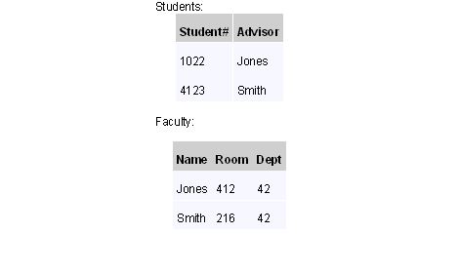
Example of Third Normal form
In the last example, Adv-Room (the advisor's office number) is functionally dependent on the Advisor attribute.
move that attribute from the Students table to the Faculty table, as shown below:

Slide 58
Example for 3NF
Let’s consider relation Emp_dept has the following structures with the following FDs:
Emp_dept (Ename,SSN, Bdate, Address,Dnumber,Dname,DMGRSSN)
SSN -> Ename
SSN -> Bdate
SSN -> DNumber
DNumber -> Dname
DNumber -> DMGRSSN

Slide 59
Contd…
In the above relation Emp_dept the dependency SSN->DMGRSSN is transitive as both the dependencies SSN->Dnumber and Dnumber->DMGRSSN holds and Dnumber is neither a key itself nor a subset of Emp_dept.
So we decompose this table to arrive at set of relations, in a state as defined by third normal form. Thus the above table EMP_PROJ gets decomposed in the following two relations say EP1 and EP2.

Slide 60
Contd…
EP1 (Ename,SSN, Bdate,Address,Dnumber) SSN->{Ename,BDate,Address,DNumber}
EP2 (Dnumber,Dname,DMGRSSN)
Dnumber->{Dname,DMGRSSN}

Slide 61

Contd…
this relation has redundancies wherein If the name of the employee is changed, the change will have to be made in every tuple of the relation, otherwise inconsistencies will creep up.
The table will further have to be decomposed to eliminate dependencies between the candidate key columns as shown,

Slide 62
BENEFITS OF NORMALIZATION
Greater overall database organization
Reduction of redundant data
Data consistency within the database
A much more flexible database design
A better handle on database security

Slide 63
DRAWBACKS OF NORMALIZATION
Reduced database performance
The acceptance of reduced performance requires the knowledge that when a query or transaction request is sent to the database
requires much more CPU, memory, and I/O to process transactions and database queries

Slide 64
Summary
RDBMS are primary used for storing transactional data.
E-R Model is prepared to map the business system to database.
Normalization is the process of refining the table schema.

Slide 65
Data Control Language

Slide 66
DCL: User Creation
Creating User Statement
Creates a new row in the mysql.user system table
Unspecified properties are set to their default values:
CREATE USER [IF NOT EXISTS]
user [auth_option] [, user [auth_option]] ...
DEFAULT ROLE role [, role ] ...
[REQUIRE {NONE | tls_option [[AND] tls_option] ...}]
[WITH resource_option [resource_option] ...]
[password_option | lock_option] ...
[COMMENT 'comment_string' | ATTRIBUTE 'json_object']
CREATE USER GIRI-PRASAD.P@ATOS.NET
IDENTIFIED WITH caching_sha2_password BY 'new_PWD’
PASSWORD EXPIRE INTERVAL 180 DAY
FAILED_LOGIN_ATTEMPTS 3
PASSWORD_LOCK_TIME 2;

Slide 67
DCL – USER CREATION
Authentication: The authentication plugin defined by the default_authentication_plugin system variable, and empty credentials
Default role: NONE
SSL/TLS: NONE
Resource limits: Unlimited
Password management: PASSWORD EXPIRE DEFAULT PASSWORD HISTORY DEFAULT PASSWORD REUSE INTERVAL DEFAULT PASSWORD REQUIRE CURRENT DEFAULT; failed-login tracking and temporary account locking are disabled
Account locking: ACCOUNT UNLOCK
An account when first created has no privileges and a default role of NONE. To assign privileges or roles, use the GRANT statement.

Slide 68
DCL: User Creation
creating a new user account name as Trainer and password as syntel123.
Example for Creating an account that uses the caching_sha2_password authentication plugin and the given password. Require that a new password be chosen every 180 days, and enable failed-login tracking, such that three consecutive incorrect passwords cause temporary account locking for two days:
CREATE USER trainer IDENTIFIED BY syntel123;
CREATE USER trainer IDENTIFIED WITH
caching_sha2_password BY 'new_password’
PASSWORD EXPIRE INTERVAL 180 DAY
FAILED_LOGIN_ATTEMPTS 3
PASSWORD_LOCK_TIME 2;

Slide 69
DCL: User Creation - AUTH_Options
IDENTIFIED BY 'auth_string’
IDENTIFIED BY RANDOM PASSWORD
IDENTIFIED WITH auth_plugin
IDENTIFIED WITH auth_plugin BY 'auth_string’
IDENTIFIED WITH auth_plugin BY RANDOM PASSWORD
IDENTIFIED WITH auth_plugin AS 'auth_string'
CREATE USER trainer
IDENTIFIED BY ‘syntel123';
CREATE USER trainer
IDENTIFIED WITH mysql_native_password BY ‘syntel123';

Slide 70
DCL: CREATE USER Role Options
Defines which roles become active when the user connects to the server and authenticates, or when the user executes the SET ROLE DEFAULT statement during a session.
Each role name uses the format; MySQL role names refer to roles, which are named collections of privileges.
The host name part of the role name, if omitted, defaults to '%'.
The DEFAULT ROLE clause permits a list of one or more comma-separated role names. These roles need not exist at the time CREATE USER is executed.
CREATE USER 'joe'@'10.0.0.1’
DEFAULT ROLE administrator, developer;

Slide 71
DCL: CREATE USER SSL/TLS Options
MySQL can check X.509 certificate attributes in addition to the usual authentication that is based on the user name and credentials. For background information on the use of SSL/TLS with MySQL.
To specify SSL/TLS-related options for a MySQL account, use a REQUIRE clause that specifies one or more tls_option values.
Order of REQUIRE options does not matter, but no option can be specified twice. The AND keyword is optional between REQUIRE options.
CREATE USER giri-prasad.p'@'localhost' REQUIRE NONE;
CREATE USER giri-prasad.p'@'localhost' REQUIRE SSL;
CREATE USER giri-prasad.p'@'localhost' REQUIRE X509;
CREATE USER giri-prasad.p'@'localhost' REQUIRE ISSUER '/C=SE/ST=Stockholm/L=Stockholm/
O=MySQL/CN=CA/emailAddress=ca@example.com';
CREATE USER giri-prasad.p'@'localhost' REQUIRE SUBJECT '/C=SE/ST=Stockholm/L=Stockholm/
O=MySQL demo client certificate/
CN=client/emailAddress=client@example.com';

Slide 72
DCL: CREATE USER SSL/TLS Options
The SUBJECT, ISSUER, and CIPHER options can be combined in the REQUIRE clause:
CREATE USER giri-prasad.p'@'localhost' CIPHER 'EDH-RSA-DES-CBC3-SHA';
CREATE USER giri-prasad.p'@'localhost’
REQUIRE
SUBJECT ‘/C=SE/ST=Stockholm/L=Stockholm/ O=MySQL demo client certificate/ CN=client/emailAddress=client@example.com’
AND ISSUER '/C=SE/ST=Stockholm/L=Stockholm/ O=MySQL/CN=CA/emailAddress=ca@example.com’
AND CIPHER 'EDH-RSA-DES-CBC3-SHA';

Slide 73
DCL: USER Resource-Limit Options
To place limits on use of server resources by an account
Resource-option values:
MAX_QUERIES_PER_HOUR count, MAX_UPDATES_PER_HOUR count, MAX_CONNECTIONS_PER_HOUR count
MAX_USER_CONNECTIONS count
CREATE USER giri-prasad.p'@'localhost’
WITH MAX_QUERIES_PER_HOUR 500 MAX_UPDATES_PER_HOUR 100;

Slide 74
DCL: USER Account-Locking Options
MySQL supports locking and unlocking user accounts using the ACCOUNT LOCK and ACCOUNT UNLOCK clauses for the CREATE USER and ALTER USER statements:
When used with CREATE USER, these clauses specify the initial locking state for a new account. In the absence of either clause, the account is created in an unlocked state.
If the validate_password component is enabled, creating an account without a password is not permitted, even if the account is locked.
When used with ALTER USER, these clauses specify the new locking state for an existing account. In the absence of either clause, the account locking state remains unchanged.
As of MySQL 8.0.19, ALTER USER ... UNLOCK unlocks any account named by the statement that is temporarily locked due to too many failed logins.
The account-locking capability depends on the presence of the account_locked column in the mysql.user system table.

Slide 75
DCL: GRANT
The GRANT statement enables system administrators to grant privileges and roles, which can be granted to user accounts and roles. These syntax restrictions apply:
GRANT cannot mix granting both privileges and roles in the same statement. A given GRANT statement must grant either privileges or roles.
The ON clause distinguishes whether the statement grants privileges or roles:
With ON, the statement grants privileges.
Without ON, the statement grants roles.
It is permitted to assign both privileges and roles to an account, but you must use separate GRANT statements, each with syntax appropriate to what is to be granted.

Slide 76
DCL: GRANT
Provide SELECT, INSERT, UPDATE, DELETE privileges on training. Employee table
to username(Trainer)
.
Provide ALL privileges on training. Employee table to username(Trainer)
GRANT SELECT, INSERT, UPDATE, DELETE ON training.employees TO Trainer;
GRANT ALL ON training.departments TO Trainer;

Slide 77
DCL: GRANT
Provide SELECT, INSERT, UPDATE, DELETE privileges on db1
to username(Trainer)
.
Provide ALL privileges on training. invoice table to username(Trainer)
GRANT ALL ON db1.* TO giri-prasad.p'@'localhost’;
GRANT 'role1', 'role2' TO giri'@'localhost’, prasad'@'localhost’;
GRANT SELECT ON world.* TO 'role3';
CREATE USER giri-p'@'localhost' IDENTIFIED BY 'password’;
GRANT ALL ON db1.* TO syntel123'@'localhost’;
GRANT SELECT ON db2.invoice TO xdda'@'localhost’;
ALTER USER giri-p'@'localhost' WITH MAX_QUERIES_PER_HOUR 90;

Slide 78
DCL: GRANT Privileges
Global privileges are administrative or apply to all databases on a given server. To assign global privileges, use ON *.* syntax:
The effect of GRANT OPTION granted at the global level differs for static and dynamic privileges:
GRANT OPTION granted for any static global privilege applies to all static global privileges.
GRANT OPTION granted for any dynamic privilege applies only to that dynamic privilege.
Database privileges
Table Privileges
Column Privileges
Stored Routine Privileges
Proxy User Privileges
GRANT ALL ON *.* TO ‘atos-syntel'@'somehost’;
GRANT SELECT, INSERT ON *.* TO ' atos-syntel'@'somehost';

Slide 79
DCL: GRANT Privileges
Database privileges
Table Privileges
Column Privileges
Stored Routine Privileges
Proxy User Privileges
GRANT ALL ON mydb.* TO 'sytel123'@'somehost’;
GRANT SELECT, INSERT ON mydb.* TO 'sytel123'@'somehost';
GRANT ALL ON mydb.mytbl TO 'sytel123'@'somehost';
GRANT SELECT, INSERT ON mydb.mytbl TO 'sytel123'@'somehost';
GRANT SELECT (col1), INSERT (col1, col2) ON mydb.mytbl TO 'sytel123'@'somehost';
GRANT CREATE ROUTINE ON mydb.* TO 'sytel123'@'somehost';
GRANT EXECUTE ON PROCEDURE mydb.myproc TO 'sytel123'@'somehost';
GRANT SELECT (col1), INSERT (col1, col2) ON mydb.mytbl TO 'sytel123'@'somehost';

Slide 80
Revoke
DCL:
SELECT, INSERT, UPDATE, DELETE privileges on training. Employee table
to username(Trainer)
.
Revoke ALL privileges on training. Employee table to username(Trainer)
REVOKE SELECT, INSERT, UPDATE, DELETE ON training.employees FROM Trainer;
REVOKE ALL ON training.departments FROM Trainer;

Slide 81
Data Definition Language

Slide 82
Data Definition Language
Data Definition Language
Used to define , modify or drop the database objects like tables , views, sequences, synonyms, etc..
Some Statements are:
CREATE : Creates the database object
ALTER : Modify the object
DROP : Delete the object

Slide 83
Data Definition Language
CREATE TABLE:
Used to create a table to hold the data
Integrity constraints are used to ensure accuracy and consistency of data in the table
Constraints can be defined at
Column Level : Specified immediately after the column definition.
Table Level : Specified after all the columns are defined.
CREATE TABLE [schema.]table (
column datatype [DEFAULT expr]
[column constraints[,…]] [,column datatype [,…]] )
[ table constraint [,…]] [ table ref constraint [,…]]

Slide 84
Data Type
Oracle Supports the following data types:
Data Type | Description
Char | A fixed-sized field of characters. Max 2000 bytes/characters.
Varchar2 | A variable-sized field of characters. Max 4000 bytes/characters.
Number | A variable-sized number. A NUMBER data type with only one parameter is NUMBER (precision), where the parameter specifies the precision of the number.
Date | A fixed-sized 7 bit field that is used to store dates.
Long | A variable-sized field of characters. Max 2GB.
RAW and Long RAW | A variable-sized field of raw binary data.
BLOB,CLOB | The Binary Large Object and Character Large Object to hold large data

Slide 85
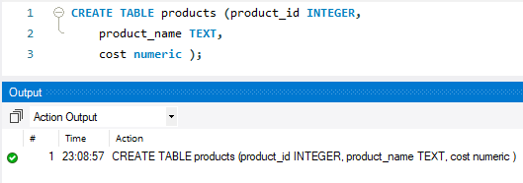
DDL – Create table
DDL:
CREATE TABLE:
Example:
CREATE TABLE products ( product_id INTEGER, product_name TEXT, cost numeric );

Slide 86
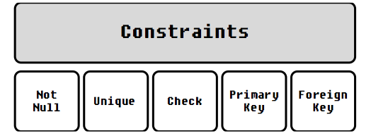
DDL:
CREATE TABLE:
Constraints
Defined as the rules to preserve the data integrity in the application.
These rules are imposed on a column of a database table, so as to define the basic behavioral layer of a column of the table and check the sanctity of the data flowing into it.
The data which violates the rule, fails to pass the constraint layer and oracle raises a predefined exception.
They can be defined when a table is first created via the CREATE TABLE statement, or after the table is already created.
The key milestones achieved by the usage of constraints are:
Validate NULL property of the data
Validate uniqueness of the data
Validate referential integrity of the data

Slide 87
Constraints
Data Type | Description
CHECK | Used to set one or more conditions that the value in a column must meet before it is stored.
UNIQUE | Ensures that all values in a specified column are distinct, that is, the column cannot contain two identical instances of any value.
NOT NULL | prevents the inclusion of NULL values in a column.
Primary Key | Used to uniquely identify each row in a table. It acts to enforce row-level integrity of the table,
Foreign Key | Defines constraint between two tables in a database The foreign key identifies a column (or set of columns) in one table (the "referencing" table) that refers to set of columns in another table (the "referenced" table).

Slide 88
Create Table – NOT NULL
Example: NOT NULL
Note : ‘Not Null’ constraint can be defined only at the column level.
If any NULL values are encountered during insertion, Oracle raises exception ‘ORA-01400: cannot insert NULL into [Column description]’.
NOT NULL constraint is also active during update operation; violation of the rule results in exception
‘ORA-10407: cannot update [Column description] to NULL’.
CREATE TABLE products ( product_id NUMBER(5), product_name TEXT NOT NULL cost numeric );

Slide 89
UNIQUE
Example: UNIQUE
It prevents duplication of the column data, but interestingly allows NULLs. It allows multiple NULLs during creation as well as modification of the column data.
Can also be defined at Table-level as :
CREATE TABLE products ( product_id NUMBER(5), product_name TEXT UNIQUE, cost numeric );
CREATE TABLE products ( product_id NUMBER(5), product_name TEXT , cost numeric,
CONSTRAINT UN_NAME UNIQUE(product_name));

Slide 90
Primary Key
PRIMARY KEY
It is referred to as the hybrid evolution of NOT NULL and UNIQUE
The declaration can be either made at Column level, Table level or using ALTER TABLE command.
Unlike other constraints, there can be one and only one Primary Key in a table. It can be either a single column or a composite primary key.
Composite primary keys can accommodate maximum of 32 columns.
Similar to UNIQUE key, a unique b-tree index is always created whenever a primary key is created, with the same name as that of primary key constraint.
CREATE TABLE products ( product_id NUMBER(5) PRIMARY KEY, product_name TEXT UNIQUE, cost numeric );

Slide 91
Foreign Key
FOREIGN KEY
Two tables can be connected through a column, where one table acts as Parent table while the other one is the child table.
The key column value set in the child table is always the subset of key column value set in the parent table, thus establishing the Parent Child relationship and obeys the referential integrity of data.
The key column in child table is known as Foreign Key i.e. its data references an ‘external or foreign’ set of values.
CREATE TABLE Sales (
sales_id integer PRIMARY KEY,
product_id integer
REFERENCES Product(product_id),
quantity INT CHECK(quantity >0), order_date DATE );

Slide 92
Foreign Key
FOREIGN KEY
Oracle prevents the deletion of a Parent record, if its corresponding child exists in the child table.
This can be solved by adding the CASCADE clause with the constraint :
ON DELETE CASCADE : This will remove the record from child table, if that value of foreign key is deleted from the main table.
and ON DELETE SET NULL : This will set all the values in that record of child table as NULL, for which the value of foreign key is deleted from the main table.
CREATE TABLE Sales ( sales_id NUMBER(4) PRIMARY KEY, product_id NUMBER(5),
quantity INT CHECK(quantity >0),
order_date DATE,
CONSTRAINT FK_PRODUCT FOREIGN KEY (product_id) REFERENCES Product(product_id) ON DELETE CASCADE );

Slide 93
Foreign Key
Guidelines for establishing Relationship
The key column in the Parent table must be a Primary Key.
Multiple Child key columns can refer single Parent key column.
Though the Parent table key column is a Primary Key (which does not allows NULLs), foreign key can accommodate NULL values.
Oracle prevents the deletion of a Parent record, if its corresponding child exists in the child table.
If the constraint is enforced with ON DELETE CASCADE option, then the child record would also be deleted.
If the constraint is enforced with ON DELETE SET NULL option, then the child record would not be deleted, but their key column value would be set to NULL
Oracle prevents the creation of a Child record, for which value of key column does not exists in the Parent table.

Slide 94
Create AS
DDL:
CREATE TABLE: Creating a Table From an Existing Table
Example:
The new Table Emp_New will be created with the data populated from HR.Employees.
Although the table structure and data is copied the constraints are not copied.
CREATE TABLE AS (SELECT Query);
CREATE TABLE Emp_New AS (
SELECT * from HR.Employees);

Slide 95
Create AS
DDL:
CREATE TABLE: Creating a Table with the same structure as an existing Table.
The structure of a table can be copied by giving in a WHERE condition that evaluates to false
CREATE TABLE Emp_New AS (
SELECT * from HR.Employees where 1=2);

Slide 96
How will you find out the structure of a table in oracle?
Answer: Using DESCRIBE/DESC Command
E.g. DESC Employees;

Slide 97
If an unique key constraint on DATE column is created, will it validate the rows that are inserted with SYSDATE ?
Answer: It won't, Because SYSDATE format contains time attached with it.

Slide 98
DDL:
ALTER TABLE:
It is used for alteration of table structures. There are various uses of alter command, such as,
To add a column to existing table
To rename any existing column
To change data type of any column or to modify its size.
alter is also used to drop a column
Rename a Table

Slide 99
ALTER TABLE
DDL:
ALTER TABLE: Columns
Add Column to an Existing Table
Syntax:
Example:
Adding multiple columns
ALTER TABLE table_name ADD (column_1 column-definition, column_2 column-definition, ... column_n column_definition);
ALTER TABLE Products ADD price NUMBER(4) NOT NULL
ALTER TABLE supplier ADD (
supplier_name varchar2(50),
city varchar2(45));

Slide 100
ALTER Table
Modifying an Existing Column
Syntax:
Example:
Altering the size of the column
Altering multiple columns
ALTER TABLE table_name MODIFY column_name column-definition[, column_2 column-definition, ... column_n column_definition]);
ALTER TABLE supplier
MODIFY supplier_name varchar2(70) not null;
ALTER TABLE supplier MODIFY (
city varchar2(75) NOT NULL,
supplier_name(75)) NOT NULL;

Slide 101
ALTER TABLE Column
Columns
Dropping an Existing Column
Syntax:
Example:
ALTER TABLE table_name DROP COLUMN column_name
ALTER TABLE supplier DROP COLUMN supplier_name;

Slide 102
ALTER TABLE RENAME
Renaming a Column
Starting in Oracle 9i Release 2, you can now rename a column.
Syntax:
Example:
ALTER TABLE table_name
RENAME old_column TO new_column_name
ALTER TABLE supplier RENAME COLUMN city TO supplier_city;

Slide 103
ALTER TABLE enable/disable
Enable / Disable a Constraint
Syntax:
Example:
ALTER TABLE table_name
ENABLE/DISABLE constraint ConstraintName;
ALTER TABLE Sales
DISABLE CONSTRAINT FK_PRODUCT

Slide 104
ALTER TABLE add / drop
Add /Drop Constraints
Example:
ALTER TABLE table_name
ADD/DROP CONSTRAINT ConstraintName
ALTER TABLE Sales
DROP CONSTRAINT FK_PRODUCT

Slide 105
ALTER – Rename a Table
Rename a Table
Example:
Note : If you change the object's name any reference to the old name will be affected. You have to manually change the old name to the new name in every reference.
RENAME old_table_name TO New_Table_name
RENAME TABLE Suppliers TO vendors

Slide 106
DROP TABLE
DROP TABLE:
Used to delete one or more table structure which is no longer in use.
When a table is dropped, all the tables' rows, indexes and privileges will also be removed.
CASCADE Constraints :
Deletes all foreign keys that reference the table to be dropped, then drops the table.
PURGE :
As of Oracle 10g, when a table is dropped it is moved into the recycle bin unless the PURGE modifier is used. If the PURGE modifier is used then the table is dropped completely from the database and is unrecoverable.
DROP TABLE table_name
DROP TABLE table_name CASCADE constraints;
DROP TABLE table_name PURGE;

Slide 107
DROP TABLE: Retrieving the Table Back
DROP TABLE: Retrieving the Table Back
With Oracle 10g, the table once dropped, cannot be queried or acted upon and is moved from schema to Oracle Recycle bin.
We can see the contents of user’s recycle bin:
Table can be retrieved back from the recyclebin using FLASHBACK utility as:
To drop the table entirely and release the space, use “PURGE” clause.
Unless you purge them, Oracle will leave objects in the recyclebin until the tablespace runs out of space, or until you hit your user quota on the tablespace.
At that point, Oracle purges the objects one at a time, starting with the ones dropped the longest time ago, until there is enough space for the current operation.
SELECT * FROM recyclebin;
FLASHBACK table table_name
TO BEFORE DROP;

Slide 108
TRUNCATE
TRUNCATE :
Used to remove (delete) all rows from a table.
Also deallocates all of the space used by the removed rows
TRUNCATE TABLE table_name;

Slide 109

How do you force a DROP command to drop the parent table even when a child table is existing?
Answer: Using the CASCADE CONSTRAINTS Option with the DROP Command

Slide 110
Where the integrity constraints are stored in Data Dictionary ?
Answer: The integrity constraints are stored in USER_CONSTRAINTS.

Slide 111
Data Manipulation Language

Slide 112
Oracle SQL
DML:
Data Manipulation Language
Used to manipulate the data stored in the database.
Inserting Data
Updating Data
Deleting Data
Merging Data

Slide 113
DML – INSERT
DML:
INSERT :
Data can be inserted into the table using INSERT Statement
Example:
If data is inserted into all the columns of the table the column_name can be skipped
INSERT INTO table_name (column-1, column-2, ... column-n) VALUES (value-1, value-2, ... value-n);
INSERT INTO suppliers (supplier_id, supplier_name,supplier_city,phone) VALUES(‘S01’,’UPS’,’Columbia’,’0441-782-7892’);
INSERT INTO suppliers VALUES(‘S01’,’UPS’,’Columbia’,’0441-782-7892’);

Slide 114
DML INSERT ALL
INSERT ALL
INSERT ALL can be used for inserting multiple rows at a time
Applicable only to Oracle10g and above
Example:
INSERT ALL
INTO table_name (column-1, ..) VALUES (value-1... )
INTO table_name (column-1, ..) VALUES (value-1... )
INSERT ALL
INTO Supplier (supplier_name) VALUES (‘A')
INTO Supplier (supplier_name) VALUES (‘B')
INTO Supplier (supplier_name) VALUES (‘C')
SELECT * FROM dual;

Slide 115
DML INSERT – sub select
INSERT :
We can also use sub-selects in an INSERT Statement
Example:
INSERT INTO table_name (column-1, column-2, ... column-n)
SELECT column1,column2 FROM table_name …..
INSERT INTO suppliers (supplier_id, supplier_name) SELECT account_no, name
FROM customers WHERE city = 'Newark';

Slide 116
DML – UPDATE
UPDATE :
Used to modify the existing data in the table.
Example:
If the WHERE Clause is ignored it will update all the rows in the table.
Example : Updating Multiple Columns
UPDATE table_name
SET column-1= value-1[, column-2 = value-2, ... column-n) [WHERE …..]
UPDATE suppliers
SET name = ‘Samsung' WHERE name = ‘Apple’;
UPDATE suppliers
SET name = ‘Nokia', product = ‘Nokia 910'
WHERE name = ‘Samsung';

Slide 117
DML - Update
Records in one table based on values in another table.
UPDATE suppliers
SET supplier_name = (SELECT customers.name
FROM customers
WHERE customers.customer_id = suppliers.supplier_id)
WHERE EXISTS
(SELECT customers.name
FROM customers
WHERE customers.customer_id = suppliers.supplier_id);

Slide 118
DML – UPDATE
Update based on a query returning multiple values
UPDATE suppliers
SET (supplier_name,city) = (SELECT customers.name,city
FROM customers
WHERE customers.customer_id = suppliers.supplier_id)
WHERE supplier_id=10;

Slide 119
DML – DELETE
DELETE :
Used to delete the data in the table
DELETE Statement by default deletes all the data from the table unless specified using a WHERE clause
DELETE
FROM table_name
[WHERE …..]

Slide 120
DML – MERGE
MERGE :
The MERGE statement was introduced in Oracle 9i to conditionally insert or update data in a single atomic statement, depending on the existence of a record.
The MERGE statement reduces table scans and can perform the operation in parallel if required.
Syntax:
MERGE into <target table>
USING <souce table/view/result of subquery>
ON <match condition>
WHEN MATCHED THEN
<update clause>
<delete clause>
WHEN NOT MATCHED THEN
<insert clause>

Slide 121
DML – MERGE
Example:
MERGE INTO dept d
USING dept_online o
ON (d.deptno = o.deptno)
WHEN MATCHED THEN
UPDATE SET d.dname = o.dname, d.loc = o.loc
WHEN NOT MATCHED THEN
INSERT (d.deptno, d.dname, d.loc) VALUES (o.deptno, o.dname, o.loc);

Slide 122
DML – MERGE
MERGE :
With the release of 10g, Oracle has added many enhancements to MERGE statement
It can now UPDATE, DELETE and INSERT with separate conditions for each.
It also supports UPDATE-only or INSERT-only operations.
Deleting during the merge operation
Example: Oracle 10g : UPDATE- only
Similarly for INSERT-only operations.
MERGE INTO dept d
USING dept_online o
ON (d.deptno = o.deptno)
WHEN MATCHED THEN
UPDATE SET d.dname = o.dname, d.loc = o.loc

Slide 123
DML – MERGE
DML:
MERGE :
With Oracle 10g, we can now apply additional conditions to the UPDATE or INSERT operation within a MERGE.
This is extremely useful if we have different rules for when a record is updated or inserted but we do not wish to restrict the ON condition that joins source and target together.
Example: Oracle 10g : Conditional dml
MERGE INTO dept d
USING dept_online o
ON (d.deptno = o.deptno)
WHEN MATCHED THEN
UPDATE SET d.dname = o.dname, d.loc = o.loc
WHERE d.deptno IN (10,20,30)

Slide 124
Oracle SQL
MERGE :
With Oracle 10g, we can conditionally DELETE rows from the target dataset during an UPDATE operation.
The DELETE works against conditions on the target data, not the source.
The DELETE works only on rows that have been updated as a result of the MERGE. Any rows in the target table that are not touched by the MERGE are not deleted, even if they satisfy the DELETE criteria.
Example: Oracle 10g : Conditional dml
MERGE INTO emp e1
USING emp_load e2
ON (e2.empno = e1.empno)
WHEN MATCHED THEN
UPDATE SET e1.sal = e2.sal DELETE WHERE sal <= 0
WHEN NOT MATCHED THEN
INSERT (empno, ename, job, mgr, hiredate, sal, comm, deptno) VALUES (e2.empno, e2.ename, e2.job, e2.mgr, e2.hiredate, e2.sal, e2.comm, e2.deptno);

Slide 125
Transaction Control Language

Slide 126
Oracle SQL
TCL:
Transaction Control Language
Properties of TCL
Commit
Rollback

Slide 127
Oracle SQL
Properties of TCL:
Atomicity: This property ensures that either all the operations of a transaction reflect in database or none.
Consistency: To preserve the consistency of database, the execution of transaction should take place in isolation (that means no other transaction should run concurrently when there is a transaction already running).
Isolation: For every pair of transactions, one transaction should start execution only when the other finished execution
Durability: Once a transaction completes successfully, the changes it has made into the database should be permanent even if there is a system failure. The recovery-management component of database systems ensures the durability of transaction.

Slide 128
TCL – COMMIT & ROLLBACK
TCL:
Commit :
Save changes permanently made on tables after query is executed successfully
Rollbackl:
undo the changes made on tables after query is execution getting failure
UPDATE suppliers
SET name = ‘Samsung' WHERE name = ‘Apple’;
Commit;
UPDATE suppliers
SET name = ‘Samsung' WHERE name = ‘Apple’;
rollback;

Slide 129
DELETE VS TRUNCATE
How is DELETE different from TRUNCATE?
Answer: Delete is a DML Operation. After performing a DELETE we need to COMMIT or ROLLBACK the transaction to make the change permanent or to undo it and this operation will cause all DELETE triggers on the table to fire.
TRUNCATE operation is a DDL Operation. It cannot be rolled back and no triggers will be fired. As far as performance is concerned TRUCATE is faster and doesn't use as much undo space as a DELETE.

Slide 130
DELETE VS TRUNCATE
Why is TRUNCATE faster than DELETE?
Answer: When you type DELETE. All the data get copied into the Rollback Tablespace first and then delete operation is performed. That’s how when you type ROLLBACK after deleting a table ,you can get back the data. All this process is time consuming.
Whereas when you type TRUNCATE, it removes data directly without copying it into the Rollback Tablespace and makes TRUNCATE a faster operation in comparison. Once you Truncate the data cannot be retrieved.

Slide 131
Recap
DDL Statements
Help in Defining and Modifying the database structure
CREATE TABLE:
Creates the Table and also help in providing in the different constraints to maintain the integrity of the data
ALTER TABLE:
Used to modify the existing data structure which includes adding a new column or constraint, dropping an existing column or constraint, enabling or disabling a constraint,etc…
DROP TABLE:
Dropping an existing data structure temporarily or permanently and also retrieving the data structure using the FLASHBACK utility of Oracle 10g.
TRUNCATE TABLE;
Used to remove all the data from the table.
DML Statements
Manipulate the data store in the tables
INSERT,UPDATE,DELETE and MERGER

Slide 132
Oracle SQL
What is SQL?
Abbreviated as Structured Query Language.
It’s a special purpose programming language to manage the data in a RDBMS.
One of the first commercial languages for Relational Model
Described as a declarative language(4GL)

Slide 133
Oracle SQL
Subsets of SQL?
Some subsets of SQL are:
DQL (Data Query Language) : Querying the Data
DML (Data Manipulation Language) : Manipulating the Data
DDL (Data Definition Language) : Defining the structure to hold the data
TCL (Transaction Control Language) : Controlling the Transactions
DQL
DML
DDL
TCL
SELECT
INSERT
UPDATE
DELETE
MERGE
CREATE
ALTER
DROP
TRUNCATE
COMMIT
ROLLBACK
SAVEPOINT

Slide 134
Oracle SQL
Rules for writing SQL Statements
Many DBMS systems normally terminate SQL statements with a semi-colon character.
Character strings and date values are enclosed in single quotes
Character values are case-sensitive and date values are format sensitive.

Slide 135
Oracle SQL
Getting Connected to Oracle:
There are two modes to get connected in Oracle 10g XE
Command Line
To work with the SQL Command Line go to
GU I
Start -> Oracle 10g XE -> Run SQL Command Line
Start -> Oracle 10g XE -> Go to Database HomePage

Slide 136
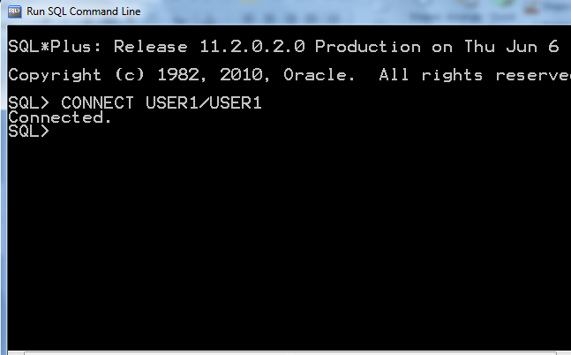
Oracle SQL
Writing a Query:
Command Line:
To Connect using a username and password the command is:
CONNECT <<username>> / <<password>>

Slide 137
Command Line
Set of commands to start working with the CLI.
Command | Description
SQL > LIST | Lists the SQL Command in the Buffer
SQL > SAVE <<filename>> | Save the Contents of the Buffer to a file
CLEAR BUFFER | Flushes the buffer
SQL > GET <<filename>> | Load the contents of the file into memory
SQL > @filename or SQL > START <<filename>> | Load the contents of the file into the memory and execute the commands in the file.
SQL > RUN or SQL > / | Executes the commands in the buffer(RUN displays the contents of the buffer before execution)
SQL > SPO[OL ] <<filename|OFF|OUT>> | To store/print the queries and the Output.

Slide 138
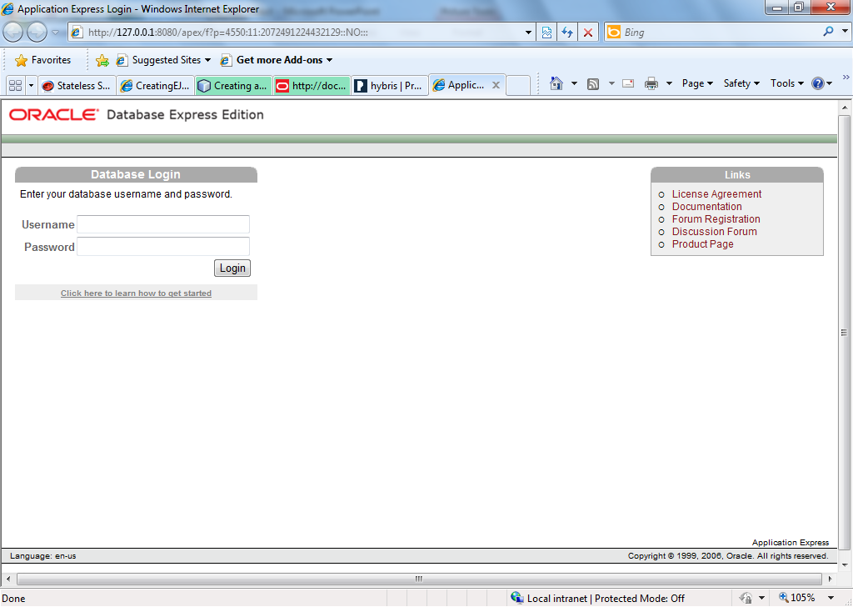
Oracle SQL
Writing a Query:
GUI Environment:
Specify the username and password

Slide 139
Data Query Language

Slide 140

Data Query Language
DQL:
Data Query Language
Used to fetch records from Database.
DISTINCT : Selecting DISTINCT records from the set
WHERE : Filtering Records based on some criteria
GROUP BY : Grouping Records
HAVING BY : Applying condition on GROUPS
ORDER BY : Arranging in Ascending / Descending Order.
SELECT [DISTINCT ]column_list |*
FROM table-name [WHERE Clause] [GROUP BY clause] [HAVING clause] [ORDER BY clause];

Slide 141
DQL - SELECT
DQL:
Fetching Records from the table
Expressions in SELECT Statement
‘ ||’ is the concatenation operator in Oracle
SELECT * FROM HR.Employees SELECT first_name,last_name,department_id
FROM Hr.Employees
SELECT DISTINCT job_id FROM HR.Employees
SELECT first_name||last_name “Emp Name”
FROM Hr.Employees
OR
SELECT first_name||last_name AS “Emp Name”
FROM Hr.Employees

Slide 142
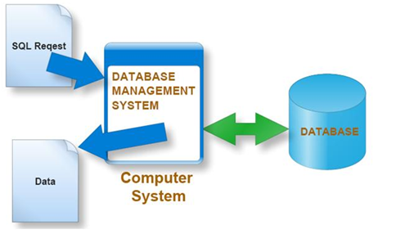
WHERE condition
DQL:
Filtering Information using Where Condition
When filtering out String or Date data enclose the data in quotes
SELECT * FROM HR.Employees
WHERE Salary > 5000;
SELECT * FROM HR.Employees
WHERE job_id=‘HR_REP’;

Slide 143
Logical Conditions & Operators
DQL:
Logical Conditions (Contd..)
AND Operator : Returns TRUE if both component conditions are TRUE.
OR Operator : Returns TRUE if either component conditions are TRUE.
NOT Operator : Returns TRUE if the following condition is FALSE.
SELECT *
FROM HR.Employees
WHERE first_name ='SAMI‘ AND salary=3000;
SELECT *
FROM HR.Employees
WHERE first_name = 'SAMI‘ OR salary >= 1000;
SELECT *
FROM HR.Employees
WHERE NOT (salary BETWEEN 1000 AND 2000);

Slide 144
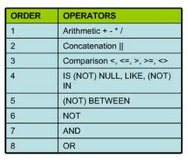
Logical Conditions & Operators
DQL:
Logical Conditions (Contd..)
Order of Precedence of Operators is as follows:

Slide 145
SELECT – IN
DQL:
Other Keywords:
IN
NOT IN : Equivalent to "!=ALL". Evaluates to FALSE if any member of the set is NULL..
SELECT *
FROM HR.Employees
WHERE deparmentid IN (10,20);
SELECT *
FROM HR.Employees
WHERE first_name NOT IN ('SCOTT', 'SMITH');

Slide 146
SELECT – NULL & LIKE
DQL:
NULL:
If a column is empty or no value has been inserted in it then it is called null.
NULL doesn’t mean 0 (Zero) or blank String “ “.
LIKE :
Used to search for a pattern
Wildcards like % and _ (Underscore) is used to match the pattern.
% Matches any number of characters
_ (underscore) matches a single character
SELECT * FROM HR.Employees
WHERE commission_pct IS NULL
SELECT * FROM HR.Employees
WHERE job_id LIKE ‘HR%’

Slide 147
ORDER BY
DQL:
Sorting the Records:ORDER BY
Results fetched can be ordered in Ascending / Descending order using the ORDER BY Clause
Default order of arranging the Records is Ascending Order.
Specifying the Descending order can be done by adding the DESC Keyword.
More than one ordering criteria can also be enforced:
SELECT * FROM HR.Employees
ORDER BY department_id
SELECT * FROM HR.Employees
ORDER BY Salary DESC
SELECT * FROM HR.Employees
ORDER BY department_id ASC, Salary DESC

Slide 148
Single & Multiple Row Funtions

Slide 149
Oracle SQL
Single Row Functions:
Used for performing calculations on data, alter data formats for display, convert data types, etc.
Return a single result row for every row of a queried table or view.
Can appear in select lists, WHERE clauses, START WITH and CONNECT BY clauses, and HAVING clauses
They are categorized as
Numeric Functions
Character Function
Date Functions
Conversion
General Functions
Character
General
Single-row
functions
Number
Conversion
Date

Slide 150
Oracle SQL
Single Row Functions:
Numeric Function:
Some of the numeric functions are :
Numeric
Functions
ROUND
TRUNC
MOD
SIGN
POWER
SQRT
GREATEST
LEAST
SIN,COS,TAN
LOG
CEIL,FLOOR

Slide 151
Single Row Numeric Functions
Single Row Functions:
Numeric Function:
Function | Description
ABS | Returns the absolute of the value
FLOOR | Returns largest integer equal to or less than n.
CEIL | Returns smallest integer equal to or greater than n.
MOD | MOD returns the remainder of n2 divided by n1.
POWER | POWER returns n2 raised to the n1 power
ROUND | ROUND returns n rounded to integer places to the right of the decimal point. If you omit integer, then n is rounded to 0 places. The argument integer can be negative to round off digits left of the decimal point.

Slide 152
Single Row Functions
Single Row Functions:
Numeric Function:
Function | Description
SIGN | SIGN returns the sign of n. This function takes as an argument any numeric datatype, or any nonnumeric datatype that can be implicitly converted to NUMBER, and returns NUMBER. of NUMBER type, the sign is: -1 if n<0, 0 if n=0, 1 if n>0
SQRT | SQRT returns the square root of n.
TRUNC | The TRUNC (number) function returns n1 truncated to n2 decimal places. If n2 is omitted, then n1 is truncated to 0 places. n2 can be negative to truncate (make zero) n2 digits left of the decimal point.

Slide 153
Single Row Functions
Single Row Functions:
Numeric Functions :
Example :
Output
TRUNC : 44.4
ROUND : 44.5
CEIL : 45
FLOOR : 44
SELECT TRUNC(44.46,1),ROUND(44.46,1),CEIL(44.46),FLOOR(44.46)
FROM Dual;

Slide 154
Single Row Character Functions:
Single Row Functions:
Character Function:
Some of the character functions are :
Character
functions
Case-manipulation
functions
Character-manipulation
functions
LOWER
UPPER
INITCAP
CONCAT
SUBSTR
LENGTH
INSTR
LPAD | RPAD
RTRIM|LTRIM|TRIM
REPLACE

Slide 155
Single Row Character Functions:
Single Row Functions:
Character Functions :
Function | Description
CONCAT | Returns the concatenation of 2 strings. You can also use the || command for this
SUBSTR | Returns a part of the String
LENGTH | Returns the length of the String
TRIM|LTRIM|RTRIM | Removes the spaces from the Left or right or both sides of the String.
INSTR | Returns the position of a String within a String.
LPAD|RPAD | Add characters to the left/right of a string until a fixed number is reached

Slide 156
Single Row Character Functions:
Single Row Functions:
Character Functions :
Function | Description
REPLACE | Replaces every occurrence of a search_string with a new string.
REVERSE | Reverses the characters of a String
UPPER|LOWER|INITCAP | Transform a string to all upper case or lower case or sentence case characters

Slide 157
Single Row Character Functions:
Single Row Functions:
Character Functions :
Example : Display the data for those employees whose last names end with the character “n”.
SELECT employee_id, CONCAT(first_name, last_name) NAME,
LENGTH (last_name), INSTR(last_name, 'a') "Contains 'a'?"
FROM employees
WHERE SUBSTR(last_name, -1, 1) = 'n';

Slide 158
Single Row Date Functions:
Single Row Functions:
Date Functions:
Some of the date functions are :
Date
Functions
SYSDATE
ADD_MONTHS
MONTHS_BETWEEN
NEXT_DAY
LAST_DAY
GREATEST
LEAST
ROUND

Slide 159
Single Row Date Functions:
Single Row Functions:
Date Function:
Function | Description
SYSDATE | returns the current date and time in the default Oracle date format. The default format for the date returned is MM-DD-YY
MONTHS_BETWEEN | returns the months between two dates
LAST_DAY | returns the date of the last day of the month that contains date.
ROUND | Rounds of the date to the nearest month or year . Syntax: ROUND(date,’MONTH/YEAR’)
GREATEST and LEAST | Returns the GREATEST or LEAST dates out of the given set of dates.

Slide 160
Single Row Date Functions:
Single Row Functions:
Date Functions :
Example : Display how many days are left in the current month
SELECT SYSDATE, LAST_DAY(SYSDATE) "Last", LAST_DAY(SYSDATE) - SYSDATE "Days Left“,
TO_CHAR(NEXT_DAY(sysdate,'MON'),'DD.MM.YYYY') "Next Monday from now“
FROM DUAL;

Slide 161
Single Row Conversion Functions:
Single Row Functions:
Conversion Functions:
These are functions that help us to convert a value in one form to another form.
Some of the conversion functions are :
Conversion
Functions
TO_CHAR
TO_DATE
NVL
DECODE

Slide 162
Single Row Conversion Functions:
Single Row Functions:
Conversion Function:
Function | Description
TO_CHAR | Converts Numeric and Date values to a character string value. It cannot be used for calculations since it is a string value.
TO_DATE | Converts a valid Numeric and Character values to a Date value. Date is formatted to the format specified by 'date_format'.
TO_NUMBER | Converts a character string containing digits to a number with the optional format model fmt.
NVL(x,y) | If 'x' is NULL, replace it with 'y'. 'x' and 'y' must be of the same datatype.

Slide 163
Single Row Conversion Functions:
Single Row Functions:
Conversion Functions :
Example : Display how many days are left in the current month
SELECT TO_CHAR(hire_date, 'DD-MON-YYYY')
FROM EMPLOYEES;
SELECT TO_DATE('01-JAN-1985','DD-MON-YYYY')
FROM DUAL;
SELECT first_name, salary, commission_pct,
(salary*12)+NVL(commisson_pct,0)
FROM employees;

Slide 164
Single Row Conversion Functions:
Single Row Functions:
Conversion Functions :
DECODE:
Decodes an expression in a way similar to the IF-THEN-ELSE logic used in various languages.
The DECODE function decodes expression after comparing it to each search value.
If the expression is the same as search, result is returned.
If the default value is omitted, a null value is retuned where a search value does not match any of the result values.
SELECT job_id, salary, DECODE(job_id,
'ANALYST' , sal*1.1,
'CLERK' , sal*1.15,
'MANAGER' , sal*1.20, salary) Increment
FROM employees ;

Slide 165
Recap
SQL is the stuctured Query Language used to query the data from the database.
Consists of some subsets as:
DQL - SELECT
DDL - CREATE, ALTER, DROP, TRUNCATE
DML - INSERT, UPDATE, DELETE
DQL Queries out the data from the database
WHERE CLAUSE : Specifies the criteria for selecting the results
ORDER BY : Sorts the Results fetched
GROUP BY : Helps in Grouping the Results and HAVING BY filters the grouped results
Aggregate Functions like COUNT,SUM,MAX,MIN and AVG are mostly used with GROUP BY Clause to enable data analysis.

Slide 166
Recap
Single- Row Functions
Single-row functions can be nested to any level. Single-row functions can manipulate the following
Character data:
LOWER, UPPER, INITCAP, CONCAT, SUBSTR, INSTR, LENGTH
Number data:
ROUND, TRUNC, MOD
Date data:
MONTHS_BETWEEN, ADD_MONTHS, NEXT_DAY, LAST_DAY, ROUND, TRUNC
Date values can also use arithmetic operators.
Conversion functions can convert character, date, and numeric values
TO_CHAR, TO_DATE, TO_NUMBER
SYSDATE and DUAL
SYSDATE is a date function that returns the current date and time. It is customary to select SYSDATE from a dummy table called DUAL.

Slide 167
Multiple Row Function
Multiple row function is also called as group function or it is also called as aggregate function.
Multiple row functions work upon group of rows and return one result for the complete set of rows.
Group function operate on set of rows to give one result per group
These functions are also called “Aggregate functions” (Or) Group functions.
All these multi row functions will process multiple records.
Applied on group of records and returns one value from the entire group.

Slide 168
Multiple Row Function
Types of Multi-Row Functions are
Maximum(Max)
Minimum(MIN)
Average(Avg)
Sum
Count

Slide 169
Multiple Row Function - Maximum(Max)
MAX ( ) Function in SQL:-
Returns the maximum value of a from the given data.
Syntax :
Max(expression)
Max() Function on Char
Select max (e_name) from employees
Output → word {based on Ascii}
Max() Function on Date
Select max(hire_date) from employees
SELECT max(salary) from employee;
Output : 87500

Slide 170
Multiple Row Function - Minimum(Min)
Min ( ) Function in SQL:-
Returns the minimum value of a from the given data.
Syntax :
Min(expression)
Min() Function on Char
Select min (e_name) from employees
Output → word {based on Ascii}
Min() Function on Date
Select min(hire_date) from employees
SELECT min(salary) from employee;
Output : 4500

Slide 171
Multiple Row Function - Average(avg)
The AVG() is an aggregate function that is used to find out an average of the list of values of columns or an expression.
The AVG() function is used with the numeric columns only.
SELECT AVG(column_name)
FROM table_name
WHERE condition;
SELECT AVG(salary) AS AVGsal
FROM employee;
Output : . .AVGsal .
. 21633 .

Slide 172
Multiple Row Function - SUM
The SUM() is an aggregate function that is used to return the total sum of a numeric column.
The SUM() function is used with the numeric columns only.
SELECT SUM(column_name)
FROM table_name
WHERE condition;
SELECT SUM(salary) AS SUMSal
FROM employee;
Output : . .SUMSal .
. 84750000 .

Slide 173
Multiple Row Function – COUNT ( * )
COUNT() function returns the number of rows in a table satisfying the criteria specified in the WHERE clause.
It sets the number of rows or non NULL column values.
COUNT() returns 0 if there were no matching rows.
COUNT(*)
COUNT( [ALL|DISTINCT] expression )
SELECT COUNT(*)
FROM orders;
Output: No of rows
COUNT(*)
---------
34

Slide 174
Multiple Row Function – COUNT ( * )
SELECT(
SELECT COUNT(*)
FROM employees
) AS Total_Employees,
(SELECT COUNT(*)
FROM departments
) AS No_Of_Departments
FROM dual
Output
TOTAL_EMPLOYEES NO_OF_DEPARTMENTS
---------------------- --------------------------
107 27

Slide 175
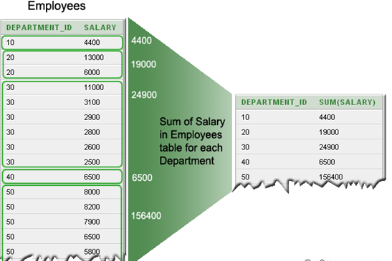
GROUP BY
GROUP BY :
Used to divide the rows in a table into smaller groups
The grouping can happen after retrieves the rows from a table.
The GROUP BY clause is rarely used without an aggregate function.

Slide 176
SELECT – GROUP BY, SUM, AGGREGATE
GROUP BY : Aggregate Functions
COUNT()
SUM()
Other Aggregate Functions are : MIN,MAX,AVG,…
SELECT department_id "Department Code“,COUNT(*) "No of Employees"
FROM employees
GROUP BY department_id;
SELECT department_id, SUM(salary)
FROM employees
GROUP BY department_id;

Slide 177
SELECT – GROUP BY, SUM, AGGREGATE
GROUP BY : Aggregate Functions
Grouping more than one column is also permissble
GROUP BY with HAVING Clause
Works with the GROUP BY clause to limit the results to groups that meet the criteria
SELECT department_id "Department Code", job_id,
SUM(salary) "Total Salary"
FROM employees
GROUP BY department_id,job_id;
SELECT department_id, count(*) "No. of Employee"
FROM employees
GROUP BY department_id
HAVING count(*) > 2;

Slide 178
GROUPING COLUMNS SELECT – GROUP BY, SUM, AGGREGATE
GROUP BY:
Rules for Grouping columns are:
If a select block does have a GROUP BY clause, any column specification specified in the SELECT clause must exclusively occur as a parameter of an aggregated function or in the list of columns given in the GROUP BY clause, or in both.
The result of an aggregation function always consists of one value for each group. The result of a column specification on which grouping is performed also always consists of one value per group. These results are compatible. In contrast, the result of a column specification on which no grouping is performed consists of a set of values. This would not be compatible with the results of the other expressions in the SELECT clause.

Slide 179
Rules for Grouping columns
GROUP BY :
Although every column included in the SELECT list must also be listed in a GROUP BY clause, this restriction doesn’t apply to number and string literals, constant expressions (expressions that do not use column values), and functions such as SYSDATE.
SELECT COUNT(employee_id), department_id, salary, SYSDATE, ‘String Literal’, 42*37 Expression
FROM Employee
GROUP BY department_id, salary
HAVING (COUNT(employee_id) > 1 OR salary < 100000)
ORDER BY department_id, salary DESC;

Slide 180
Rules for Grouping columns
GROUP BY:
Rules for Grouping columns are:
An expression that is used to form groups can also occur in the SELECT clause within a compound expression.
For SELECT statements with a GROUP BY clause: DISTINCT (if used outside an aggregation function) that is superfluous when the SELECT clause includes all the columns specified in the GROUP BY clause. The GROUP BY clause groups the rows in such a way that the columns on which they are grouped no longer contain duplicate values.
SELECT AMOUNT * 100 AS AMOUNT_IN_CENTS
FROM PENALTIES
GROUP BY AMOUNT

Slide 181
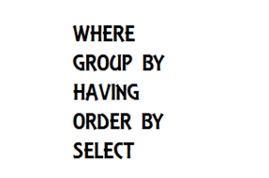
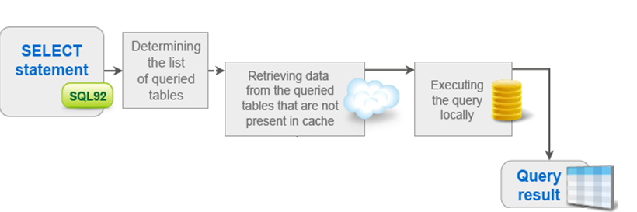
Execution Order
Execution Order
The Execution order of the various clauses in the SELECT Statement are as follows:

Slide 182
Multiple Row Function – COUNT ( * )
Application of COUNT() function
COUNT with DISTINCT
eliminates the repetitive appearance of the same data. The DISTINCT can come only once in a given select statement.
Syntax :
COUNT(DISTINCT expr,[expr...])

Slide 183
Multiple Row Function – COUNT ( * )
Application of COUNT() function
COUNT HAVING
can be used to set a condition with the select statement. The HAVING clause is used instead of WHERE clause with SQL COUNT() function.
The GROUP BY with HAVING clause retrieves the result for a specific group of a column, which matches the condition specified in the HAVING clause.
Example:
To get data of number of agents from the 'agents' table with the following condition -
1. number of agents must be greater than 3,
the following SQL statement can be used:
SELECT COUNT( * ) FROM agents
HAVING COUNT(*)>3;

Slide 184
Multiple Row Function – COUNT ( * )
Application of COUNT() function
COUNT with GROUP BY
is useful for characterizing our data under various groupings. A combination of same values (on a column) will be treated as an individual group.
Example:
To get data of 'working_area' and number of agents for this 'working_area' from the 'agents' table with the following condition
1. 'working_area' should come uniquely,
the following SQL statement can be used :
SELECT working_area, COUNT(*)
FROM agents
GROUP BY working_area;

Slide 185
Set operations in SQL

Slide 186
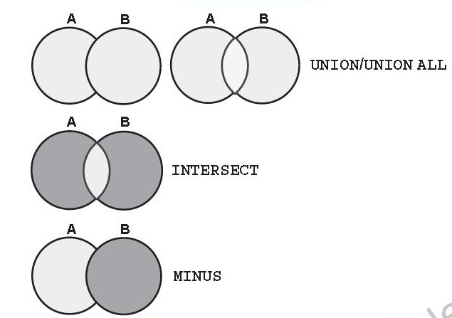
Oracle SQL
Set Operations:
Oracle provides SET operators to combine the result of more than one SELECT statements into one result set in a logical manner.
Set Operators are:
UNION ALL and UNION
INTERSECT
MINUS

Slide 187
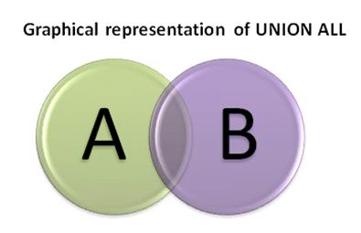
Set Operators – UNION & UNION ALL
Set Operators:
UNION ALL:
operator simply unites the result sets of two SELECT queries, without eliminating duplicates from the combined result set.
In addition, it doesn’t sorts the final result set in any order.
UNION :
operator simply unites the result sets of two SELECT queries, eliminating duplicates from the combined result set.

Slide 188
Set Operators –UNION ALL
Set Operators:
UNION ALL
Example
Ordering of the UNION ALL query result set can be achieved using positional ordering mechanism.
SELECT JOB_ID
FROM EMPLOYEEs
WHERE DEPARTMENT_ID = 10
UNION ALL
SELECT JOB_ID
FROM EMPLOYEEs
WHERE DEPARTMENT_ID = 20

Slide 189
Set Operators –UNION ALL
Set Operators:
UNION ALL
Order BY Clause in Set Operation
Example :
If you omit the ORDER BY, then by default the output will be sorted in the ascending order of employee_id. You cannot use the columns from the second query to sort the output.
SELECT employee_id, job_id,salary FROM employees UNION SELECT employee_id, job_id,0 FROM job_history ORDER BY 2;

Slide 190
Set Operators – INTERSECT
Set Operators:
INTERSECT :
Operator return all distinct rows selected by the first query, but not present in the second query result set (the first SELECT statement MINUS the second SELECT statement).
Syntax
SELECT expression1, expression2, ... expression_n
FROM tables
[WHERE conditions]
INTERSECT
SELECT expression1, expression2, ... expression_n
FROM tables
[WHERE conditions];

Slide 191
Set Operators – INTERSECT
Set Operators:
INTERSECT :
Operator return all distinct rows selected by the first query, but not present in the second query result set (the first SELECT statement MINUS the second SELECT statement).
Example: Display the employee IDs of those employees who have not changed their jobs even once.
SELECT employee_id, job_id, department_id FROM employees INTERSECT SELECT employee_id, job_id, department_id FROM job_history;

Slide 192
Oracle SQL
Set Operators:
MINUS :
Operator simply returns all rows that are common to multiple queries.
Syntax
SELECT expression1, expression2, ... expression_n
FROM tables
[WHERE conditions]
MINUS
SELECT expression1, expression2, ... expression_n
FROM tables
[WHERE conditions];

Slide 193
Oracle SQL
Set Operators:
MINUS :
Operator simply returns all rows that are common to multiple queries.
Example: Display the employee IDs and job IDs of those employees who currently have a job title that is the same as their previous one
SELECT employee_id
FROM employees MINUS SELECT employee_id
FROM job_history;

Slide 194
Guidelines while using sub queries
Set Operations:
Some Guidelines while using sub queries are:
The expressions in the SELECT lists must match in number.
The data type of each column in the second query must match the data type of its corresponding column in the first query.
ORDER BY clause can appear only at the very end of the statement.

Slide 195
Joins in SQL

Slide 196
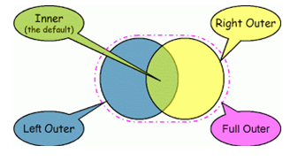
Oracle SQL
Joins:
Joins help retrieving data from two or more database tables.
The tables are mutually related using primary and foreign keys.
A programmer writes a JOIN predicate to identify the records for joining.
If the evaluated predicate is true, the combined record is then produced in the expected format, a record set or a temporary table.
Types of Joins:
Inner Join
Self Join
Outer Join

Slide 197
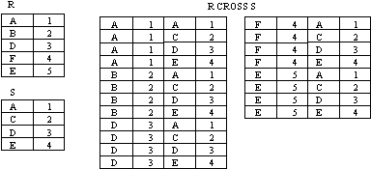
Why use Joins?
Why use Joins?
A Cartesian product is formed when:
A join condition is omitted
A join condition is invalid
All rows in the first table are joined to all rows in the second table
To avoid a Cartesian product, always include a valid join condition in a WHERE clause.

Slide 198
JOINS
Joins:
To join the tables:
Write the join condition in the WHERE clause.
Prefix the column name with the table name when the same column name appears in more than one table.
Improve performance by using table prefixes.
Optionally distinguish columns that have identical names but reside in different tables by using column aliases.
Note : To join n tables together, you need a minimum of n-1 join conditions.
For example, to join three tables, a minimum of two joins is required.

Slide 199

Inner Join
Joins
Inner Join:
A join in which the joining condition is based on equality between values in the common columns
Simplest type of join
Also called: Equality join, Equijoin, Natural join

Slide 200
Inner Join
Joins:
Inner Join
Example
When you perform an INNER JOIN, only rows that match up are returned. Any time a row from either table doesn’t have corresponding values from the other table, it is disregarded.
The keyword INNER is optional because a JOIN clause will be INNER by default.
An equijoin is a join with a join condition containing an equality operator ( = ).
SELECT e.employee_id, e.last_name, e.department_id, d.location_id
FROM employees e, departments d
WHERE e.department_id=d.department_id

Slide 201
Non Equi-Joins
Joins:
Non Equi-Joins
Non equi joins is used to return result from two or more tables where exact join is not possible
Example
SELECT e.last_name, e.salary, j.grade_level
FROM employees e, job_grades j
WHERE e.salary BETWEEN
j.lowest_sal AND j.highest_sal;

Slide 202

Outer Join
Joins
Outer Join:
Returns
all rows from one table (called inner table) and
only matching rows from second table (outer table)
Three types:
Left
Right
Full
The outer join operator is the plus sign (+).
LEFT OUTER JOIN keeps the stray rows from the “left” table (the one listed first in your query statement). In the result set, columns from the other table that have no corresponding data are filled with NULL values.
Similarly, the RIGHT OUTER JOIN keeps stray rows from the right table, filling columns from the left table with NULL values.
The FULL OUTER JOIN keeps all stray rows as part of the result set.

Slide 203

LEFT Outer-Join
Joins:
Outer-Join
Example : LEFT Outer Join
SELECT e.last_name, e.department_id,d.department_name
FROM employees e, departments d
WHERE e.department_id(+) = d.department_id;
OR
SELECT e.last_name, e.department_id, d.department_name
FROM employees e
LEFT JOIN departments d
ON e.department_id(+) = d.department_id;

Slide 204

RIGHT Outer-Join
Joins:
Outer-Join
Example : RIGHT Outer Join
SELECT e.last_name, e.department_id, d.department_name
FROM employees e, departments d
WHERE e.department_id = d.department_id(+);
OR
SELECT e.last_name, e.department_id, d.department_name
FROM employees e
RIGHT JOIN departments d
ON e.department_id(+) = d.department_id;

Slide 205
FULL Outer Join
Joins:
Outer-Join
Example : FULL Outer Join
SELECT e.last_name, e.department_id, d.department_name
FROM employees e
FULL JOIN departments d
ON e.department_id(+) = d.department_id;

Slide 206
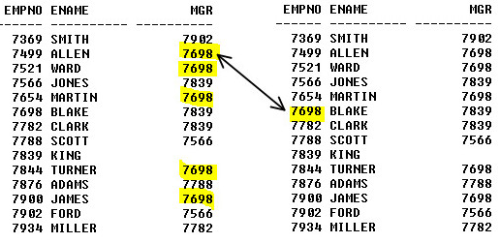
Self Join
Joins
Self Join:
Query that joins table to itself
This table appears twice in the FROM clause and is followed by table aliases that qualify column names in the join condition.
Must create table alias
Alternate name assigned to table in query’s FROM clause
A
B

Slide 207
Self Join
Joins:
Self-Join
Example
SELECT worker.first_name “FirstName”, worker.last_name “LastName”, manager.first_name||manager.last_name “ManagerName”
FROM employees worker, employees manager
WHERE worker.manager_id = manager.employee_id;

Slide 208
Suppose that we want to find all employees from employees table and their department_name from dept table. However the problem is some of the employees have a department_id that does not exist in dept table.
So which type of join can help us extract the data?
Answer: Outer Join.

Slide 209
SubQueries in SQL

Slide 210
SubQueries:
SubQueries:
A subquery is a query within another query. The outer query is called as main query and inner query is called as subquery.
Subqueries enable you to write queries that select data rows for criteria that are actually developed while the query is executing at run time.
Using a subquery is equivalent to performing two sequential queries and using the result of the first query as the search value in the second query.
The subquery (inner query) executes before the main query (outer query).
The result of the subquery is used by the main query.
The subquery is often referred to as a nested SELECT, sub-SELECT, or inner SELECT statement.

Slide 211
SubQueries:
SubQueries:
A subquery may occur in :
SELECT clause
FROM clause
WHERE clause
The subquery can be nested inside a SELECT, INSERT, UPDATE, or DELETE statement or inside another subquery.

Slide 212
SubQuery Types:
SubQueries:
Types of Subqueries:
Single row subquery : Returns zero or one row.
Multiple row subquery : Returns one or more rows.
Multiple column subquery : Returns one or more columns.
Correlated subqueries : Reference one or more columns in the outer SQL statement. The subquery is known as a correlated subquery because the subquery is related to the outer SQL statement.
Inline Views: An inline view is a query placed inside the FROM clause or inside a WITH clause.

Slide 213
Single row subquery
SubQueries:
Single row subquery :
A single row subquery returns all columns for a single row.
We can use a single row subquery as the select list of arguments for an INSERT, UPDATE, and DELETE statement.
It can be used with the equal comparison operators (=,<,>,<>, etc).
Example: Display the employees whose job ID is the same as that of employee 141
SELECT last_name, job_id FROM employees WHERE job_id = (SELECT job_id FROM employees WHERE employee_id = 141);

Slide 214
Single row subquery
Subquery:
Single Row Subquery
Example: Display employees who do the same job as “Taylor,” but earn more salary than him.
Note: The outer and inner queries can get data from different tables
SELECT last_name, job_id FROM employees WHERE job_id =(SELECT job_id FROM employees WHERE employee_id = 141); AND salary > (SELECT salary
FROM employees
WHERE last_name=‘Taylor’);

Slide 215
Single row subquery
Subquery:
Single Row Subquery
Example: Group By Functions in a Subquery
Display the employee last name, job ID, and salary of all employees whose salary is equal to the minimum salary.
Example : HAVING clause with subqueries
Display all the departments that have a minimum salary greater than that of department 50.
SELECT last_name "Last Name", first_name "First Name", salary "Salary"
FROM employees
WHERE salary = (SELECT MIN(salary)
FROM employees);
SELECT department_id,MIN(salary)
FROM employees
GROUP BY department_id
HAVING MIN(salary) >= (SELECT MIN(salary)
FROM employees
WHERE department_id=50);

Slide 216
Single row subquery – Common Errors
Two common errors that occurs when writing sub-queries are:
A single-row subquery returns more than one row.
If a subquery contains a GROUP BY clause. The GROUP BY clause implies that the subquery returns multiple rows, one value for each group the query encounters.
Another error occurs when you write a single-row subquery that returns no rows.

Slide 217
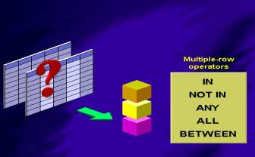
Multiple row subquery
Subqueries that return more than one row are called multiple-row subqueries.
You use a multiple-row operator, instead of a single-row operator, with a multiple-row subquery.
There are five multiple-row comparison operators you can use in a multiple-row subquery to compare a single value to a list of values. You can use IN, NOT IN, ANY, ALL, and BETWEEN.

Slide 218
Multiple row subquery
SubQueries:
Multiple row subquery :
Example: Using IN Operator
We can use the IN operator to compare a single value specified in the outer query to any member in a list returned by a subquery.
A multiple-row subquery always must be enclosed in parentheses and must appear to the right of a multiple-row comparison operator.
SELECT last_name, salary, department_id FROM employees WHERE salary IN (SELECT MIN(salary) FROM employees GROUP BY department_id);

Slide 219
Multiple row subquery
SubQueries:
Multiple row subquery :
Example: Using ANY Operator (Display employees who are not IT programmers and whose salary is less than that of any IT programmer.)
The ANY operator (and its synonym, the SOME operator) compares a value to ach value returned by a subquery.
Here:
ANY means less than the maximum.
>ANY means more than the minimum.
=ANY is equivalent to IN.
SELECT employee_id,last_name, job_id,salary FROM employees WHERE salary < ALL (SELECT mgr.manager_id FROM employees mgr);

Slide 220
Multiple row subquery
SubQueries:
Multiple row subquery :
Example: Using ALL Operator (Display employees whose salary is less than the salary of all employees with a job ID of IT_PROG and whose job is not IT_PROG.)
The ALL operator compares a value to every value returned by a sub query.
Here :
ALL means more than the maximum and
<ALL means less than the minimum.
SELECT emp.last_name FROM employees emp WHERE emp.employee_id < ALL (SELECT salary FROM employees WHERE job_id=‘IT_PROG’);

Slide 221
Multiple row subquery
SubQueries:
Multiple row subquery :
Example: Using NOT Operator
The NOT operator can be used with IN, ANY, and ALL operators.
Display all employees who do not have any subordinates:
Note: If one of the values returned by the inner query is a null value, the entire query returns no rows.
The reason is that all conditions that compare a null value result in a null.
So whenever null values are likely to be part of the results set of a subquery, do not use the NOT IN operator. The NOT IN operator is equivalent to <> ALL.
SELECT last_name FROM employees WHERE employee_id NOT IN (SELECT manager_id FROM employees WHERE manager_id IS NOT NULL);

Slide 222
Multiple column subquery
There are times when you need to use a subquery that compares more than just one column between the parent query and the subquery. This is known as a multiple-column subquery.
the IN clause is used to compare the outer query's columns to the columns of the subquery.
A subquery in which more than one column is selected for comparison to the main query using the same number of columns.
Example:
If the columns do not match in number, then an error message is displayed.
If the data types do not match, then the results of the query are incorrect.
SELECT employee_id, last_name, job_id, salary
FROM employees
WHERE (job_id, salary) IN (select job_id, salary
FROM employees
WHERE employee_id = 136);

Slide 223
Multiple column subquery
SubQueries:
Multiple Column subquery :
Example: Display only those employees who have worked the longest time in each job title.
SELECT first_name, job_id, hiredate
From employees WHERE (job_id,hiredate) IN
(SELECT job_id,MIN(hiredate_date) FROM employees GROUP BY job_id);

Slide 224
Multiple column subquery
SubQueries:
Multiple Column subquery :
Example: Display details about employees whose salary and commission match the salary and commission of any employee in Department 30.
SELECT first_name, department_id, salary, commission_pct
FROM employees
WHERE (salary, NVL(commission_pct,-1)) IN
(SELECT salary, NVL(commission_pct,-1)
FROM employees WHERE department_id = 30);

Slide 225
Multiple column subquery
Queries in FROM Clause
We can create a logical subset of data by writing a subquery in the FROM clause of a SELECT statement.
These subsets are virtual tables that we can use to return specific data to the main query.
Use a table alias to identify the result set of the subquery
Example: Display the names, salaries, department numbers, and average salaries for all employees who earn more than the average salaries in their departments.
SELECT a.first_name, a.salary, a.department_id, b.salavg FROM employees a,
(SELECT department_id, AVG(sal) salavg
FROM employees GROUP BY department_id ) b WHERE a. department_id =b. department_id AND a.salary > b.salavg

Slide 226
Multiple column subquery
SubQueries:
Multiple Column subquery :
Queries in FROM Clause
Example: Display details for employees who earn the lowest salary in each job title.
SELECT e.job_id, e.first_name, e.salary, sub.low_sal
FROM employees e,
(SELECT job_id, MIN(salary) low_sal
FROM employees
GROUP BY job_id) sub
WHERE e.job_id = sub.job_id
AND e.salary = sub.low_sal;

Slide 227
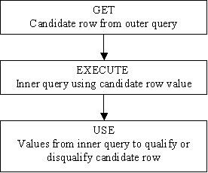
Correlated Subqueries
Correlated Subqueries:
A subquery that contains a reference to a column in the main, or parent, query and is evaluated once for each row of the outer query.
A correlated subquery looks very much like other subquery, with one important difference:
The correlated subquery references a column in the main query as part of the qualification process to see if a given row will be returned by the query.
For each row in the parent query, the subquery is evaluated to see if the row will be returned.
It is used for row-by-row processing. Each subquery is executed once for every row of the outer query.

Slide 228
Correlated Subqueries
SubQueries:
Correlated Sub Query :
Example: Display employees who earn more than the average for their department across all departments.
SELECT employee_id, last_name, department_id, salary
FROM employees emp
WHERE salary > (SELECT avg(salary)
FROM employees
WHERE department_id = emp.department_id);

Slide 229
Correlated Subqueries
SubQueries:
Correlated Sub Query :
Example: Display details of those employees who have switched jobs at least twice.
SELECT e.employee_id, e.last_name, e.job_id FROM employees e WHERE 2 <= ( SELECT COUNT(*) FROM job_history WHERE employee_id = e.employee_id);

Slide 230
In-line Views
The inline view is a construct in Oracle SQL where you can place a query in the SQL FROM, clause, just as if the query was a table name.
It allows you to use a filtered data set not found in a table like a view, but only in the scope of the query or SQL statement.
A common use for in-line views in Oracle SQL is
to simplify complex queries by removing join operations and
condensing several separate queries into a single query.
Example: Display the employees who earn the highest salary in each department.
SELECT a.last_name, a.salary, a.department_id, b.maxsal FROM employees a,
( SELECT department_id, max(salary) maxsal
FROM employees
GROUP BY department_id ) b
WHERE a.department_id = b.department_id
AND a.salary = b.maxsal;

Slide 231
Sub Queries - Guidelines
A subquery must be enclosed in parentheses.
A subquery must be placed on the right side of the comparison operator.
Sub queries cannot manipulate their results internally, therefore ORDER BY clause cannot be added in to a subquery.
However we can use a ORDER BY clause in the main SELECT statement (outer query) which will be last clause.
Use single-row operators with single-row sub queries.
If a subquery (inner query) returns a null value to the outer query, the outer query will not return any rows when using certain comparison operators in a WHERE clause.

Slide 232
Recap
Set Operations:
Used to combine the results of more than one Query
Different types of set Opearations supported are:
UNION, UNION ALL, INTERSECT and MINUS
Joins:
Used to fetch the results from more than one table
Different Joins supported are :
INNER JOIN,OUTER JOIN and SELF Join
SubQueries:
Used to write a Query within another Query

Slide 233
Thank You

