Slide 1
Capstone Project
Presented by :
CreativeKillers
K.HariChandana
A. Shivadath
A. Gangadhar
M . Lokesh
A. V. Yaswanth
G. Gouthami
M. Tejaswini
D. Swarna

Slide 2
INDEX
Introduction
Technologies
Project Flow
Test Cases
Advantages
Disadvantages
Output

Slide 3
Introduction
E-Commerce website is online portals that facilitate online transactions of goods and services through means of the transfer of information and funds over the Internet. In the early days, e-commerce was done partially through emails and phone calls.
Now, with a single website, anything and everything that a transaction needs, can be executed online.

Slide 4
Technologies
HTML
CSS
SQL
SPRINGBOOT

Slide 5
Project Flow
Customer
Admin
Register
Login
Add Products
View Products
Restock products
Order Products
Review
orders

Slide 6
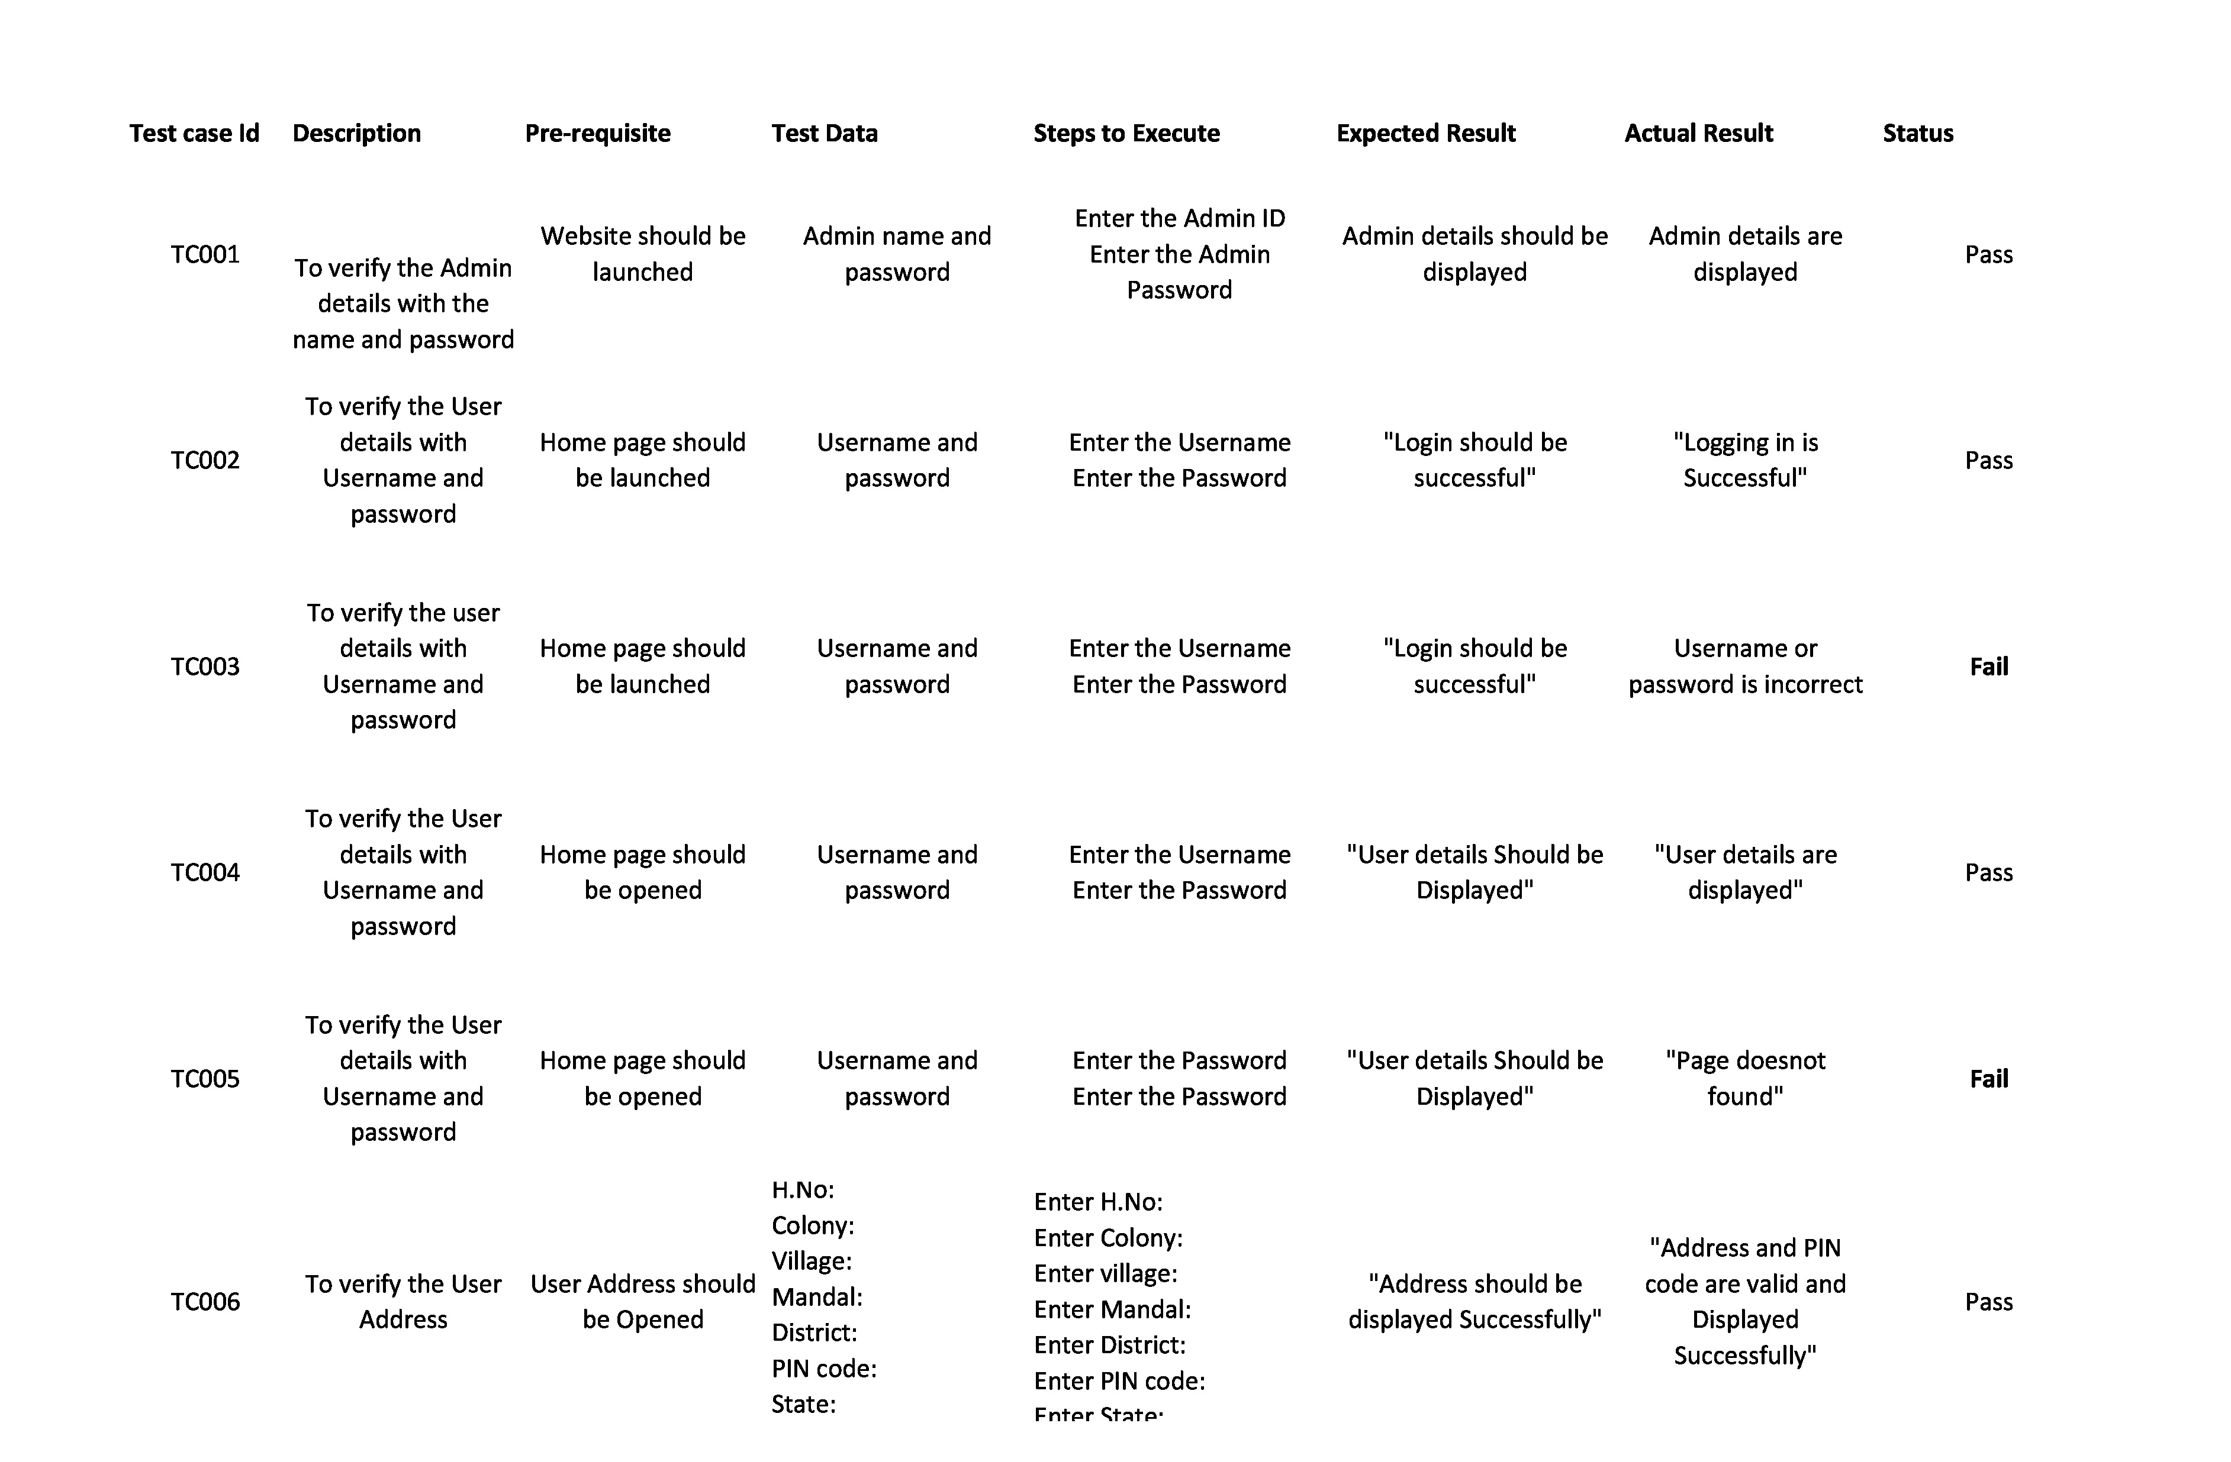
Testcases

Slide 7
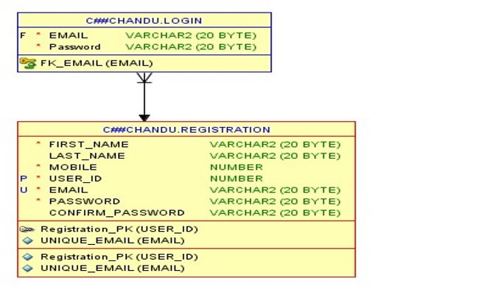
SQL Output:
Registration Table :

Slide 8
Advantages
Faster buying process
Store and product listing creation
Cost reduction
Flexibility for customers
Product and price comparison

Slide 9
Disadvantages
No One Can Buy During a Site Crash
Customers Can’t Try Before They Buy
Ecommerce Is Highly Competitive
Customers Can Be Impatient
Shipping Times Can Be Lengthy

Slide 10
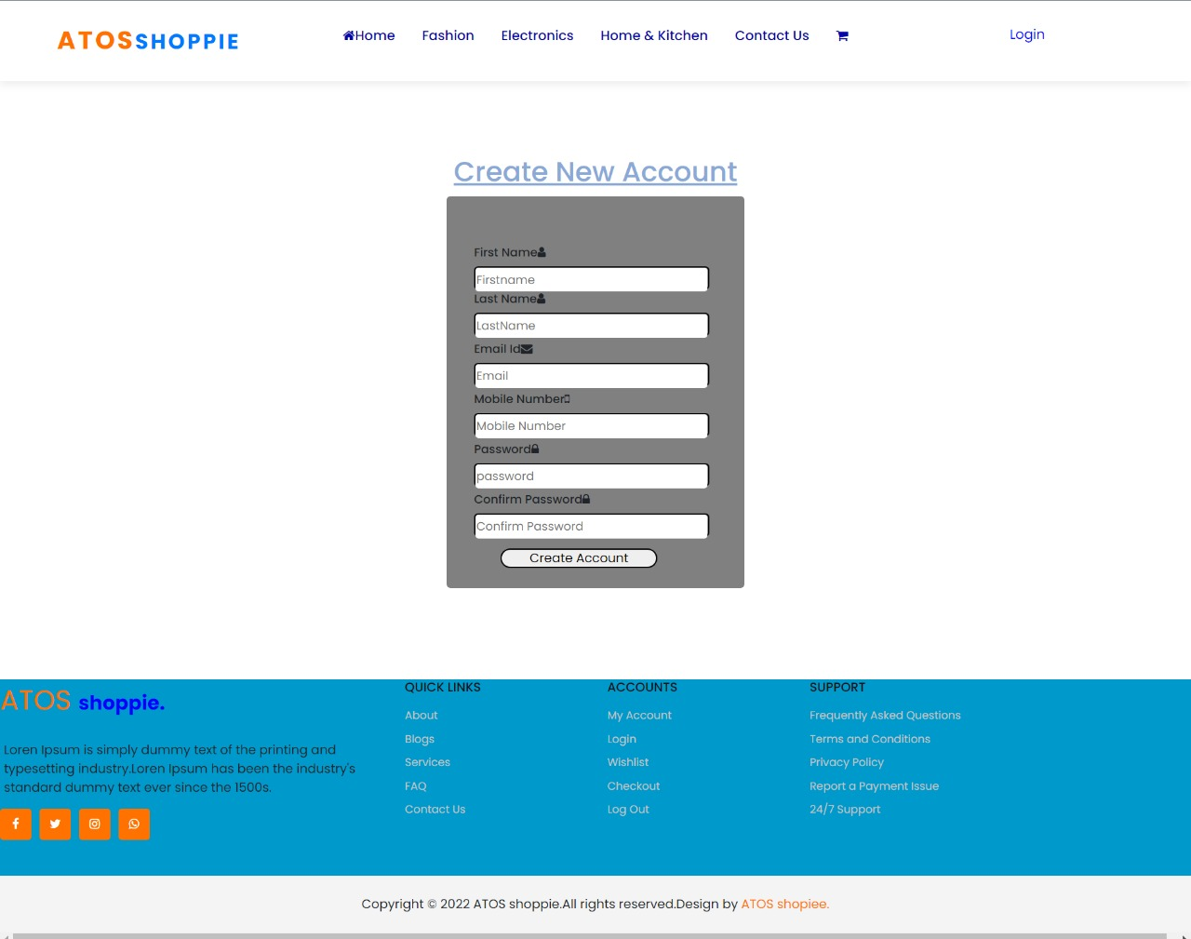
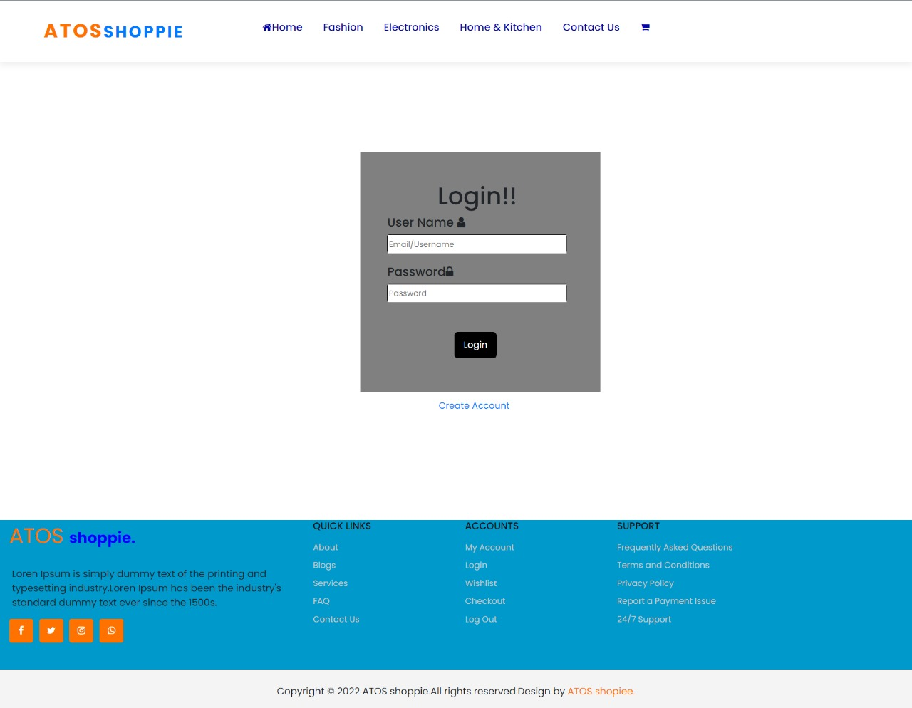
Output :

Slide 11
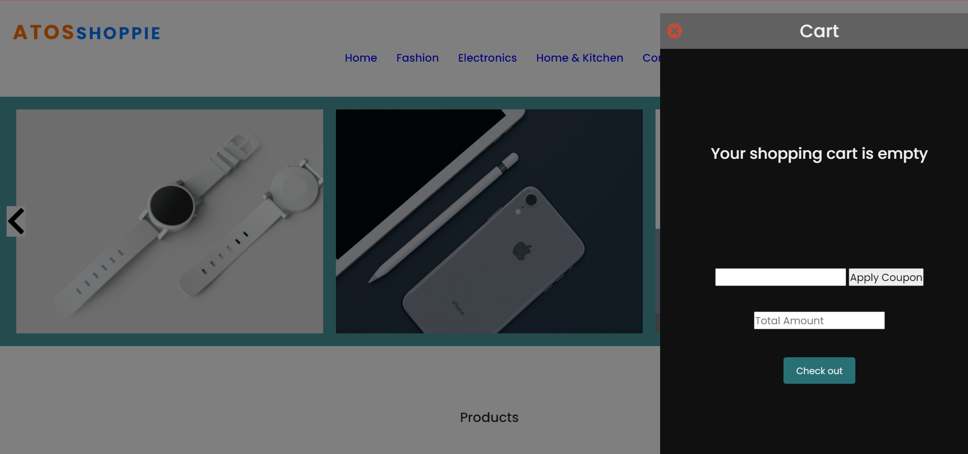
Coupon code:

Slide 12
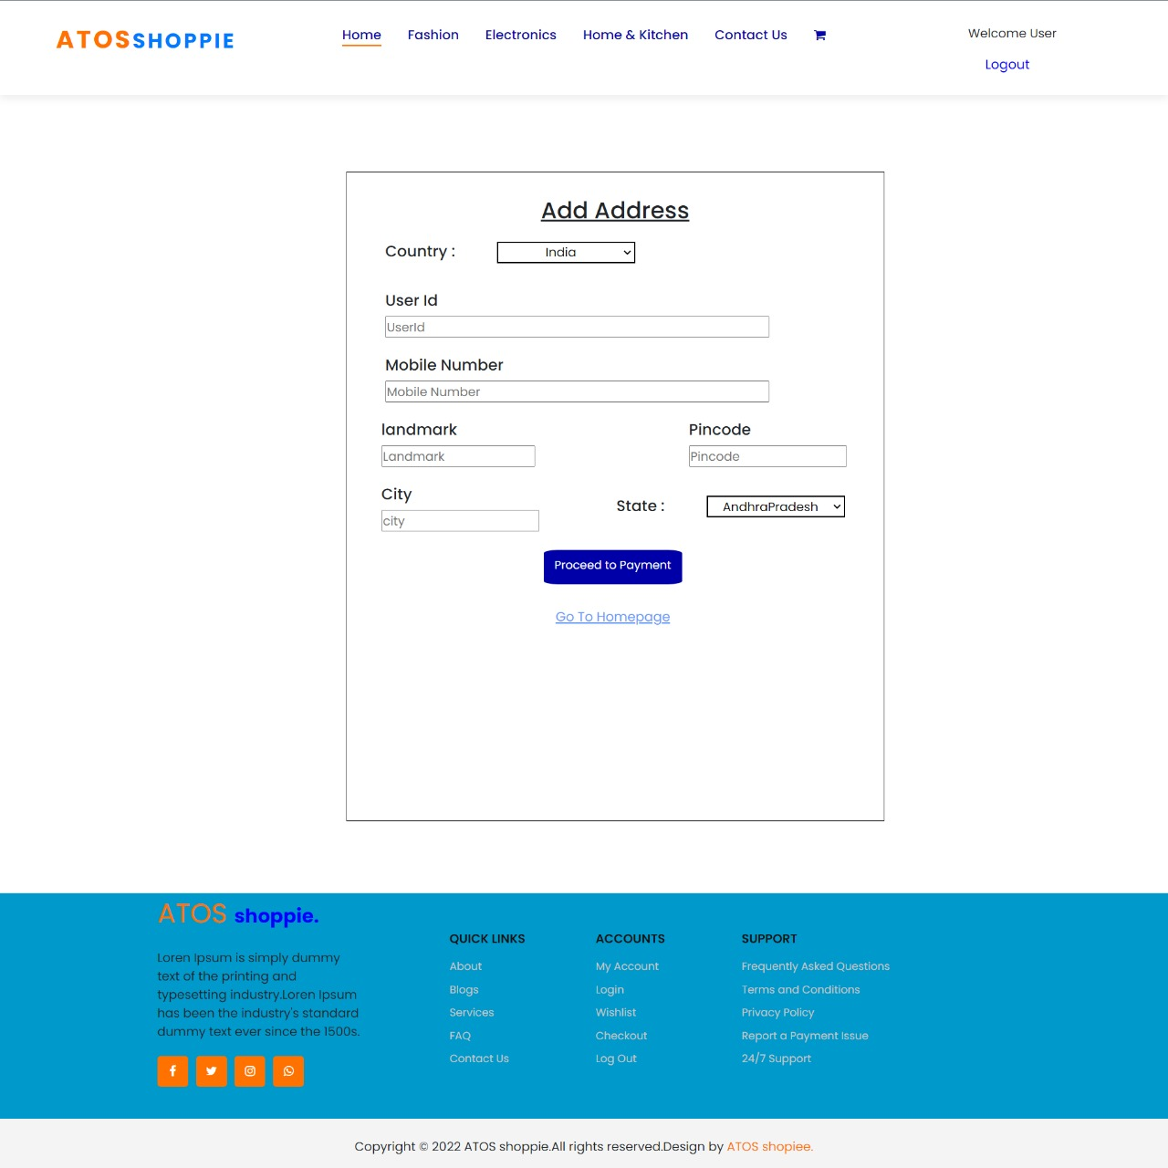
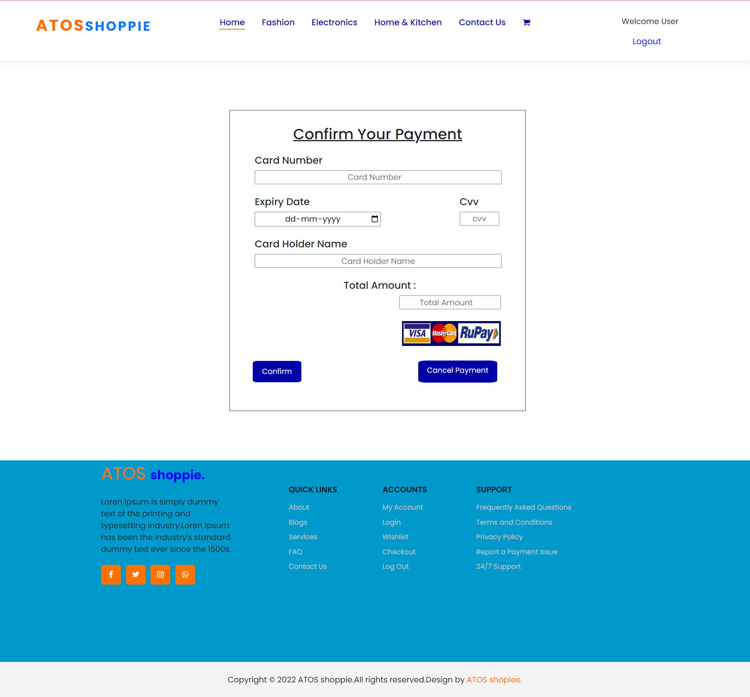
Output :

Slide 13
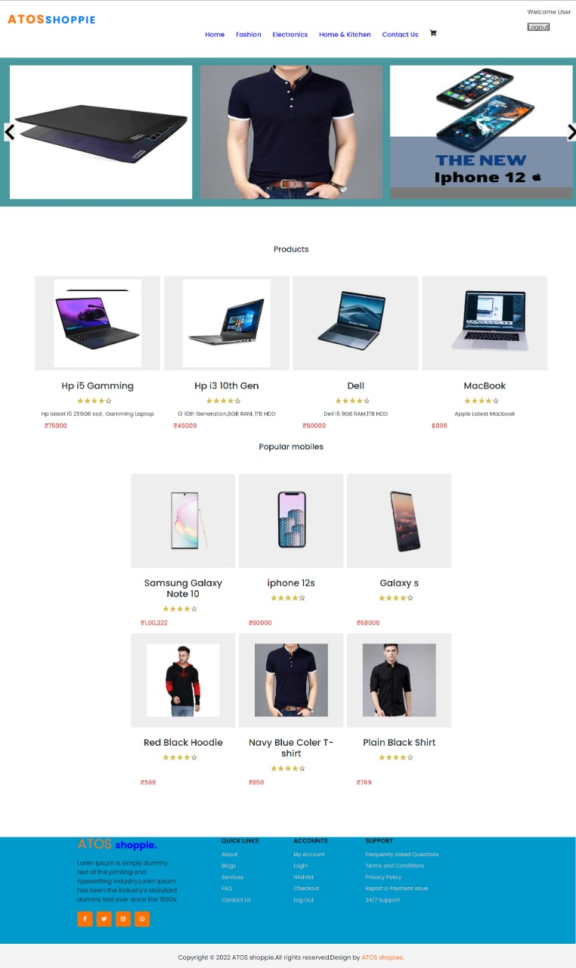
Output
Find it, love it, buy it.

Slide 14
ThankYou

