Slide 1
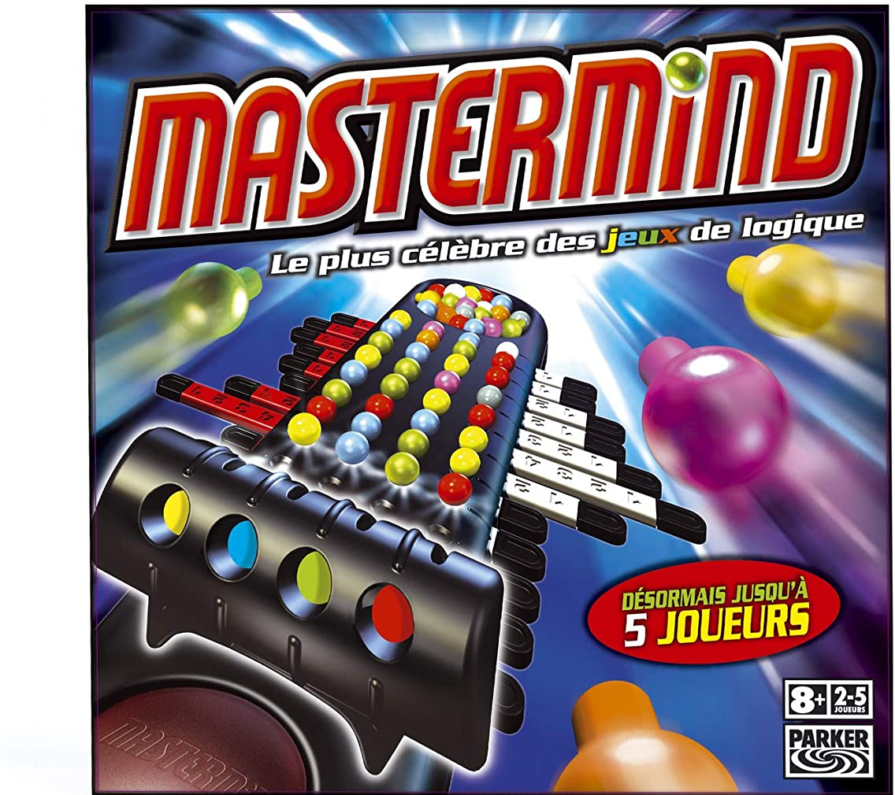
Mastermind
Ildem Sanli
Olivier Masson

Slide 2
Process
Preparation
Coding
Deliverables
Research on mastermind
Designing our game
Planning of the project on Jira
Preparation of the flowchart
Split the code in functions
Share the functions and write the code
Combine the functions and finalize the code
Testing
Upload the materials on Github
Write the readme file
Prepare the slides

Slide 3
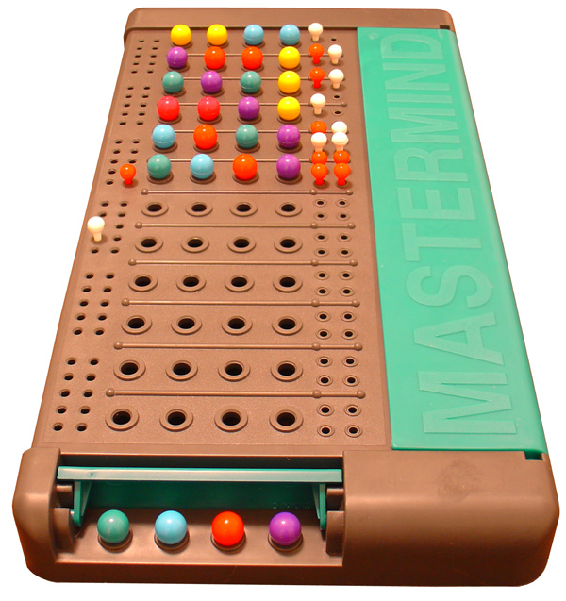
Mastermind for dummies
Random combination of 4 out of 6 possible coloured pins
Player has 12 attempts max to try and guess the combination
Right colour + right position → Exact match
Right colour + wrong position → Near match
Wrong colour → No match
4 exact match wins!

Slide 4
Challenges
Highlights
Making sure that we could break the loop when we get 4 exact matches
Comparing the inputs when the same colour was picked more than once
Refining the code to make it readable by any aspiring pythonista
Refining our game to boost playability
Splitting the code into blocks
Combining the blocks and making it consistent (lots of testing involved)
Explaining/understanding each other’s code and helping each other
Friendly cooperation to make the code flawless

Slide 5
Ideas for a v2
Replace all figures with colors to avoid confusion on the player’s part
Feedback messages could be improved to boost player morale

