Slide 1
1/29
“the blockchain will do to the financial system what the internet did to media.”
Block chain Banking System

Slide 2
2/29
Contributors
Supervised by:
Prof. Ahmed Shawky
Prof. Cherry Ahmed
ID | Name
Omar Bassuni | 20160157
Philopater Maher | 20160177
Waleed Ahmed | 20160284
George Nabil | 20160087
Andrew Emad | 20160070

Slide 3
3/29
Introduction

Slide 4

4/29
Project Objective
Connecting Lenders and Borrowers in a secure integral way

Slide 5
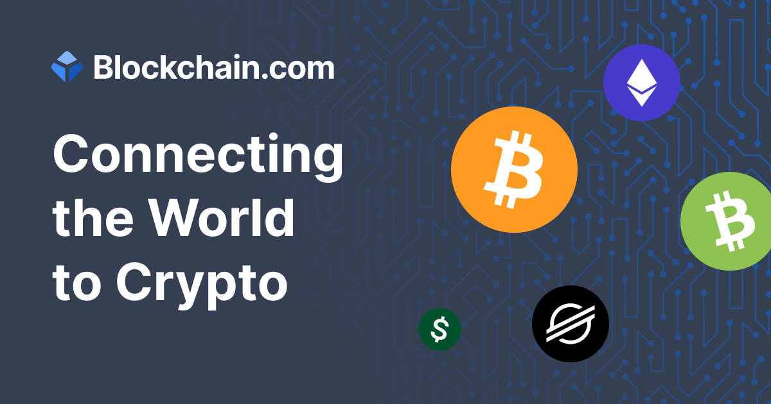
5/29
Technology Used
We Choose Blockchain Technology!

Slide 6
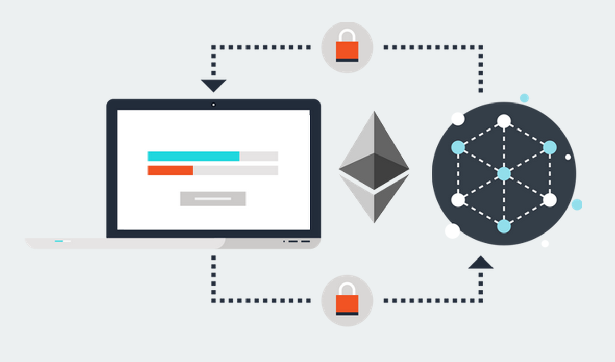
6/29
Ethereum
Smart Contracts and Solidity

Slide 7

7/29
Ethereum
Properties of transactions in Ethereum
Paying with Ethers
Nodes don’t Mine Ethers
Integrating Ethereum in Web Project

Slide 8
8/29
Comparing BCB & Current systems

Slide 9

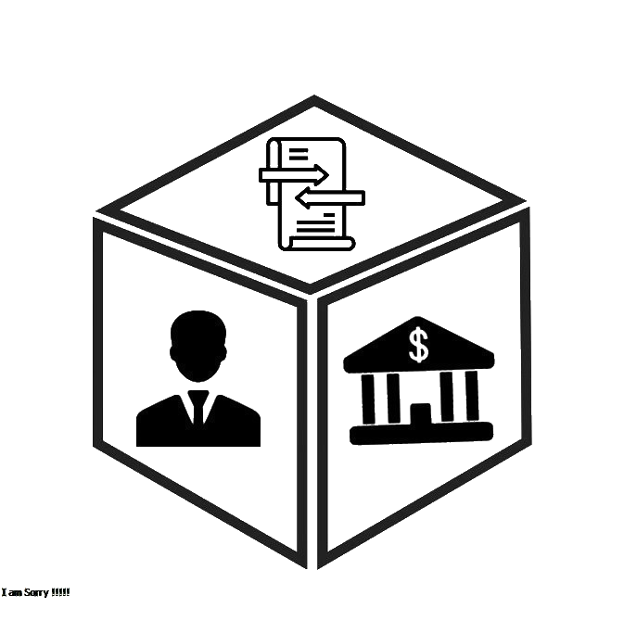

Comparing BCB & Current systems
9/29
Security
over all users data and transactions.
Transaction speed
Limited transaction speed compared to centralized model
Integrity & Transparency
Of the immutable data blocks.
No Third-Party
Data and transactions are not owned by single entity.
Scoring System
Ranking the borrowers inside the system to degrade the irrelevant accounts.

Slide 10
Technologies Used & Their Explanations
10/29

Slide 11



Technologies Used & their explanations
11/29
Front-end
HTML, CSS, Bootstrap
JavaScript
Ajax
Blockchain
Solidity
Sublime editor
Ganache local-Network
Back-end
Django Framework
Python

Slide 12
12/29
System Features

Slide 13
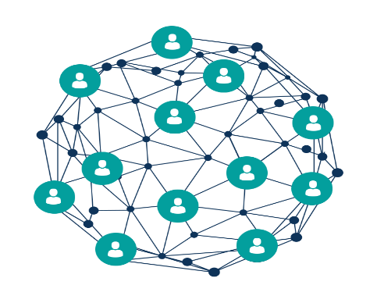




13/29
Systems Features
:
Create account

Slide 14
14/29
Systems Features
:
Pending loan
Create loan
My Score is: 0

Slide 15
15/29
Systems Features
:
Pending loan
Create loan
Reject
My Score is: 0

Slide 16
16/29
Systems Features
:
Pending loan
Create loan
Confirmed loan
Confirm
Confirmed loan
eject
My Score is: 0

Slide 17
17/29
Systems Features
:
Confirmed installment
Confirm installment
Pay installment
My Score is: 10

Slide 18

18/29
Systems Features
:
Search
My Score is: 25

Slide 19
19/29
System Design & Interactions

Slide 20
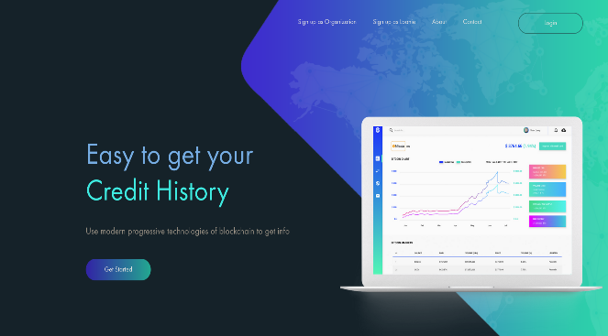
20/29
3-Tier Architecture
Ethereum
Front-end
Server

Slide 21

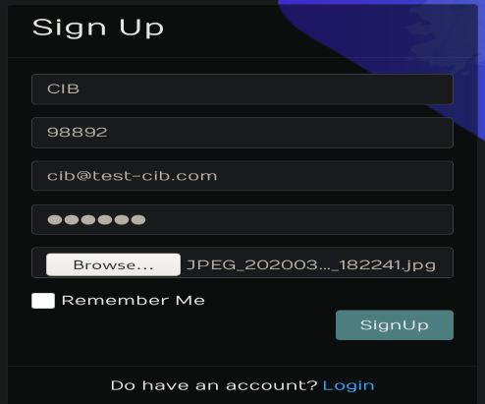
21/29
Organization Account Creation

Slide 22

22/29
Organization Account Creation
Accounts contract
-accounts:[ ] +add(account: address, type: bool)

Slide 23
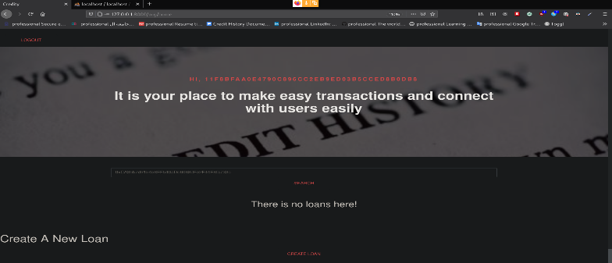
23/29
Organization Account Creation

Slide 24
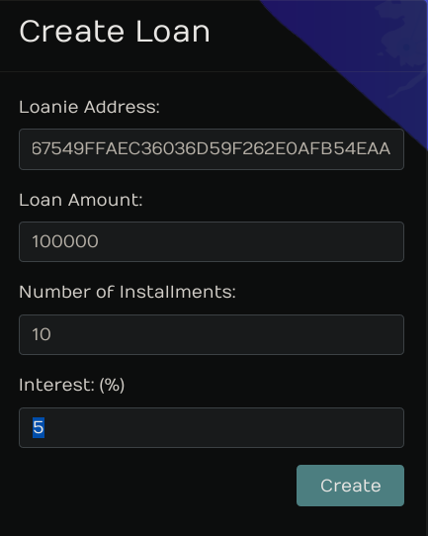
24/29
Organization Create Loan

Slide 25
25/29
Organization Create Loan
Organization Contract
+createLoan()
Loans Contract
-loans:[] -pendingLoans:[]

Slide 26
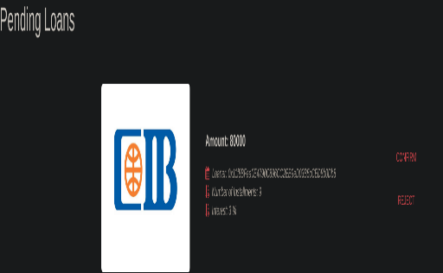
26/29
Organization Create Loan

Slide 27
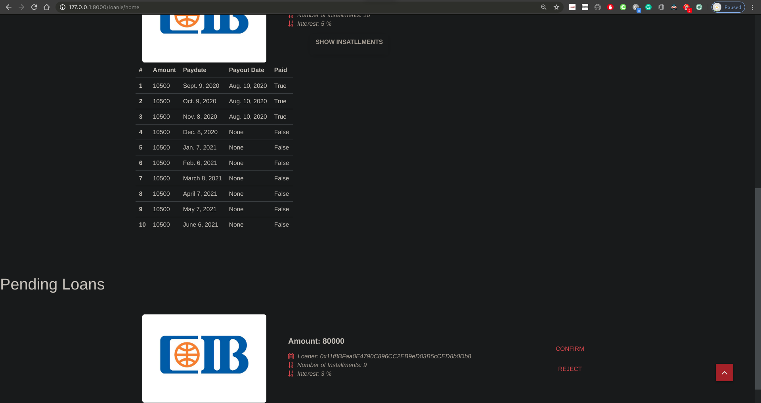
27/29
Confirm A Pending Loan

Slide 28
28/29
Organization Create Loan
User Contract
+confirmPendingLoan()
Loans Contract
-loans:[] -pendingLoans:[] +confirmPendingLoans()

Slide 29
29/29
System Running

