Slide 1




You must copy all the elements of the slide: ctrl-a
Application
Application
V1
V2
78
DEPLOYMENT RISK

Slide 2
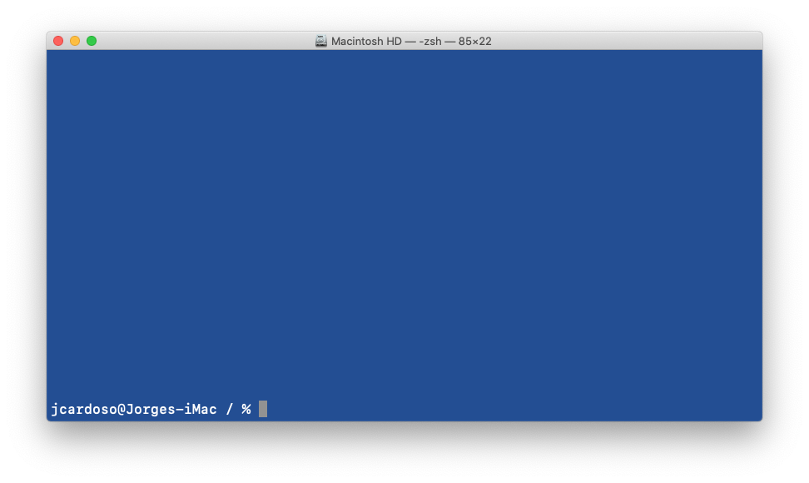
$ logsight application create --name hadoop_name_node app_id: a3de4ae5-a0be-42c5-a6d9-9e9c245831f5 $ export LOGSIGHT_APP_ID=a3de4ae5-a0be-42c5-a6d9-9e9c245831f5 $ logsight log upload samples/hadoop_name_node_v1 --tag v1 $ logsight log upload samples/hadoop_name_node_v2 --tag v2 flush_id: cd7bb237-f6b6-4124-925d-9419eca75a48 $ logsight compare log --tags v1 v2 --flush_id cd7bb237-f6b6-4124-925d-9419eca75a48 +---------------------------------+--------------------------------------+ | KEY | VALUE | +---------------------------------+--------------------------------------+ ... | risk | 23 | | totalLogCount | 8332 | | baselineLogCount | 4166 | ... +---------------------------------+--------------------------------------+
$

