Slide 1

A3-PS003-TC174
Federated Traffic-Flow Prediction: Evaluating FedAvg and FedAdam under IID and Non-IID Data Distributions
A . Sri Chandana
Srichandana734@gmail.com
AIORI Hackathon 3
October,13 2026

Slide 2
Problem Description
Identifying and addressing unequal prediction performance in federated traffic-flow prediction.
Different traffic clients may have different traffic patterns and data distributions.
A global model may perform well overall but produce high prediction errors for some clients.
Standard Federated Averaging (FedAvg) may not sufficiently address the needs of poorly performing clients.
Additional local training may improve a weak client's predictions, but its impact on communication cost must be evaluated.
A systematic comparison is needed to assess overall accuracy, worst-client performance, communication cost, and convergence under IID and non-IID data distributions.

Slide 3
Background
Federated Learning enables multiple clients to train a shared machine-learning model without directly sharing their raw data. In traffic-flow prediction, different locations may have different traffic patterns and data distributions.
Federated Averaging (FedAvg) combines model updates from multiple clients to create a global model.
Non-IID data can cause differences in prediction performance across clients.
A model with good overall performance may still produce high prediction errors for an individual client.
Evaluating each client's MAE and RMSE helps identify poorly performing clients.
Our proposed approach investigates whether providing additional local training to the worst-performing client can improve its predictions while monitoring communication cost.

Slide 4
Literature & RFC Review
1. FedTraffic (2026) — Candy Abboud and Serge Khalil
He Proposes a hierarchical Edge–Fog–Cloud framework combining TCN, CVAE, FedProx, and adaptive aggregation for traffic prediction.
Limitations:
No explicit graph-based road modelling
2. Traffic-Aware Federated Learning with Custom Aggregation (2026) — Seerat Kaur et al.
he Uses an attention-based LSTM, traffic clustering, and custom client-weighted aggregation.
Limitations:
Evaluated on a regional dataset,aggregation relies on predefined metrics and tuned weights. More diverse datasets and client personalization need further study.

Slide 5
Proposed Solution
Data Preparation: Clean a public traffic dataset and split it chronologically into training and testing data.
Client Setup: Divide the data among three simulated clients and test both IID and non-IID distributions.
FedAvg Baseline: Train a global model by combining local model updates without sharing raw traffic data.
Error Identification: Use MAE and RMSE to identify clients with high prediction errors.
Proposed Improvement: Investigate whether additional local training for the worst-performing client reduces its prediction error.
Evaluation: Compare the baseline and proposed approach using prediction error, communication cost, and convergence across three random seeds.
Expected Outcome: Evaluate whether the proposed approach improves predictions for poorly performing clients while keeping communication costs manageable.

Slide 6
Optimization Proposed
Aspect | before | Proposed enhancement
Client evaluation | Evaluate overall performance | Evaluate each client”s MAE andRMSE
Error identification | No targeted client selection | Identify the worst performing client
Local training | Standard local training | Investigate additional training for the selected client
Prediction performance | Measure baseline error | Check whether client-wise error decreases
Communication cost | measured by bytes | Measure additional communication overhead
Final comparison | Baseline results | Compare accuracy,worst-client error,and communication cost

Slide 7
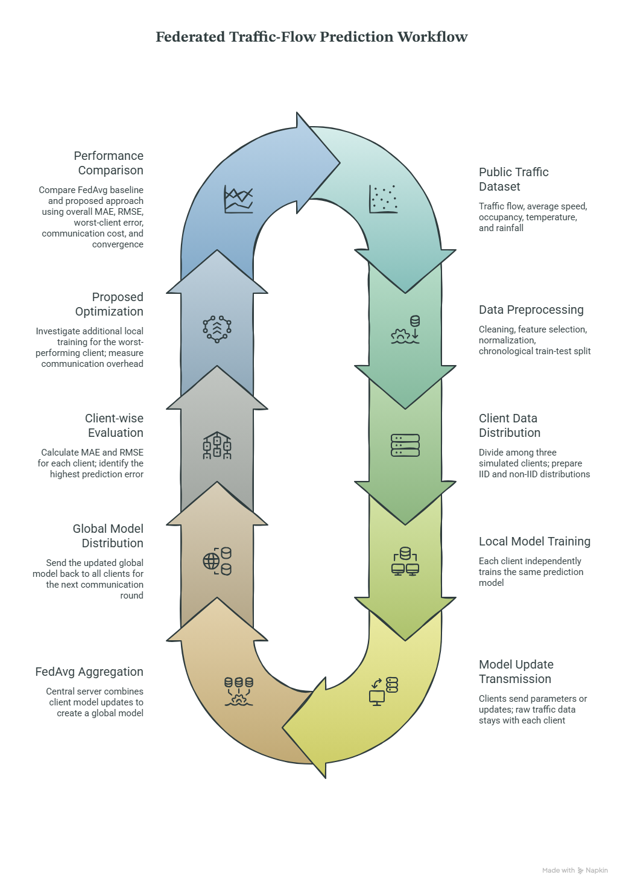
System Architecture & Design

Slide 8
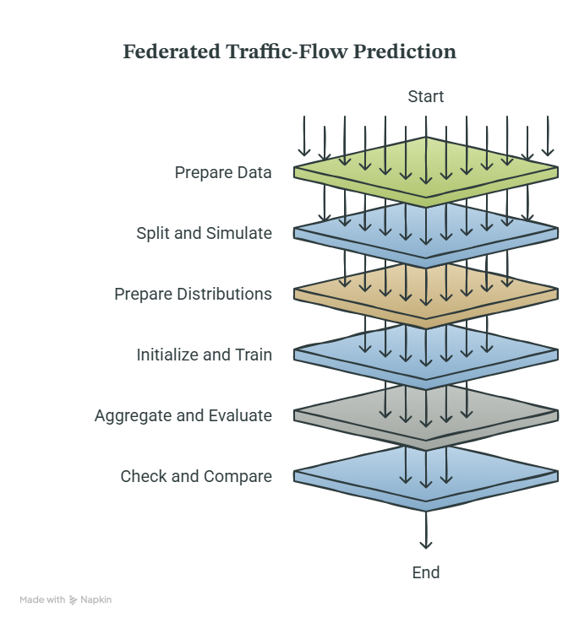
Data flow diagram

Slide 9
Deployment Timeline
Phase 1 – Data Preparation
Select a public traffic dataset, clean the data, and prepare chronological training and testing sets.
Phase 2 – Client Setup
Create three simulated clients and prepare IID and non-IID data distributions.
Phase 3 – Model Development
Implement the FedAvg baseline and train the traffic-flow prediction model across multiple communication rounds.
Phase 4 – Proposed Optimization
Identify the client with the highest prediction error and test additional local training.
Phase 5 – Evaluation
Compare MAE, RMSE, worst-client error, communication cost, and convergence under both data distributions.
Phase 6 – Final Analysis
Repeat experiments using three random seeds, analyze the results, and prepare the final report and presentation.

Slide 10
Bibliography
Abboud, C., & Khalil, S. (2026). “FedTraffic: A Hierarchical Federated Learning Framework for Traffic Flow Prediction in Intelligent Transportation Systems.” Eng, 7(8), 362. https://doi.org/10.3390/eng7080362
Kaur, S., et al. (2026). “A Traffic-Aware Federated Learning Prediction Framework with Custom Aggregation.” Machine Learning with Applications, 23, Article 100829. https://doi.org/10.1016/j.mlwa.2025.100829

Slide 11
Thank You for Your Attention

