Slide 1

A3-PS006-TC385
Policy-Constrained Service Failover Demonstrator
Vishal Raj
vr790313@gmail.com
AIORI Hackathon 3
October 14, 2026

Slide 2
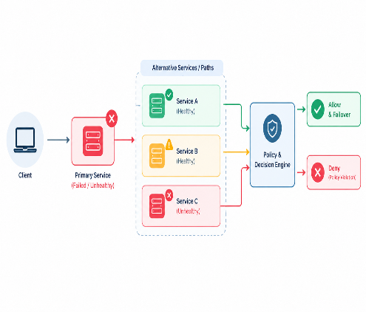
AIORI 3
Abstract
Problem Description
The Problem: Availability Without Policy Creates Risk
01 — Service Failure
The active service or network path becomes unavailable.
02 — Multiple Alternatives
Backup services may be available, but not all are suitable.
03 — Policy Violations
A healthy alternative may violate security, trust, or operational constraints.
04 — Unsafe Failover
Routing traffic based only on health can send it to an unauthorized destination.
THE CORE CHALLENGE
How can we restore service availability while ensuring that every failover decision follows explicit security and operational policies?
Vishal Raj· A3-PS006-TC385· October 14, 2026

Slide 3
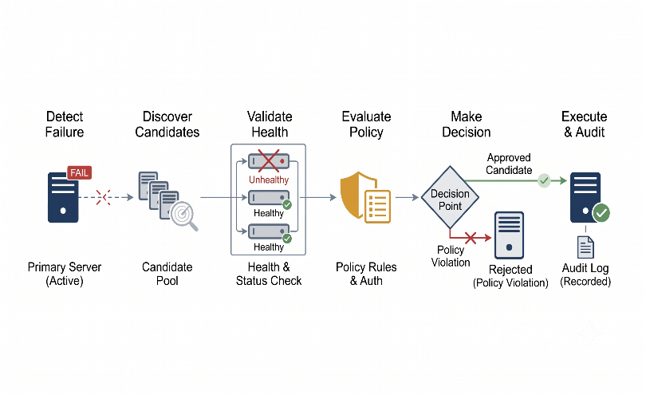
Background
AIORI 3
Background
Policy-Constrained Service Failover
A failover system that checks both service health and policy compliance before redirecting traffic.
1. Detect
Identify service or network failure.
2. Discover
Find alternative services or paths.
3. Validate
Check health and readiness.
4. Evaluate
Verify security and operational policies.
6. Execute
Redirect traffic only to an eligible candidate.
7. Audit
Record decisions and failover outcomes.
Core Principle: Healthy + Authorized = Eligible
If no eligible candidate exists, deny failover and raise an alert.
Vishal Raj· A3-PS006-TC385· October 14, 2026

Slide 4
AIORI 3
Literature & RFC Review
Literature & RFC Review
Research Source & Standard | Contribution to Our Design | Boundary / Limitation
NIST SP 800-207Zero Trust Architecture csrc.nist.gov/pubs/sp/800/207 | Supports explicit authorization rather than trusting network location alone. | Does not validate our specific failover implementation.
Open Policy Agent (OPA)Official Documentation openpolicyagent.org/docs | Supports policy-as-code and separation of policy decision-making from enforcement. | Does not guarantee that our policies are correct or complete.
KubernetesContainer Probes Specification kubernetes.io/docs/pods/probes | Explains health checks, readiness checks, and liveness checks. | Health and readiness checks do not establish authorization.
Envoy ProxyUpstream Health Checking Architecture envoyproxy.io/docs/health_checking | Documents mechanisms for checking the health of upstream services. | Health checking alone does not enforce our policy constraints.
IETF RFC 5880Bidirectional Forwarding Detection (BFD) rfc-editor.org/rfc/rfc5880 | Defines BFD for detecting faults in bidirectional forwarding paths. | Does not provide end-to-end service authorization.
Key Research Takeaway: “Established standards inform our design; implementation effectiveness must be demonstrated through testing.”
Vishal Raj· A3-PS006-TC385· October 14, 2026

Slide 5
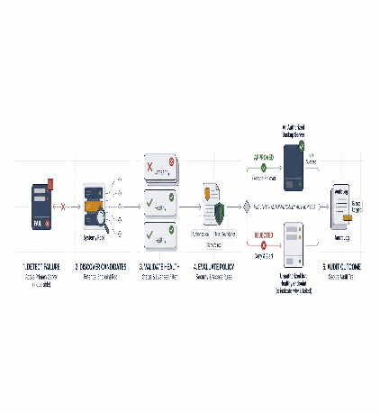
AIORI 3
Proposed Solution
Proposed Solution
Policy-Constrained Service Failover
Objective: Restore service availability without violating security or operational policies.
1. Detect & Discover
Identify service failures and discover alternative endpoints.
2. Validate & Authorize
Check health, readiness, and policy compliance before selection.
3. Enforce & Audit
Redirect traffic only to an eligible candidate and record the outcome.
Decision Rule:
Healthy + Authorized = Eligible for Failover
If no eligible candidate exists, deny the failover and raise an alert.
Vishal Raj· A3-PS006-TC385· October 14, 2026

Slide 6
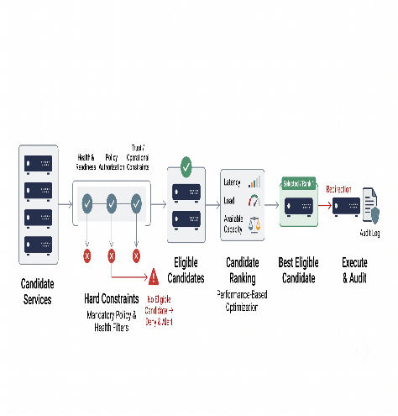
AIORI 3
Solution Optimization
Optimization Proposed
Intelligent & Policy-Aware Failover
Objective: Select the best available backup service without compromising security policies.
Key Optimization Strategies
Health-Based Filtering: Remove unhealthy or unready services.
Policy-Based Selection: Reject destinations that violate security or operational rules.
Latency Optimization: Prefer eligible services with lower response times.
Load Balancing: Avoid overloading a single service.
Capacity Awareness: Select a backup capable of handling incoming traffic.
Automated Failover: Redirect traffic to the best eligible candidate and record the decision.
Expected Benefits
Faster and more reliable recovery.
Reduced risk of unauthorized routing.
Better utilization of available resources.
Transparent and auditable decisions.
Core Principle: Security first, performance second.
Vishal Raj· A3-PS006-TC385· October 14, 2026

Slide 7
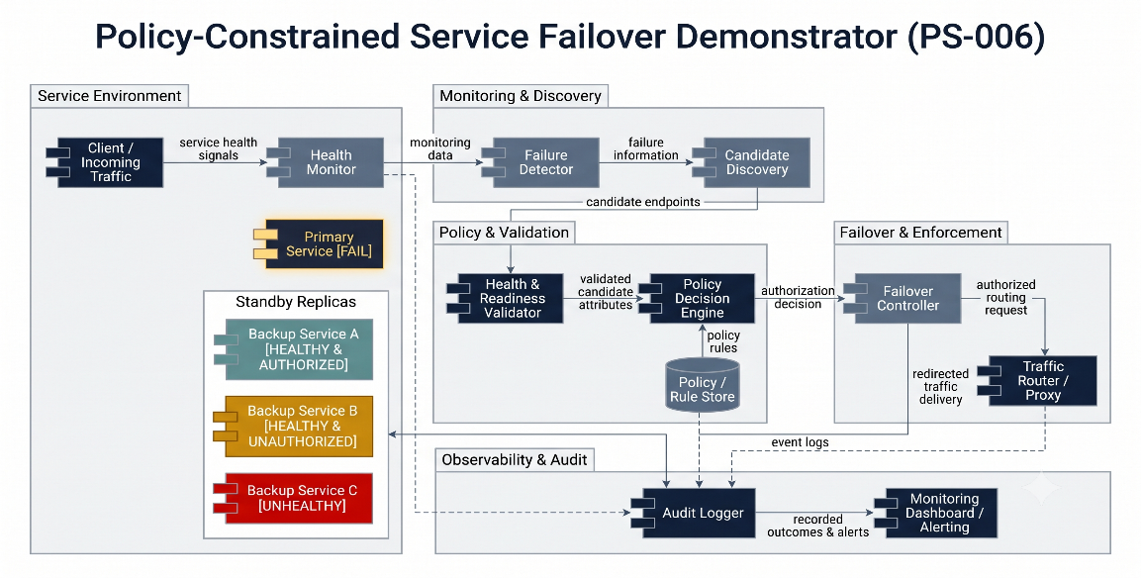
AIORI 3
Solution Architecture & Design
Architecture Design (UML Diagram)
Image
Figure: System Architecture UML Diagram
Vishal Raj· A3-PS006-TC385· October 14, 2026

Slide 8
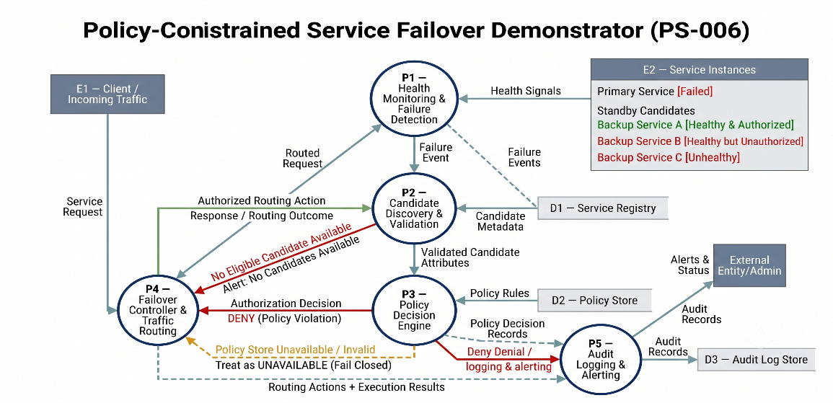
Data Flow Diagram
AIORI 3 Data Flow Diagram
Image
Figure: Data Flow Diagram (DFD)
Vishal Raj· A3-PS006-TC385· October 14, 2026

Slide 9
AIORI 3
Deployment Timeline
Deployment Timeline
Phase 4 — Failover Automation
Integrate the failover controller and traffic router.
Execute authorized routing changes.
Deliverable: Automated failover prototype.
Phase 5 — Logging & Observability
Record policy decisions and routing outcomes.
Add alerts for denied or failed failover attempts.
Deliverable: Audit and monitoring module.
Phase 6 — Testing & Demonstration
Test service failures, policy violations, and recovery.
Measure failover time and verify audit records.
Deploy the demonstrator in a controlled test environment.
Deliverable: Tested demonstrator and evaluation report.
Phase 1 — Requirements & Policy Design
Define security constraints and failover rules.
Establish test scenarios.
Deliverable: Policy specification.
Phase 2 — Service Monitoring
Set up primary and backup service instances.
Implement health checks and failure detection.
Deliverable: Working monitoring module.
Phase 3 — Policy Engine Integration
Implement candidate validation and policy evaluation.
Handle approval and rejection decisions.
Deliverable: Policy-based eligibility checks.
Final Milestone
Policy-Compliant Failover Demonstration
Timeline represents the proposed implementation plan; completion depends on development and testing.
Vishal Raj· A3-PS006-TC385· October 14, 2026

Slide 10
Bibliography I
Bibliography
Technical foundations and official documentation
[1] NIST SP 800-207 — Zero Trust Architecture
csrc.nist.gov/pubs/sp/800/207/final
[2] Open Policy Agent — Official Documentation
openpolicyagent.org/docs
[3] Kubernetes — Container Probes
kubernetes.io/docs/concepts/workloads/pods/probes/
[4] Envoy — Health Checking
envoyproxy.io/docs/envoy/latest/intro/arch_overview/upstream/health_checking
[5] IETF RFC 5880 — Bidirectional Forwarding Detection
rfc-editor.org/rfc/rfc5880.html
Vishal Raj· A3-PS006-TC385· October 14, 2026

Slide 11
Thank You for Your Attention!

