Slide 1

Team CYBER SENTRY
A3-PS011-TC139
Authorized Attack-Surface Inventory and Change monitor
Ananda Kumaran K I Hariharan VB Dinesh Kumar A(MENTOR)
anandu4678@gmail.com hariharanjee23@gmail.com dineshkumara@stjosephstechnology.ac.in
AIORI Hackathon 3
October 5, 2026

Slide 2
AIORI 3
Abstract
Problem Description
Multi-Cloud Asset Sprawl: Organizations running multi-cloud infrastructure accumulate exposed digital assets over time, including unmaintained test subdomains, expired TLS certificates, open service ports, and dangling DNS CNAME records.
Hackathon Challenge (PS-011): The project requires building an authorized attack-surface discovery and monitoring system for a lab portfolio of up to 20 domains and 10 hosts to catalogue public records, verify TLS certificates, and inspect service ports.
Operational Blind Spots: Unmonitored digital footprints leave organizations vulnerable to unpredicted infrastructure drift, necessitating scheduled inventory comparisons and immediate alerts for unexpected services.
Strict Safety Mandates: The monitoring system must rely exclusively on written, organizer-approved target scopes while strictly prohibiting unauthorized exploitation, and unrestricted scanning.
Cyber Sentry· A3-PS011-TC139

Slide 3
AIORI 3
Background
Background
The EASM Paradigm: EASM has shifted to continuous asset discovery, but legacy open-source tools suffer from high false-positive rates and heavy manual configuration overhead
Dangers of Dangling DNS: Orphaned CNAMEs pointing to deleted cloud instances allow attackers to register the missing resource and hijack subdomains.
Operational Blind Spots: Unverified initial baselines risk normalizing pre-existing vulnerabilities (e.g., expiring certificates, open database ports) as "expected state".
Need for Authorized Automation: Dynamic cloud tracking requires continuous automation governed by strict cryptographic authorization to guarantee safe monitoring
Cyber Sentry· A3-PS011-TC139

Slide 4
AIORI 3
Literature & RFC Review
Literature & RFC Review
OWASP Testing Guide (WSTG): Applies industry-standard OWASP passive reconnaissance methodologies for non-destructive, safe infrastructure discovery.
Certificate Transparency (RFC 6962): Passively monitors public CT logs to detect newly issued domain certificates without triggering active network alarms.
DNS & DNSSEC Standards (RFC 1034 / 4033): Implements multi-resolver consensus models and DNSSEC awareness to resolve dynamic CNAME chains and prevent DNS poisoning.
Rate Limiting & Safety Controls: Employs token-bucket rate limiting and exponential backoff circuit breakers to guarantee non-disruptive, safe probing.
Cyber Sentry· A3-PS011-TC139

Slide 5
AIORI 3
Proposed Solution
Proposed Solution
Inventory & Scope Enforcement: Monitors up to 20 domains and 10 hosts using an immutable, append-only database secured by a cryptographically signed scope to block unauthorized probes.
Discovery & Monitoring Checks: Performs safe DNS, TLS, and service checks using a multi-resolver quorum, metadata verification, and ML-driven adaptive port profiling.
Scheduled Change Detection: Utilizes a core Diff Engine for scheduled inventory comparisons to track infrastructure drift and detect seeded issues like expired certificates or dangling CNAMEs.
AI False-Positive Analysis: Integrates AI/ML scope recommendations and a FPP scoring to filter transient network noise and perform a safer fingerprinting.
Alerting & Demonstration: Delivers actionable reports and an interactive visual dashboard to fulfill the final technical report and prototype demonstration requirements.
Cyber Sentry· A3-PS011-TC139

Slide 6
AIORI 3
Solution Optimization
Optimization Proposed
Scope Definition: Before: Manual, error-prone YAML files. After: ML-drafted scopes with 1-click Ed25519 cryptographic approval.
Port Discovery: Before: Aggressive full-port scans that risk DoS and violate safety rules. After: ML-driven adaptive profiling for targeted, safe port checks.
False Positives: Before: High alert fatigue from transient DNS flakiness. After: Automated FPP scoring intelligently suppresses network noise.
Data Integrity: Before: Mutable databases vulnerable to historical tampering. After: Append-only, hash-chained storage guarantees an immutable audit trail.
Cyber Sentry· A3-PS011-TC139

Slide 7
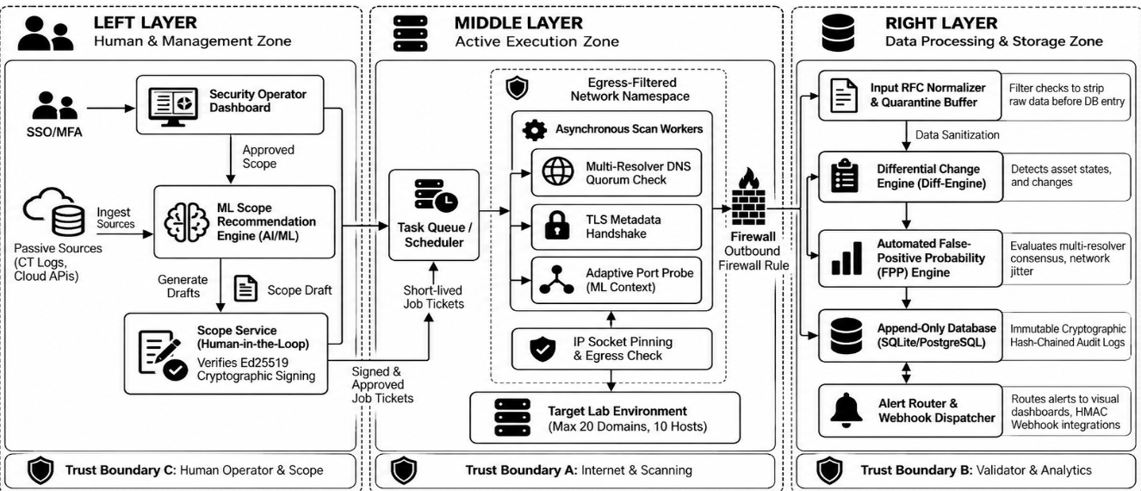
AIORI 3
Solution Architecture & Design
Architecture Design (UML Diagram)
Figure: System Architecture UML Diagram
Cyber Sentry· A3-PS011-TC139

Slide 8
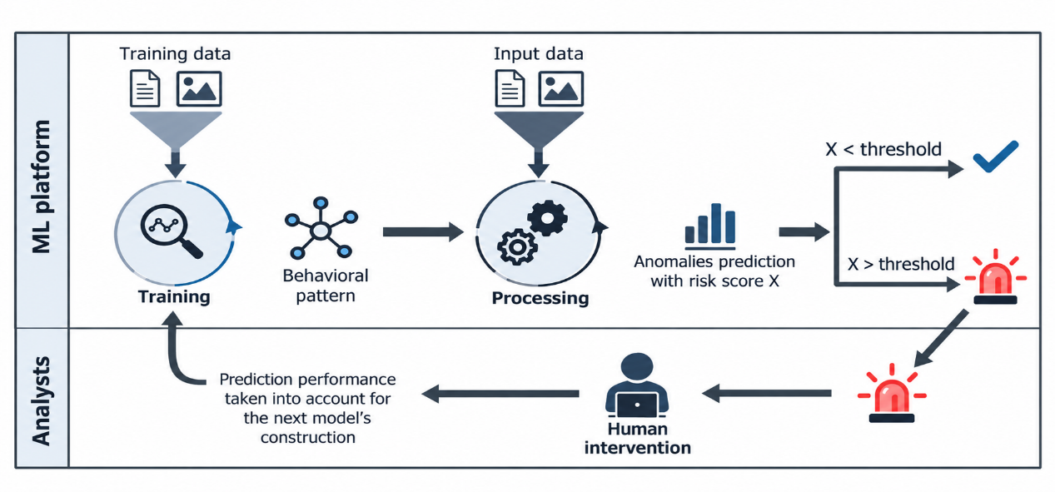
Data Flow Diagram
AIORI 3 Data Flow Diagram
Figure: Data Flow Diagram (DFD)
Cyber Sentry· A3-PS011-TC139

Slide 9
Deployment Timeline
AIORI 3
Deployment Timeline
Project Milestone | Date | Description
Requirement analysis & environment setup | 15 Oct – 18 Oct | Define lab scope, setup isolated container environment and ai scope engine.
Authorization & validation | 19 Oct – 23 Oct | Implement Ed25519 scope signing, IP pinning and DNS/TLS/Port workers.
Storage , Diffing & AI Triage | 24 Oct – 28 Oct | Deploy append-only DB, Day-0 isolation and False positive engine.
Dashboard, Reporting & final demo | 29 Oct – 31 Oct | Build, visual node-graph UI, finalize documentation and conduct live demo
Cyber Sentry· A3-PS011-TC139

Slide 10
Bibliography I
Bibliography
1] Advanced Internet Operations Research in India (AIORI). "PS-011: Authorised Attack-Surface Inventory and Change." AIORI Hackathon Problem Statement, 2026.
[2] OWASP Foundation. "Web Security Testing Guide." Methodologies for passive reconnaissance and infrastructure discovery.
[3] Internal Design Draft. "Secure Design: Authorized Attack-Surface Discovery and Monitoring System." Lab Portfolio EASM Blueprint.
Cyber Sentry· A3-PS011-TC139

