Slide 1

A3-PS011-TC215
Authorised Attack-Surface Inventory and Change Monitor
SK Aneesa Begum
Shaikaneesabegum64@gmail.com
Namburi Naga Venkata Likhitha Sri
likhithasrinamburi25@gmail.com
CH Sireesha
karumurisireesha1@gmail.com
AIORI Hackathon 3
October 8, 2026

Slide 2
Problem Description
PS-011: Authorised Attack-Surface Inventory and Change Monitor
Organisations cannot protect what they do not know exist: hosts, open ports, services and domains drift out of any manually kept inventory.
New, modified or forgotten (shadow) assets appear without review and silently enlarge the attack surface.
Scanning must stay inside an explicitly authorised scope; out-of-scope probing is legally and ethically unacceptable.
Spreadsheet-based inventories go stale and give no trustworthy baseline to compare against.
Small teams need clear, low-noise alerts on what changed, not raw scan dumps.
Goal: a lab prototype that keeps an authorised asset inventory, discovers what is actually exposed, and flags every change against an approved baseline.

Slide 3
Background
Why continuous, scope-controlled attack-surface visibility matters
Attack surface = every internet- or network-reachable asset, service and entry point an adversary could target.
Asset inventory is the first control in common security frameworks; without it, patching, monitoring and incident response all have blind spots [1][3].
Continuous monitoring means comparing observed state with an approved baseline and reporting deviations [1][2].
Typical changes to catch: new host, new open port or service, changed service version, asset gone offline.
Authorisation matters: only assets the administrator has declared in scope are discovered, stored and reported.

Slide 4
Literature & RFC Review
Most relevant standards and studies
Reference | Relevance to PS-011
NIST SP 800-137 (ISCM) [1] | Continuous monitoring cycle: define, establish, implement, analyse, respond, review
NIST SP 800-128 [2] | Security-focused configuration management and baseline control
CIS Controls v8, Controls 1 and 2 [3] | Inventory and control of enterprise assets and software
ZMap, USENIX Security 2013 [4] | Fast, scope-limited network scanning; informs discovery design
RFC 8520 (MUD) [5] | Describing expected device behaviour; supports baseline definition
RFC 5424 (Syslog) [6] | Standard format for alert and audit log records

Slide 5
Proposed Solution
Six cooperating components built around an approved baseline
Asset Inventory & Baseline Manager: the administrator declares authorised assets and scope; approved baseline is stored in the inventory database (D1).
Discovery Engine: scans only in-scope targets and records IP, MAC, services and ports in a temporary store (D2).
Change Detection Engine: compares observed assets with the baseline and classifies new, modified or removed.
Alert & Log Manager: raises alerts and writes an audit trail for every change.
Inventory update: unchanged, in-scope results refresh the inventory.
Dashboard / Reports: view inventory, alerts and change history; export reports.

Slide 6
Optimization Proposed
Before and after comparison
Aspect | Before (manual process) | After (proposed monitor)
Asset inventory | Static spreadsheet, quickly outdated | Authoritative, continuously refreshed database
Scope control | Ad hoc, risk of out-of-scope scans | Scans restricted to administrator-declared scope
Change visibility | Found late or by accident | Every new, modified or removed asset flagged
Alerting | Raw scan output, high noise | Baseline-compared, categorised alerts
Evidence | Scattered notes | Audit log and change history, exportable reports

Slide 7
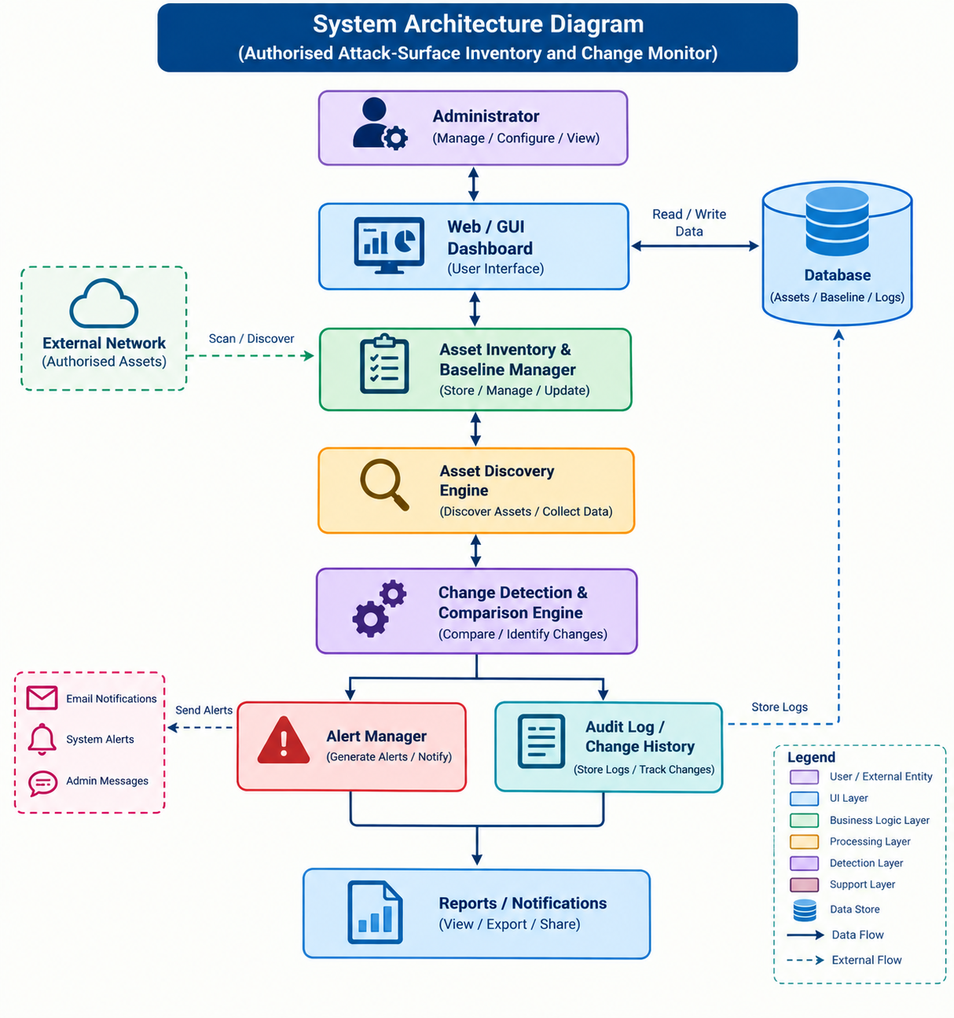
Solution Architecture & Design
Layered design: UI, business logic, processing, detection and support layers.
Web / GUI dashboard is the single administrator touchpoint.
Discovery targets only the authorised external network.
Alerts go out by email, system alert and admin message.
One database holds assets, baseline and logs.
Figure: System Architecture Diagram

Slide 8
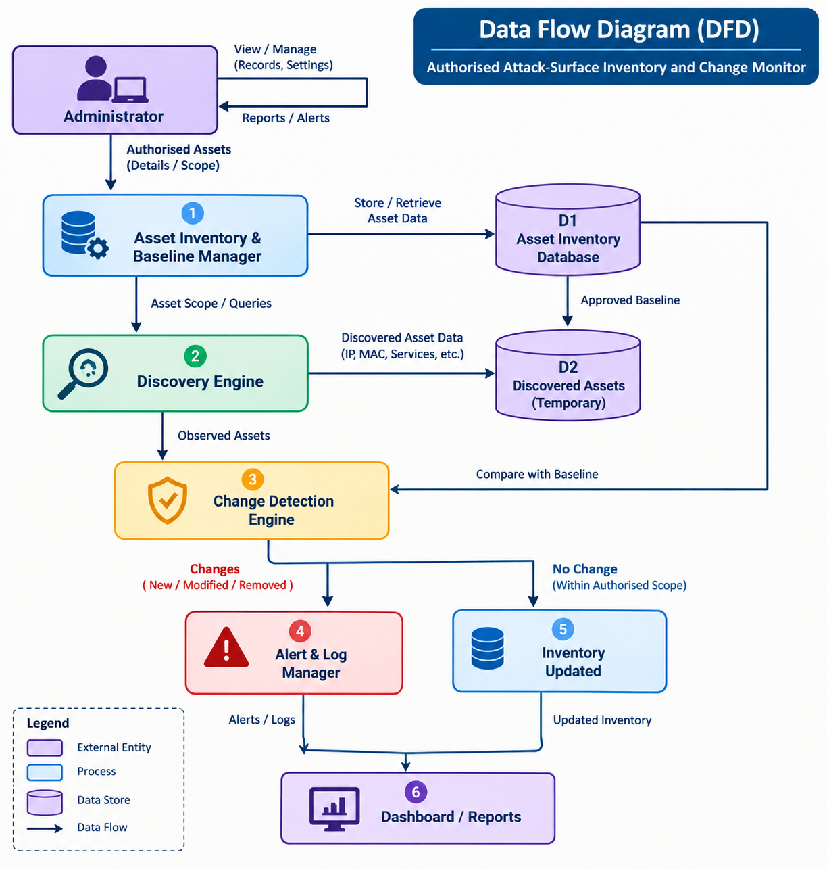
Data Flow Diagram
Administrator supplies authorised assets and scope (process 1).
Approved baseline is held in D1; observations in temporary store D2.
Process 3 compares observed assets with the baseline.
Changes go to Alert & Log Manager (4); no-change results update inventory (5).
Dashboard (6) returns reports and alerts to the administrator.
Figure: Data Flow Diagram (DFD)

Slide 9
Deployment Timeline
Phased, iterative methodology in a controlled lab
Phase | Milestone | Outcome
Week 1 | Requirements, authorised scope definition, lab setup | Approved scope file and test assets
Week 2 | Inventory and baseline manager, database (D1, D2) | Baseline created and stored
Week 3 | Discovery engine with scope enforcement | Observed assets collected
Week 4 | Change detection, alert and audit logging | New / modified / removed flagged
Week 5 | Dashboard, reports, end-to-end testing | Working prototype and demo

Slide 10
Bibliography
[1] Dempsey, K. et al. Information Security Continuous Monitoring (ISCM) for Federal Information Systems and Organizations. NIST SP 800-137, 2011.
[2] Johnson, A. et al. Guide for Security-Focused Configuration Management of Information Systems. NIST SP 800-128, 2011.
[3] Center for Internet Security. CIS Critical Security Controls, Version 8, 2021.
[4] Durumeric, Z., Wustrow, E., Halderman, J. A. ZMap: Fast Internet-wide Scanning and Its Security Applications. USENIX Security, 2013.
[5] Lear, E., Droms, R., Romascanu, D. Manufacturer Usage Description Specification. RFC 8520, 2019.
[6] Gerhards, R. The Syslog Protocol. RFC 5424, 2009.

Slide 11
Thank You for Your Attention!

