Slide 1

PS-011
Authorised Attack-Surface Inventory and Change Monitor
Kirti Singh
Kirtisingh239on@gmail.com
AIORI Hackathon 3
October 14,2026

Slide 2
AIORI 3 Abstract
Problem Description
Internet-facing assets change faster than manual inventories are updated; unnoticed drift becomes unmanaged exposure.
Abstract. Multi-cloud estates accumulate unmaintained test subdomains, expiring TLS certificates, unplanned open services and CNAME records that outlive the cloud instances they pointed. We propose a defensive, deterministic monitor for the organiser-approved lab portfolio (at most 20 domains and 10 hosts). A written scope allowlist gates every operation; DNS, TLS and four documented service checks yield time-stamped observations that are normalised into a versioned inventory, compared with an approved baseline on a schedule, and classified by transparent rules into evidence-backed alerts. Planned outputs: inventory, change and alert reports, seeded-issue detection results, a false-positive analysis, and the technical report with a demonstration. The design involves no exploitation and no unrestricted scanning.
► Stale DNS. CNAME/A records can reference decommissioned resources. Such a record is a candidate for investigation, not proof of exploitability; takeover depends on how the provider verifies ownership .
► Certificates. Expired certificates harm trust and availability ; expiry must be separated from chain, hostname and handshake failures .
► Unexpected services. Exposure that is not compared with an approved expectation goes unnoticed.
► Central gap. A one-off scan records state; it does not identify change, retain evidence or quantify false positives. A repeatable, baseline-driven, auditable workflow is required.
► Constraints. Written, organiser-approved scope only; a failed check stays inconclusive and is never promoted to a finding by default .
Kirti Singh• PS-011 •October 14,2026
2 / 11

Slide 3
AIORI 3 Background
Background
An inventory is useful only if each observation is time-stamped, attributable to a check, comparable with a baseline and backed by evidence.
► Attack-surface inventory. The set of externally reachable assets (domains, hosts, DNS records, certificates, services) with an accountable owner; unowned entries are where drift hides.
► DNS. Names map to resource records in zones . A CNAME aliases one name to another; if the target resource is retired, the alias can remain. A target that no longer resolves makes the record a potentially dangling candidate; it is not automatic proof of exploitability, which needs provider context and authorised manual verification .
► TLS. An X.509 certificate carries validity period, issuer, subject and subject alternative names . Clients also validate trust and check that the server identity matches the requested name ; in TLS 1.3 the server presents its certificate during the handshake . Expiry, untrusted chain and hostname mismatch are distinct outcomes.
► Service exposure. A TCP connection to an approved port shows reachability only. A timeout or reset is ambiguous (filtered, down, rate-limited), so it is inconclusive, not “closed”.
► Baselines and snapshots. Each observation stores time, target, check, result and evidence. A new snapshot is compared field by field with the last valid baseline to give new, removed, changed, unchanged or unknown states.
► Signal vs. finding. A signal is an unexpected observation; a finding is a signal that persists on re-check and survives review. Rejected signals are logged as false positives.
► Scope and reproducibility. Only allowlisted lab targets are touched; identical configuration should reproduce identical results. Documentation address blocks suit safe fixtures.
Kirti Singh• PS-011 •October 14,2026
3 / 11

Slide 4
AIORI 3 Literature & RFC Review
Literature & RFC Review
Only sources that drive a design decision are cited; we make no novelty claim over existing attack-surface tools.
1. What established guidance provides.
► OWASP WSTG treats subdomain takeover (WSTG-CONF-10) as enumeration followed by validation, ties risk to providers that fail to verify ownership, and advises removing vulnerable records; WSTG also covers weak transport-layer security testing .
► RFC 1034/1035 define names, resource records, CNAME semantics and resolution . RFC 5280 defines the certificate validity period, issuer and SAN fields ; RFC 9525 specifies server-identity verification ; RFC 8446 defines the TLS 1.3 handshake . RFC 9110 defines HTTP status semantics . RFC 5737 reserves three IPv4 blocks for documentation .
2. What our proposed system applies.
► WSTG’s validate-before-concluding step → candidate vs. confirmed states; confirmation stays manual and authorised.
► RFC 5280 notAfter and RFC 9525 hostname matching → separate expiry, trust and hostname outcomes, so a handshake failure is never reported as expiry.
► RFC 1034/1035 CNAME semantics → canonicalised record values and chain-target resolution state; RFC 9110 status classes → response metadata only; RFC 5737 → fixture addresses.
3. What the scoped workflow contributes operationally (our engineering choices).
► Binds these checks into allowlist-gated, scheduled, baseline-compared runs with provenance, deduplicated alerts and explicit false-positive accounting. No comparison with commercial or open-source tools has been performed, so no superiority claim is made.
Kirti Singh• PS-011 •October 14,2026
4 / 11

Slide 5
AIORI 3 Proposed Solution
Proposed Solution
Scope-gated pipeline: Approved Scope → Discovery → Normalised Inventory → Baseline Comparison → Classification → Alerts & Evidence. All components are proposed; none is claimed as implemented.
A. Scope registry. Versioned allowlist (YAML/JSON) of at most 20 domains and 10 hosts, permitted checks and ports, and the organiser approval reference. Targets are canonicalised (lower-case, IDNA, no trailing dot) and validated before every operation; out-of-scope input is rejected before any network I/O; scope changes are audit-logged.
B. Observation layer. DNS (A, AAAA, CNAME, NS, MX, TXT) per approved name, TLS certificate inspection, and four service checks. Every observation records target, check, UTC time and a result in {ok, failed, timeout, inconclusive}.
C. Normalised inventory. Stable ID = type + canonical key (e.g. dns:name:type, svc:host:port/tcp, cert:host:port). Stored: values, certificate subject/SANs/issuer/validity/days left/trust/hostname result, provenance and timestamps; missing data is stored as unknown.
D. Baseline and change engine. The first approved snapshot is the baseline; scheduled runs are diffed field by field into new / removed / changed / unchanged / unknown. A failed collection never overwrites the last valid observation and never yields “removed”; removal needs N consecutive successful negative observations (configurable). Runs are idempotent.
E. Detection rules. Expired certificate: notAfter < now, reported separately from untrusted chain, hostname mismatch and handshake failure. Unexpected service: open port or banner absent from the approved baseline. DNS classes: consistent / anomalous / potential dangling candidate (e.g. CNAME target NXDOMAIN on repeated observation) / inconclusive / needs authorised manual verification.
F. Alerts and reports. Severity from a transparent rule table. Each alert carries asset ID, observation time, expected vs. observed state, evidence and the next manual verification step; alerts are deduplicated with states (open, acknowledged, suppressed, false positive). Reports (JSON/CSV/HTML) include false-positive and inconclusive tallies.
G. Safety and audit. Bounded concurrency, timeouts, capped retries and rate limits; no exploitation, payloads, brute force or broad port scans; structured audit log; secrets kept in environment variables outside the repository; minimal evidence retention. Proposed stack: Python, SQLite, cron/APScheduler.
Four documented service checks (proposed)
C1 TCP reachability. Input: approved host:port. Connect with timeout. Output: open / refused / timeout (timeout = inconclusive, never “closed”).
C2 Minimal handshake. Protocol-appropriate, read-only probe on an approved port (TLS handshake, HTTP HEAD, SSH banner read). No authentication or payloads. Output: protocol, banner or ALPN; failures are inconclusive.
C3 HTTP(S) metadata. One request to an approved URL: status class [9], redirect target, Server header. No crawling or parameters.
C4 Expected-vs-observed. Compare C1–C3 results with the approved service list; emit unexpected / missing / changed. Limit: only approved ports are examined, so absence elsewhere is unknown.
Flow. Orchestrator checks scope → dispatches tasks → collectors return observations → normaliser stores a snapshot → comparator diffs it against the baseline → classifier applies rules → reporter emits alerts; every step writes audit events.
Kirti Singh• PS-011 •October 14,2026
5 / 11

Slide 6
AIORI 3 Solution Optimization
Optimization Proposed
Before vs. proposed approach. This is a design comparison; no experimental results exist yet.
# | Before (manual / ad hoc) | Proposed approach
1 | Manual asset inventory | Scheduled, versioned snapshots
2 | Isolated check output | Normalised, time-stamped observations with provenance
3 | Informal change review | Deterministic field-level baseline comparison
4 | Generic warning messages | Evidence-backed alerts: expected vs. observed, next step
5 | Binary DNS suspicion | Cautious candidate classes; manual verification required
6 | Repeated alerts | Deduplication and state tracking
7 | Unbounded target input | Allowlisted, canonicalised scope validation
8 | Unverified success claims | Seeded tests and false-positive reporting
Practical optimisations. Incremental comparison (only records whose value hash changed); stable IDs and canonicalised DNS values; configurable timeouts, retry caps, bounded concurrency and rate limiting; idempotent runs keyed by run ID; explicit handling of failed or partial observations; separated collection, classification and reporting; retained evidence for replay; transparent rule-based detection (no machine learning).
Evaluation metrics (to be measured in testing; not existing results). Seeded expired-certificate detection rate; seeded unexpected-service detection rate; correct classification of seeded dangling-DNS candidates; false-positive rate; out-of-scope rejection rate (target: 100% before any network I/O); repeatability across identical runs; diff and report-generation time.
Kirti Singh• PS-011 •October 14,2026
6 / 11

Slide 7
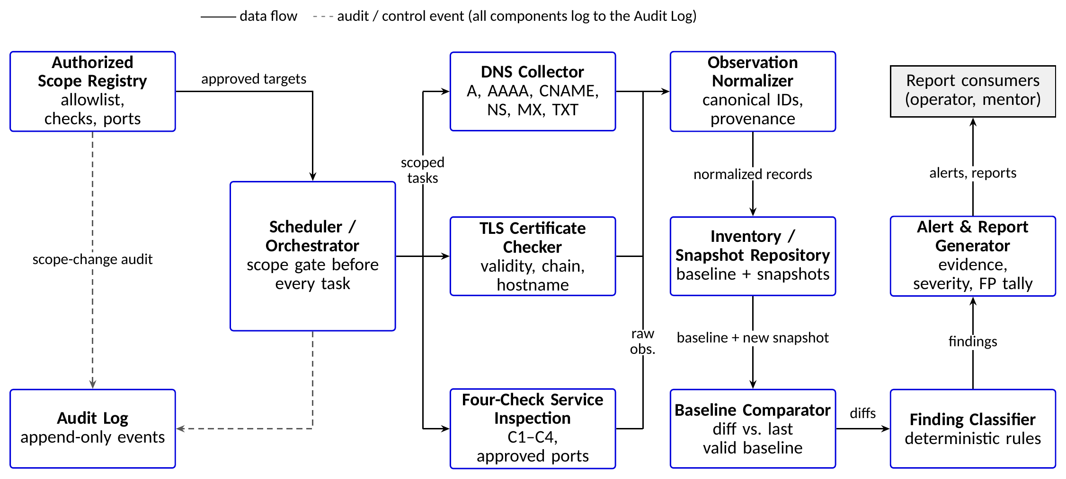
AIORI 3 Architecture Design (UML Diagram)
Solution Architecture & Design
Visual: component diagram of the scope-gated monitoring pipeline.
Figure: System Architecture UML Diagram
Kirti Singh• PS-011 •October 14,2026
7 / 11

Slide 8
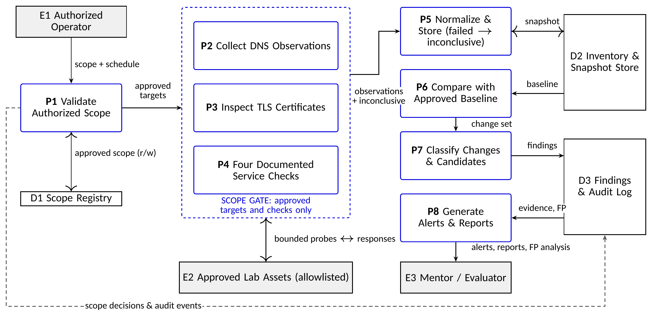
AIORI 3 Data Flow Diagram
Data Flow Diagram
Overview of information movement: scope gate, observations, baseline, findings and reports.
Figure: Data Flow Diagram (DFD)
Kirti Singh• PS-011 •October 14,2026
8 / 11

Slide 9
AIORI 3 Deployment Timeline
Deployment Timeline
Relative stages (no deadline was supplied); iterative delivery via GitHub issues and pull requests in the team repository.
# | Work | Deliverable | Acceptance / validation
1 | Requirements review, obtain written organiser-approved scope, create private repo named after the team | Scope file, repo, README | Scope approval reference stored; aiori-hackathon added as collaborator
2 | Inventory schema and scope enforcement (canonicalisation, allowlist, audit log) | Schema, scope module | Out-of-scope inputs rejected with zero network calls (unit tests)
3 | DNS and TLS collectors with explicit result states | Collectors | Fixtures give expected records; expiry, trust and hostname outcomes kept distinct
4 | Four documented service checks C1–C4, with timeouts and rate limits | Check module, docs | Checks bounded; timeouts recorded as inconclusive
5 | Baseline snapshots, field-level diff, removal rule | Comparator | Identical runs give identical diffs; failed collection never yields “removed”
6 | Rule-based classifier, alert deduplication, JSON/CSV/HTML reports | Reports | Each alert has evidence, expected vs. observed, next step
7 | Seeded cases and false-positive evaluation | Test report | Metrics of the optimisation slide measured and reported as observed
8 | End-to-end demo, pseudocode, technical report, PDF upload, ownership transfer | Demo, report, PDF | Full pipeline run on lab assets; repo transferred to aiori-hackathon
Demonstration plan (planned, on authorised lab assets and RFC 5737 fixtures ; no uncontrolled external infrastructure). A: baseline with expected DNS, TLS and services. B: seeded expired certificate. C: seeded unexpected service. D: potential dangling-DNS candidate (reported as candidate only). E: failed or inconclusive check, not treated as removal. F: out-of-scope target rejected before any network activity. For each: fixture, expected finding or status, recorded evidence and pass/fail check are defined in the demo plan.
Kirti Singh• PS-011 •October 14,2026
9 / 11

Slide 10
AIORI 3 Bibliography
Bibliography I
[1]
AIORI-3 organisers. PS-011: Authorised Attack-Surface Inventory and Change Monitor, problem statement (PDF supplied to participants), 2026.
[2]
OWASP Foundation. Web Security Testing Guide (stable, v4.2), incl. WSTG-CONF-10 “Test for Subdomain Takeover”. https://owasp.org/www-project-web-security-testing-guide/
[3]
P. Mockapetris. RFC 1034: Domain Names – Concepts and Facilities. IETF, Nov. 1987. https://www.rfc-editor.org/info/rfc1034
[4]
P. Mockapetris. RFC 1035: Domain Names – Implementation and Specification. IETF, Nov. 1987. https://www.rfc-editor.org/info/rfc1035
[5]
D. Cooper et al. RFC 5280: Internet X.509 Public Key Infrastructure Certificate and CRL Profile. IETF, May 2008. https://www.rfc-editor.org/info/rfc5280
[6]
E. Rescorla. RFC 8446: The Transport Layer Security (TLS) Protocol Version 1.3. IETF, Aug. 2018. https://www.rfc-editor.org/info/rfc8446
[7]
P. Saint-Andre, R. Housley. RFC 9525: Service Identity in TLS. IETF, Nov. 2023. https://www.rfc-editor.org/info/rfc9525
[8]
J. Arkko, M. Cotton, L. Vegoda. RFC 5737: IPv4 Address Blocks Reserved for Documentation. IETF, Jan. 2010. https://www.rfc-editor.org/info/rfc5737
[9]
R. Fielding, M. Nottingham, J. Reschke (eds.). RFC 9110: HTTP Semantics. IETF, June 2022. https://www.rfc-editor.org/info/rfc9110
Kirti Singh• PS-011 •October 14,2026
10 / 11

Slide 11
Thank You for Your Attention!

