Slide 1

A3-PS013-TC123
Incident Timeline and Evidence Collection for Small Teams
Utkarsh Narwade
utkarshnarwade2006@gmail.com
AIORI Hackathon 3
October 5, 2026

Slide 2
AIORI 3
Abstract
Problem Description
Fragmented Logs: Evidence is scattered across multiple systems and sources.
Format Diversity: Incompatible log formats complicate analysis.
Clock Skew: Time differences hinder accurate event sequencing.
Evidence Integrity: Original logs must remain verifiable and unaltered.
Data Gaps: Missing timestamps and parsing failures create uncertainty.
Manual Analysis: Timeline reconstruction is time-consuming and error-prone.
Core Problem: Lack of a unified solution for evidence preservation, timestamp normalization, clock-skew analysis, and reliable incident timeline reconstruction.
Utkarsh Narwade · A3-PS013-TC123 · October 5, 2026

Slide 3
AIORI 3
Background
Background
Digital forensic investigations rely on system logs to reconstruct cybersecurity incidents and establish event sequences. However, logs from different sources often use heterogeneous formats, inconsistent time zones, and unsynchronized system clocks, complicating accurate event correlation. Manual analysis further increases investigation time and the risk of errors. A unified approach combining evidence preservation, timestamp normalization, and clock-skew estimation can improve timeline reconstruction while identifying missing data and uncertainties .
Utkarsh Narwade · A3-PS013-TC123 · October 5, 2026

Slide 4
AIORI 3
Literature & RFC Review
Literature & RFC Review
RFC 3339: Date and Time on the Internet: Timestamps https://www.rfc-editor.org/info/rfc3339/
RFC 5424: Syslog Protocol https://www.rfc-editor.org/info/rfc5424/
RFC 8259: JSON Data Interchange Format https://www.rfc-editor.org/info/rfc8259/
RFC 9110: HTTP Semantics https://www.rfc-editor.org/info/rfc9110/
NIST SP 800-86: Guide to Integrating Forensic Techniques into Incident Response https://csrc.nist.gov/pubs/sp/800/86/final
NIST FIPS 180-4: Secure Hash Standard
Utkarsh Narwade · A3-PS013-TC123 · October 5, 2026

Slide 5
AIORI 3
Proposed Solution
Proposed Solution
Develop a lightweight, modular Python-based digital forensics tool to reconstruct incident timelines from fragmented system logs.
Support multiple log formats, including Linux Syslog/auth.log, Nginx access logs, and JSON Lines (JSONL), through format-specific parsers.
Preserve original evidence and generate SHA-256 hashes, unique Evidence IDs, and an evidence manifest for integrity verification and traceability.
Normalize timestamps to UTC and estimate clock offsets using trusted time anchors when sufficient evidence is available.
Correlate events from different sources to generate a unified chronological incident timeline.
Provide search, filtering, structured reports, and diagnostics for parsing failures, missing timestamps, evidence gaps, and unresolved uncertainty.
Validate the tool using three synthetic scenarios: clean logs, clock-skewed logs, and degraded evidence.
Utkarsh Narwade · A3-PS013-TC123 · October 5, 2026

Slide 6
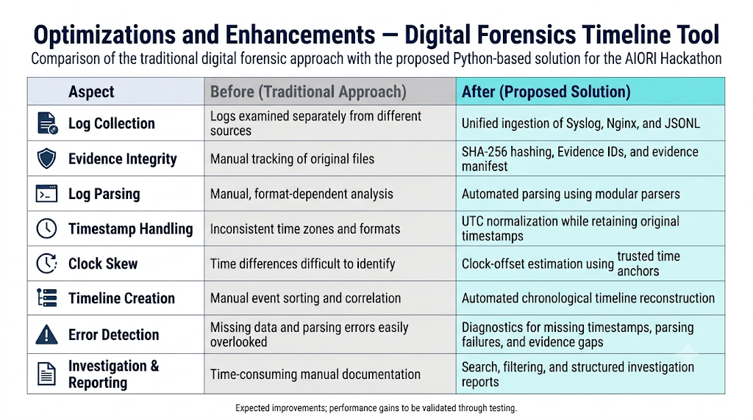
AIORI 3
Solution Optimization
Optimization Proposed
Utkarsh Narwade · A3-PS013-TC123 · October 5, 2026

Slide 7
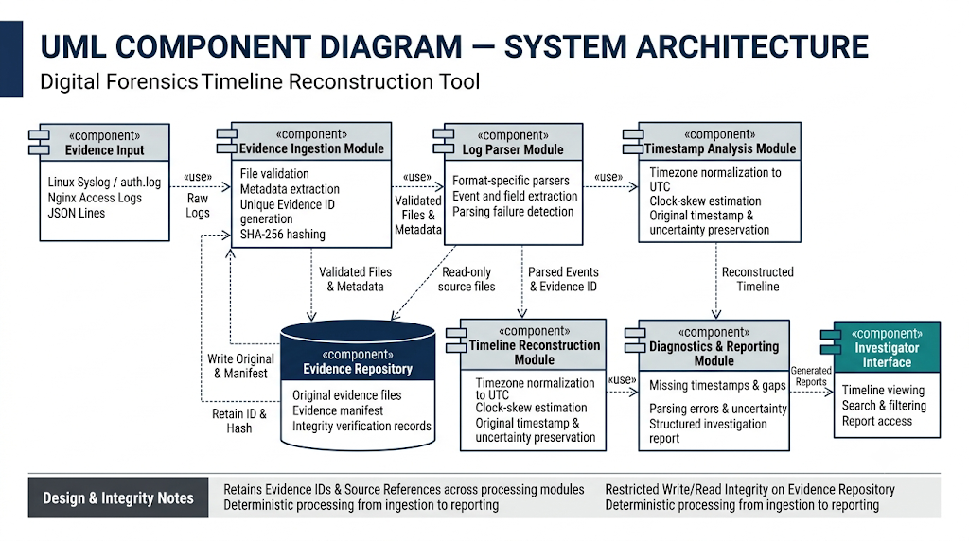
AIORI 3
Solution Architecture & Design
Architecture Design (UML Diagram)
Figure: System Architecture UML Diagram
Utkarsh Narwade · A3-PS013-TC123 · October 5, 2026

Slide 8
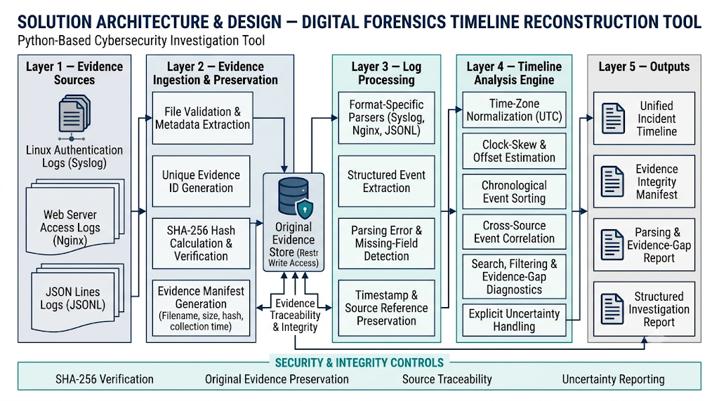
Data Flow Diagram
AIORI 3 Data Flow Diagram
Figure: Data Flow Diagram (DFD)
Utkarsh Narwade · A3-PS013-TC123 · October 5, 2026

Slide 9
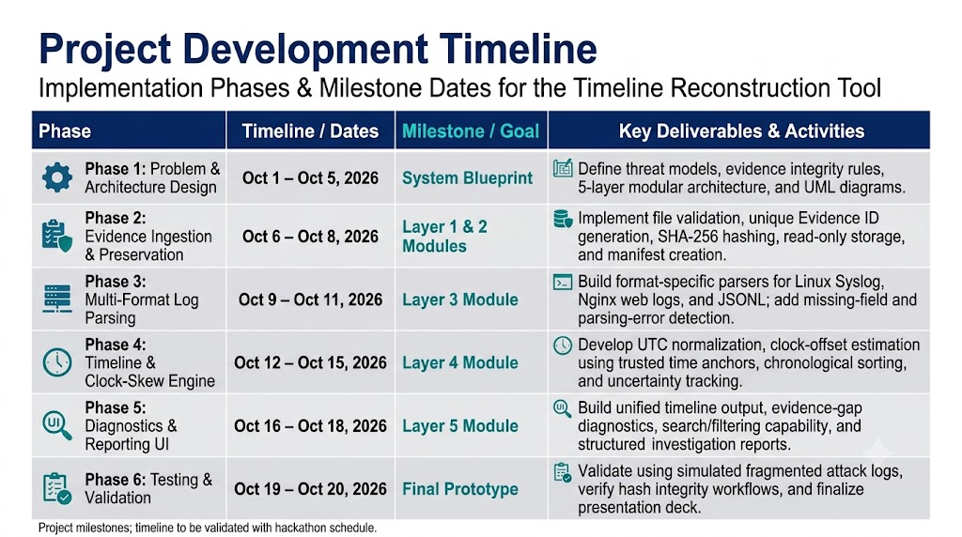
AIORI 3
Deployment Timeline
Deployment Timeline
Utkarsh Narwade · A3-PS013-TC123 · October 5, 2026

Slide 10
Bibliography
Bibliography
[1] K. Kent, S. Chevalier, T. Grance, and H. Dang, “Guide to Integrating Forensic Techniques into Incident Response,” NIST Special Publication 800-86, 2006. https://csrc.nist.gov/pubs/sp/800/86/final
[2] K. Kent and M. Souppaya, “Guide to Computer Security Log Management,” NIST Special Publication 800-92, 2006. https://csrc.nist.gov/pubs/sp/800/92/final
[3] R. Gerhards, “The Syslog Protocol,” RFC 5424, IETF, March 2009. https://www.rfc-editor.org/rfc/rfc5424
[4] G. Klyne and C. Newman, “Date and Time on the Internet: Timestamps,” RFC 3339, IETF, July 2002. https://www.rfc-editor.org/rfc/rfc3339
[5] National Institute of Standards and Technology, “Secure Hash Standard (SHS),” FIPS PUB 180-4, 2015. https://csrc.nist.gov/pubs/fips/180-4/upd1/final
Utkarsh Narwade · A3-PS013-TC123 · October 5, 2026

Slide 11
Thank You for Your Attention!

