Slide 1

A3-PS019-TC072
NDEMS: National Digital Evidence Management System
Arun Bharti | arunpbt1025
Anushka Pandit | anushka2108
AIORI Hackathon 3
October 5, 2026

Slide 2
AIORI 3
Abstract
Problem Description
Citizen Privacy Leaks (DPDPA 2023):
Case files and chat logs often contain personal details without automatic detection or redaction.
Risk of Evidence Tampering:
Normal storage like pen drives and local servers cannot prove if a file was edited or altered.
Slow Court Approval (BSA 2023 Sec 63):
Proving evidence authenticity manually in court takes too much time and effort.
No Verifiable Record:
Existing tools scan data but cannot create an unchangeable, permanent proof of evidence history.
A.Bharti · A3-PS019-TC072 · October 5, 2026

Slide 3
AIORI 3
Background
Background
The Urgent Need for Tamper-Proof Evidence and Privacy Compliance
Massive Digital Evidence Growth:
Police and investigative agencies process terabytes of digital logs and disk images daily, making manual inspection impossible.
Strict Legal Pressure:
Investigators must redact citizen personal data under DPDPA 2023 while proving strict electronic evidence authenticity under BSA 2023 (Section 63).
Broken Tool Ecosystem:
Current forensics tools only inspect raw files—they completely lack an automated bridge
to discover private data and anchor chain-of-custody onto an immutable ledger.
A. Bharti · A3-PS019-TC072 · October 5, 2026

Slide 4
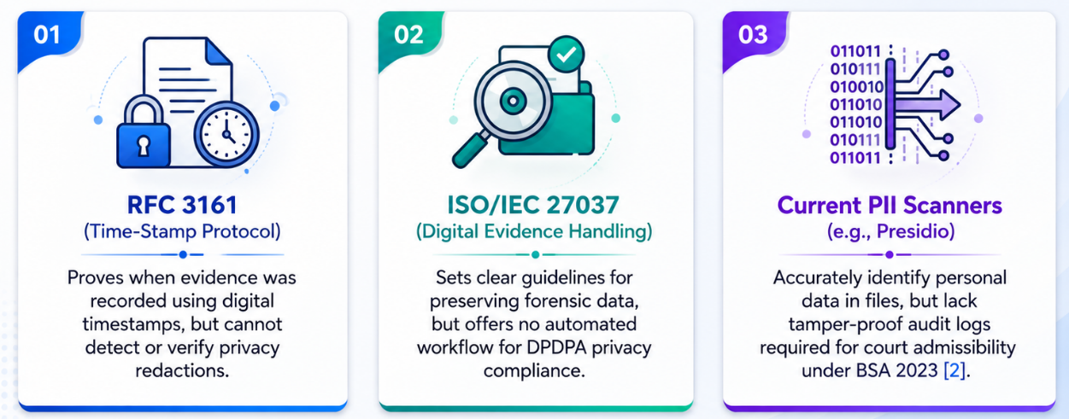

AIORI 3
Literature & RFC Review
Literature & RFC Review
Evaluation of Relevant Security Standards and Forensics Frameworks
A. Bharti · A3-PS019-TC072 · October 5, 2026

Slide 5
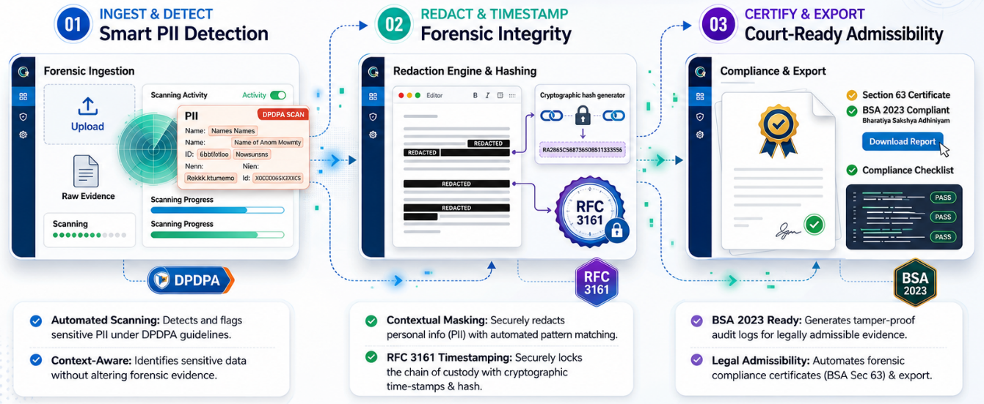
AIORI 3
Proposed Solution
Proposed Solution
Automated, Privacy-Preserving Digital Forensics for DPDPA & BSA 2023 Compliance
A. Bharti · A3-PS019-TC072 · October 5, 2026

Slide 6
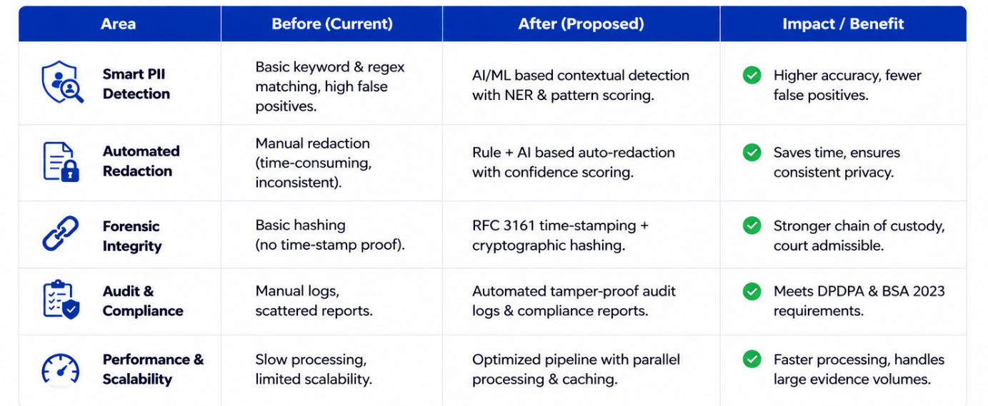
AIORI 3
Solution Optimization
Optimization Proposed
A. Bharti · A3-PS019-TC072 · October 5, 2026

Slide 7
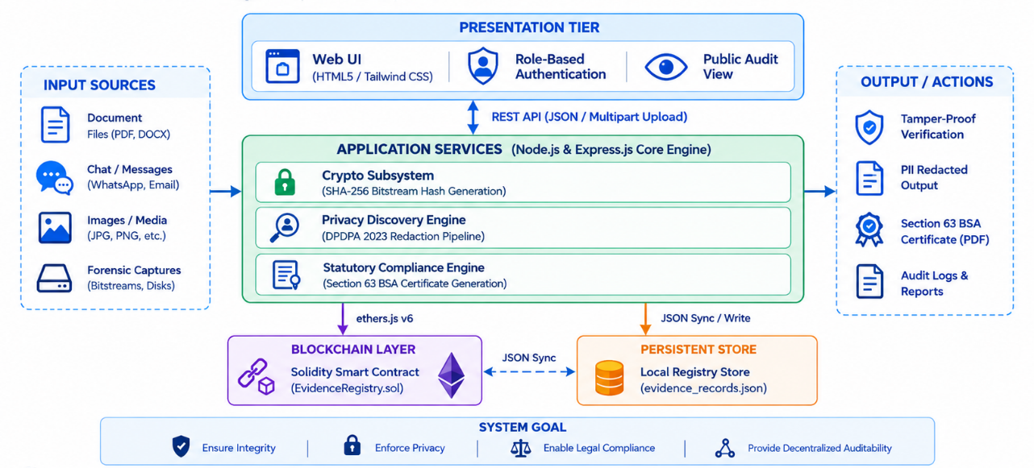
AIORI 3
Solution Architecture & Design
Architecture Design (UML Diagram)
Figure: System Architecture UML Diagram
A. Bharti · A3-PS019-TC072 · October 5, 2026

Slide 8
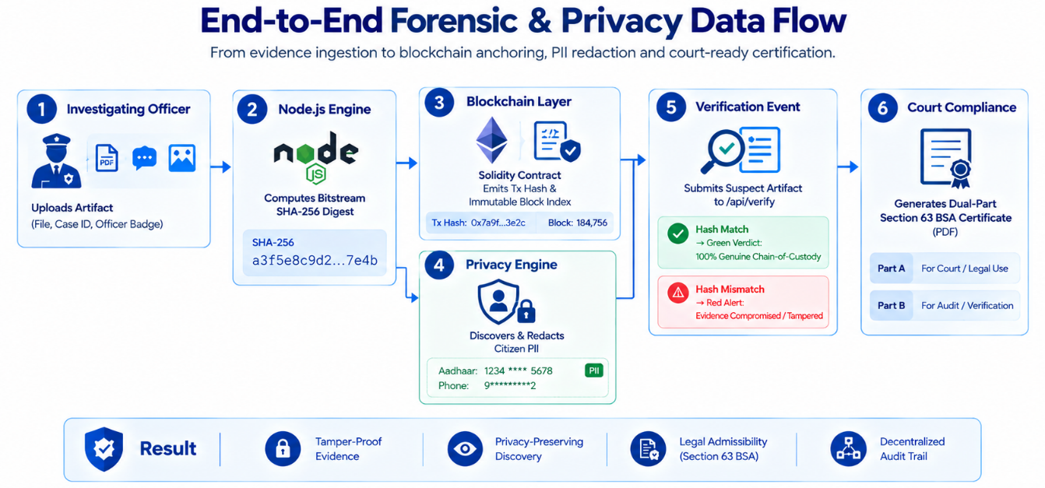
Data Flow Diagram
Overview of the architecture. Include the flow chart diagram created earlier. Visual: Diagrams or architecture visuals.
AIORI 3 Data Flow Diagram
Image
Figure: Data Flow Diagram (DFD)
A. Bharti · A3-PS019-TC072 · October 5, 2026

Slide 9
AIORI 3
Deployment Timeline
Deployment Timeline
Phase 1: Core Engine & Testing (Months 1–2)
Set up the offline scanning system, test automated privacy masking (ID numbers, PAN), and process large test drives (500GB+).
​Phase 2: Security & Tamper-Proofing (Month 3)
Audit blockchain contracts and integrate official digital timestamps to guarantee files cannot be altered.
​Phase 3: Real-World Trials (Months 4–5)
Run pilot trials in forensic labs to generate and verify legal court certificates (Section 63 BSA) on actual case samples.
​
​Phase 4: Full Deployment (Month 6+)
Connect the platform directly to national police and court databases (CCTNS / e-Courts) for seamless nationwide access.
Phase 5: Officer Training (Month 7–8)
Conduct hands-on training workshops for investigating officers and forensic lab staff to streamline daily evidence handling.
​Phase 6: Auditing & Maintenance (Month 9+)
Perform quarterly cryptographic audits, update PII detection models for new document types, and ensure ongoing DPDPA compliance.
A. Bharti · A3-PS019-TC072 · October 5, 2026

Slide 10
Bibliography
Bibliography
1. RFC 3161 — Trusted Digital Timestamping (IETF)
Provides tamper-proof cryptographic timestamps to verify the exact creation time of evidence.
​2. Microsoft Presidio — Context-Aware PII Masking
Open-source NER framework adapted for automatic detection and redaction of Indian IDs (Aadhaar, PAN).
​3. ISO/IEC 27037 — Digital Evidence Handling
International guidelines followed for secure collection, integrity preservation, and chain-of-custody tracking.
​4. BSA 2023 (Section 63) — Court Admissibility Framework
Statutory legal standards implemented to generate automated, compliant digital evidence certificates.
A. Bharti · A3-PS019-TC072 · October 5, 2026

Slide 11

Thank You!
Questions & Discussion
NDEMS: National Digital Evidence Management System
Tamper-Proof Digital Forensics with Dual-Certificate BSA 2023 & DPDPA
Team Code – A3-PS019-TC072
Team Lead: Arun Bharti
Team Member: Anushka Pandit
Faculty Mentor: Mr. Vishal Bhatt
GitHub:
https://github.com/arunpbt1025/ndems

