Slide 1

Team Segfault · A3-PS022-TC005
Dropping DNS floods
at kernel speed

Slide 2
Line-Rate DNS Flood Defense · eBPF / XDP
2
An in-kernel DNS flood defense built on eBPF / XDP.
Trust by proof, not by rate
Cost, not count — each query priced by what it costs the server
Adaptive controller: CALM → GUARD → SIEGE
Line-rate on server NICs
Meet
Segfault

Slide 3
Line-Rate DNS Flood Defense · eBPF / XDP
3
100%
goodput held in every attack scenario — while every rate-only baseline dropped the real client.

Slide 4
Line-Rate DNS Flood Defense · eBPF / XDP
4
Rate is the lever
the attacker controls.

Slide 5
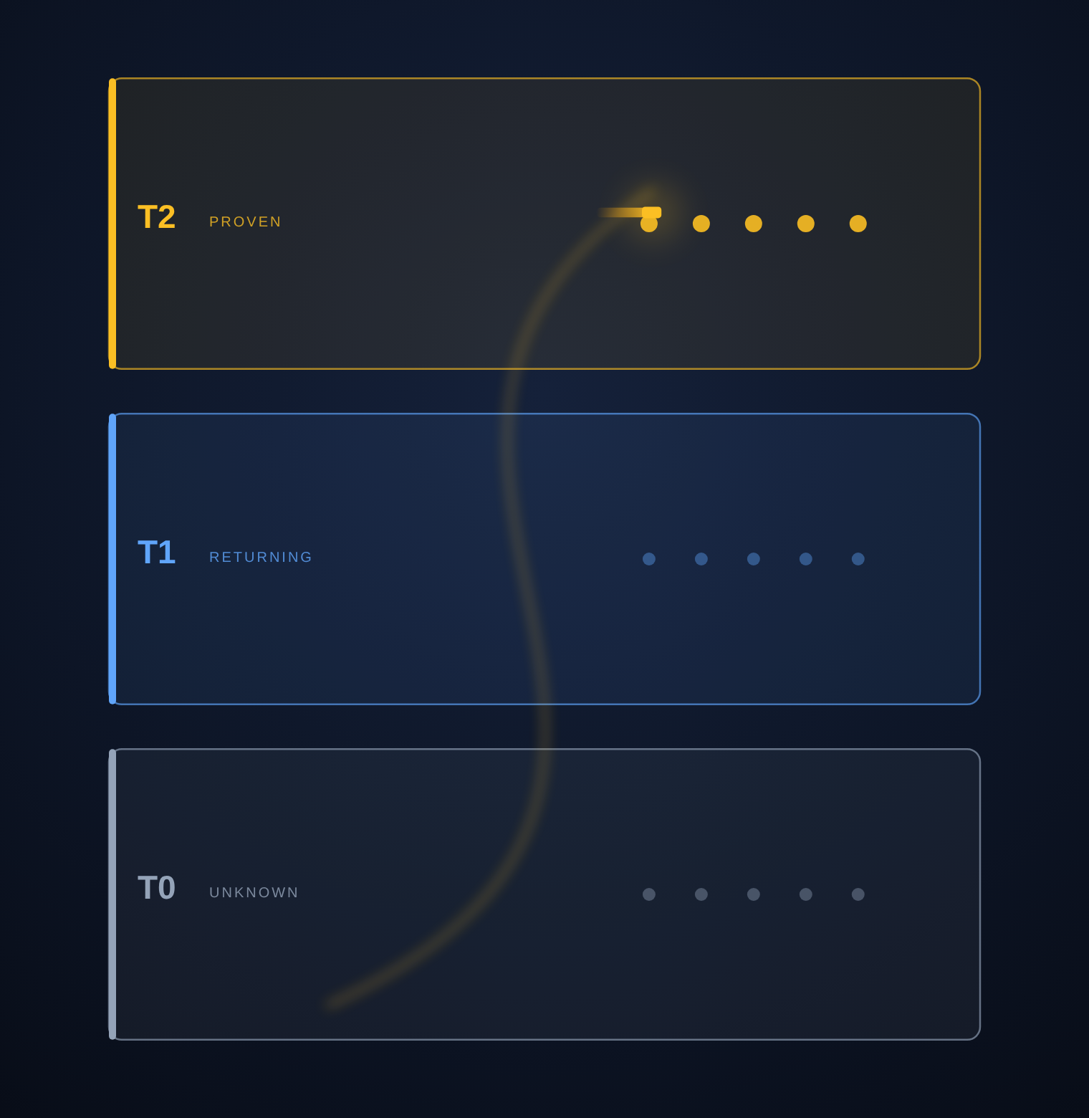
Line-Rate DNS Flood Defense · eBPF / XDP
5
Trust by
proof
Who, not how fast
Every source earns a trust tier from evidence of a real return path. A spoofer cannot fake a cookie or a completed TCP exchange.
Cost, not count
Each query is priced by what it costs the server, so cheap-to-send, expensive-to-answer floods are shed at the NIC.

Slide 6
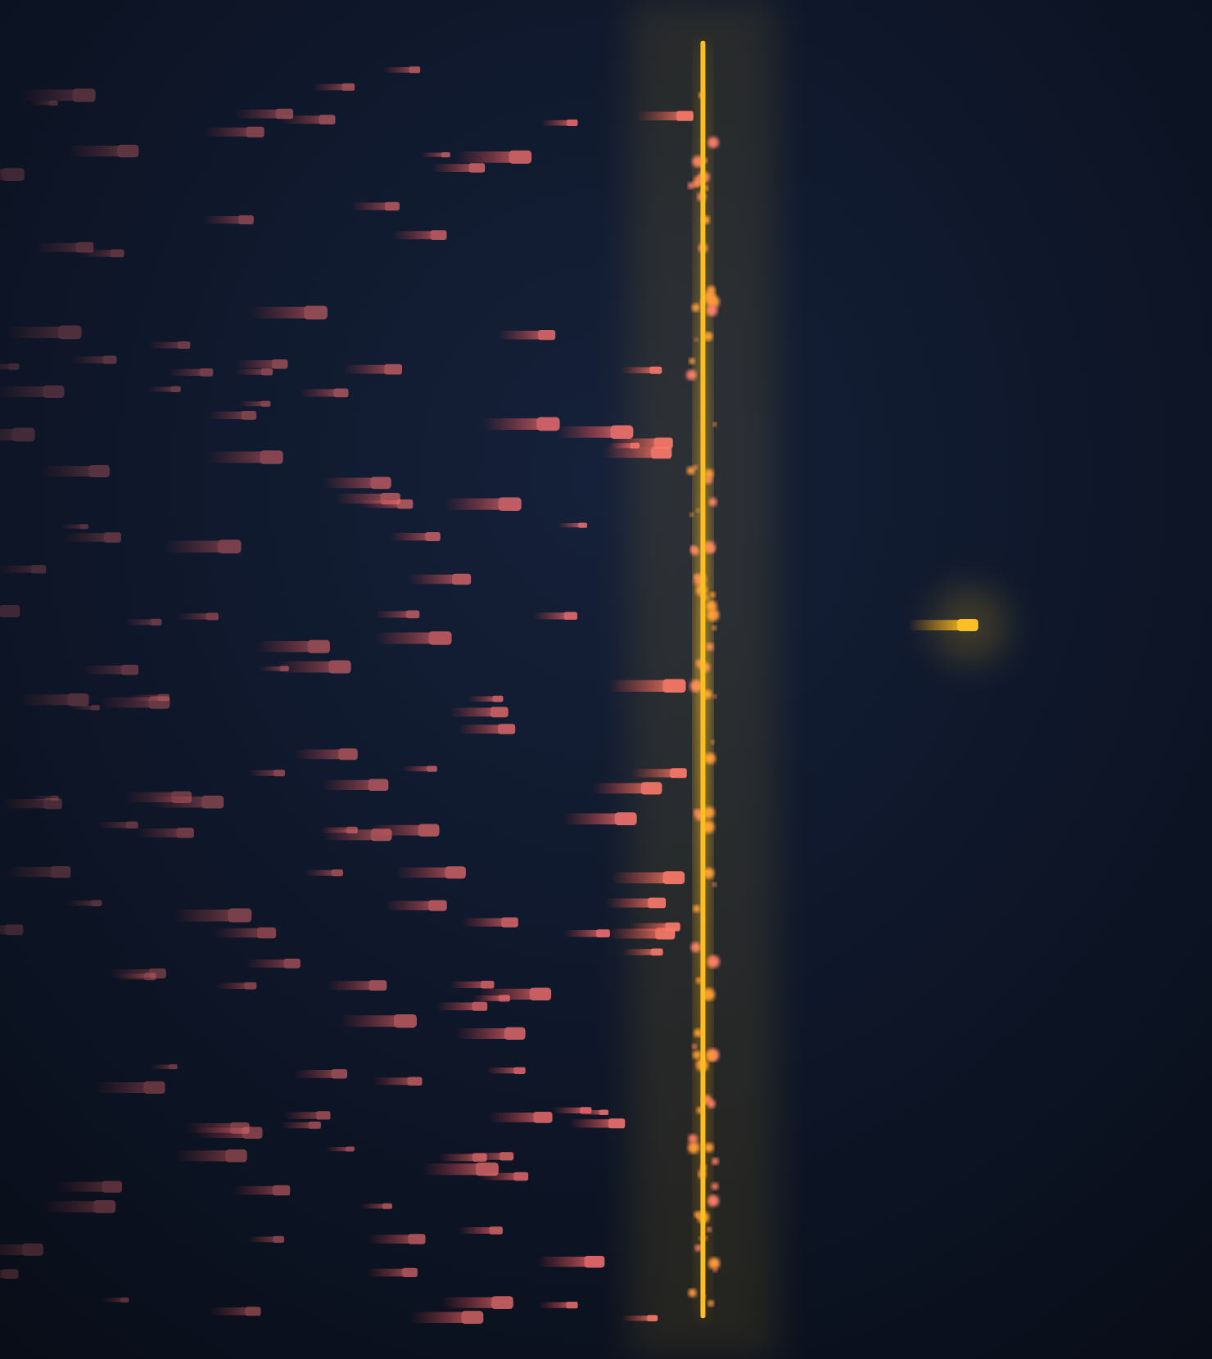
How does it
hold?

Slide 7
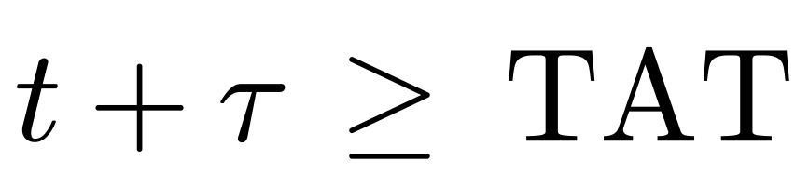
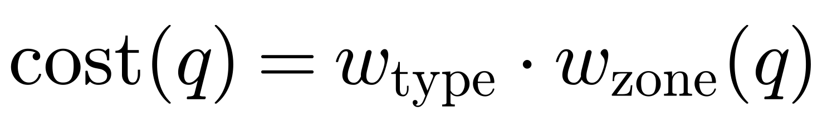
Line-Rate DNS Flood Defense · eBPF / XDP
7
The admission
decision
Per-source / per-prefix / per-tier GCRA token bucket
Cost-weighted admission
A query is admitted only when its bucket has room (t = now, τ = burst). The bucket fills faster for costlier queries — random-subdomain / NXDOMAIN zones are repriced up.

Slide 8
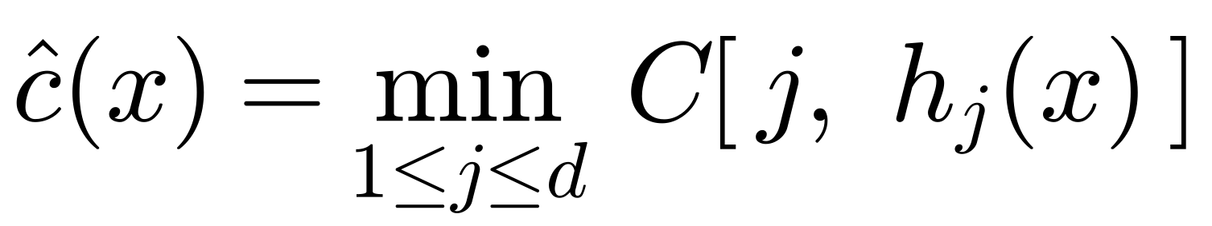
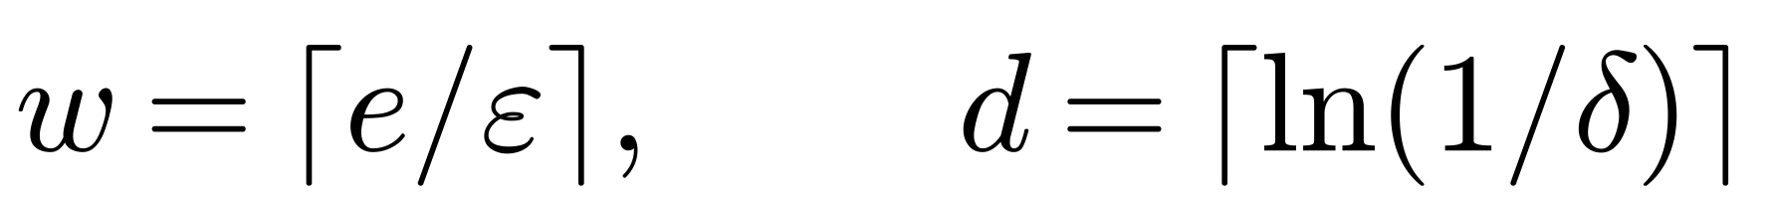
Line-Rate DNS Flood Defense · eBPF / XDP
8
Shedding the
unknown, cheaply
Count-Min sketch — no per-source state for tier T0
Heavy hitters are estimated in fixed memory with d hash rows of w counters: the estimate never underflows and overshoots by at most εN with probability 1 − δ. Unknown floods are shed before any per-source table is touched.

Slide 9
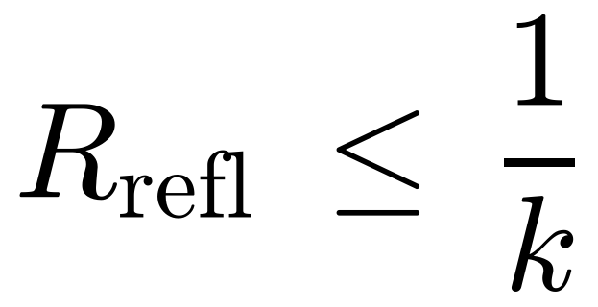
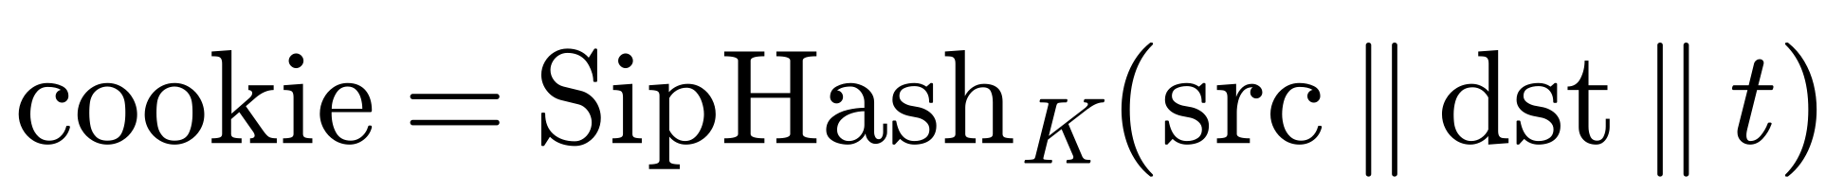
Line-Rate DNS Flood Defense · eBPF / XDP
9
Bounded
by design
Reflection is bounded, not just claimed
a truncated (TC=1) reply slips out only every k-th drop, so the reflection ratio can never exceed 1/k.
Proof, not prefix
a keyed MAC (SipHash-2-4) or a completed TCP exchange promotes a source to tier T2 — unforgeable off-path.
Verifier-proven parse
fixed loop bounds and a per-CPU scratch buffer — the kernel's eBPF verifier statically rejects any unbounded walk before load.

Slide 10
Line-Rate DNS Flood Defense · eBPF / XDP
10
The
results
Scenario | Best baseline | Segfault
distributed | 119 / 544 ms | 3719 / 1.1 ms
adaptive | 65 / 432 ms | 3670 / 1.1 ms
prefix-spoof | 0 | 3729 / 0.4 ms
water-torture | 68 / 680 ms | 3684 / 1.1 ms
queries completed / p99 tail latency

Slide 11
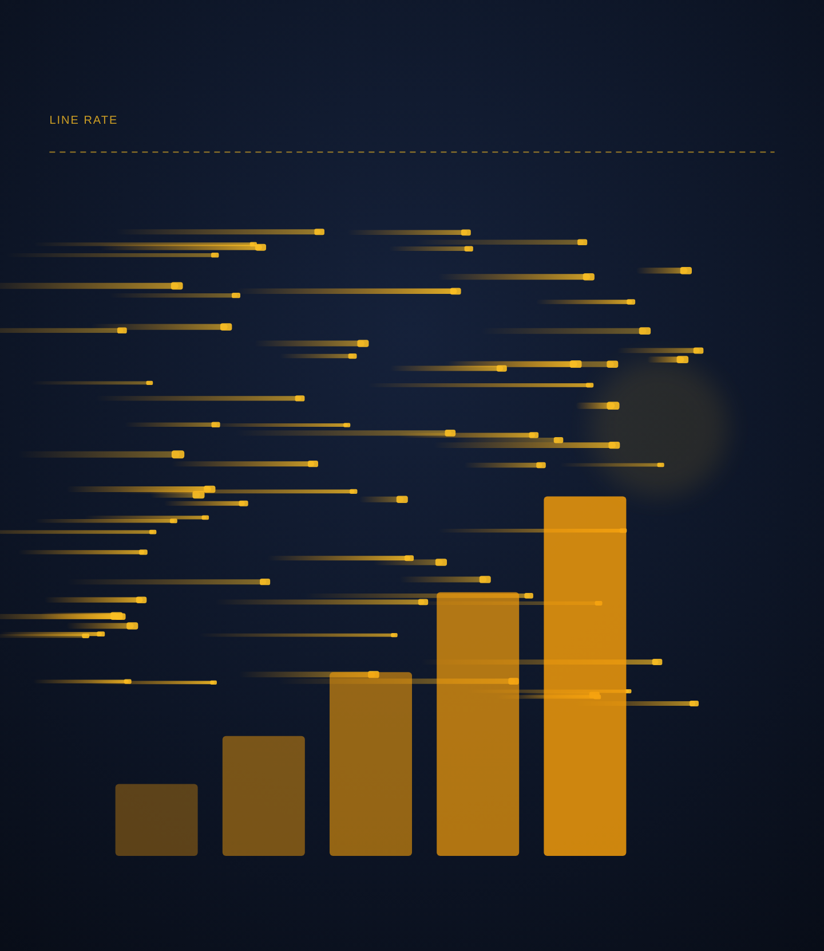
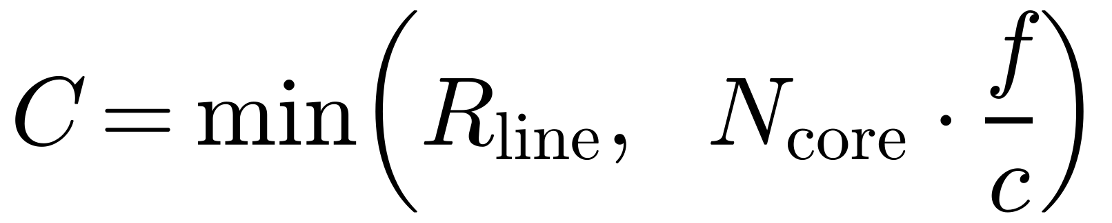
~40% over a bare XDP drop in-kernel; line-rate-bound on server NICs.
c ≈ 290 cycles / packet measured → 6.9–10 Mpps per core; a 100 GbE line rate needs ≈ 12 cores.
Built to run
at line rate.

Slide 12
Line-Rate DNS Flood Defense · eBPF / XDP
12
“Segfault asks who,
and what it costs.”
Segfault design principle

Slide 13
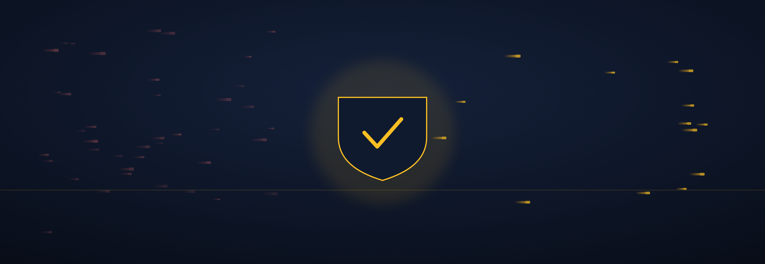
Thank you
Built by Team Segfault
Debangan Mali · Saraswata Chatterjee · Partha Chakraborty (Faculty)
debanganmali99@gmail.com · IEM Kolkata · A3-PS022-TC005

