Slide 1

Team Segfault · A3-PS022-TC005
Segfault
Complete Project Report
eBPF / XDP Rate Limiting for DNS Query Floods in a Lab · PS-022 · Cybersecurity Debangan Mali · Saraswata Chatterjee · Partha Chakraborty (Faculty)

Slide 2
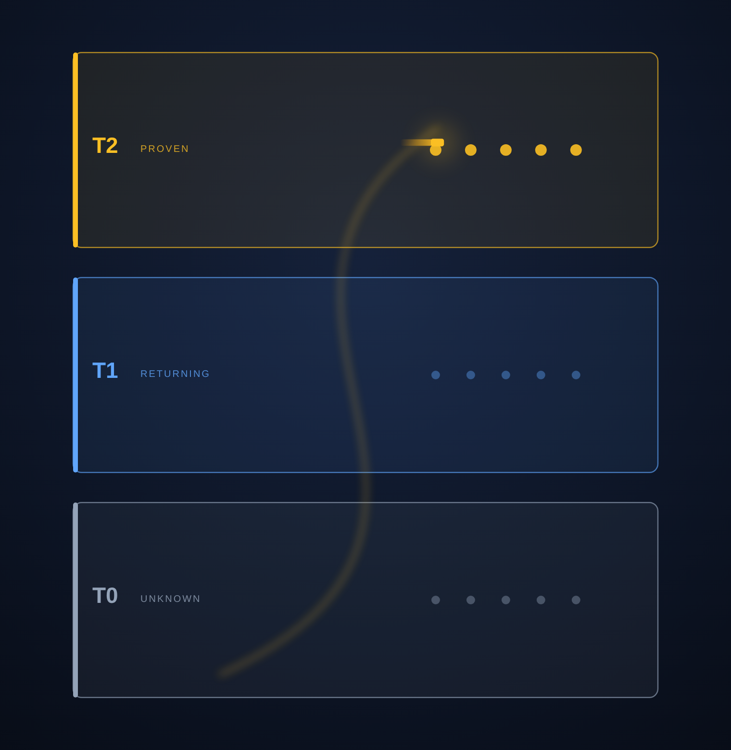
Segfault — Complete Project Report
2
Executive summary
Segfault is an in-kernel defence against DNS query floods, built on eBPF/XDP. It replaces the single rate scalar that rival designs rely on with two ideas: admit traffic by proof of a real return path, and price each query by what it costs the server — both enforced at the earliest point in the kernel, before the packet reaches a socket.
Headline outcomes
100% goodput for the legit client in every IPv4 attack scenario, while every baseline collapsed
3,729 legit queries served under prefix-spoof where every baseline served 0
~290 cycles/packet — the line-rate regime of production XDP
Verified with a failing control and exact counter reconciliation

Slide 3
Segfault — Complete Project Report
3
Contents
01
The problem
DNS floods, and why a rate limit alone is the wrong lever
02
Our approach
How we started, the design philosophy, and why eBPF/XDP
03
Architecture
Two kernel hooks, pinned maps, and a userspace controller
04
Mechanisms
GCRA, cost weighting, Count-Min, proof, slip, controller
05
Implementation
Stack, lab, attack generator, and benchmark methodology
06
Results
IPv4 / IPv6 matrices, integrity, and the throughput ceiling
07
Evaluation
Compliance, honest limits, future work, timeline, conclusion

Slide 4
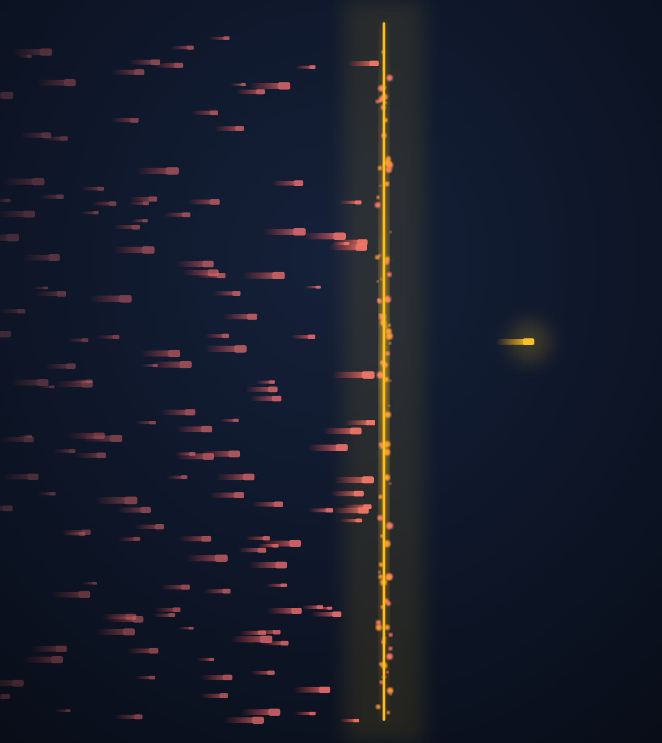
PART 01
The problem
DNS floods, and why rate limiting alone is the wrong lever

Slide 5
Segfault — Complete Project Report
5
Problem statement — PS-022
“eBPF/XDP Rate Limiting for DNS Query Floods in a Lab.” The brief set hard requirements:
Bounded packet parsing
the DNS parser must be provably bounded — no unbounded loops.
Per-source and global limits
rate-limit each source and cap the total offered load.
Baselines
compare against no-filter and nftables.
Four metrics
goodput, tail latency, packets absorbed, and CPU cost.
Bounded reflection
any response-based mitigation must bound amplification.
Reproducibility
pseudocode and a repeatable benchmark harness.

Slide 6
Segfault — Complete Project Report
6
DNS as an attack surface
A recursive resolver does real work for every query — parsing, cache lookup, and on a miss an upstream recursion of tens of milliseconds. That asymmetry is what attackers exploit.
Cheap to send, expensive to answer
a 60-byte query can trigger a full recursion.
Single-threaded intake bottleneck
the resolver's front door saturates long before the link does.
Spoofable transport
UDP source addresses are trivially forged, so per-source accounting can be gamed.
Random-subdomain (water-torture)
forces cache misses and upstream load with names that never resolve.

Slide 7
Segfault — Complete Project Report
7
Why rate limiting alone fails
A single rate scalar is exactly the quantity the attacker controls. Three attack classes defeat it:
Adaptive multi-source
spreads the flood over thousands of forged sources, each staying just under the per-source cap.
Prefix-spoof
forges sources inside the victim's own /24 — a per-prefix limit then drops the real client to zero.
Water-torture
random subdomains force expensive recursion; cheap to send, costly to answer, hard to rate-match.
Against every baseline, the real client drops to 0 completed queries under prefix-spoof.

Slide 8
Segfault — Complete Project Report
8
Goals & success criteria
Measured on four metrics
Design goals
Goodput — legit queries completed under attack
Tail latency — p99 of the legit client
Packets absorbed — attack pps shed
CPU cost — core utilisation while defending
Protect the legitimate client, not just the server
Shed unknown floods at the NIC, cheaply
Distinguish proven clients from spoofed ones
Adapt to attack intensity, reversibly
Stay provably safe for the kernel verifier

Slide 9
PART 02
Our approach
How we started, the design philosophy, and why eBPF / XDP

Slide 10
Segfault — Complete Project Report
10
How we started
We selected PS-022 in September 2026 because it sits where our interests meet: kernel-level systems and practical network security. The first prototype — provisionally named SentryXDP — was a conventional fixed-threshold XDP limiter, and testing it taught us its weakness: a single rate knob is the thing an adaptive attacker tunes around.
That reframed the project. We renamed it Segfault and rebuilt the datapath around trust tiers and cost accounting rather than a scalar rate — turning the question from “how fast is this source?” into “who is this, and what does the query cost?”. The scope stayed deliberately honest: a reproducible lab, real VMs, and measured numbers rather than claims.

Slide 11
Segfault — Complete Project Report
11
Design philosophy
Trust by proof
A source earns standing by proving a real return path — a cookie or a completed TCP exchange — which an off-path spoofer cannot fake.
Cost, not count
Each query is priced by what it costs the server; a bucket fills faster for costlier work, so expensive floods are shed first.
Adaptive & reversible
The system tightens only as far as the attack forces it, and relaxes again as the flood eases — never permanently locked down.

Slide 12
Segfault — Complete Project Report
12
Why eBPF / XDP
XDP runs the program in the NIC driver, before the kernel allocates a socket buffer. Dropping there costs almost nothing — which is why it is the right layer for volumetric defence.
Layer | Where it runs | Why Segfault is earlier / cheaper
iptables / nftables hashlimit | after socket-buffer allocation | the packet already cost memory before the decision
nftables netdev / ingress | early, in the stack | earlier, but still no trust tiers, proof, or cost model
dnsdist (userspace proxy) | userspace | per-packet userspace cost; not kernel-bypass line rate
Segfault (XDP) | NIC driver, pre-skb | drops before allocation, at native line rate

Slide 13
PART 03
Architecture
Two kernel hooks, pinned maps, and a userspace controller

Slide 14
Segfault — Complete Project Report
14
System architecture
Client / flood
XDP ingress
DNS server
TC egress observer
mixed legit + spoofed UDP:53
bounded parse → admit / drop / slip
unbound / BIND
records TCP proofs → T2, per-zone NXDOMAIN
Pinned eBPF maps · /sys/fs/bpf/segfault
T1 sources (LRU)
T2 proven (TTL)
Count-Min sketch
GCRA pools
per-prefix buckets
config + counters
Userspace controller (libbpf-rs)
Polls counters, measures the live drop fraction, and re-tunes the datapath between modes with hysteresis so it does not flap. The kernel stays on the fast path; policy lives in userspace.

Slide 15
Segfault — Complete Project Report
15
Trust tiers
Tier | What it is
T0 — Unknown | No per-source state. Counted by a Count-Min sketch; heavy hitters shed on the cheapest path.
T1 — Returning | Promoted when it behaves. Per-source GCRA bucket (LRU); repeated abuse earns a temporary ban.
T2 — Proven | Proved a real return path (RFC 9018 cookie or TCP). Bypasses per-prefix and heavy-hitter checks.

Slide 16
Segfault — Complete Project Report
16
The admission pipeline
Each ingress packet runs a fixed, ordered sequence — any early stage can short-circuit to drop or slip:
# | Stage | What it does
1 | Bounded parse | validate L2–L4 + DNS header into a per-CPU scratch buffer
2 | Allow / deny | explicit LPM allow-list and deny-list first
3 | Cost | price the query by type and zone
4 | Tier lookup | T2 proven? T1 returning? else T0 unknown
5 | Heavy-hitter | T0 only — shed if the sketch estimate is over threshold
6 | Per-source bucket | GCRA for T1; strikes may trigger a ban
7 | Per-prefix bucket | GCRA on the /24 (or /64) — bypassed for T2
8 | Tier pool | global GCRA pool for the tier
9 | Admit / slip / drop | pass, or slip a truncated reply every k-th drop

Slide 17
Segfault — Complete Project Report
17
The egress observer
A second eBPF program on the TC egress hook watches the server's own replies. It never blocks traffic — it learns from it.
Records proofs
a completed TCP response is evidence of a real client, so its address is written into the T2 map with a TTL.
Counts NXDOMAIN per zone
a high NXDOMAIN ratio flags a likely water-torture target, which the cost model then reprices.
Feeds the controller
response and SERVFAIL counts give the controller a live picture of server health.

Slide 18
PART 04
Mechanisms
The algorithms, with the math that bounds them

Slide 19
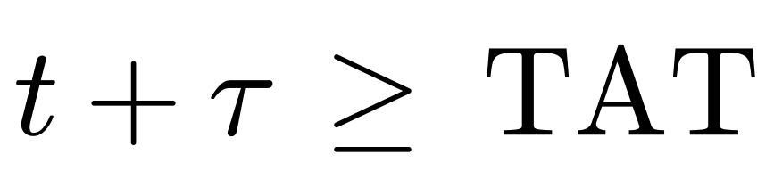
Segfault — Complete Project Report
19
GCRA token buckets
Every source, prefix and tier pool is rate-limited by a Generic Cell Rate Algorithm bucket — a leaky bucket with no timers, stored as a single nanosecond timestamp and updated with a lock-free compare-and-swap.
Admit when the bucket has room (t = now, τ = burst allowance):
Then advance the theoretical arrival time by the query's cost:

Slide 20
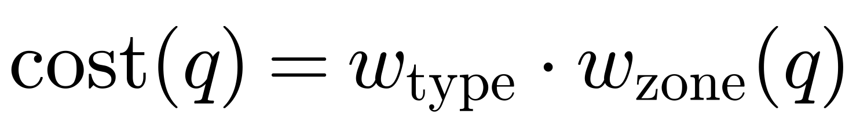
Segfault — Complete Project Report
20
Cost-weighted admission
A query is not one unit — it is priced by what it will cost the server. The bucket increment scales with that cost, so cheap-to-send but expensive-to-answer floods drain a bucket far faster than ordinary traffic.
w_type weights by query type; w_zone is raised for zones showing a high NXDOMAIN ratio (water-torture targets), so repeated random-subdomain queries are repriced upward automatically.

Slide 21
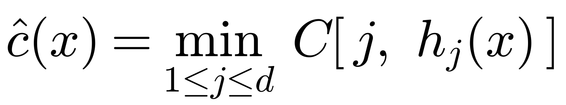
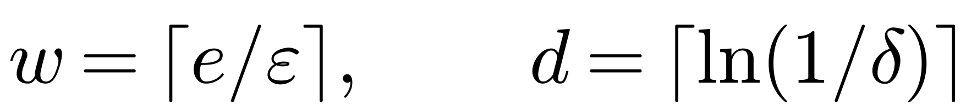
Segfault — Complete Project Report
21
Count-Min sketch — cheap T0 shedding
Unknown (T0) sources get no per-source table entry — that would be memory the attacker could exhaust. A Count-Min sketch estimates each source's rate in fixed memory.
The estimate never underflows and overshoots by at most εN with probability 1 − δ, using d hash rows of w counters. Heavy hitters are shed before any per-source state is created.

Slide 22
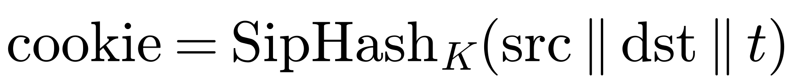
Segfault — Complete Project Report
22
Proof of a real return path
Promotion to the proven tier T2 requires evidence an off-path spoofer cannot manufacture.
DNS cookie (RFC 9018) — a keyed MAC over the client/server addresses and time; the client must echo a value only the server could produce.
TCP proof — a completed TCP exchange, observed on egress, is itself proof of a returnable address and promotes the source to T2.
The MAC is SipHash-2-4 — fast enough to run per-packet in XDP, strong enough that the cookie cannot be forged.

Slide 23
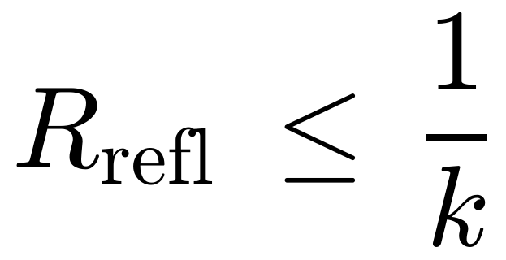
Segfault — Complete Project Report
23
Bounded slip — reflection control
To nudge a mis-tiered but legitimate client toward TCP, Segfault occasionally answers a dropped query with a truncated (TC=1) reply via XDP_TX. Because the source can be spoofed, this is a reflection risk — so it is strictly rate-limited.
A truncated reply is sent only on every k-th drop, so the reflection ratio is bounded:
This bounds amplification as the brief requires — it does not eliminate it — and the measurements confirm the slip count tracks ½ of drops at k = 2.

Slide 24
Segfault — Complete Project Report
24
The adaptive controller
The controller reads the live drop fraction and moves between three modes with hysteresis, so a noisy flood does not make it oscillate:
Mode | Trigger | Action
CALM | low drop fraction | Admit everything; quietly learn who returns politely and promote them to T1.
GUARD | rising drop fraction | Enforce per-source, per-prefix and per-tier limits; shed T0 heavy hitters.
SIEGE | sustained heavy flood | Hardest pricing and tightest pools; only proven and well-behaved sources pass.
Escalation is reversible — as the flood eases, the controller de-escalates back toward CALM.

Slide 25
Segfault — Complete Project Report
25
Bounded parsing & verifier safety
PS-022 requires provably bounded parsing. The eBPF verifier enforces it statically — a program with an unbounded loop will not load.
Fixed loop bounds
qname labels (≤ 255), VLAN tags (≤ 2) and extension headers (≤ 4) are each walked with a compile-time maximum.
Per-CPU scratch buffer
a 288-byte per-CPU buffer holds the parse state; no dynamic allocation on the datapath.
Index masking
every buffer access is masked so the verifier can prove it is in-bounds.
Result
the parser is proven safe before load — exactly the property the brief asked for.

Slide 26
PART 05
Implementation
Stack, lab, attack generator, and benchmark methodology

Slide 27
Segfault — Complete Project Report
27
Technology stack
Component | Technology | Role
Datapath (ingress + egress) | C, compiled to eBPF | bounded parse, trust-tier admission, egress observer
Loader & controller | Rust + libbpf-rs | load/pin maps, poll counters, adaptive mode control
Shared state | pinned eBPF maps | /sys/fs/bpf/segfault — tiers, pools, sketch, config
Attack generator | Rust (raw sockets, AF_PACKET) | spoofed IPv4/IPv6 floods, water-torture, pacing
Benchmark harness | Bash + Rust prober | scenario matrix, preflight, counter reconciliation

Slide 28
Segfault — Complete Project Report
28
The laboratory
Two Hyper-V virtual machines on a Windows host, connected by an internal switch — a controlled, reproducible network with no exposure to the open internet.
Target VM
Linux kernel 6.8 with native XDP; runs the Segfault datapath and the DNS server (Unbound, authoritative and recursive).
Attacker VM
Kali; runs the multi-threaded flood generator and the legitimate-client prober.
Resolver realism
tested against a local-NXDOMAIN zone, a resolver recursing to a local authoritative, and one with 50 ms of synthetic upstream latency.

Slide 29
Segfault — Complete Project Report
29
The attack generator
A purpose-built generator reproduces each attack class; a prober measures the legitimate client alongside it.
Six scenarios
distributed, adaptive, prefix-spoof, water-torture, plus plain and burst.
Source spoofing
raw IPv4 sockets (IP_HDRINCL) and AF_PACKET for IPv6 (no IPV6_HDRINCL), with a correct UDP6 checksum.
Water-torture
random-subdomain NXDOMAIN flood against a real recursive resolver.
Multi-threaded + paced
N sender threads with target-rate pacing, and a fail-fast preflight so no run is trusted unless packets actually left the NIC.

Slide 30
Segfault — Complete Project Report
30
Benchmark methodology
Baselines
every scenario is run against no-filter, nftables, nftables-netdev, and a fixed-threshold XDP limiter (representative of rival designs), then Segfault.
Median of three
each cell is the median of three runs to damp noise.
Preflight
a family-aware check confirms the flood can actually be sent before a run counts, eliminating ghost (zero-sent) runs.
Counter reconciliation
datapath counters are summed and checked to equal the offered load, so the result is auditable, not just observed.

Slide 31
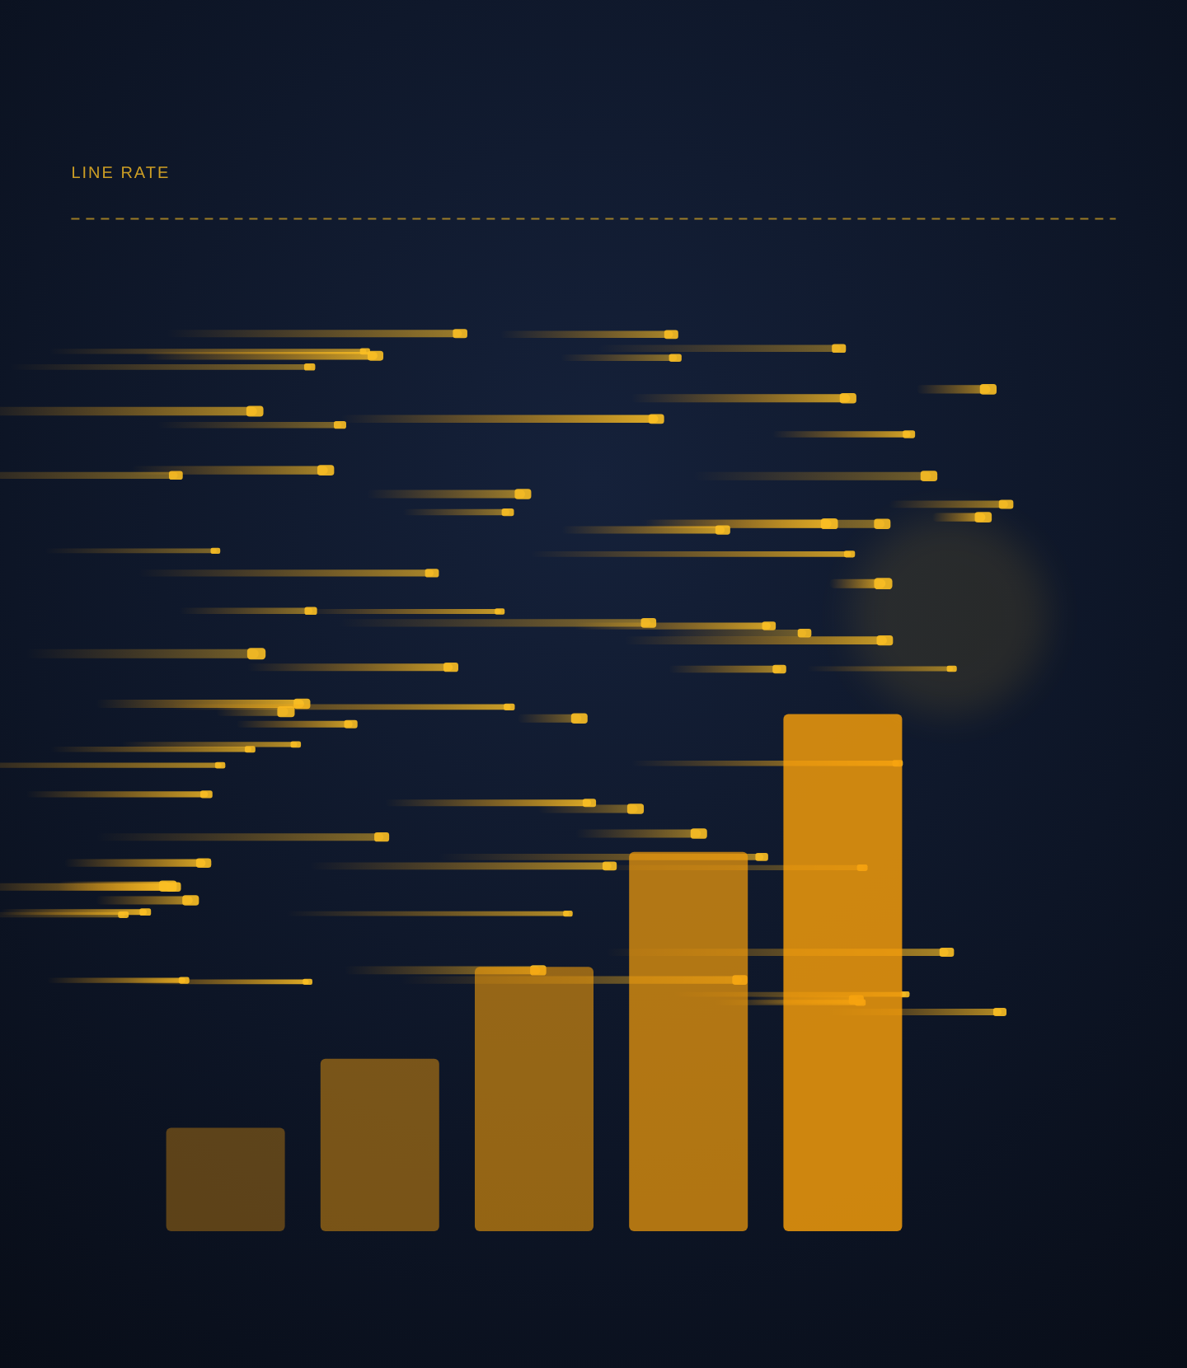
PART 06
Results
IPv4 / IPv6 matrices, integrity, and the throughput ceiling

Slide 32
Segfault — Complete Project Report
32
IPv4 results — median of 3
Scenario | none | nftables | nft-netdev | fixed-xdp | segfault
distributed | 116 / 414 | 53 / 529 | 28 / 594 | 119 / 544 | 3719 / 1.1
adaptive | 180 / 422 | 38 / 620 | 60 / 451 | 65 / 432 | 3670 / 1.1
prefix-spoof | 0 | 0 | 0 | 0 | 3729 / 0.4
water-torture | 113 / 392 | 49 / 469 | 52 / 592 | 68 / 680 | 3684 / 1.1
queries completed / p99 latency (ms). Segfault held 100% goodput while absorbing 7–12 million packets per run; 30–56× the best rival under multi-source floods.

Slide 33
Segfault — Complete Project Report
33
IPv6 results — median of 3
Scenario | none | nftables | nft-netdev | fixed-xdp | segfault
distributed | 1242 / 204 | 97 / 208 | 97 / 208 | 94 / 205 | 3499 / 12.7
water-torture | 2722 / 2.6 | 96 / 208 | 97 / 208 | 96 / 208 | 3680 / 1.4
prefix-spoof | 0 | 0 | 0 | 0 | up to 246 / 0.92 gp
Segfault is the only defence that keeps an IPv6 client alive under a spoofed flood. Honest note: IPv6 prefix-spoof recovers to 0.92 goodput once the resolver answers over IPv6 TCP, but is intermittent — the slip-to-TCP nudge is currently IPv4-only. This is the top future-work item.

Slide 34
Segfault — Complete Project Report
34
Water-torture at three realism levels
The random-subdomain flood was run against progressively more realistic resolvers (segfault vs best baseline):
Resolver realism | segfault (queries / p99) | best baseline (queries / p99)
Local NXDOMAIN | 3684 / 1.11 ms | 113 / 392 ms
Recursive (loopback) | 3511 / 1.9 ms | 113 / 446 ms
Recursive + 50 ms upstream | 3706 / 1.58 ms | 129 / 526 ms
Segfault sheds the flood at the NIC before the resolver's intake bottleneck, so making each query more expensive bends the baselines further (392 → 526 ms) without touching Segfault.

Slide 35
Segfault — Complete Project Report
35
Result integrity
A result as clean as “100% goodput, sub-millisecond tail” was verified four ways:
1. A failing control
the no-defence baseline visibly degrades under the identical attack (294 ms, or 0 under prefix-spoof) — the attack is real.
2. No allow-list shortcut
pass_allow = 0. The client earns protection through the proof path: proofs = 1, tcp_resp = 1 → pass_t2 = 6,417, all answered.
3. Counters reconcile exactly
13,142,956 T0 queries = 9,285,073 pool + 3,835,672 heavy + 64 prefix + 22,147 admitted. Only 0.17% admitted; slips ≈ ½ of drops (k = 2).
4. Full offered load
the prober sent its full ~3,700 queries per run — “100% goodput” is of a real workload, not a trickle.

Slide 36
Segfault — Complete Project Report
36
Throughput ceiling — measured
A single-source ramp (up to 8 Mpps requested) against Segfault plateaued at ~900 kpps — the Hyper-V virtual switch's limit — at which point Segfault held 100% goodput using only ~13% of one core (85–88% idle), with no change in p99. Doubling the generator threads did not raise the rate, confirming the wall is the switch, not Segfault.
In-kernel efficiency (veth + pktgen, no virtual switch)
Bare XDP_DROP sheds 2.52 Mpps at 16% of one core. Segfault's full pipeline sheds 2.32 Mpps at 21% — only ~40% more CPU per packet than a do-nothing drop. Neither was CPU-saturated; a typical rival reports ~0.21 Mpps, roughly one tenth the rate.
In short: the lab never reached Segfault's limit.

Slide 37
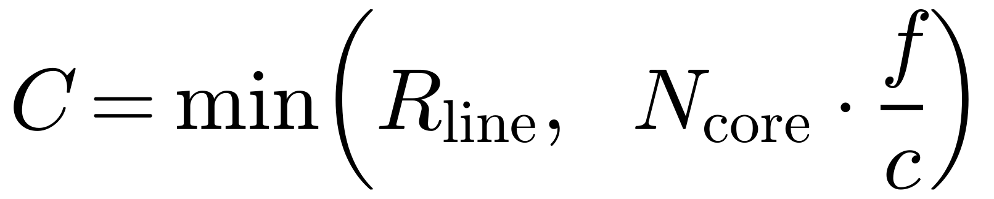
Segfault — Complete Project Report
37
Throughput ceiling — theoretical
From the measured operating point (900 kpps at 13% of one core) the per-packet cost is ~290 cycles. The ceiling is the smaller of the NIC line rate and the CPU budget:
~6.9 Mpps per core (conservative); ~10 Mpps on a 3 GHz core.
Server NIC | Line-rate cap (108 B) | Cores to saturate | Segfault ceiling
10 GbE | 11.6 Mpps | ~1–2 | 11.6 Mpps (line rate)
25 GbE | 29 Mpps | ~3 | 29 Mpps (line rate)
100 GbE | 116 Mpps | ~12 | 116 Mpps (line rate)
On server hardware Segfault is line-rate-bound — the theoretical maximum any in-kernel defence can reach.

Slide 38
Segfault — Complete Project Report
38
Comparison with alternatives
Approach | Strength | Structural limitation
BIND RRL | mature per-prefix response limiting | acts after processing; weak vs random-subdomain; no proven-client notion
iptables / nftables hashlimit | general, well understood | runs after socket-buffer alloc; defeated by adaptive/spoofed; no cost model
nftables netdev / ingress | earlier, cheaper hook | still no trust tiers, proof, or cost model
dnsdist | flexible userspace proxy | userspace per-packet cost; not kernel-bypass line rate
Fixed-threshold XDP (rivals) | very fast; drops early | one scalar the attacker controls; can't tell proven from spoofed; punishes prefix-spoof victims
Segfault (this work) | line rate + trust-by-proof + cost + bounded slip + adaptive | needs native-XDP NIC; proven tier costs one round-trip; single-host

Slide 39
PART 07
Evaluation
Compliance, honest limits, future work, and timeline

Slide 40
Segfault — Complete Project Report
40
PS-022 compliance
✓
Bounded packet parsing (verifier-proven)
✓
Per-source and global rate limits
✓
Baselines: no-filter and nftables
✓
All four metrics measured
✓
Reflection bounded (≤ 1/k), not just claimed
✓
Pseudocode + reproducible benchmark harness

Slide 41
Segfault — Complete Project Report
41
Honest scope & limitations
Laboratory, not the open internet
two Hyper-V VMs, a synthetic generator at ~0.2–0.9 Mpps; this demonstrates the mechanism, not silicon-limit throughput.
Below link saturation
Segfault protects server CPU and service; link-saturating volumetric attacks are an upstream / anycast problem.
Proven tier has a cost and a TTL
a first-contact UDP client pays one round-trip before promotion, and proven status expires after a TTL.
Reflection bounded, not eliminated
slip reflection is ≤ 1/k; random-subdomain detection is a heuristic (zone NXDOMAIN ratio), not universal.
IPv6 prefix-spoof is intermittent
recovers to 0.92 goodput over IPv6 TCP, but the slip-to-TCP nudge is currently IPv4-only.

Slide 42
Segfault — Complete Project Report
42
Future work
1. IPv6 slip support
Extend the slip-to-TCP nudge to IPv6 so proven-tier establishment under same-prefix spoofing is fast, not intermittent — the top priority.
2. Automatic capacity calibration
Learn the controller's thresholds from live load rather than configuring them, so deployment needs no hand-tuning.
3. Server-class evaluation
Run on a multi-queue NIC with native XDP to measure the true saturation point beyond the lab's virtual-switch wall.

Slide 43
Segfault — Complete Project Report
43
Timeline of delivery
Milestone | Window | Status
Problem selection & proposal (PS-022) | Sep 2026 | Complete
Datapath, controller, generator, bench — full build | 16–27 Oct 2026 | Complete
Hardware validation on real VMs (kernel 6.8, native XDP) | 27 Oct 2026 | Complete
Full benchmark matrix + IPv6 + water-torture + ceiling | 28 Oct 2026 | Complete
Code + report submission to private GitHub repo | by 31 Oct 2026 | In progress
Evaluator connection window | 31 Oct – 4 Nov 2026 | Upcoming
Regional round (Kolkata) | 24–30 Nov 2026 | Upcoming
Finals (IIT Jammu) | 17 Dec 2026 | Upcoming

Slide 44
Segfault — Complete Project Report
44
Conclusion
Segfault answers PS-022 by moving the question from “how fast is this source?” to “who is this, and what does the query cost?”, and by enforcing that answer at the earliest point in the kernel.
Across six attack scenarios on IPv4, three on IPv6, and a water-torture flood tested at three realism levels, a legitimate client stayed at its no-attack latency while every baseline — including a fixed-threshold XDP limiter representative of rival designs — collapsed to hundreds of milliseconds and single-digit query counts, dropping to zero under prefix-spoof. The result was verified with a failing control and exact counter reconciliation, and the datapath's ~290-cycle per-packet cost places it in the line-rate regime of production XDP systems.
The design, the measurements, and the honest accounting of scope together make Segfault a complete, defensible answer to the problem statement.

Slide 45
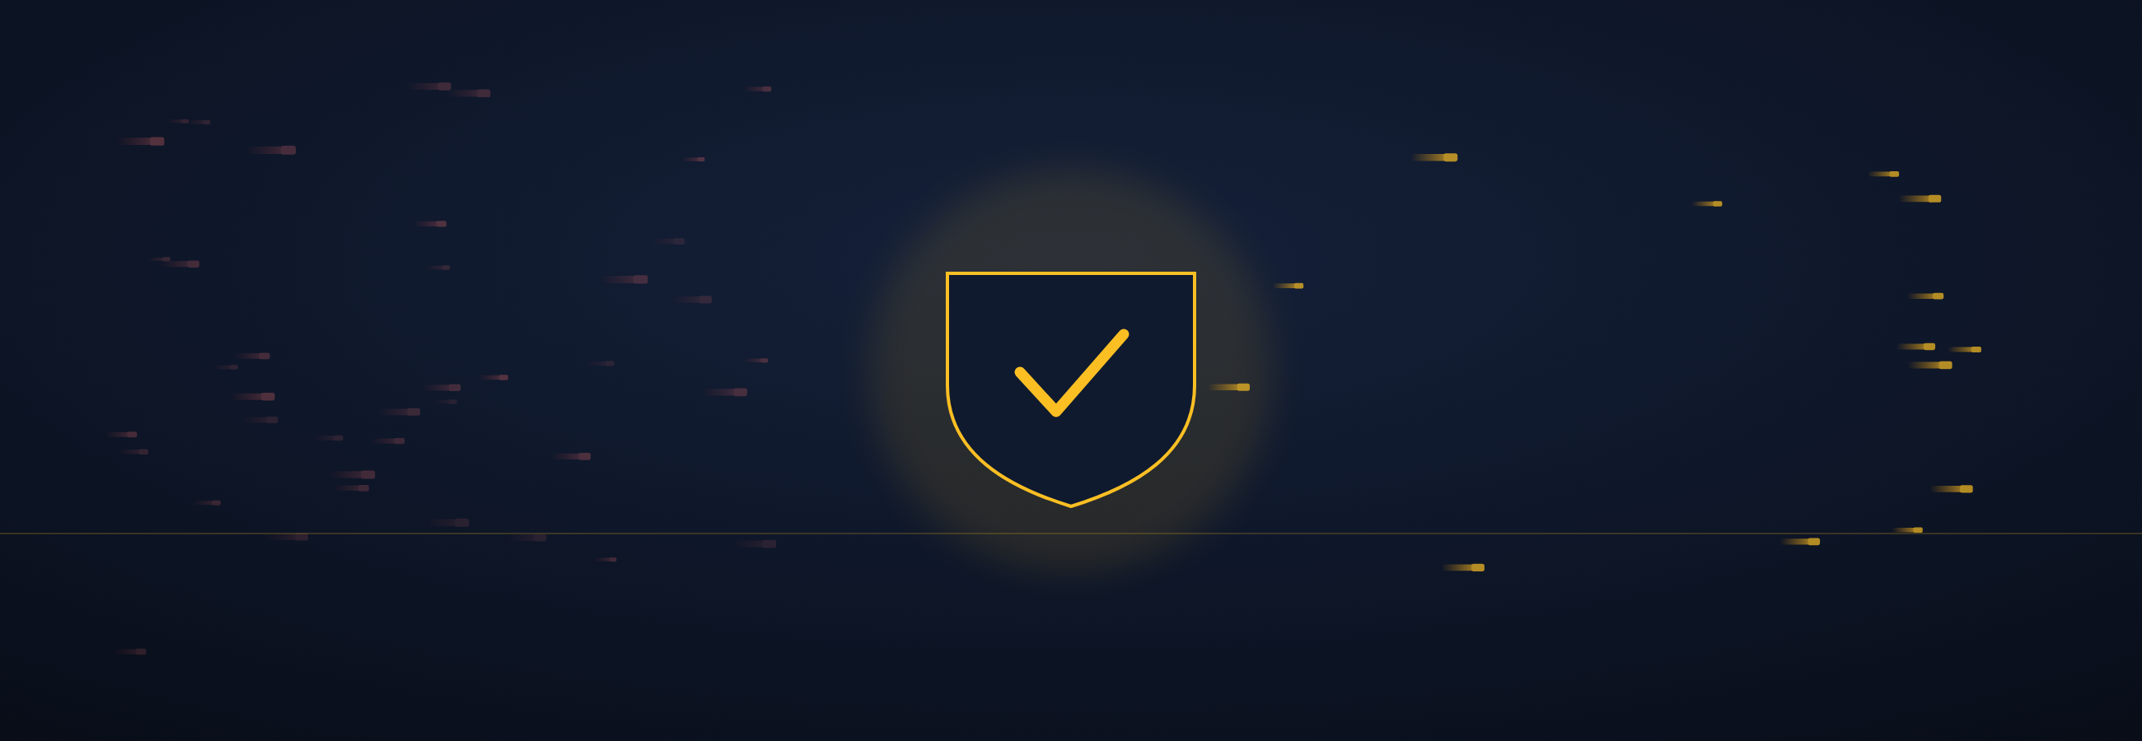
Thank you
Built by Team Segfault
Debangan Mali · Saraswata Chatterjee · Partha Chakraborty (Faculty)
debanganmali99@gmail.com · IEM Kolkata · A3-PS022-TC005

