Slide 1

A3-PS022-TC005
Segfault: Drop the Flood, Keep the Queries
PS-022: eBPF/XDP Rate Limiting for DNS Query Floods in a Lab
Debangan Mali · Saraswata Chatterjee · Partha Chakraborty (Faculty)
debanganmali99@gmail.com
Team Segfault, Institute of Engineering and Management, Kolkata
AIORI Hackathon 3
October 11, 2026

Slide 2
Table of Contents
AIORI 3 Contents
1. Problem Description | 3
2. Background | 4
3. Literature and RFC Review | 5
4. Proposed Solution | 6
5. Solution Optimization | 9
6. Solution Architecture and Design | 12
7. Data Flow Diagram | 13
8. Evaluation Plan | 14
9. Real-World Deployment | 15
10. Timeline of Delivery | 16
11. Conclusion | 17
12. References | 18
Numbers on the right are slide numbers. All performance figures in this deck are targets, to be validated, unless marked measured.

Slide 3
Problem Description
AIORI 3 Abstract
Under a DNS query flood, a Linux server fails twice: it burns CPU on every packet, and then drops packets blindly.
Cost: each packet pays about 1 to 3 µs of kernel work (skb allocation, netfilter, socket) before any drop.
Blind drops: a full socket queue drops legitimate and attack queries alike.
Spoofing: forged source addresses defeat per-source limits.
Pulses, random subdomains: bursts beat slow averages; unique names bypass the resolver cache.
PS-022 asks for
one Linux host pair in a lab
bounded UDP/DNS parsing
per-source and global limits
3 synthetic flood patterns
comparison with no filter and nftables
throughput, CPU, legit success, drops
Out of scope: public floods, full DNS semantics, universal PRSD detection, eliminating reflection.

Slide 4
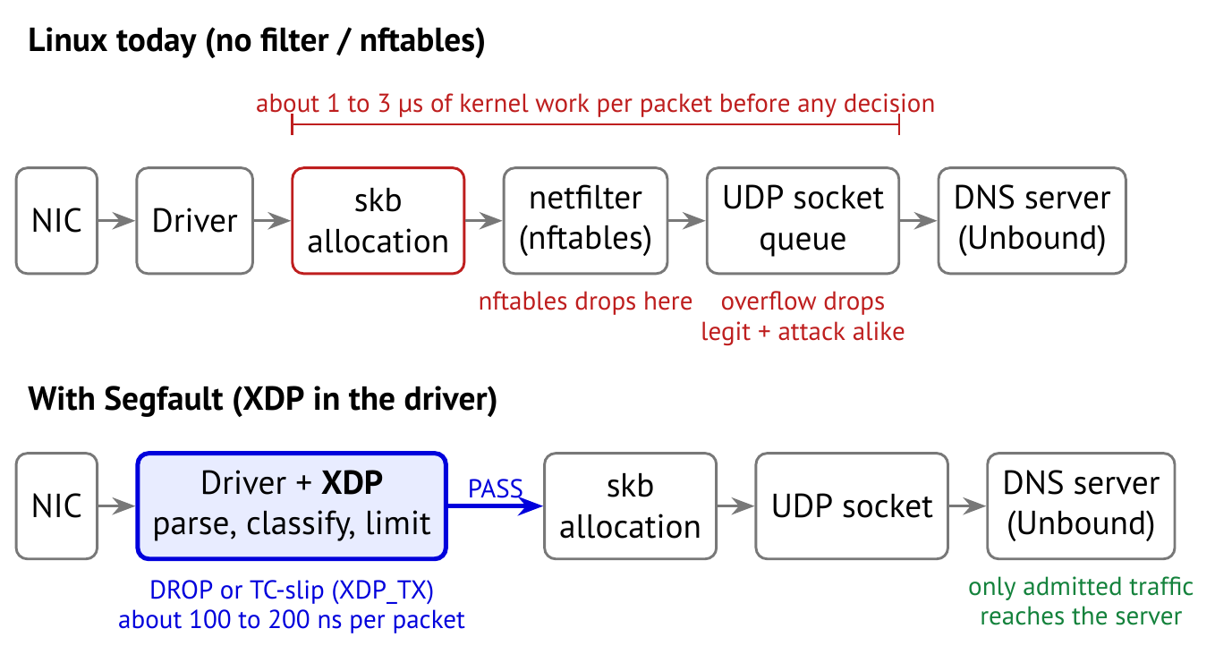
Background
AIORI 3 Background
XDP runs eBPF code inside the NIC driver, before the kernel allocates a socket buffer [1].
A spoofer never receives replies, so it cannot complete a TCP handshake [8] or echo a server cookie [9, 10]: both prove a source is real.

Slide 5
Literature & RFC Review
AIORI 3 Literature & RFC Review
XDP rate limiting for DNS already exists; Segfault builds on it and fixes where it breaks.
Prior work | What it does | Where it falls short | What Segfault adds
NLnet Labs XDP RRL [2, 3] | Per-source rate limiting in XDP | State churned by spoofed floods | Sketch-first state, lockless GCRA [5, 17]
NLnet Labs XDP Cookies [4] | Cookie holders skip limits | Only cookie-capable clients; no global fairness | TCP verifier (sockops); leased global pool
BIND / Unbound RRL [16] | Limits inside the DNS server | Full kernel cost already paid | Decision in the driver
nftables meter + limit | Limits in netfilter | After skb allocation; no verification | Earlier, cheaper, verification-aware
Sketches in eBPF [6] | In-kernel measurement | Measurement only | Drives promotion to exact limiters
Standards used: RFC 1035 [7], RFC 7766 DNS over TCP [8], RFC 7873 and RFC 9018 DNS Cookies [9, 10], RFC 8198 aggressive NSEC [11], RFC 8955 FlowSpec [12], RFC 9132 DOTS [13].

Slide 6
Proposed Solution
AIORI 3 Proposed Solution
One XDP program with three cheap layers, run cheapest first, plus slow-path kernel hooks for proof and feedback.
1. Bounded parse and sanity: 2 VLANs, IPv4/6 (up to 4 extension headers), QNAME up to 255 B; fragments and malformed headers dropped.
2. Spoof-resistant state: Count-Min Sketch first; only heavy hitters get an exact GCRA limiter.
3. Verified priority: clients proven by a DNS cookie (checked in XDP [14]) or a TCP handshake (sockops) skip the global and zone limits.
Over budget: TC-slip (truncated reply, rate-limited) so real resolvers retry over TCP; otherwise drop.
Class | Treatment under attack
Verified | Cookie or TCP proof; skips zone and pool limits; still per-source limited
Familiar | Seen often in calm periods; reserved share of the pool
Unknown | Shares the rest; over budget is slipped or dropped
Feedback: TC egress reads response codes per zone; a 50 ms kernel timer runs the CALM, SUSPECT, ATTACK modes.

Slide 7
Proposed Solution: the Three Scenarios
AIORI 3 Proposed Solution
Each flood pattern is beaten by a different layer, and each layer stays cheap under the attack it targets.
Scenario | How Segfault resolves it | Attack-path cost
A Single-source flood | Sketch flags the source within a few packets; an exact GCRA entry drops the excess; repeat offenders get short bans. | about 90 ns/pkt
B Distributed spoofed flood | Random sources are never promoted (no churn); prefix keys (/24 to /16, /64 to /48) catch clusters; the leased pool caps unknown traffic near 90% of server capacity; verified clients keep their share. | about 170 ns/pkt
C Pulsed random-subdomain flood | GCRA acts per packet, so pulses get no free window; fast-attack, slow-decay modes; zone sketch plus NXDOMAIN ratio flags the hammered zone; a good-name cache keeps popular names working. | about 200 ns/pkt
D Flash crowd (extra test) | High familiar share and low NXDOMAIN keep the mode in SUSPECT; no slips to familiar clients. | false-positive test
Scenario C is bounded mitigation of a hammered zone, not universal PRSD detection. Costs are estimates to be measured.

Slide 8
Proposed Solution: Per-Packet Pseudocode
AIORI 3 Proposed Solution
xdp_main(pkt):
p = parse_bounded(pkt) # <=2 VLAN, IPv4/6 + <=4 ext hdrs, UDP/TCP, QNAME <=255B
if !p.dns: return PASS
if p.frag_to_dns: return frag_policy(p) # drop or per-source GCRA
if !hdr_sane(p): return DROP # QR=0, opcode, section counts
if p.tcp: return syn_guard(p) # per-source SYN GCRA
key = p.cookie_ok ? (p.src, p.client_cookie) : p.src # CGNAT users counted apart
cls = p.cookie_ok or verified[p.src] ? VERIFIED : familiar[p.src] ? FAMILIAR : UNKNOWN
e = src_table.lookup(key) # lookup only
if !e:
est = cms_add(key, prefixes(p.src), epoch(now)) # conservative update, epoch tags
if est > promote_th(mode, n_epoch) and gcra(&insert_rate): e = src_table.insert(key)
if e and !gcra(&e.tat, rate[cls]): return deny(p, e)
if cls == VERIFIED: return PASS
if mode != CALM and zone_flagged(p.zone) and !good_name[p.qname]:
if !gcra(&zone[p.zone].tat, zone_rate): return deny(p, e)
if !lease_token(cls, mode): return deny(p, e) # ceiling always on
return PASS
deny(p, e):
strike(e) # bans UNKNOWN only, short
if slip_ok(p) and !tcp_blocked(prefix(p.src)):
build_tc_reply(p, server_cookie_if_client_sent_one); return XDP_TX
return DROP

Slide 9
Optimization Proposed
AIORI 3 Solution Optimization
Eight engineering choices turn a basic XDP limiter into one that stays fast and fair under spoofing.
Concern | Before (basic XDP limiter) | After (Segfault)
State under spoofing | LRU insert per new source; legit buckets evicted | Sketch first; only heavy hitters inserted; inserts rate-capped
Per-source limiter | Token bucket with a lock | GCRA: one 64-bit timestamp, one cmpxchg [17]
CPU contention | Shared LRU free list | Per-CPU LRU lists; small promoted set
Global budget | Fixed per-CPU split, unfair under RSS skew | Shared pool leased 64 tokens per atomic; always on
Reaction to pulses | Userspace polling | Kernel timer plus lazy tick in the datapath, ≤ 100 ms
Slip safety | Reply can act as a reflector | Reply ≤ request (+16 B with cookie); slips rate-limited
Real-user fairness | One IP = one user | CGNAT users keyed by client cookie; verified share
Config cost | Map lookup per packet | mmapped config, zero lookups, atomic hot-reload
GCRA: emission interval T = 1/r, tolerance τ = (B − 1)·T. Deny if t < TAT − τ, else TAT ← max(TAT, t) + T.

Slide 10
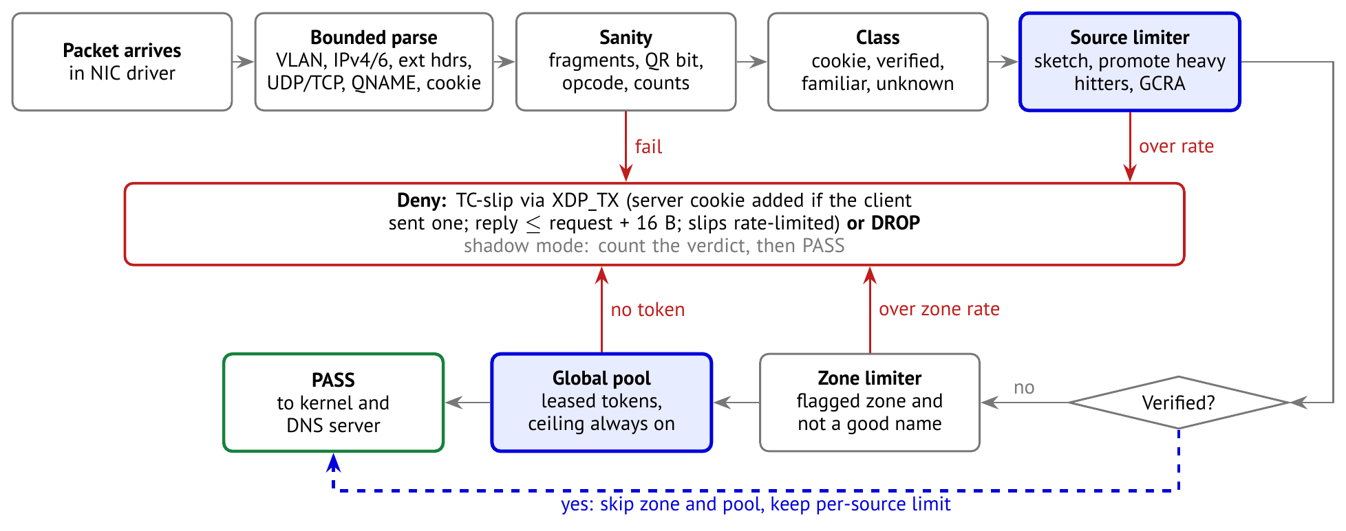
Optimization Process
AIORI 3 Solution Optimization
Every packet takes the cheapest path that can decide it; only one stage touches shared state.

Slide 11
Optimization: Targets
AIORI 3 Solution Optimization
Definition of done at about 10x server capacity (targets, to be validated).
Scenario | Legit success | p99 latency | Reaction
A single source | ≥ 99.5% | < 2x baseline | per packet
B spoofed, distributed | ≥ 98% | < 3x baseline | ≤ 100 ms
C pulsed random-subdomain | ≥ 98% | < 3x baseline | ≤ 100 ms
Path | Estimate
Calm legit query | 150 ns
Spoofed packet, drop | 170 ns
Promoted attacker, drop | 90 ns
Slip reply (XDP_TX) | 250 ns
Kernel path avoided | 1 to 3 µs
Guarantees hold while the network link itself is not saturated; link-filling floods are handed upstream (FlowSpec, DOTS).
Measured later with kernel BPF statistics (ns per packet).

Slide 12
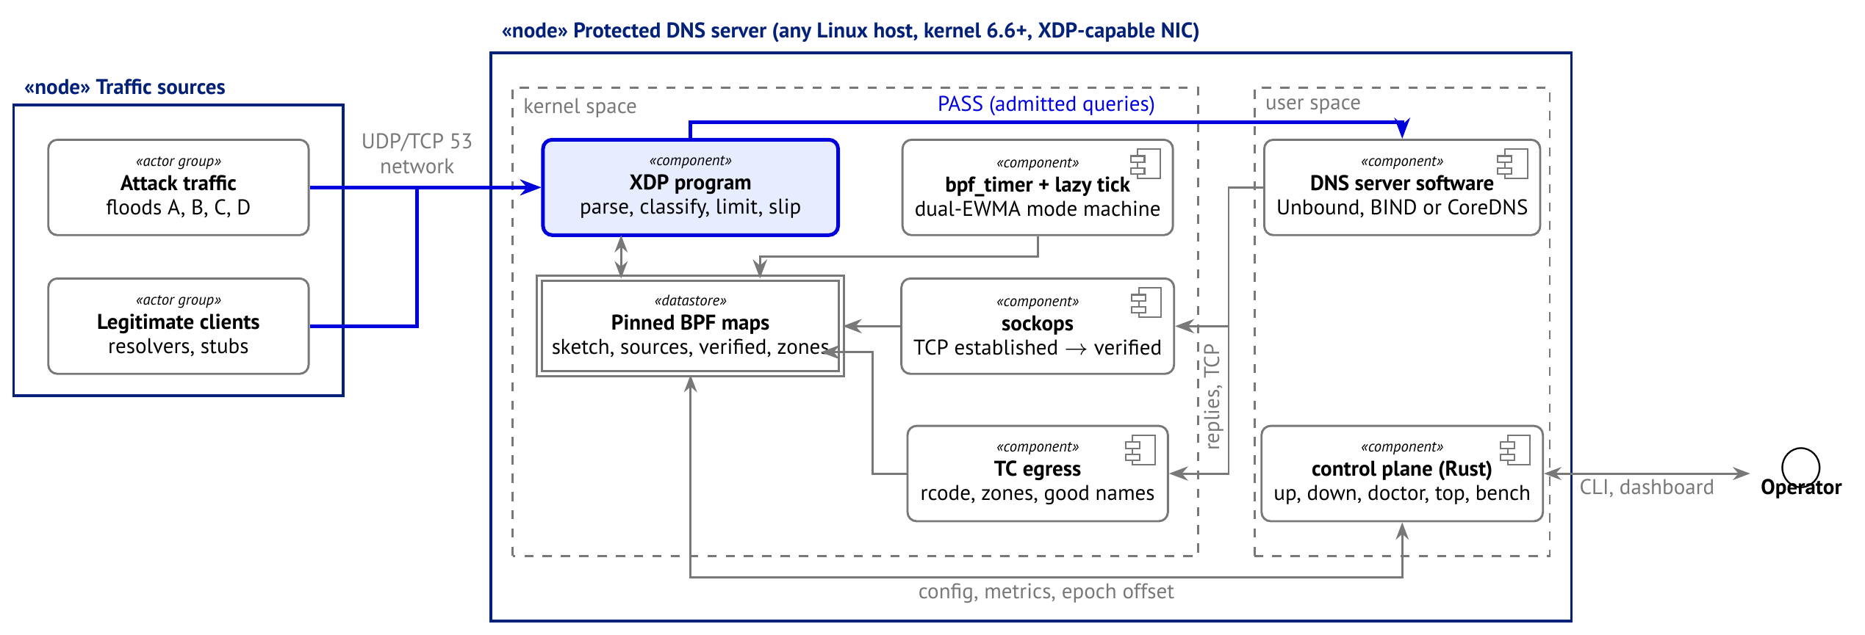
Solution Architecture & Design
AIORI 3 Architecture Design (UML Diagram)
Only the XDP program touches every packet; the other components run off the hot path.
Figure: System Architecture UML Diagram (deployment and components)

Slide 13
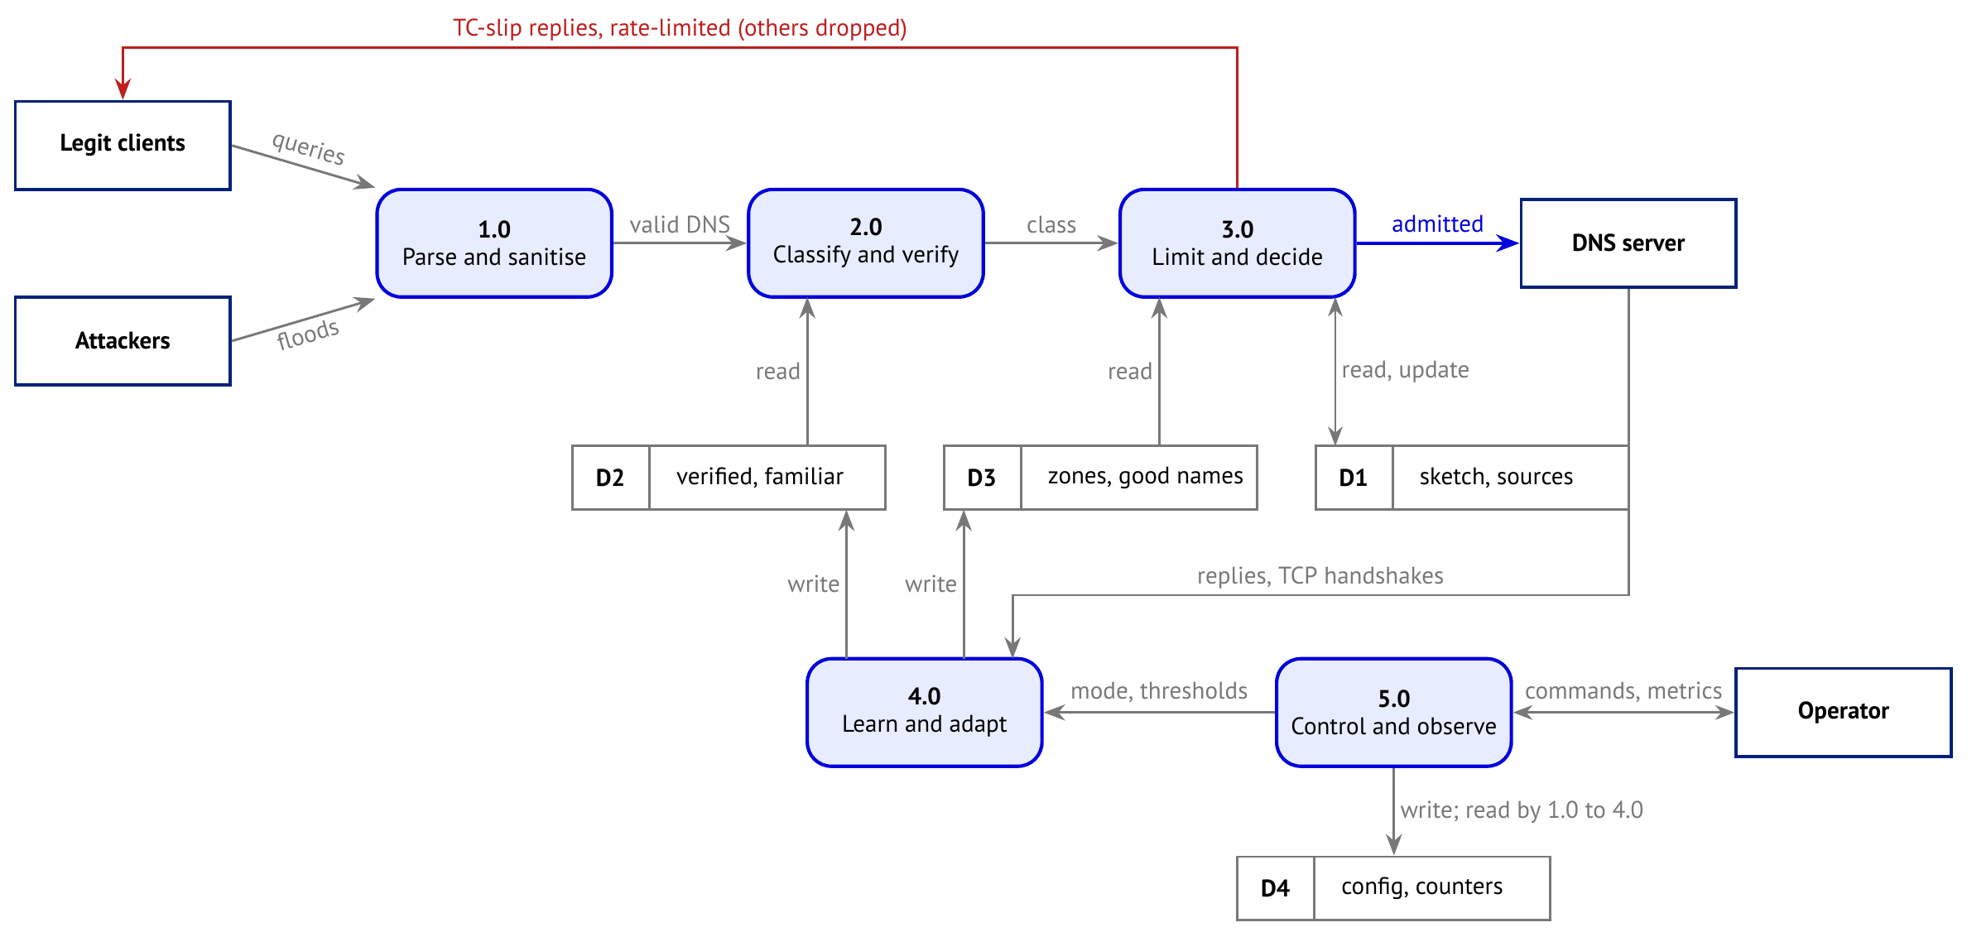
Data Flow Diagram
AIORI 3 Data Flow Diagram
Queries flow left to right; learning and control loops feed the stores the datapath reads.
Figure: Data Flow Diagram (DFD), level 1

Slide 14
Evaluation Plan and PS-022 Compliance
AIORI 3 Evaluation Plan
One command, segfault bench run, produces every number.
4 scenarios x 5 modes x 5 repeats: no filter, nftables, basic XDP, Segfault, Segfault generic mode
Ablation: remove one feature at a time to show its value
Open-loop legit client (no hidden latency), cookie and TCP aware
Metrics: pps, CPU, softirq, steal time, legit success, p50/p99, drops by stage, ns/pkt
10 s warmup, 60 s run, 95% confidence intervals; offered load verified per run
PS-022 requirement | Where it is met
Host pair, controlled lab | Hyper-V target + generator, private switch
Bounded UDP/DNS parsing | Fixed loop limits, verifier-checked
Per-source and global limits | GCRA source table + leased pool
3 synthetic patterns | Scenarios A, B, C (+ D)
No filter and nftables baselines | Same runs, same conditions
XDP-capable NIC or generic mode | hv_netvsc native + generic, both measured
Throughput, CPU, success, drops | Bench metrics
No public flood testing | Generator locked to lab ranges

Slide 15
Beyond the Lab: Real-World Deployment
AIORI 3 Real-World Deployment
The same program is designed for clouds and ISP fleets; these are roadmap items after the hackathon core.
Need | Design
Cloud VMs | Native XDP on AWS (ENA), Azure (netvsc, MANA), Google Cloud (gVNIC) [15]; segfault doctor applies MTU, LRO and channel settings, falls back to generic mode
Indian mobile users (CGNAT) | Trust keyed by client cookie, so users sharing one address are counted separately
ISP scale | Fleet controller shares heavy hitters and zone flags; shared cookie secret for anycast
Floods larger than the link | Upstream signalling: BGP FlowSpec or RTBH [12], DOTS to scrubbing providers [13]
Production readiness | .deb/.rpm, container, Helm; versioned config and maps; Prometheus; fuzzing; kernel test matrix
Privacy | No full query logs by default; truncated client IPs; aligned with India's DPDP Act 2023

Slide 16
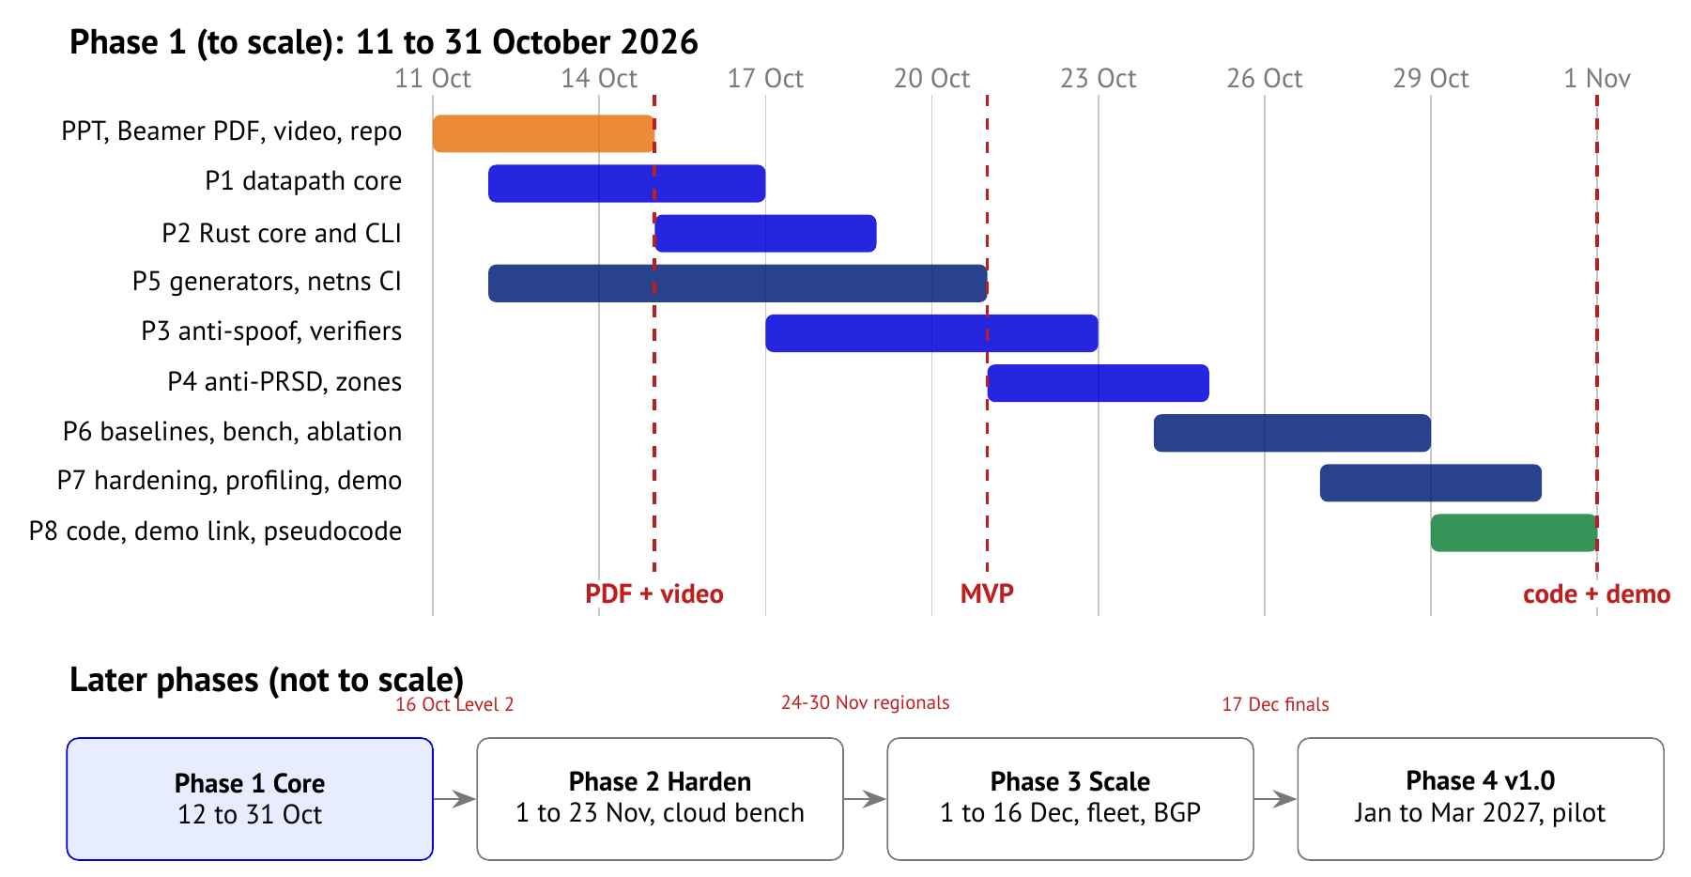
Timeline of Delivery
AIORI 3 Deployment Timeline
An MVP that meets every PS-022 requirement lands by 20 Oct; Phase 1 scope is frozen.

Slide 17
Conclusion
AIORI 3 Conclusion
Segfault keeps a Linux DNS server answering real users during spoofed, distributed and pulsed floods.
Summary
What we do not claim
Decides in the NIC driver for about 100 to 200 ns per packet
Spoof-resistant: sketch-first state, two spoof-proof verifiers
Fair: leased global pool, CGNAT-aware, flash-crowd aware
Measured honestly against no filter and nftables, with ablation
Saving a server whose link is full
Universal PRSD detection
Eliminating reflection attacks
Next steps
Phase 1 code and demo by 31 Oct
Cloud benchmarks and hardening for the regionals
Shadow-mode pilot on a real resolver; open-source v1.0

Slide 18
Bibliography I
AIORI 3 References
[1] T. Høiland-Jørgensen et al. “The eXpress Data Path: Fast Programmable Packet Processing in the Operating System Kernel.” ACM CoNEXT (2018).
[2] W. Toorop, L. Hendriks. “XDPeriments: Tinkering with DNS and XDP.” DNS-OARC 34 (2021).
[3] NLnet Labs. “Journeying into XDP: Augmenting the DNS.” APNIC Blog (Oct. 2020).
[4] NLnet Labs. “Journeying into XDP: Fully-fledged DNS service augmentation.” APNIC Blog (Feb. 2022).
[5] G. Cormode, S. Muthukrishnan. “An improved data stream summary: the count-min sketch and its applications.” Journal of Algorithms 55.1 (2005).
[6] S. Miano et al. “Fast In-kernel Traffic Sketching in eBPF.” ACM SIGCOMM Computer Communication Review (2023).
[7] P. Mockapetris. RFC 1035: Domain Names, Implementation and Specification (1987).
[8] J. Dickinson et al. RFC 7766: DNS Transport over TCP, Implementation Requirements (2016).
[9] D. Eastlake 3rd, M. Andrews. RFC 7873: Domain Name System (DNS) Cookies (2016).

Slide 19
Bibliography II
AIORI 3 References
[10] O. Surý, W. Toorop, D. Eastlake 3rd, M. Andrews. RFC 9018: Interoperable Domain Name System (DNS) Server Cookies (2021).
[11] K. Fujiwara, A. Kato, W. Kumari. RFC 8198: Aggressive Use of DNSSEC-Validated Cache (2017).
[12] C. Loibl et al. RFC 8955: Dissemination of Flow Specification Rules (2020).
[13] M. Boucadair, J. Shallow, T. Reddy.K. RFC 9132: DOTS Signal Channel Specification (2021).
[14] NLnet Labs. Unbound 1.18.0 and 1.21.0 release notes: DNS cookies and cookie-secret rollover (2023, 2024).
[15] Linux kernel documentation: BPF, Hyper-V netvsc, Amazon ENA drivers. docs.kernel.org.
[16] P. Vixie, V. Schryver. “DNS Response Rate Limiting (DNS RRL).” ISC Technical Note (2012).
[17] ITU-T. Recommendation I.371: Traffic control and congestion control in B-ISDN (Generic Cell Rate Algorithm).

Slide 20
Thank You for Your Attention!

