Slide 1
An Equivalent-Key Chosen-Plaintext Break of a 2025 Chaos-Based Image Cipher
Good statistics are not security: a 2025 cipher broken in 4 chosen plaintexts
UBMK’25 · International Conference on Computer Science and Engineering
Track: Computer and Data Security
Author(s) and affiliation withheld for review

Slide 2
Introduction: chaos image ciphers keep breaking the same way
Chaos-based image ciphers scramble a picture using chaotic (random-looking) math. Most follow a permutation–diffusion design: first shuffle the pixels around (confusion), then mask their values with a keystream, a long random-looking sequence the cipher mixes in (diffusion).
Recurring lesson: if that keystream depends only on the secret key (never on the image), the whole cipher is one fixed transformation, so an equivalent key (a stand-in that decrypts any image without being the real key) can be recovered from a few chosen plaintexts (images the attacker picks and has the cipher encrypt).
Second problem (method): schemes are judged by statistics: entropy (a randomness score), neighbouring-pixel correlation, NPCR/UACI. Near-ideal values are treated as proof of security.
But none of those scores tests resistance to a chosen-plaintext attack.
Why this matters operationally: image ciphers protect real data: medical scans, sealed evidence, access-controlled documents. A break is not a per-image slip but a standing ability to decrypt every future ciphertext of that size, so security must rest on an attack model, not a statistics table.
We apply both lessons to a 2025 scheme: “LLEO” (Jain et al., Optik, 2025).

Slide 3
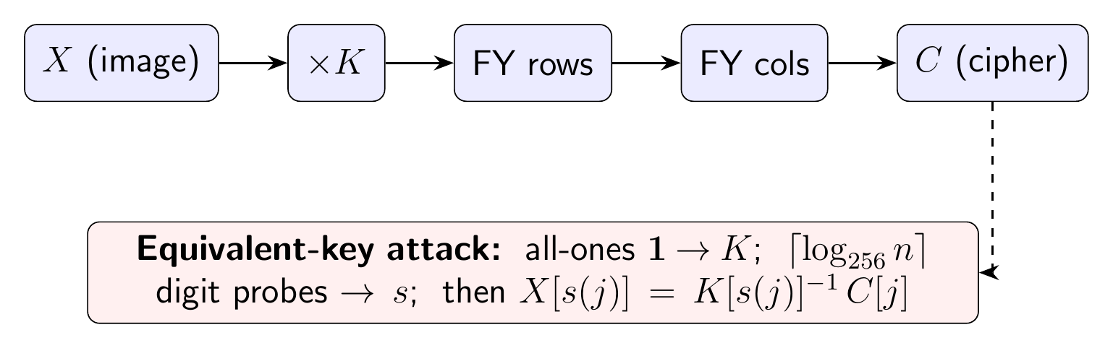
The target: LLEO (Jain et al., Optik 2025)
Two chaotic maps (simple formulas whose output looks random: Lorenz and logistic) make the keystream that masks each pixel (multiply by K).
Then two Fisher–Yates shuffles (a standard way to randomly reorder a list) rearrange 16 row-blocks, then 16 column-blocks.
Every key element comes from the secret key alone, nothing depends on the image X.
Called “asymmetric,” but the same keys both encrypt and decrypt: it is really symmetric.
LLEO encryption (top) and the equivalent-key attack (bottom).

Slide 4
Key insight: LLEO is one fixed “multiply-and-reorder” map
Write the image as a list of n = M×N pixels. Every step is just multiply-and-reorder using arithmetic that wraps around at 256 (like hours on a clock), and is fixed once the key is set.
Masking multiplies pixel p by a fixed odd number K[p] (odd, so it can always be divided back out); the two shuffles combine into one fixed reordering of positions.
So C[j] = K[s(j)] · X[s(j)] (mod 256): each output pixel is exactly one input pixel times a fixed number, a “monomial” map.
Two gifts to the attacker: no added constant, and no diffusion (each output pixel depends on only one input pixel).

Slide 5
Four images recover the full map
(a) The multiplier, 1 query: encrypt an all-ones image; the output directly reveals K at every position.
(b) The reordering, a few queries: encrypt images whose pixels carry their own position number, then divide out the known K to read off where each pixel came from (the map s).
The pair (s, K) is the equivalent key. It inverts any ciphertext: X[s(j)] = K[s(j)]^-1 · C[j].
Total cost: 1 + ceil(log_256 MN) chosen plaintexts = just 4 for a 512×512 image, no matter how long the advertised key is.
This matches the known best-possible bound for shuffle-only ciphers; adding more rounds or maps doesn't change the form, so the same attack still works.

Slide 6
Experimental setup
Reconstructed LLEO from its published description, reimplemented from scratch, no code reused.
Four standard 512×512 grayscale images (Cameraman, Moon, Gravel, Brick); one fixed secret key.
Verified the reconstruction reproduces LLEO's reported statistics before attacking.
All timings single-core wall-clock.

Slide 7
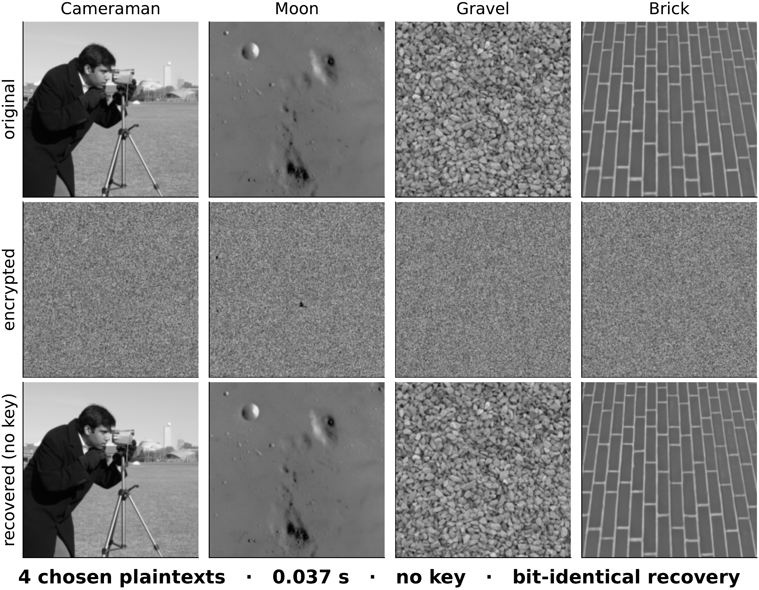
Result: every image recovered pixel-exactly, without the key
Only 4 chosen plaintexts per image.
Recovery is bit-identical to the original.
Decryption in 0.037 s at 512x512 (single core), no key used.
Original -> LLEO ciphertext -> key-free recovery (bit-identical), four images.

Slide 8
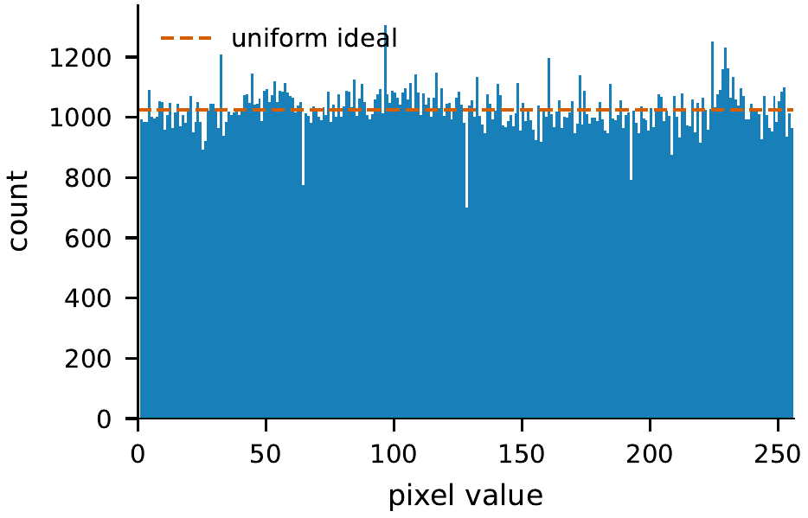
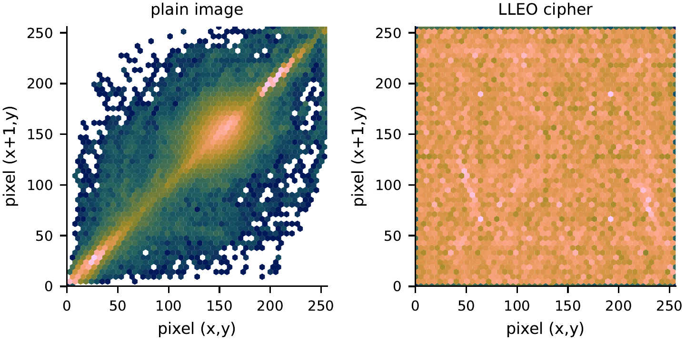
Good statistics are not security
Flat histogram of cipher pixel values
Neighbouring-pixel pattern: structure -> uniform
Entropy (a randomness score, maximum 8) rises 7.23 -> 7.99; neighbouring pixels go from very alike to almost unrelated (correlation ~ 0); the spread of pixel values is flat.
By every usual yardstick LLEO looks strong, yet it is broken in 4 queries.

Slide 9
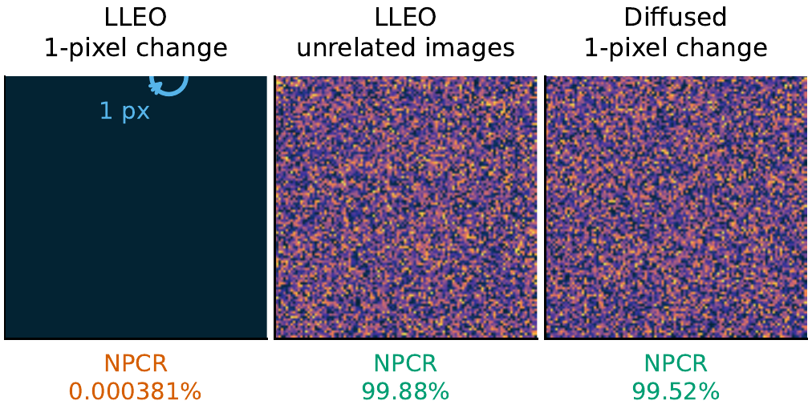
The “differential” score (NPCR) is illusory
NPCR = the percent of pixels that change when you flip a single input pixel. A good cipher should change almost all of them (~99.6%), and LLEO reports ~99.6%.
But with no diffusion, flipping one input pixel changes exactly one output pixel, so the true value is 100/MN ~ 0.0004%, five orders of magnitude smaller.
The 99.6% is really just the difference between two unrelated images (here 99.88%), which any near-uniform cipher reaches and which says nothing about security.
Difference image |C_0-C_1|: dark = unchanged, bright = changed (one fixed key).

Slide 10
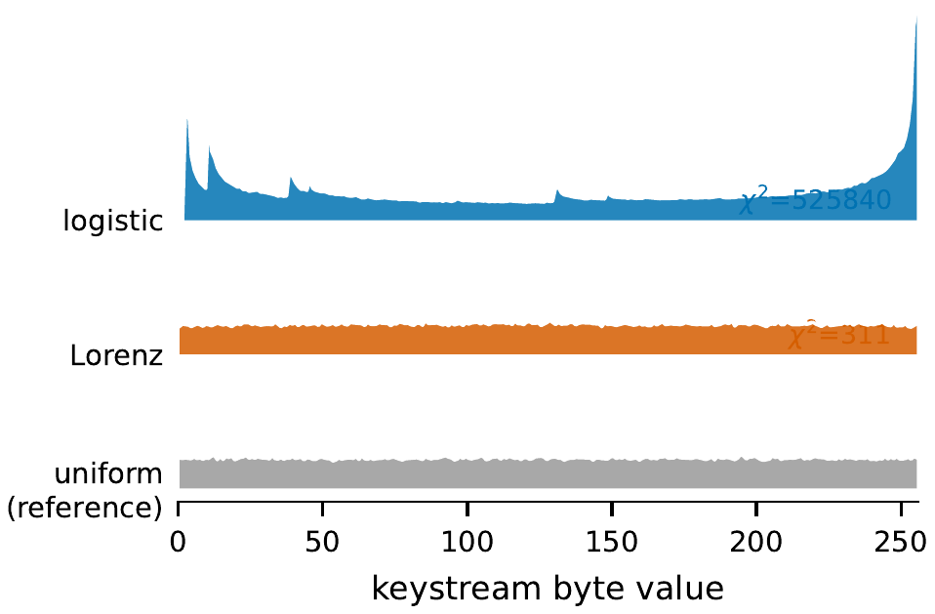
Even the chaotic keystreams are not evenly random
A chi-square test (a standard check for whether values are evenly spread) strongly rejects “evenly random” for both chaotic streams (logistic chi^2 ~ 5.3×10^5).
A secure keystream would be flat, like the uniform reference row at the bottom.
How often each byte value appears: logistic and Lorenz vs. a truly uniform source.

Slide 11
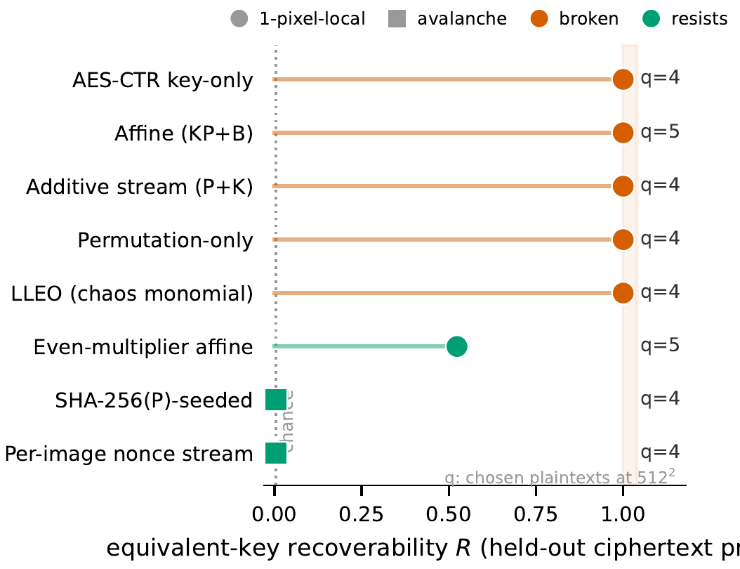
The contribution: a reusable structural audit
We package the attack as a black-box test: given only the ability to encrypt chosen images, it decides whether a cipher is one fixed plaintext-independent map and, if so, recovers an equivalent key, knowing nothing about the scheme inside, and CERTIFYING each verdict by predicting fresh ciphertext exactly (a check we prove sound).
On 8 structural archetypes it breaks all 5 fully key-only ones at R = 1 in <= 5 chosen plaintexts (chaos, permutation, additive, affine, even a modern AES-CTR key stream); 2 image-/nonce-bound schemes correctly resist; a 6th, with non-invertible multipliers, degrades GRACEFULLY (R = 0.52, PARTIAL), the deliberate boundary.
The chaos was never the point: a reused, image-independent keystream is. This is a reusable audit, not a one-paper break.
Recoverability R per scheme on an archetype corpus (red = broken, green = resists); chosen plaintexts at 512x512.

Slide 12
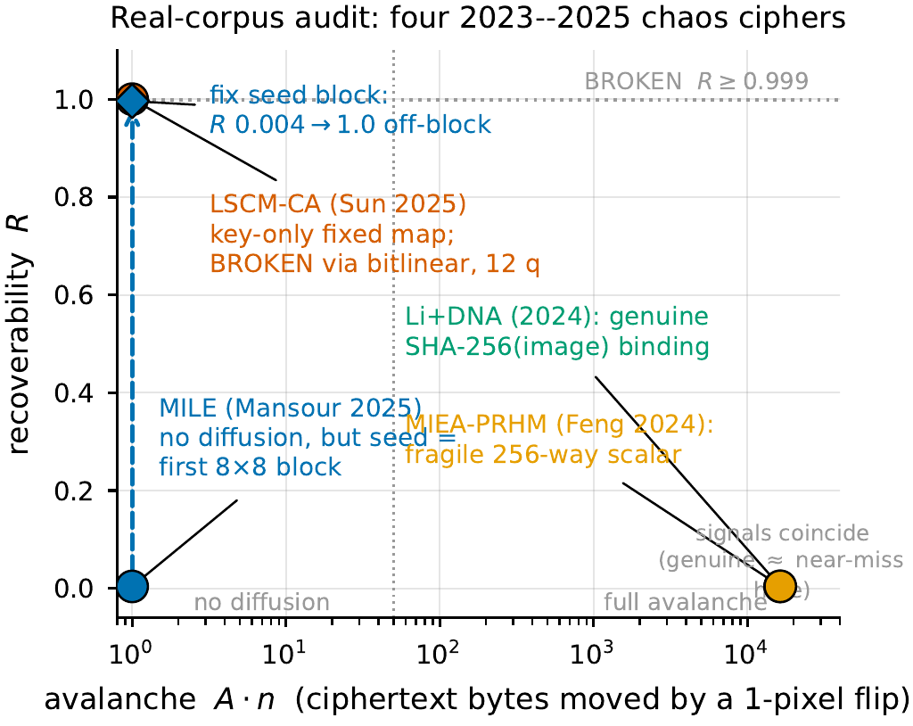
Run on four real published 2023–2025 ciphers
We reconstructed four real, open-access chaos image ciphers from their equations and ran the audit. Each reproduces the originals' near-ideal entropy (~7.99) and inter-image NPCR (~99.6%), so the rebuilds behave like the published ciphers where it counts.
Seeding decides the verdict. LSCM-CA (Sun et al. 2025) is key-only -> BROKEN (R = 1.0, 12 chosen plaintexts), but only after a GF(2)-affine 'bitlinear' extension to peel its per-pixel cellular-automata layer, which the plain affine/XOR model misses. The other three bind the keystream to the plaintext (SHA-256 / block sum) -> correctly RESIST.
Honest limits: two 'resists' are thin (one injects only a 256-way scalar; one collapses if a 64-pixel seed block is fixed), and the two cheap signals cannot tell genuine binding from a near-miss. We mark this, not hide it. Reconstructions are paper-only; LLEO is the one fully-validated break.
The audit in its two signals (avalanche vs. recoverability) on real schemes rebuilt from their papers.

Slide 13
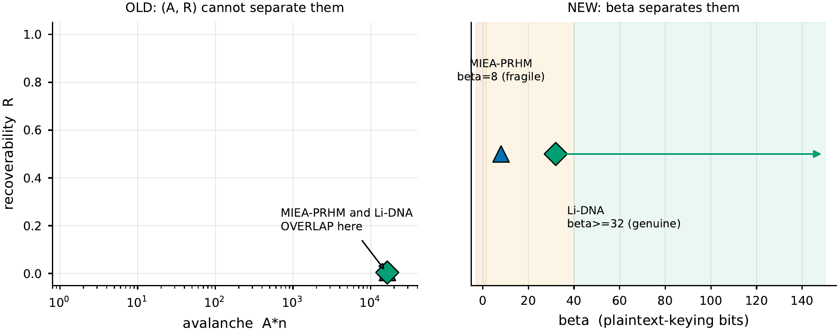
The graded fix: plaintext-keying capacity beta
The avalanche and recoverability signals cannot tell a fragile near-miss from genuine binding: the two schemes overlap (left). So we add a graded capacity beta: how many genuinely different ciphers the plaintext can switch the cipher's map between.
beta = 0 means one fixed map (key-only, BROKEN); a large beta means every image gets its own unrelated map (RESISTS). It is estimated black-box from chosen plaintexts as a collision rate.
So beta separates the schemes the two signals could not: a fragile 256-way scalar (beta = 8) from genuine SHA-256 binding (beta >= 32), turning the one-bit verdict into a measured, falsifiable gap.
Left: the two cheap signals overlap. Right: the beta axis separates fragile from genuine.

Slide 14
Discussion: good statistics are not security
A flat histogram, ideal entropy, near-zero correlation, and a large inter-image NPCR all hold for our fixed, key-only map, yet it is broken in 4 queries.
The single deciding question is binary: does any key material depend on the image? The oracle answers it automatically for any scheme.
The break is sound by construction: LLEO forces its multipliers odd (always invertible), and the equivalent key predicts fresh ciphertexts exactly, the falsifiable check that the cipher truly ignores the image.
(The scheme's 'asymmetric' label is also a misnomer, same keys encrypt and decrypt, but that is cosmetic.)

Slide 15
Conclusions, remedies, and disclosure
LLEO is completely broken by an equivalent-key chosen-plaintext attack in 4 queries and a fraction of a second, despite near-ideal statistics.
More than one break: the audit flags every fully key-only scheme in an 8-archetype corpus and, on four real published 2023-2025 ciphers, breaks the one key-only design (LSCM-CA) and clears three plaintext-bound ones, one break needing a GF(2)-affine extension.
Remedies (standard): (i) tie the keystream to the image (seed the chaos from a SHA-256 hash of the image); (ii) add real diffusion (a chaining rule). The identical attack then recovers 100% of pixels against the key-only cipher but only 0.25% (chance) once the keystream is image-seeded.
Statistical scores should support, not replace, an explicit chosen-plaintext argument. Authors of both broken schemes (LLEO and LSCM-CA) emailed at submission; no response yet (responsible disclosure).

Slide 16
Appendix: why the break is sound (invertibility & fidelity)
Odd multipliers: LLEO inverts its substitution by a modular conjugate, which forces every multiplier odd (always invertible mod 256). On the reconstruction all are odd and E(0)=0 holds exactly; if even multipliers were allowed the oracle degrades gracefully (about half the positions recovered) rather than returning a wrong inverse.
Fidelity: matching entropy/correlation proves nothing. The load-bearing check is that the recovered key predicts fresh ciphertexts exactly, which only a plaintext-independent cipher can.
Generality & scale: a very different XOR-and-chain (CBC-like) cipher also falls in 3-4 chosen plaintexts; cost grows only logarithmically with image size (3-4 plaintexts up to 1024x1024).

Slide 17
Selected references
J. Jain et al., LLEO chaos-based image-encryption scheme, Optik 327:172304, 2025 (target scheme).
C. Li et al., “When an attacker meets a cipher-image,” survey of chaos-cipher breaks, 2019.
G. Alvarez and S. Li, “Some basic cryptographic requirements for chaos-based cryptosystems,” 2006.
C.-Y. Li and C.-C. Lo, optimal known/chosen-plaintext bound for permutation-only ciphers, 2011.
Y. Wu et al., NPCR and UACI randomness tests for image encryption, 2011.

Slide 18
Thank you
Questions? · Reproduction and attack code released for verification.

