Slide 1
Knowing When to Abstain: Calibration and Selective Prediction for ML Network Intrusion Detection
The much-cited 'detection collapse' on unknown attacks is mostly a thresholding artifact
UBMK’25 · International Conference on Computer Science and Engineering
Track: Computer and Data Security
Author(s) and affiliation withheld for review

Slide 2
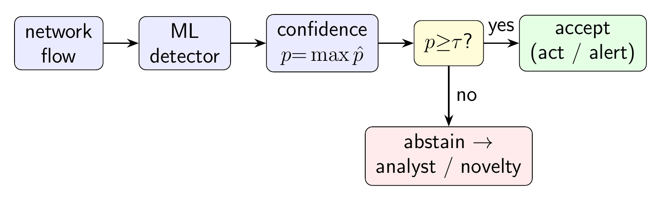
Introduction: detectors that fail silently
A detector that outputs a single hard label (“attack” or “normal”) gives no signal of when to trust it, and stays silent on attacks it never saw in training.
Why it matters: a missed novel attack reaches production before any analyst reviews it, exactly the case a single hard label handles worst.
Better: let it abstain, say “I’m not sure” on low-confidence inputs and pass them to an analyst or a backup check. This is called selective prediction.
Question: do ordinary, off-the-shelf detectors know when they are wrong?
We propose no new detector; we test the ones people already use.
The selective-prediction (“reject-option”) wrapper we evaluate.

Slide 3
Contributions: a dissociation between two failure modes
Over-confidence is task-dependent: detectors are badly miscalibrated under NSL-KDD's shift and NO post-hoc fix (Platt, isotonic, or temperature scaling) transfers, yet on two modern flow datasets the same task is well calibrated.
The benign-mimicry blind spot is an operating-point failure, not a representational one, and it recurs across all three datasets. R2L is nearly missed at the default threshold (recall 0.06) yet its score is discriminative (AUROC 0.87); a per-family threshold recovers much of it (0.49). Class balancing does not help, so the cause is the threshold, not class frequency.
Selective prediction is useful but bounded: it helps only when confidence ranks errors; and on the benign-mimicking blind spot the lever is the OPERATING POINT: a budget-tuned threshold recovers most of what argmax misses, while stacking abstention+novelty adds no gain at matched cost.

Slide 4
Method
Calibration: does a model's stated confidence match how often it is right? We measure the gap with expected calibration error (ECE), and the Brier score, a proper scoring rule, agrees, then try three standard fixes (Platt, isotonic, and temperature scaling), each fit only on held-out training data so no test information leaks in.
Selective prediction: confidence = the model's top class probability. The risk-coverage curve plots error against the fraction answered; the area under it (AURC) summarizes it (lower is better).
Open-set (LOFO): drop one attack family from training, retrain, and measure detection on the unseen family. To separate a threshold artifact from true indistinguishability we also report threshold-free per-family detection AUROC.
Honesty checks: a bootstrap over the (fixed) test set (the seed-only intervals understate uncertainty about 5x) and conformal prediction, which promises a hit-rate as long as new data looks like the old.

Slide 5
Models, confidence signals, and novelty detectors
Detectors: logistic regression (a simple linear model), a random forest, and gradient boosting (both built from many decision trees), deliberately ordinary; the subject is their confidence, not the architecture.
A neural MLP is added as a supplementary fourth family in the model summary, to check the confidence-ranking finding generalizes beyond trees and the linear model.
Confidence signals compared: the top class probability (max-softmax), how much the forest’s trees disagree, and two “distance-from-normal” scores (Mahalanobis and nearest-neighbour).
Novelty detectors, trained only on normal traffic to flag anything unusual: Isolation Forest and a one-class SVM.

Slide 6
Experimental setup: datasets
NSL-KDD: a public benchmark of network connections (~126k train / 22.5k test, 41 measured features each); attacks fall into four families: DoS (denial of service), Probe (network scanning), R2L (remote-to-local intrusion), and U2R (user-to-root escalation). Its test set deliberately includes attack types missing from training, a built-in unknown-attack test.
CIC-IDS-2017: a newer dataset of network “flows” (per-connection summaries, 78 features), over three days (DDoS, PortScan, Web attacks).
CSE-CIC-IDS-2018: a different network and year, used to test transfer on the 27 features the two datasets share by name.
Each result averages many random repeats; the official test sets are kept fixed.

Slide 7
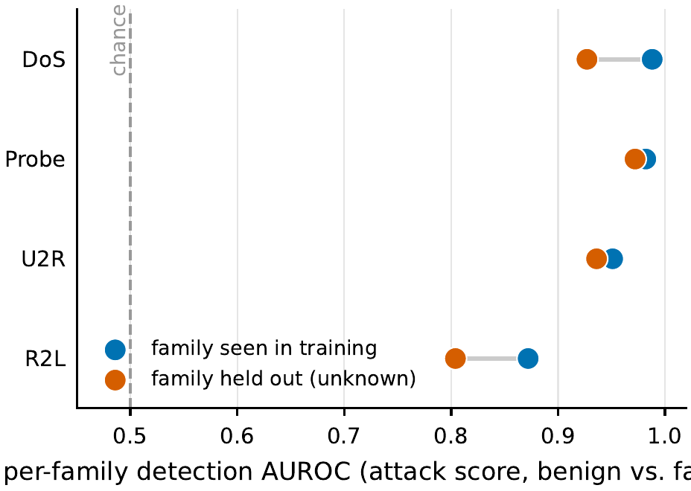
Finding 1: the blind spot is a threshold failure, not indistinguishability
The most attackable reading ('R2L is just an unbalanced classifier at the default cut') is wrong about the cause. The attack score separates R2L from normal well above chance (AUROC 0.87 seen, 0.80 unknown).
At the global default threshold only 0.06 of R2L is flagged; class-balancing barely moves it (0.06); a per-family threshold recovers 0.49. So a single global operating point fails a minority, look-like-normal family.
Threshold-free, holding a family out of training costs little AUROC (DoS -0.06, R2L -0.07), so the dramatic 'detection collapse' on unknown families is largely a thresholding artifact.
Per-family detection AUROC (threshold-free), family seen vs. held out of training.

Slide 8
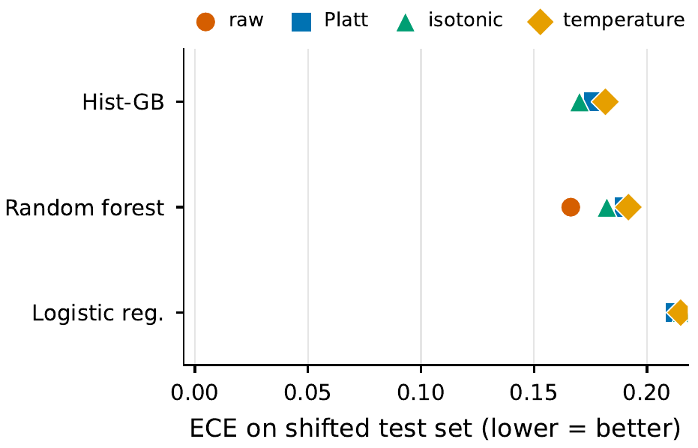
Finding 2: over-confident under shift, and no calibrator fixes it
On data like the training set the models are nearly perfectly calibrated (error below 0.01); on the real shifted test set it jumps to about 0.16-0.22.
No post-hoc fix removes it: Platt, isotonic, and temperature scaling all stay high (every marker clusters at the top), each is fit on the source distribution.
Source-calibrated probabilities do not certify the deployed distribution, which is why we turn to abstention (it needs only a usable confidence ranking).
Calibration error on the shifted test set under four post-hoc calibrators (per model).

Slide 9
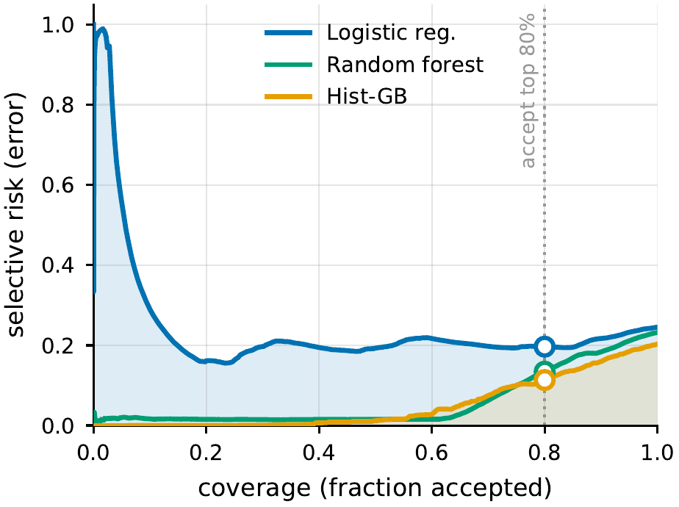
Finding 3: abstaining helps, if confidence ranks errors
Tree-based models: refusing the least-confident 20% cuts error 0.20 -> 0.11 (area under the curve ~ 0.05; lower is better).
The linear model’s confidence barely ranks its mistakes (area ~ 0.23), so abstaining buys little.
Abstaining is only as good as the confidence signal behind it.
Error among answered cases vs. the fraction answered; ring = the 80%-answered point.

Slide 10
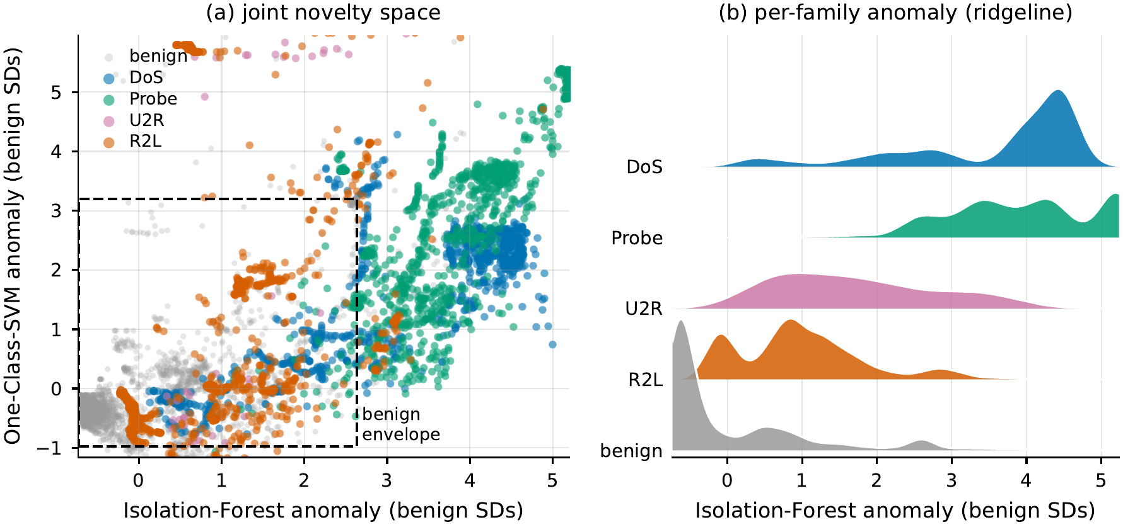
Finding 4: why R2L is the blind spot
R2L’s records pile up right on top of the normal ones, inside the “looks-normal” region, for both independent novelty detectors.
It mimics ordinary traffic, so neither abstaining nor a normal-only novelty check can cleanly flag it; DoS, Probe, and U2R clearly stand out.
(a) how unusual each record looks to two “normal-only” detectors; (b) the same, per family.

Slide 11
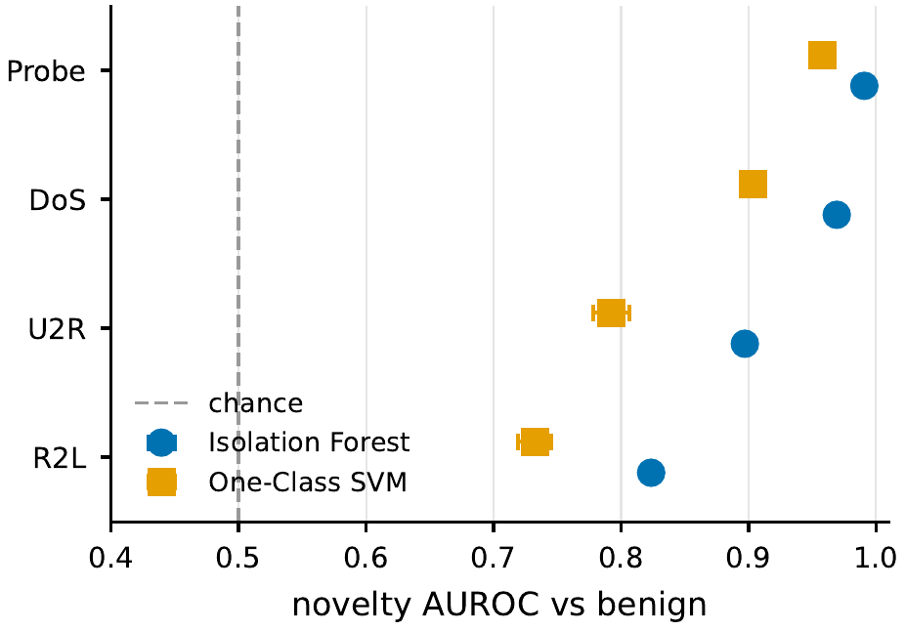
Finding 5: a normal-only novelty stage partly closes the gap
Trained only on normal traffic, Isolation Forest / one-class SVM separate DoS, Probe, U2R well (score ~ 0.90–0.99).
R2L stays hardest (~ 0.73–0.82), it overlaps normal traffic the most.
Abstaining and novelty detection catch different failures, so use both.
How well each attack family separates from normal traffic (1 = perfect, 0.5 = chance).

Slide 12
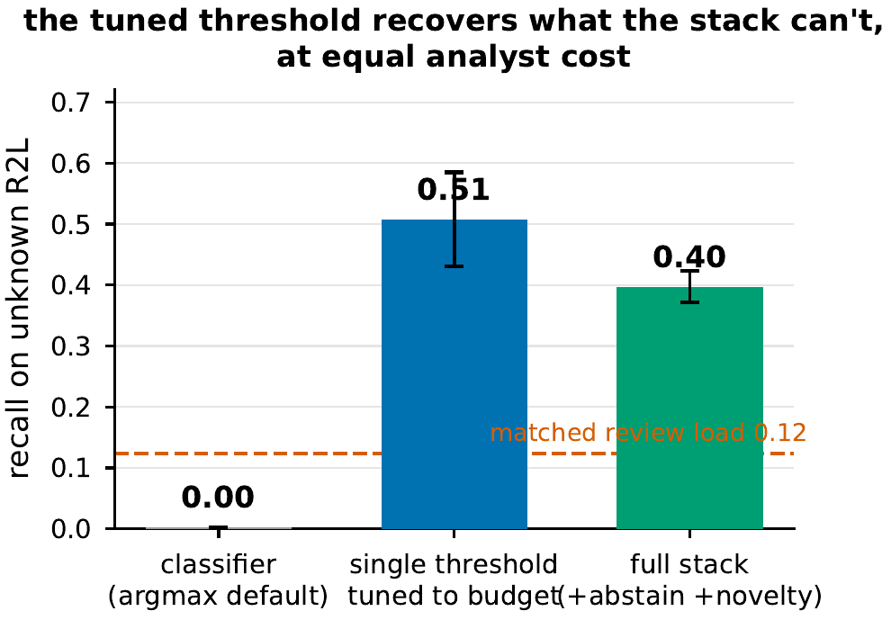
The recipe, re-baselined honestly
The earlier 0.003 -> 0.40 gain was measured against the argmax default, a bad threshold for a minority family. We re-baseline against a single threshold TUNED to the same review budget.
At matched cost: argmax 0.00; a tuned threshold 0.51; the full stack (argmax+abstention+novelty) only 0.40, BELOW the tuned threshold (paired gap -0.11).
So the lever is the operating point, not the gates: stacking adds no net recall once the threshold is set to the budget. (Even so, about half of unknown R2L is still missed.)
Unknown (held-out) R2L at a matched review budget: argmax vs tuned threshold vs full stack.

Slide 13
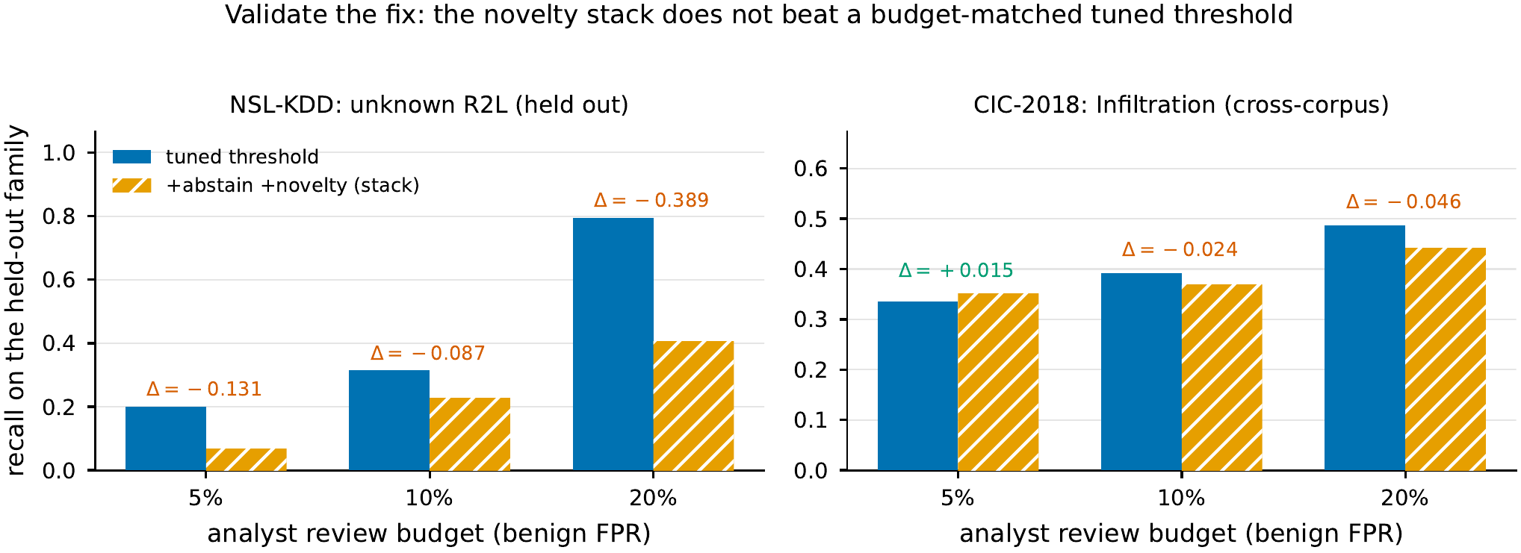
Validating the fix: across budgets and a second corpus
Is the re-baseline a one-point fluke? We sweep three review budgets (5/10/20%) and add a second corpus, CIC-2018 Infiltration, the look-like-normal family there.
The abstention+novelty stack beats a budget-tuned threshold in just 1 of 6 budget x corpus cells (CIC at 5%, +0.015); it loses the other five, decisively on unknown R2L (e.g. -0.39 at 20%).
So at equal analyst cost the stack adds no recall a tuned threshold doesn't already give, and we tune the stack FAVOURABLY, not as a strawman; a harder-tuned threshold only widens the gap. (Headline gap: seed-paired -0.11; bootstrap -0.06, 95% CI [-0.10, 0.00].)
Tuned threshold vs. the full stack at matched analyst budget, on unknown R2L and cross-corpus Infiltration.

Slide 14
Finding 6: calibration need is task-dependent; the blind spot recurs (3 datasets)
CIC-IDS-2017: the within-day task is easy and already well-calibrated (accuracy ~1.0, calibration error ~0.0001), over-confidence is a property of the task, not a built-in flaw.
Drift (train one day, test another): Web detection 0.98 -> 0.79, and abstaining catches 0.95 of unknown Web, far more than R2L, because Web does not look like normal traffic.
CIC-IDS-2018 (third dataset): Infiltration is the canonical look-like-normal family and repeats the R2L signature exactly: well-calibrated (error 0.006), yet missed at the default cut (recall 0.25) while its score is discriminative (AUROC 0.71) and a per-family threshold recovers 0.39.

Slide 15
Which confidence signal? Can we promise a hit-rate?
Comparing the signals fairly (same data, paired): the cheap top-probability is statistically tied with the fancier ones; the distance score is slightly better at ranking errors but worse at spotting unknown attacks.
So on this kind of tabular traffic data, plain confidence is a strong default: the value is in the abstain framework, not the exact signal. (Classical signals only; energy/ODIN-style scores need a neural net we deliberately avoid.)
Conformal prediction's promised 90% hit-rate holds on training-like data (0.93) but falls to 0.61 once the traffic shifts, the guarantee breaks exactly when deployment changes.

Slide 16
Discussion: a practical recipe
Pick a model whose confidence is informative (good at ranking its own errors, a tree-based model, not the linear one).
Choose how much to answer from the risk–coverage curve; send the refused cases to a human or a backup check.
Watch the abstain rate as a cheap, label-free warning that the traffic is drifting.
Add a normal-only novelty check for the look-like-normal attacks abstaining cannot catch.

Slide 17
Conclusions and future work
Detectors are over-confident under NSL-KDD's shift and not fixable by post-hoc calibration, yet well-calibrated on two modern datasets: calibration need is task-dependent.
The second failure recurs on all three datasets but is an operating-point one: a single global threshold misses minority look-like-normal families whose score is in fact discriminable, so the much-cited 'detection collapse' is mostly a thresholding artifact.
Abstention lowers error where confidence ranks it; and simply tuning the operating point to the analyst budget recovers much of the look-like-normal traffic the argmax default hides; a stacked novelty gate adds no further recall at matched cost.
Future: a full time-ordered evaluation, the label-corrected CIC-2017, and a shared NetFlow feature format for transfer across networks.

Slide 18
Selected references
M. Tavallaee et al., “A detailed analysis of the KDD Cup 99 / NSL-KDD data set,” 2009.
C. Guo et al., “On calibration of modern neural networks,” 2017.
Y. Geifman and R. El-Yaniv, selective prediction / risk–coverage, 2017; El-Yaniv & Wiener, 2010.
D. Hendrycks and K. Gimpel, max-softmax baseline for misclassification/OOD, 2017.
D. Arp et al., “Dos and Don'ts of machine learning in computer security,” 2022.
A. Angelopoulos and S. Bates, conformal prediction, 2023.

Slide 19
Appendix: uncertainty signals on NSL-KDD
AURC (lower is better): max-softmax 0.060, Mahalanobis 0.058, k-NN 0.068, RF disagreement 0.060.
Mahalanobis is marginally better at error-ranking but significantly worse at unknown-attack separation than max-softmax.
Split-conformal coverage: 0.93 in-distribution -> 0.61 under the train–test shift (target 0.90).
All metrics: means over K seeds with 95% confidence intervals.

Slide 20
Thank you
Questions? · LOFO protocol and analysis code released for verification.

