Slide 1
Teen Loneliness and AI Companions
By: Emily Bishop

Slide 2
Thesis
Technology and social media have facilitated superficial relationships in young people that have lead to the highest reported scores of loneliness among young people
→
AI Companions will be a useful tool for teens to develop fulfilling connections and combat loneliness while also allowing young people to remain connected with their peers.

Slide 3
Screen-time is not inherently evil
Screen-time in and of itself is not the cause of the increased loneliness among young people, it is the superficial relationships digital technologies facilitate
Boys have significantly lower scores of reported loneliness when compared to young girls
Boys spend most of their time online gaming which is said to encourage teamwork and cooperation, useful skills when developing fulfilling social connections
Girls are more likely to spend the majority of their time online on social media sites which facilitates self-comparison and leads to negative feelings
Notes:
Therefore, it is HOW teens use the internet that leads to loneliness, not the internet itself

Slide 4
Integration within existing social lives
Young people’s social lives exist increasingly online and it is naive to think that this trend will stop
Therefore, reducing screen time detaches teens from their peers (via social media)
A benefit of AI companions is that they can meet young people where they already are socially
Allows teens to continue interacting with their friends online, i.e. improves upon existing methods of communication
Helps makes online interactions more fulfilling

Slide 5
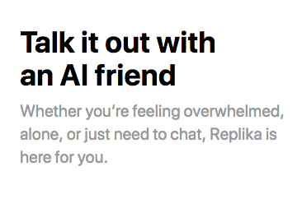
Openness to AI companions
Young people, especially Generation Z, have a much different relationship with technology - digital natives
Childhood exposure to technology, view technology as integral part of their social and academic life
AI companions designed to be non-judgemental and wholly supportive, therefore no need to impress or self-compare

