Slide 2
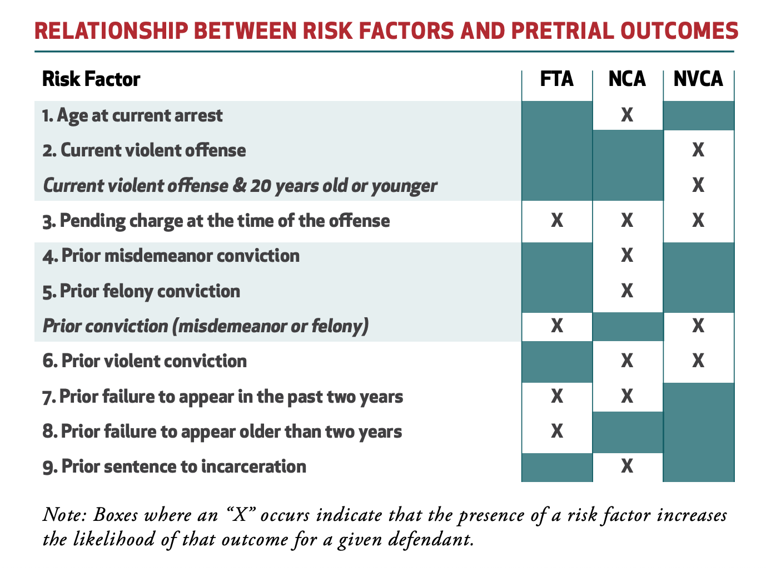
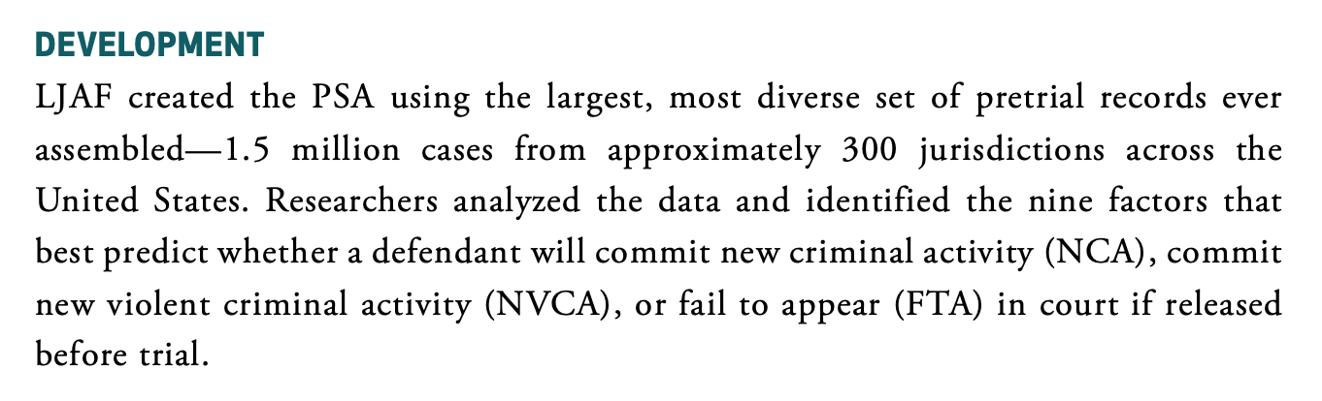
Arnold Foundation PSA

Slide 3
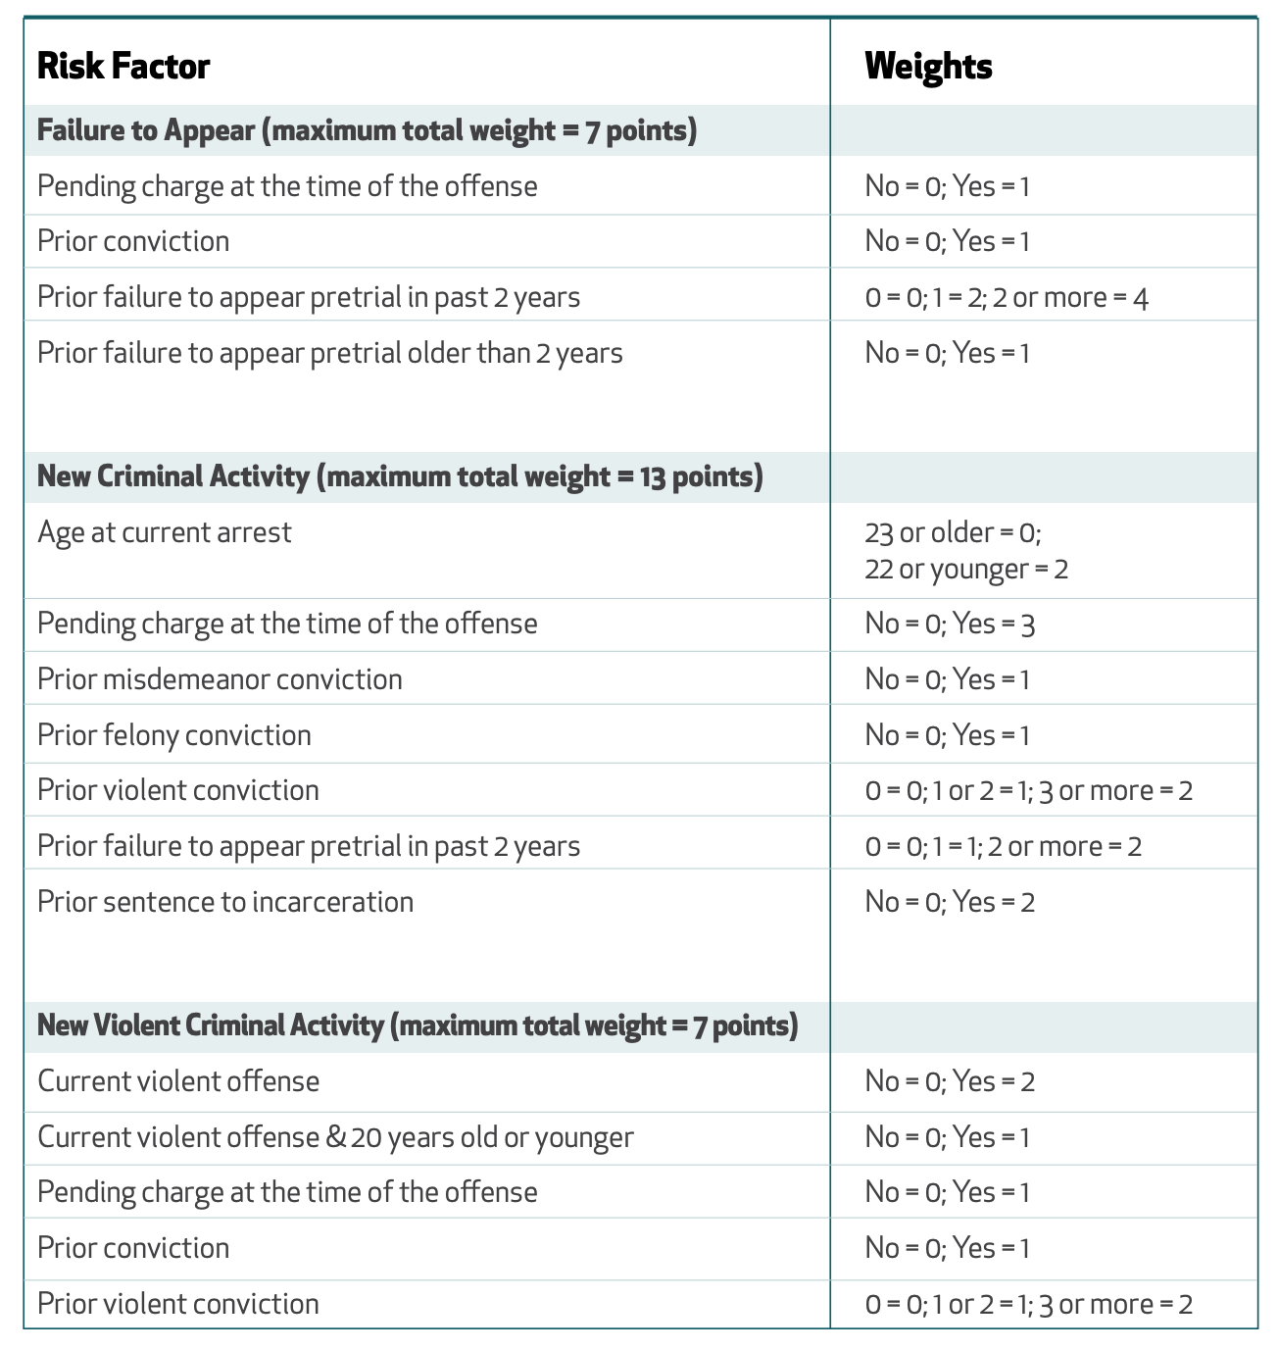
Arnold Foundation PSA

Slide 4
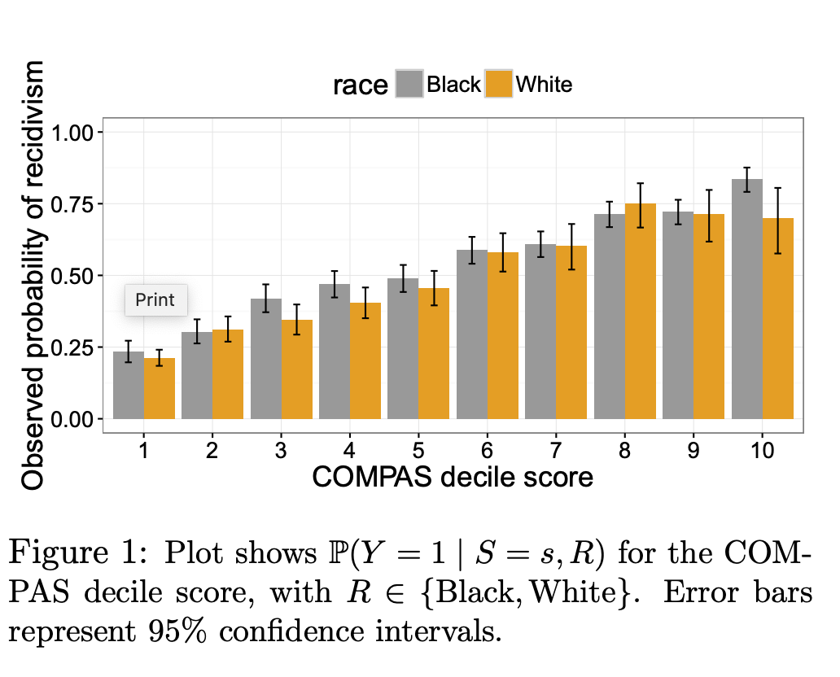
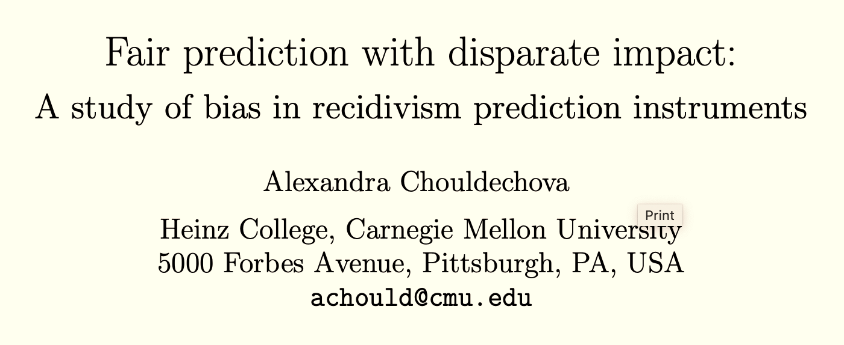
Test-Fairness

Slide 5
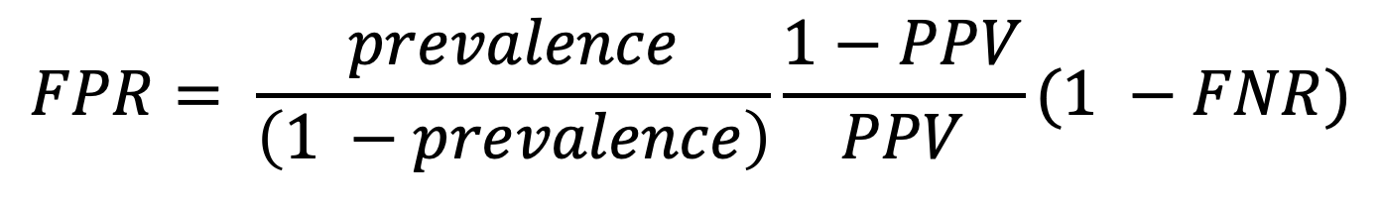
$$FPR= \frac{prevalence}{\left(1 −prevalence\right)}\frac{1−PPV}{PPV}(1 −FNR)$$

