Slide 1



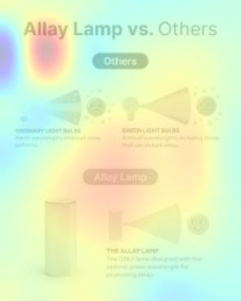







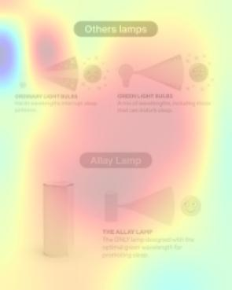




CASE STUDY OVERVIEW
an aiphrodite.ai powered campaign had 58% lower CPC than average campaigns, even during BFCM
Challenge
allay’s marketers were looking for a tool to optimize their creative.
Solution
aiphrodite.ai’s scoring system identified which creative elements in their ads best resonated with their customers.
Result
CPC lowered by 58% and saved an estimated 30% of their ad budget.
aiphrodite.ai pre-flight tests creative assets by simulating your target persona with AI. Instant creative optimization feedback.
allaylamp.com

