Slide 1
Supervised Learning
(Building your first regression and classification model)

Slide 2
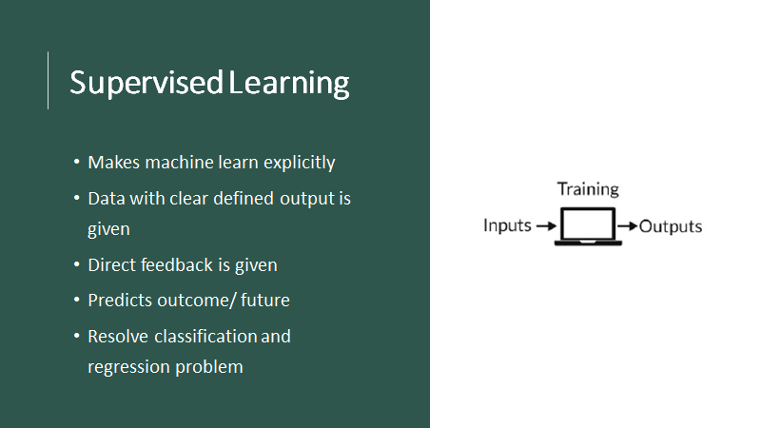

Slide 3
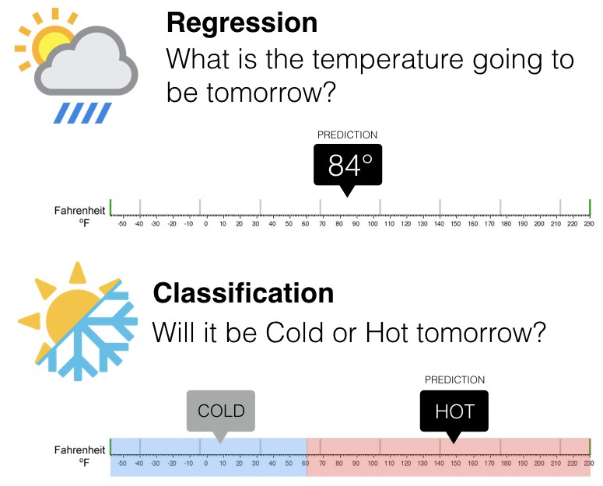
Supervised Learning
Types of Problems
Source: Pinterest

Slide 4
Supervised Learning Examples
Classification:
Classify the outcome
Examples:
  Predict whether a transaction is fraud or not fraud
  Predict whether to give loan or not
  Predict whether to give college admission or not
  Predict the grade (Grade A, B, C, D)
  Note: Classification can be more than two
Regression
Regression is the problem of predicting a continuous outcome (a numeric outcome)
Examples:
  Predict house price
  Predict crime rate

Slide 5
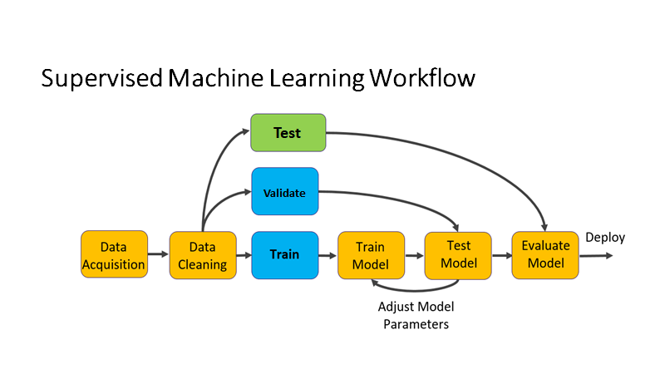
Notes:
We b

Slide 6
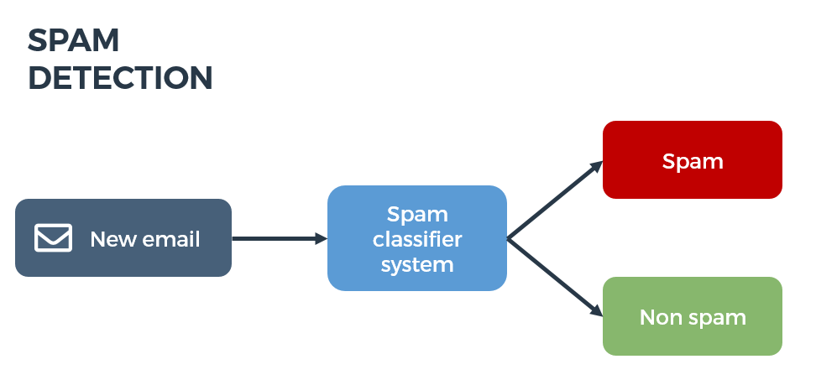
Label/Target Variable
The target variable or label of a dataset is the variable of a dataset about which you want to gain a deeper understanding.
It is the variable that is, or should be the output.
In the example of detecting spam emails, the label will be the category the email belongs to, i.e it will be either ‘spam’ or ‘not spam’.

Slide 7

Predictor/Input Variables/Features
One or more variables that are used to determine (or predict) the 'Target Variable' are known as Input Variables. They are sometimes called Predictor Variable as well.
In the spam detector example, the features could include the following:
  words in the email text
  sender's address
  time of day the email was sent
  email contains the phrase "congrats you won $1 billion - share your bank details."

Slide 8
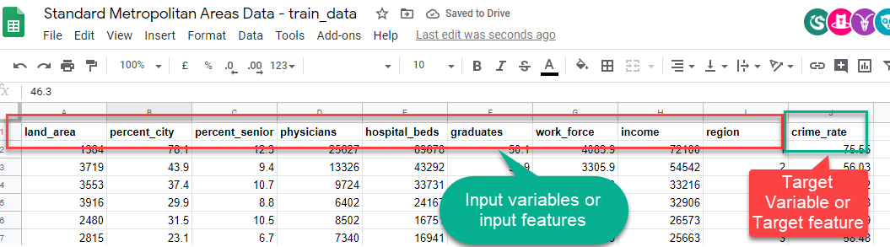
Another Example
Standard Metropolitan Areas Data: In this dataset we might be curious to predict “crime_rate” in future, so that becomes our target and rest of the variables become input variables or features for building a machine learning model.

Slide 9
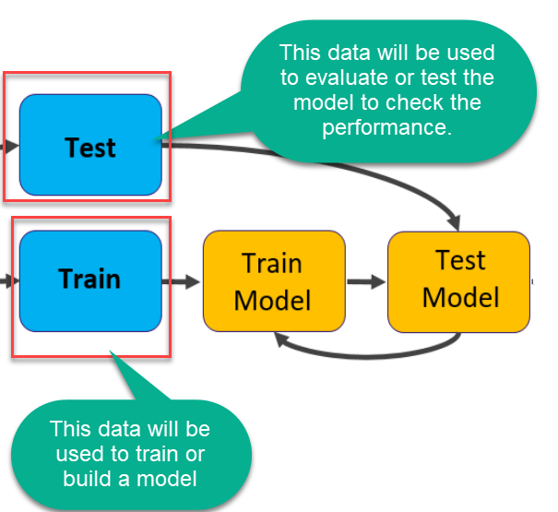
Split the data into train and test
Data

Slide 10
        Let’s dive into the notebook!

