Slide 1
KARNAVATI UNIVERSITY | UNITEDWORLD INSTITUTE OF TECHNOLOGY
SMALL OFFICE NETWORK
DESIGN & SIMULATION
Using VLANs, Inter-VLAN Routing, DHCP and DNS
Presented by: Manav Sarvaiya | KU2407U683
Class: CSE – E | Computer Networks – Semester V

Slide 2
Project Overview
• Build a simulated small-office network in Cisco Packet Tracer.
• Separate Administration, Sales, IT and Guest devices into VLANs.
• Use a router to enable controlled communication between VLANs.
• Use DHCP for automatic IP configuration and DNS for name resolution.

Slide 3
Problem Statement & Objectives
• A flat office LAN can be difficult to organize and manage.
• Create logical departmental separation using VLANs.
• Configure gateways and routing for communication across VLANs.
• Automate host configuration using DHCP.
• Demonstrate DNS resolution for an internal service.

Slide 4
Syllabus Mapping
• Unit I: DNS and network applications.
• Unit III: IP addressing, routing and Dynamic Host Configuration Protocol (DHCP).
• Unit IV: VLANs, switches, MAC addressing and LAN concepts.
• Practical 6: Router as DHCP Server Simulation.
• Practicals 7–8: VLAN implementation and configuration in Cisco Packet Tracer.

Slide 5
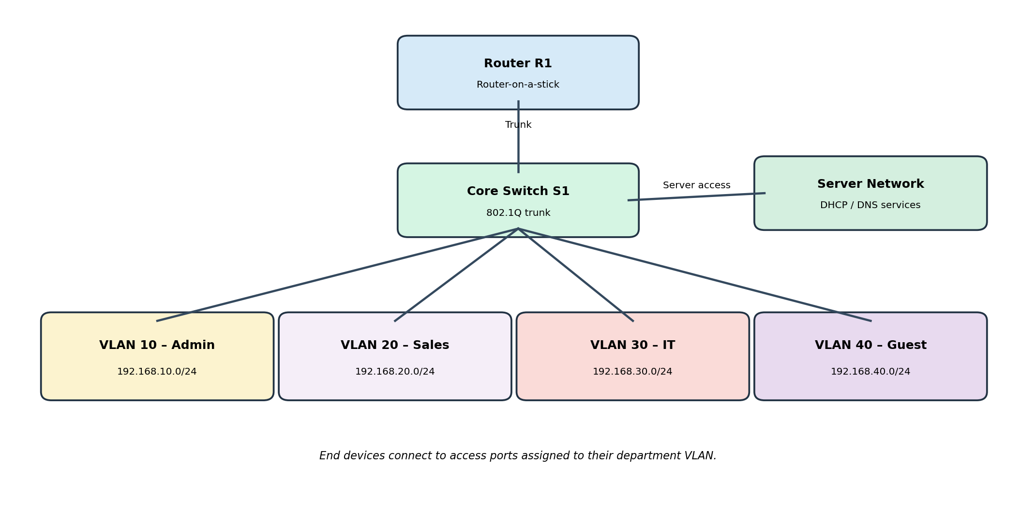
Proposed Network Topology
Logical design of the simulated office network

Slide 6
VLAN & IP Addressing Plan
• VLAN 10 – Administration: 192.168.10.0/24 | Gateway 192.168.10.1
• VLAN 20 – Sales: 192.168.20.0/24 | Gateway 192.168.20.1
• VLAN 30 – IT: 192.168.30.0/24 | Gateway 192.168.30.1
• VLAN 40 – Guest: 192.168.40.0/24 | Gateway 192.168.40.1
• VLAN 50 – Servers: 192.168.50.0/24 | Gateway 192.168.50.1

Slide 7
Key Technologies
• VLAN: creates separate logical Layer 2 broadcast domains.
• 802.1Q trunk: carries traffic for multiple VLANs over one switch-router link.
• Inter-VLAN routing: router subinterfaces act as gateways for each VLAN.
• DHCP: supplies IP address, subnet mask, gateway and DNS settings automatically.
• DNS: maps a domain name such as intranet.office.local to an IP address.

Slide 8
Implementation Workflow
• Place router, managed switch, server and end devices in Packet Tracer.
• Create VLANs and assign switch access ports.
• Configure the switch-router trunk and router subinterfaces.
• Configure DHCP scopes or pools; add DHCP relay if the server is remote.
• Configure DNS service and an A record.
• Set clients to DHCP and verify network services.

Slide 9
Testing & Verification
• Check client IP configuration using DHCP.
• Ping each VLAN’s default gateway.
• Ping between VLANs to verify routing.
• Resolve intranet.office.local to the configured server IP.
• Check VLAN membership and trunk status on the switch.
• Record actual Packet Tracer results and screenshots after implementation.

Slide 10
Expected Outcomes
• Departmental devices are logically separated.
• Clients receive IP settings automatically.
• Inter-VLAN communication works through the router when permitted.
• Internal hostnames resolve through DNS.
• The design provides a scalable foundation for a small office LAN.

Slide 11
Security, Limitations & Future Scope
• Use ACLs or firewall rules to restrict Guest VLAN access.
• A single router and switch are single points of failure.
• The simulation does not measure real-world performance.
• Future scope: redundant devices, wireless LAN, monitoring and stronger access controls.

Slide 12
Conclusion
• The project integrates Application, Network and Link Layer concepts.
• VLANs organize the LAN; routing connects the subnets.
• DHCP simplifies host configuration and DNS simplifies service access.
• Cisco Packet Tracer allows safe configuration and verification before real deployment.

Slide 13
References
1. Kurose, J. F. and Ross, K. W., Computer Networking: A Top-Down Approach.
2. Forouzan, B. A., Data Communications and Networking.
3. Cisco Networking Academy – Packet Tracer: www.netacad.com/courses/packet-tracer
4. Computer Networks syllabus, Unitedworld Institute of Technology, Karnavati University.

