Slide 1
National Mobile Application Trainer and Innovative Application Development Program
Mobile Application Training Program
Topic: Exception Handling

Slide 2
Exception Handling
When a program runs into a runtime error, the program terminates abnormally. How can you handle the runtime error so that the program can continue to run or terminate gracefully? This is the subject we will introduce in this chapter.

Slide 3
Exceptional Event (Exception)
An exception is an event, which occurs during the execution of a program, that disrupts the normal flow of the program's instructions.
When an exceptional condition arises, an object representing that exception is created and thrown in the method that caused the error.
Exceptions can be generated by the Java run-time system, or they can be manually generated by your code.

Slide 4
Exceptions
An exception should be caught and processed, otherwise, the program quits abnormally
Exceptions thrown by JVM relate to fundamental errors that violate the rules of the Java language or the constraints of the Java execution environment
Manually generated exceptions are typically used to report some error condition to the caller of a method.
Java exception handling is managed via five keywords: try, catch, throw, throws, and finally.

Slide 5
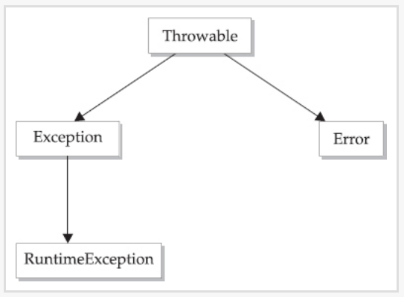
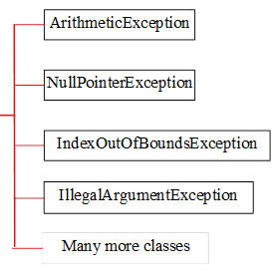
Exception Types
Exception describes errors caused by your program and external circumstances. These errors can be caught and handled by your program.
System errors are thrown by JVM and represented in the Error class. The Error class describes internal system errors. Such errors rarely occur. If one does, there is little you can do beyond notifying the user and trying to terminate the program gracefully.
RuntimeException is caused by programming errors, such as bad casting, accessing an out-of-bounds array, and numeric errors.

Slide 6
Exception-Handling Overview
Public static void test() {
int a = 15, b = 0, c;
c = a/b;
}
Public static void test(){
int a = 15, b = 0, c;
if (b!=0) c = a/b;
}

Slide 7
Catching/Handling Exception
Public static void test() {
int a = 15, b = 0, c;
try {
c = a/b;
} catch (Exception x) {
System.out.println(x);
}
}

Slide 8
Uncaught Exception
Public static void test() {
int a = 15, b = 0, c;
c = a/b;
}
Public static void caller(){
try {
test();
} catch (Exception x) { … … … }
}

Slide 9
Declaring, Throwing, and Catching Exceptions
Public static void test() throws ArithmeticException {
int a = 15, b = 0, c;
if (b==0)
throw new ArithmeticException(“Zero Divisor”);
c = a/b;
}
Public static void caller(){
try {
test();
} catch (Exception x) { … … … }
}

Slide 10
Declaring Exceptions
Every method must state the types of checked exceptions it might throw. This is known as declaring exceptions.
public void myMethod()
throws IOException
public void myMethod()
throws IOException, OtherException

Slide 11
Throwing Exceptions
When the program detects an error, the program can create an instance of an appropriate exception type and throw it. This is known as throwing an exception. Here is an example,
throw new TheException();
TheException ex = new TheException(); throw ex;

Slide 12
Throwing Exceptions Example
/** Set a new radius */
public void setRadius(double newRadius)
throws IllegalArgumentException {
if (newRadius >= 0)
radius = newRadius;
else
throw new IllegalArgumentException(
"Radius cannot be negative");
}

Slide 13
Catching Exceptions
try {
statements; // Statements that may throw exceptions
}
catch (Exception1 exVar1) {
handler for exception1;
}
catch (Exception2 exVar2) {
handler for exception2;
}
...
catch (ExceptionN exVar3) {
handler for exceptionN;
}

Slide 14
Rethrowing Exceptions
try {
statements;
}
catch(TheException ex) {
perform operations before exits;
throw ex;
}

Slide 15
The finally Clause
try {
statements;
}
catch(TheException ex) {
handling ex;
}
finally {
finalStatements;
}

Slide 16
Trace a Program Execution
try {
statement1;
statement2;
statement3;
}
catch(Exception1 ex) {
handling ex;
}
catch(Exception2 ex) {
handling ex;
throw ex;
}
finally {
finalStatements;
}
Next statement;
statement2 throws an exception of type Exception2.

Slide 17
When to Throw Exceptions
An exception occurs in a method. If you want the exception to be processed by its caller, you should create an exception object and throw it. If you can handle the exception in the method where it occurs, there is no need to throw it.

Slide 18
When to Use Exceptions
When should you use the try-catch block in the code? You should use it to deal with unexpected error conditions. Do not use it to deal with simple, expected situations. For example, the following code
try {
System.out.println(refVar.toString());
}
catch (NullPointerException ex) {
System.out.println("refVar is null");
}

Slide 19
When to Use Exceptions
is better to be replaced by
if (refVar != null)
System.out.println(refVar.toString());
else
System.out.println("refVar is null");

Slide 20
Defining Custom Exception Classes
Use the exception classes in the API whenever possible.
Define custom exception classes if the predefined classes are not sufficient.
Define custom exception classes by extending Exception or a subclass of Exception.

Slide 21
// This program creates a custom exception type.
class GreaterThanTenExp extends Exception {
private int detail;
GreaterThanTenExp(int a) {
detail = a;
}
public String toString() {
return “GreaterThanTenExp[" + detail + "]";
}
}
class ExceptionDemo {
static void compute(int a) throws GreaterThanTenExp {
System.out.println("Called compute(" + a + ")");
if(a > 10)
throw new GreaterThanTenExp(a);
System.out.println("Normal exit");
}
public static void main(String args[]) {
try {
compute(1);
compute(20);
} catch (GreaterThanTenExp e) {
System.out.println("Caught " + e);
}
}
}

