Slide 1
EVRC Python Course Training 6: Data Analysis with Pandas
Vaishnavi Karanam, Aaron Rabinowitz

Slide 2
01
PYTHON VS. R FOR DATA ANALYSIS

Slide 3
DESCRIPTION
R
Programming language developed in 1993
For statistical analysis
To be used by statisticians, data miners and analysts
Python
General purpose programming language developed in the late 1980s
Starting to become the most popular programming language

Slide 4
LIBRARIES
R
Data Collection: Rcrawler, readx1, readrl, RCurl
Data Wrangling: dplyr, sqldf, data.table, readr, tidyr
Data Visualizations: ggplot2, ggvis, plotly, Esquisse, Shiny
Python
Data Collection: Pandas, Requests, BeautifulSoup
Data Wrangling: Pandas, NumPy, SciPy
Data Visualizations: Matplotlib, Seaborn, Plotly

Slide 5
CODE
R
Medium difficultly to learn
Difficult to write maintainable, large-scale code
Python
Easy to learn
Easy to write maintainable, large-scale code

Slide 6
SYNTAX
R
library(readr)
data <- read_csv(“path/to/data.csv”)
library(purrr)
library(dplyr)
Data %>%
select_if(is_numeric) %>%
map_db1(mean, na.rm = TRUE)
Python
Import pandas as pd
data = pandas.read_csv(“path/to/data.csv”)
data.mean()

Slide 7
PROS & CONS
R
Pros:
Open Source
Great for statistical analysis
Lots of packages/libraries for data analysis
Cons:
Need to know a lot of libraries
Can be slow because of how R stores data
Cannot be embedded in web apps
Python
Pros:
Open Source
Easy to read
Growing number of libraries
Can be embedded in web apps
Cons:
Uses a large amount of memory – processing can be slow
Sometimes too simple
Libraries for data analysis still being developed
Notes:
Now we’re going to look at the pros and cons of the languages
Starting with R:
It’s open source,
it’s great for statistical analysis,
it has hundreds of packages for data analysis
And it’s very easy to build data visualizations with R
As for the cons,
It can’t be embedded in web apps, apparently for security reasons
You also need to know a large number of packages and libraries, you can’t just use one or two to perform all tasks in a data analysis.
In python, you can use pandas and do a lot of things with just that
Lastly, R can run slow because of how it stores data
Moving onto python
Python is also open-source
It’s easy to read and learn especially if you’re picking it up for the first time
It can be embedded in web applications
And there’s a growing number of libraries for data analysis
For the cons,
The processing speed can be slow depending on the library you use – partially because it uses a lot of memory
It’s simple to learn, but sometimes its too simple to perform certain data analysis tasks whereas R is made to handle such complex data analysis tasks
And lastly, the libraries for different analytical needs are still being developed for python while R already has several data analytics libraries built out

Slide 8
WHICH ONE SHOULD YOU USE?
It depends on individual preferences and project requirements
In general
For purely statistical projects, R is more robust
For machine learning, Python is better
R is harder to learn but has more features for data science
Python is easier to learn, but data science specific packages are still being developed
Dplyr to Pandas Dictionary Coming Soon

Slide 9
02
FUNDAMENTALS OF PANDAS

Slide 10
PANDAS OVERVIEW
Provides data analysis features similar to: R, MATLAB, SAS
Rich data structures and functions to make working with datasets easy and expressive
It is built on top of NumPy
Key components provided by Pandas:
Series
DataFrame

Slide 11
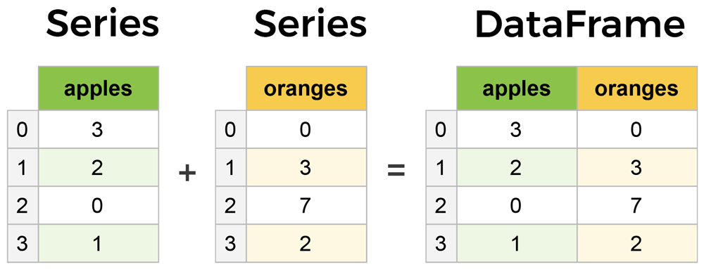
SERIES & DATAFRAMES
The primary two components of pandas are the Series and DataFrame.
Series is a column
DataFrame is a multi-dimensional table made up of a collection of Series
DataFrames and Series are similar in that many operations can be performed on both
A Dataframe is a two-dimensional data structure, i.e., data is aligned in a tabular fashion in rows and columns.
Features of DataFrames:
Columns can be different types
Size – Mutable
Labeled axes (rows and columns)
Can perform arithmetic operations
on rows and columns
columns
Buses
Trains
Buses
Trains
rows

Slide 12
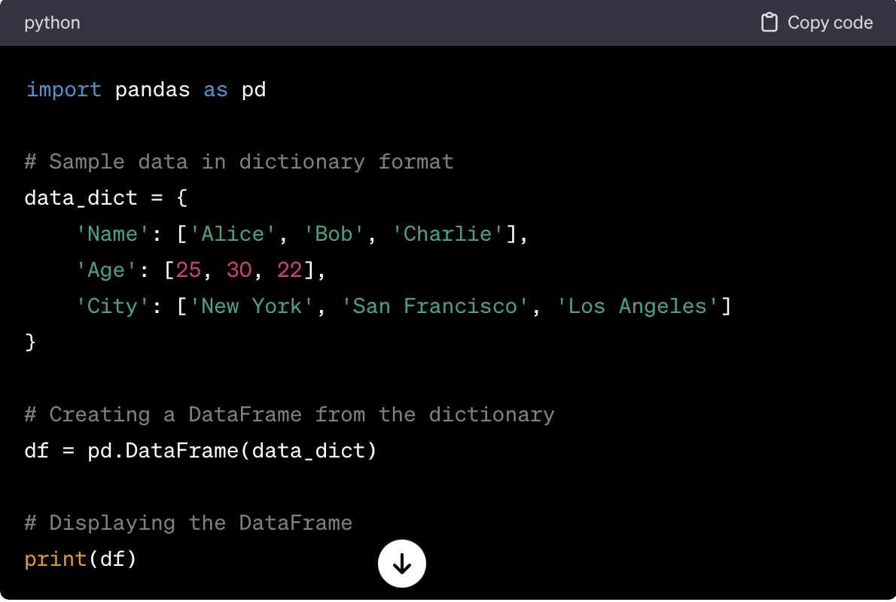
pandas.DataFrame
pandas.DataFrame(data, index , columns , dtype , copy )
data: data takes various forms like ndarray, series, map, lists, dict, constants and also another DataFrame.
index: For the row labels, that are to be used for the resulting frame, Optional, Default is np.arrange(n)if no index is passed.
columns: For column labels, the optional default syntax is - np.arrange(n). This is only true if no index is passed.
dtype: Data type of each column.
copy: This command (or whatever it is) is used for copying of data, if the default is False.

Slide 13
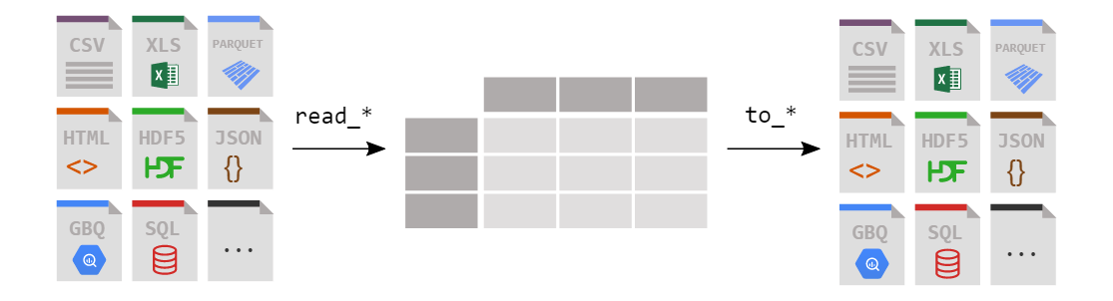
DATAFRAMES FROM FILES
Read
Write

Slide 14
PRACTICUM: TRANSPORTATION WORK MODE CHOICE DATASET
Download: transportation_work_mode_choice.csv
Data on the mode of transportation to work for California, its regions, counties, cities/towns, and census tracts
Data from the U.S. Census Bureau, Decennial Census and American Community Survey.

Slide 15
INSTALL PANDAS
Open up your terminal program (shell or cmd) and install it using either of the following commands:
For jupyter notebook users, you can run this cell:
To import pandas we usually import it with a shorter name since it's used so much:
$ conda install pandas
OR
$ pip install pandas
!pip install pandas
import pandas as pd

Slide 16
THANKS

