Slide 1

CEC Charger Reliability Study Economics
Aaron Rabinowitz
2/7/2024

Slide 2
Routing Methodology
Overview
Goal is to minimize the cost of the project by computing optimal routes which minimize for time
Less time is less student pay
Less time is less car rental expense
Less time is less operational expenditure
Routing is accomplished by solving Non-Homogenous Fleet Capacitated Vehicle Routing Problem (NHFCVRP)
Chargers are destinations to be visited
EVRC + overnight stay locations are depots
Fleet size is reflected in vehicle days (each itinerary is treated as an independent vehicle)
NHFCVRP is solved using the Clarke-Wright savings method and solution is refined via Simulated Annealing
In line with current operations planning

Slide 3
Routing Methodology
Constraints
There are three types of route - short, regular, and long to accomodate student schedules as possible
Short routes:
Distance is less than vehicle range
Time is less than 4 hours (testing included)
Must visit at least two stations*
Medium routes
Distance is less than vehicle range
Time is less than 8 hours (testing included)
Must visit at least two stations*
Long routes
Time is less than 20 hours (testing included)
Chargers in close proximity to depots neglected unless unreached
For all routes, in order to enable testing, no leg can be less than 20 km
*This is done to aviod skewing the economics presented later - many 1 station routes are possible for short and medium routes but should be avoided as they are very inefficient and, instead, be included in longer routes

Slide 4
Routing Methodology
Testing time
The basic assumption is that a given plug-in test takes a given amount of time
Values are in 5, 10, or 15 minutes per plug-in test (effects will be shown)
For a full slate of 4 DC and 2 AC chargers that would be 30, 60, or 90 minutes at one station
The testers may also have to wait in a queue to use a charger
Expected queue wait time is modeled using queuing theory with exponential distributions
Expected arrival frequency is sampled randomly from separate distributions for urban and rural chargers
Expected service time per vehicle is 40 minutes for DC chargers and randomly sampled between 1 and 8 hours for AC chargers
The number of servers is modeled as the listed number of chargers
Note that, at this stage all are assumed to be functional - could be adjusted
In general, this model may be adjusted as more information comes in, it is likely an underestimate because of the functionality assumption

Slide 5
Routing Methodology
Operational Concept
The following process will be carried out iteratively until the project is complete
Optimal routes are computed for remaining chargers at midnight (takes about 1 minute)
Students check out a route based on vehicle and time allowance
Students go out and test (will not always follow route)
Students mark off visited stations
It is not possible to know, a priori how students will allocate their time, half-day routes can be scheduled easier but, eventually, will no longer be possible as the close-by chargers are exhausted.
The assumption is that selection of route duration is random. All route durations are equally likely.
The economics of routes will, thus be considered by duration category in the following slides

Slide 6
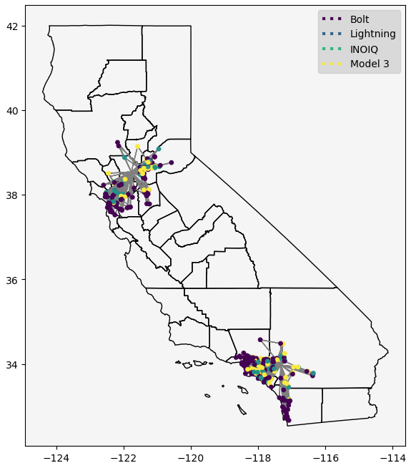
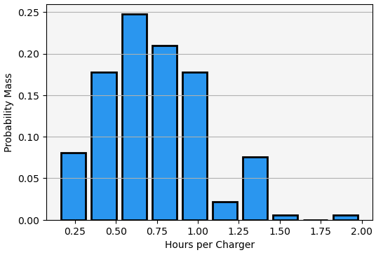
Routing Economics
Short Routes and Short Testing Duration (SRST)
190 routes
807 stations (4.25 per route)
1,079 chargers (5.77 per route)
633 person-hours (0.78 per station, 0.59 per charger)

Slide 7
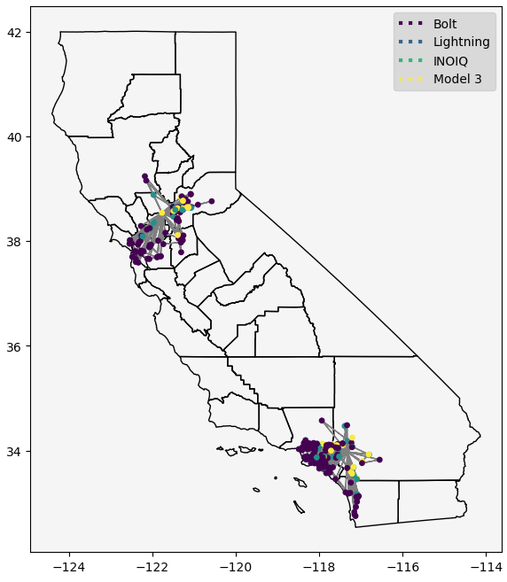
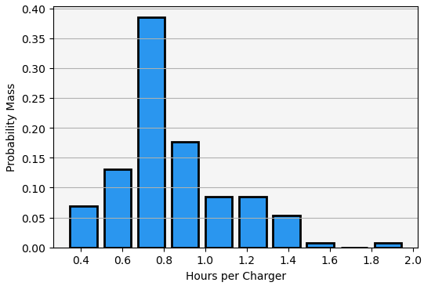
Routing Economics
Short Routes and Medium Testing Duration (SRMT)
130 routes
534 stations (4.11 per route)
578 chargers (4.45 per route)
454 person-hours (0.85 per station, 0.78 per charger)

Slide 8
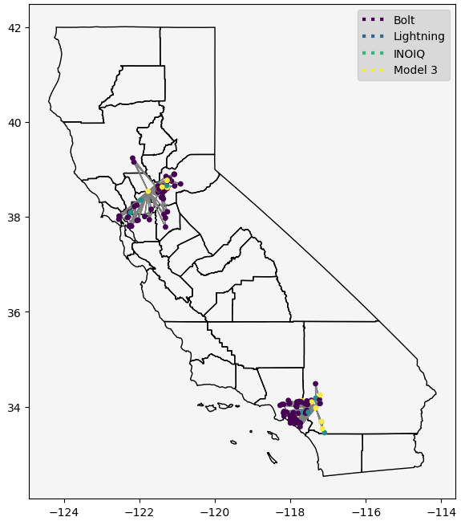
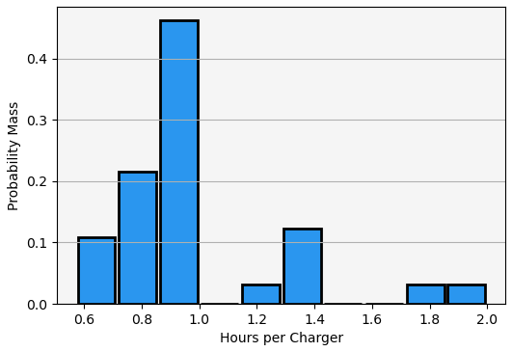
Routing Economics
Short Routes and Long Testing Duration (SRLT)
65 routes
253 stations (3.89 per route)
261 chargers (4.02 per route)
236 person-hours (0.93 per station, 0.91 per charger)

Slide 9
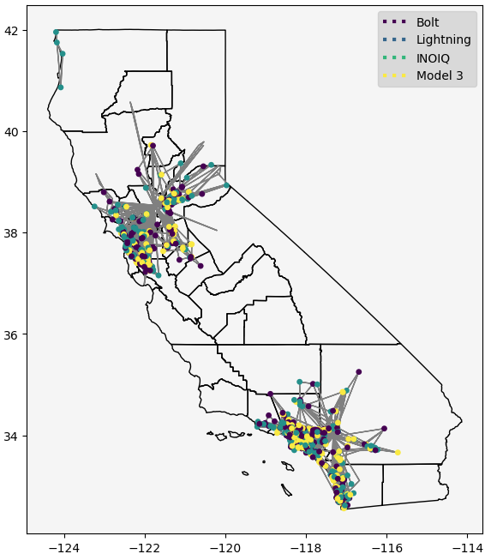
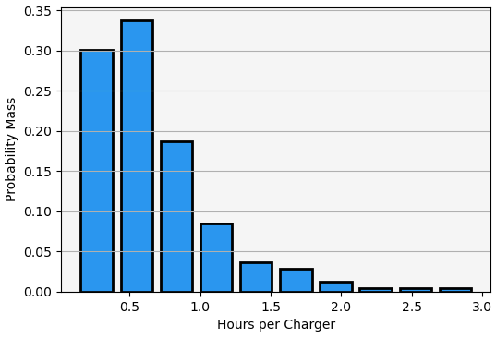
Routing Economics
Medium Routes and Short Testing Duration (MRST)
246 routes
1,612 stations (6.55 per route)
3,813 chargers (15.50 per route)
1,653 person-hours (1.03 per station, 0.43 per charger)

Slide 10
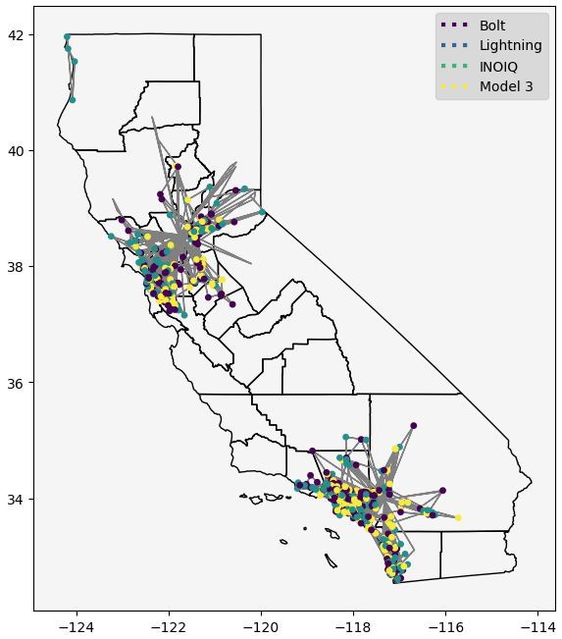
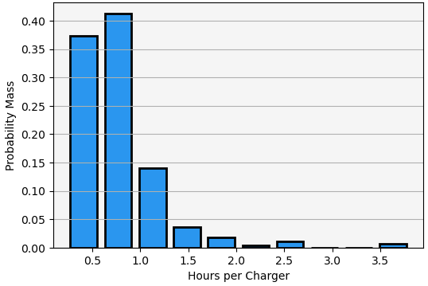
Routing Economics
Medium Routes and Medium Testing Duration (MRMT)
279 routes
1,664 stations (5.96 per route)
3,385 chargers (12.13 per route)
1,989 person-hours (1.20 per station, 0.59 per charger)

Slide 11
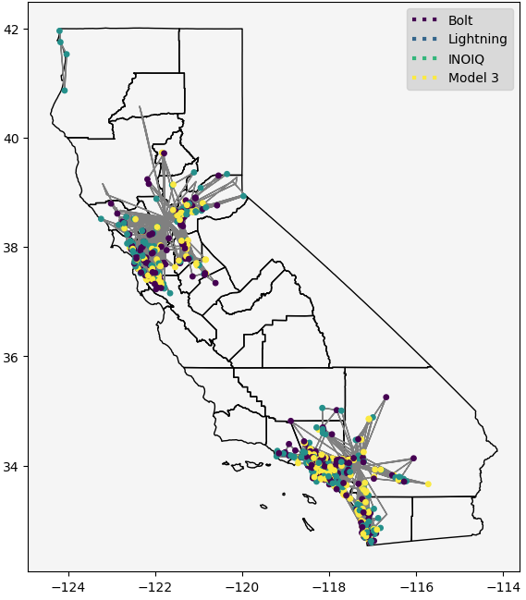
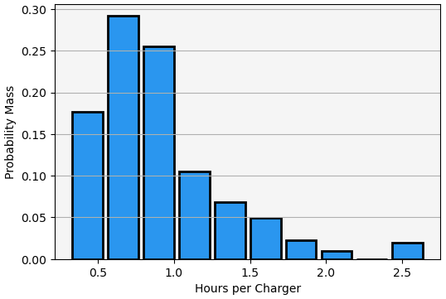
Routing Economics
Medium Routes and Long Testing Duration (MRLT)
305 routes
1,690 stations (5.54 per route)
2,983 chargers (9.78 per route)
2,236 person-hours (1.32 per station, 0.75 per charger)

Slide 12
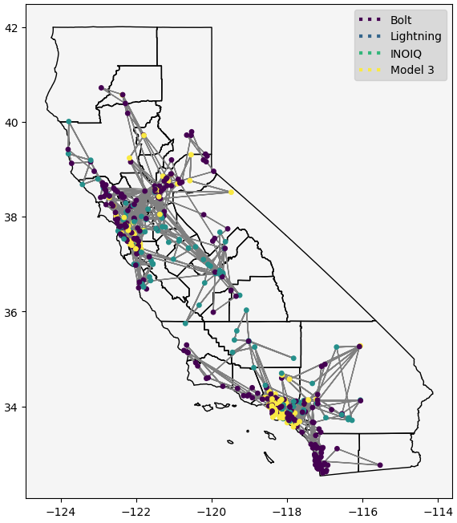
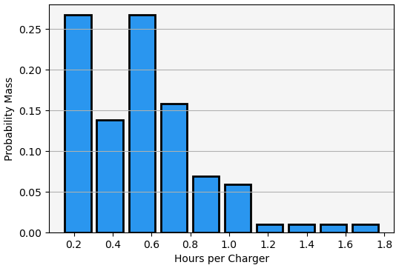
Routing Economics
Long Routes and Short Testing Duration (LRST)
102 routes
1,565 stations (15.34 per route)
4,839 chargers (47.44 per route)
1,881 person-hours (1.20 per station, 0.39 per charger)

Slide 13
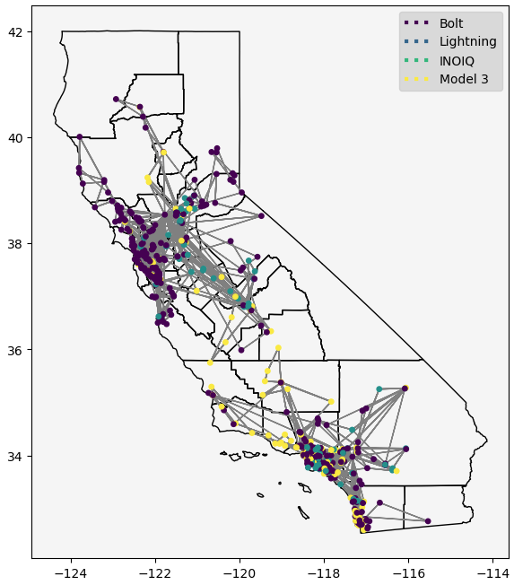
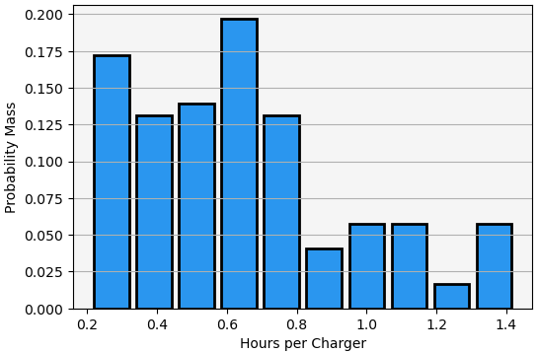
Routing Economics
Long Routes and Medium Testing Duration (LRMT)
122 routes
1,600 stations (13.11 per route)
4,492 chargers (36.82 per route)
2,289 person-hours (1.43 per station, 0.51 per charger)

Slide 14
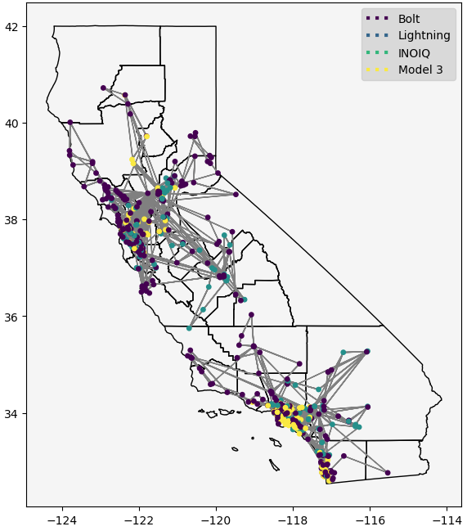
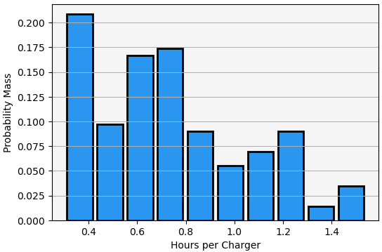
Routing Economics
Long Routes and Long Testing Duration (LRLT)
144 routes
1,636 stations (11.36 per route)
4,404 chargers (30.58 per route)
2,708 person-hours (1.65 per station, 061 per charger)

Slide 15
Routing Economics
Cost Structure
Car Rentals:
$79,839 over 3 years
$26,613 per year
$19,960 per car
$6,635 per car-year
Salaries:
$20 per tester-hour
Hotels:
$120 - $275 per tester-night (assume $200)
Per-Diems:
$79 per tester-day
Energy Cost:
$0.50 - $0.72 per kWh
All costs expected to rise in years 2 and 3
Max Route Duration | Dollars per Work Hour Without Non-UCD Depots | Dollars per Work Hour With Non-UCD Depots
4 Hour | 40 | 109.75
8 Hour | 40 | 74.875
16 Hour | 84.75 | 84.75
24 Hour | 84.75 | 84.75

Slide 16
Routing Economics
Cost Structure
Car Rentals (Vehicular):
$79,839 over 3 years
$26,613 per year
$19,960 per car
$6,635 per car-year
Salaries (Personnel):
$20 per tester-hour
Hotels (Personnel):
$120 - $275 per tester-night (assume $200)
Per-Diems (Personnel):
$79 per tester-day
Energy Cost (Operational):
$0.50 - $0.72 per kWh
All costs expected to rise in years 2 and 3
Max Route Duration | Personnel Costs per Work Hour (Single Day) | Personnel Costs per Work Hour (Overnight)
4 Hour | 40 | 109.75
8 Hour | 40 | 74.875
16 Hour | 84.75 | 84.75
24 Hour | 84.75 | 84.75

Slide 17
Routing Economics
Expected Test Costs (Non-UCD Depot Hotels Not Included)
Route Duration | Test Duration | Mean Hours per Charger Test | Mean Dollars per Charger Test | Mean Dollars per Charger Test * 3600
Short (< 4 hours) | Short (5 minutes) | 0.59 | 23.33 | 83,980
Short (< 4 hours) | Medium (10 minutes) | 0.78 | 29.79 | 107,256
Short (< 4 hours) | Long (15 minutes) | 0.93 | 34.90 | 125,632
Medium (< 8 hours) | Short (5 minutes) | 0.43 | 17.88 | 64,378
Medium (< 8 hours) | Medium (10 minutes) | 0.59 | 23.33 | 83,980
Medium (< 8 hours) | Long (15 minutes) | 0.75 | 28.77 | 103,581
Long (< 20 hours) | Short (5 minutes) | 0.39* | 30.48** | 109,741**
Long (< 20 hours) | Medium (10 minutes) | 0.51* | 38.86** | 139,908**
Long (< 20 hours) | Long (15 minutes) | 0.61* | 45.85** | 165,047**
* Working hours only
** Includes two hotel rooms and per-diems

Slide 18
Routing Economics
Expected Test Costs (Non-UCD Depot Hotels Included)
Route Duration | Test Duration | Mean Hours per Charger Test | Mean Dollars per Charger Test | Mean Dollars per Charger Test * 3600
Short (< 4 hours) | Short (5 minutes) | 0.59 | 64.48 | 232,129
Short (< 4 hours) | Medium (10 minutes) | 0.78 | 84.20 | 303,114
Short (< 4 hours) | Long (15 minutes) | 0.93 | 99.77 | 359,155
Medium (< 8 hours) | Short (5 minutes) | 0.43 | 32.88 | 118,365
Medium (< 8 hours) | Medium (10 minutes) | 0.59 | 43.90 | 158,054
Medium (< 8 hours) | Long (15 minutes) | 0.75 | 54.93 | 197.744
Long (< 20 hours) | Short (5 minutes) | 0.39* | 30.48** | 109,741**
Long (< 20 hours) | Medium (10 minutes) | 0.51* | 38.86** | 139,908**
Long (< 20 hours) | Long (15 minutes) | 0.61* | 45.85** | 165,047**
* Working hours only
** Includes two hotel rooms and per-diems

Slide 19
Routing Economics
Paths to 3,600 Tests Without Inflation (Random Selection)
Test Duration | Chargers Tested on Short Routes | Chargers Tested on Medium Routes | Chargers Tested on Long Routes | Expected Testing Cost
Short (5 minutes) | 1,079 | 1,900 | 621 | 78,073
Medium (10 minutes) | 578 | 2,273 | 749 | 99,354
Long (15 minutes) | 261 | 2,530 | 809 | 118,990
Without non-UCD Depot Hotels
Test Duration | Chargers Tested on Short Routes | Chargers Tested on Medium Routes | Chargers Tested on Long Routes | Expected Testing Cost
Short (5 minutes) | 1,079 | 1,900 | 621 | 150,974
Medium (10 minutes) | 578 | 2,273 | 749 | 177,588
Long (15 minutes) | 261 | 2,530 | 809 | 202,105
With non-UCD Depot Hotels

Slide 20
Routing Methodology
Operational Concept - Ordered Durations
The following process will be carried out iteratively until the project is complete
Optimal routes are computed for remaining chargers at midnight (takes about 1 minute)
Students check out a route based on vehicle and time allowance
Students go out and test (will not always follow route)
Students mark off visited stations
It is not possible to know, a priori how students will allocate their time, half-day routes can be scheduled easier but, eventually, will no longer be possible as the close-by chargers are exhausted.
The assumption is that selection of route duration is ordered - short reoute are exhausted, then medium, then long.
The economics of routes will, thus be considered by duration category in the following slides

Slide 21
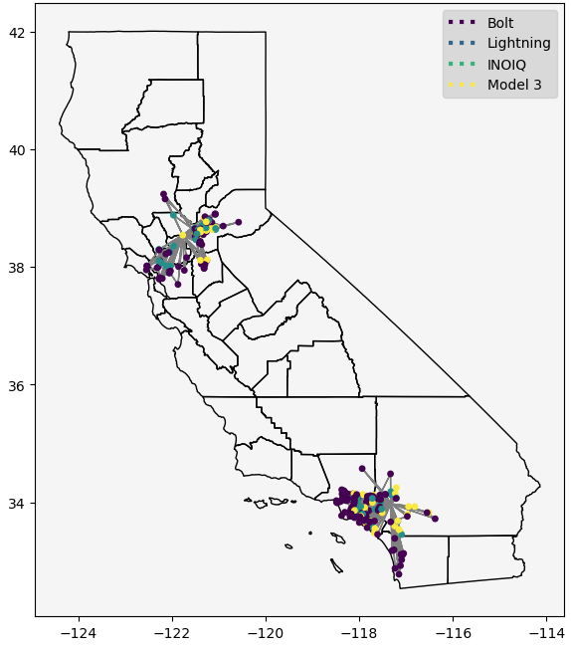
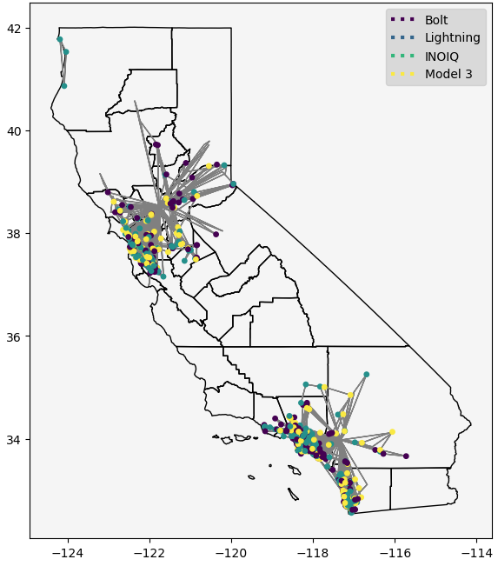
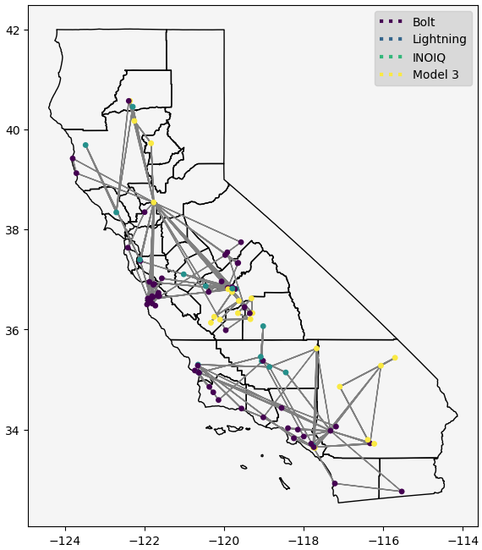
Routing Methodology
Operational Concept - Ordered Durations
Random Duration Selection
Longer duration routes are less efficient under the ordered duration selection assumption because depot-proximate chargers are known to be tested.
Ordered Duration Selection
Short Routes
Medium Routes
Long Routes

Slide 22
Routing Economics
Expected Test Costs (Non-UCD Depot Hotels Not Included)
Route Duration | Test Duration | Mean Hours per Charger Test | Mean Dollars per Charger Test | Mean Dollars per Charger Test * 3600
Short (< 4 hours) | Short (5 minutes) | 0.59 | 23.33 | 83,980
Short (< 4 hours) | Medium (10 minutes) | 0.78 | 29.79 | 107,256
Short (< 4 hours) | Long (15 minutes) | 0.93 | 34.90 | 125,632
Medium (< 8 hours) | Short (5 minutes) | 0.45 | 18.56 | 66,829
Medium (< 8 hours) | Medium (10 minutes) | 0.61 | 24.01 | 86,430
Medium (< 8 hours) | Long (15 minutes) | 0.78 | 29.79 | 107,256
Long (< 20 hours) | Short (5 minutes) | 0.76* | 56.32** | 202,755**
Long (< 20 hours) | Medium (10 minutes) | 0.66* | 49.34** | 177,616**
Long (< 20 hours) | Long (15 minutes) | 0.65* | 48.64** | 175,102**
* Working hours only
** Includes two hotel rooms and per-diems

Slide 23
Routing Economics
Expected Test Costs (Non-UCD Depot Hotels Included)
Route Duration | Test Duration | Mean Hours per Charger Test | Mean Dollars per Charger Test | Mean Dollars per Charger Test * 3600
Short (< 4 hours) | Short (5 minutes) | 0.59 | 64.48 | 232,129
Short (< 4 hours) | Medium (10 minutes) | 0.78 | 84.20 | 303,114
Short (< 4 hours) | Long (15 minutes) | 0.93 | 99.77 | 359,155
Medium (< 8 hours) | Short (5 minutes) | 0.45 | 34.26 | 123,326
Medium (< 8 hours) | Medium (10 minutes) | 0.61 | 45.28 | 163,015
Medium (< 8 hours) | Long (15 minutes) | 0.78 | 57.00 | 205,185
Long (< 20 hours) | Short (5 minutes) | 0.76* | 56.32** | 202,755**
Long (< 20 hours) | Medium (10 minutes) | 0.66* | 49.34** | 177,616**
Long (< 20 hours) | Long (15 minutes) | 0.65* | 48.64** | 175,102**
* Working hours only
** Includes two hotel rooms and per-diems

Slide 24
Routing Economics
Paths to 3,600 Tests Without Inflation (Ordered Selection)
Test Duration | Chargers Tested on Short Routes | Chargers Tested on Medium Routes | Chargers Tested on Long Routes | Expected Testing Cost
Short (5 minutes) | 1,079 | 2,521 | 0 | 71,963
Medium (10 minutes) | 578 | 1,417 | 1,605 | 130,431
Long (15 minutes) | 261 | 1,559 | 1,780 | 140,131
Without non-UCD Depot Hotels
Test Duration | Chargers Tested on Short Routes | Chargers Tested on Medium Routes | Chargers Tested on Long Routes | Expected Testing Cost
Short (5 minutes) | 1,079 | 2,521 | 0 | 155,943
Medium (10 minutes) | 578 | 1,417 | 1,605 | 192,020
Long (15 minutes) | 261 | 1,559 | 1,780 | 201,482
With non-UCD Depot Hotels

Slide 25
Routing Economics
Takeaways
Ignoring inflation, testing likely to cost in 150,000 - 200,000 range
Value of UC Riverside / Humboltd depots are huge
Ordered scheduling likely to contribute to higher costs
Selecting chargers closer to depots will reduce project cost
Limitations:
Inflation not included
Queuing downside risk - this may be significant as it may cause testers to cut routes short
No value-of-information directly computed for this
Time lost due to traffic - may also be significant
Future steps:
Direct cost minimization in route generation
Risk tolerance based route assignment

Slide 26

Q & A

