Slide 1

CEC Charger Reliability Study Economics
Aaron Rabinowitz
1/11/2024

Slide 2
Routing Methodology
Overview
Goal is to minimize the cost of the project by computing optimal routes which minimize for time
Less time is less student pay
Less time is less car rental expense
Less time is less operational expenditure
Routing is accomplished by solving Non-Homogenous Fleet Capacitated Vehicle Routing Problem (NHFCVRP)
Chargers are destinations to be visited
EVRC + overnight stay locations are depots
Fleet size is reflected in vehicle days (each itinerary is treated as an independent vehicle)
NHFCVRP is solved using the Clarke-Wright savings method and solution is refined via Simulated Annealing
In line with current operations planning

Slide 3
Routing Methodology
Constraints
There are three types of route - short, regular, and long to accomodate student schedules as possible
Short routes:
Distance is less than vehicle range
Time is less than 4 hours (testing included)
Must visit at least two stations*
Medium routes
Distance is less than vehicle range
Time is less than 8 hours (testing included)
Must visit at least two stations*
Long routes
Time is less than 20 hours (testing included)
Chargers in close proximity to depots neglected unless unreached
For all routes, in order to enable testing, no leg can be less than 20 km
*This is done to aviod skewing the economics presented later - many 1 station routes are possible for short and medium routes but should be avoided as they are very inefficient and, instead, be included in longer routes

Slide 4
Routing Methodology
Testing time
The basic assumption is that a given plug-in test takes a given amount of time
Values are in 5, 10, or 15 minutes per plug-in test (effects will be shown)
For a full slate of 4 DC and 2 AC chargers that would be 30, 60, or 90 minutes at one station
The testers may also have to wait in a queue to use a charger
Expected queue wait time is modeled using queuing theory with exponential distributions
Expected arrival frequency is sampled randomly from separate distributions for urban and rural chargers
Expected service time per vehicle is 40 minutes for DC chargers and randomly sampled between 1 and 8 hours for AC chargers
The number of servers is modeled as the listed number of chargers
Note that, at this stage all are assumed to be functional - could be adjusted
In general, this model may be adjusted as more information comes in, it is likely an underestimate because of the functionality assumption

Slide 5
Routing Methodology
Operational Concept
The following process will be carried out iteratively until the project is complete
Optimal routes are computed for remaining chargers at midnight (takes about 1 minute)
Students check out a route based on vehicle and time allowance
Students go out and test
Students mark off visited stations
It is not possible to know, a priori how students will allocate their time, half-day routes can be scheduled easier but, eventually, will no longer be possible as the close-by chargers are exhausted.
The economics of routes will, thus be considered by duration category in the following slides

Slide 6
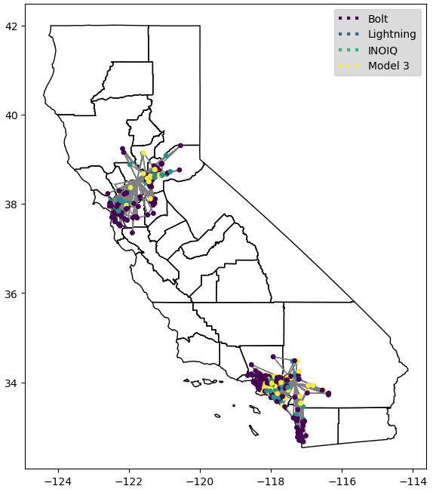
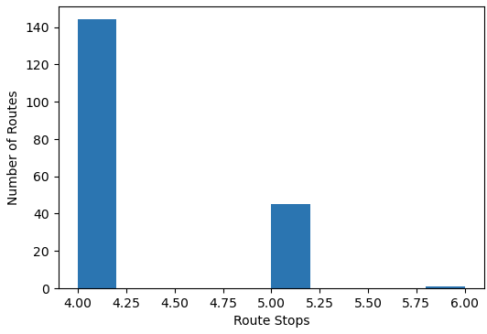
Routing Economics
Short Routes and Short Testing Duration (SRST)
190 routes
807 stations (4.25 per route)
1,079 chargers (5.77 per route)
633 person-hours (0.78 per station, 0.59 per charger)

Slide 7
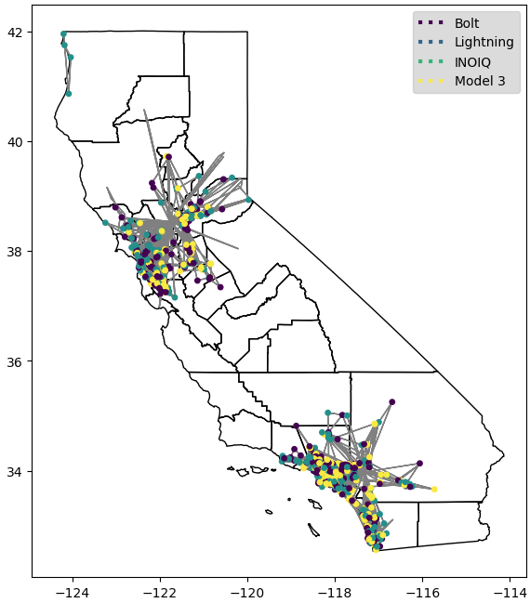
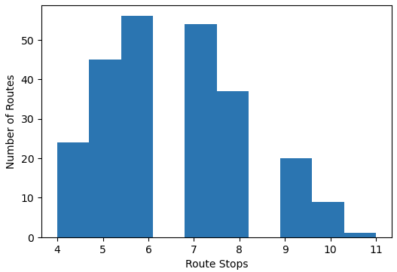
Routing Economics
Medium Routes and Short Testing Duration (SRST)
246 routes
1,612 stations (6.55 per route)
3,813 chargers (15.50 per route)
1,653 person-hours (1.03 per station, 0.43 per charger)

Slide 8
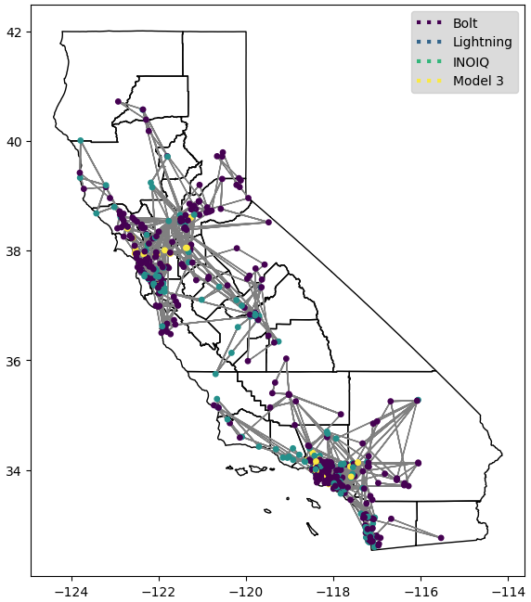
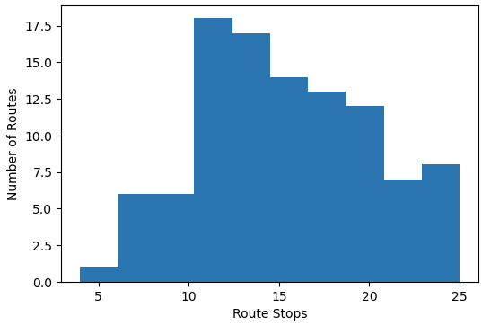
Routing Economics
Long Routes and Short Testing Duration (SRST)
102 routes
1,565 stations (15.34 per route)
4,839 chargers (47.44 per route)
1,881 person-hours (1.20 per station, 0.39 per charger)

Slide 9
Routing Economics
Long Routes and Short Testing Duration (SRST)
Route Duration | Test Duration | Hours per Charger Test | Dollars per Charger Test
Short | Short | 0.59
Short | Medium
Short | Long
Medium | Short | 0.43
Medium | Medium
Medium | Long
Long | Short | 0.39*
Long | Medium
Long | Long

Slide 10
Routing Economics
Takeaways
Longer routes are more efficient on a per-charger basis

Slide 11

Q & A

