Slide 1
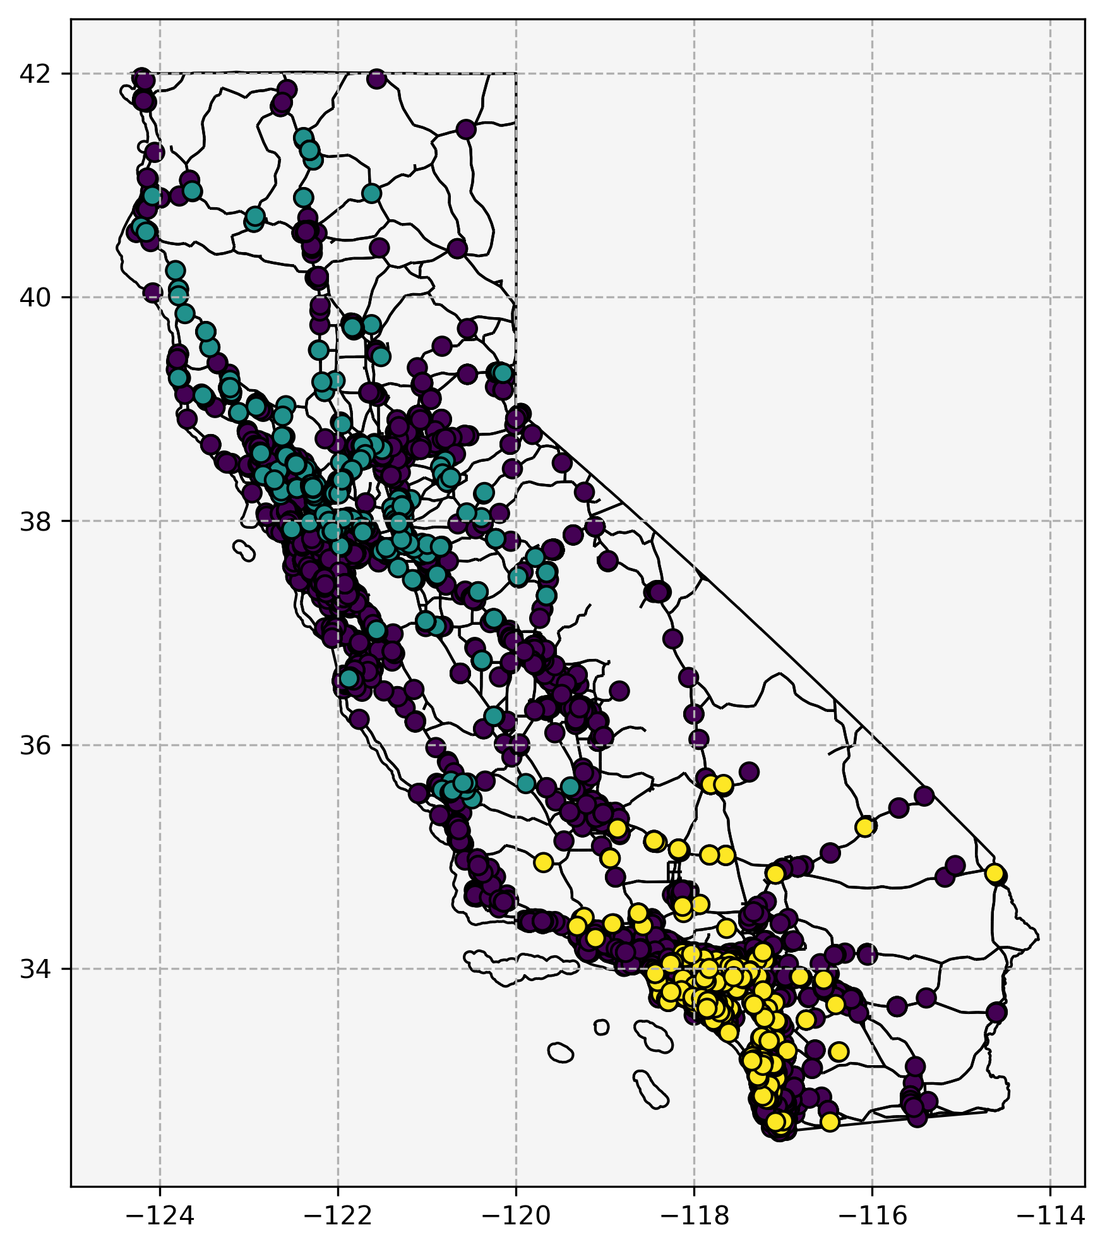
New Sampling Logic:
Goal - select the best stations for routing in order to minimize total hours.
Limitation - Computationally intractable to co-optimize sampling and routing and probably not really worth the effort/computational load as compared to the heuristic approach below
Approach - minimize distance to assigned depot while meeting group minimum counts
Groups - defined by region, network, DAC/LIC status, URB/RUR status, and AC/DC. e.g. (Los Angeles, Tesla, True, URB, AC)
Assignments for Davis/Irvine depots shown
Green - Davis - 578 Total
Yellow - Irvine - 1045 Total
Purple - Not Selected
Notes:
Most testing has been around Davis so the area is somewhat depleted compared to Irvine
This technique introduces a “proximity-to-depot” bias that was not present with random sampling. Not sure if this is a problem.

