Slide 1

Multi-Threading
Asynchronous Programming

Slide 2
Definitions
Program
  A set of instructions written in a programming language (source code) that is translated into a compiled binary file or interpreted, enabling it to be executed by the computer.
Process
  An instance of a program that is being executed, including its code, data, and allocated system resources.
Thread
  The smallest unit of execution within a process that carries out tasks independently.
Multi-Thread
  The ability of a process to run multiple threads simultaneously to perform concurrent tasks.
Async Programming
  A programming model that enables Tasks to run independently without blocking the main thread, improving responsiveness.
The study of Operating Systems is the discipline that explores foundational concepts like user interface, processes, threads, and resource management, as it deals with the design and functioning of systems that manage computer hardware and software.
The Operating System (OS) is the responsible to mange the Process, Threads, and Tasks execution.

Slide 3
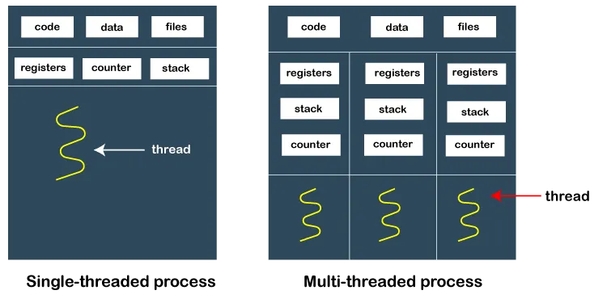
Process & Thread

Slide 4
Challenges and Pitfalls in Asynchronous Programming
Race Conditions
  Occurs when multiple async operations access and modify shared data simultaneously.
  Example: Two tasks checking and incrementing the same counter might produce inconsistent results.
Deadlocks
  Happens when two or more tasks wait indefinitely for each other to release a resource.
  Example: Task A locks Resource X and waits for Resource Y, while Task B locks Resource Y and waits for Resource X.
Callback Hell
  Excessive nesting of callbacks makes code hard to read and maintain.
  Example: Async function calling another async function, deeply nested.
Context Switching Overhead
  Frequent task switching can reduce performance instead of improving it.
  Example: Overusing async tasks for CPU-bound operations can lead to inefficiency.
Debugging Complexity
  Tracing issues in async code is harder due to non-linear execution order.
  Mitigation: Use structured logging, proper error handling, debugging tools.
Improper Exception Handling
  Unhandled exceptions in async tasks can be lost or cause unexpected behavior.
  Mitigation: Always handle exceptions, use proper try/catch in async functions.

Slide 5
Race Condition
...
if (sharedVariable < 10) {
DoSomething(….); // OS puts to sleep
SharedVariable++;
} ...
temp = counter;
temp = temp + 1;
counter = temp;
Low level
Thread 1
Thread 2
Thread 3
Thread N
9
9
9
9
10
10
9
10
10

Slide 6
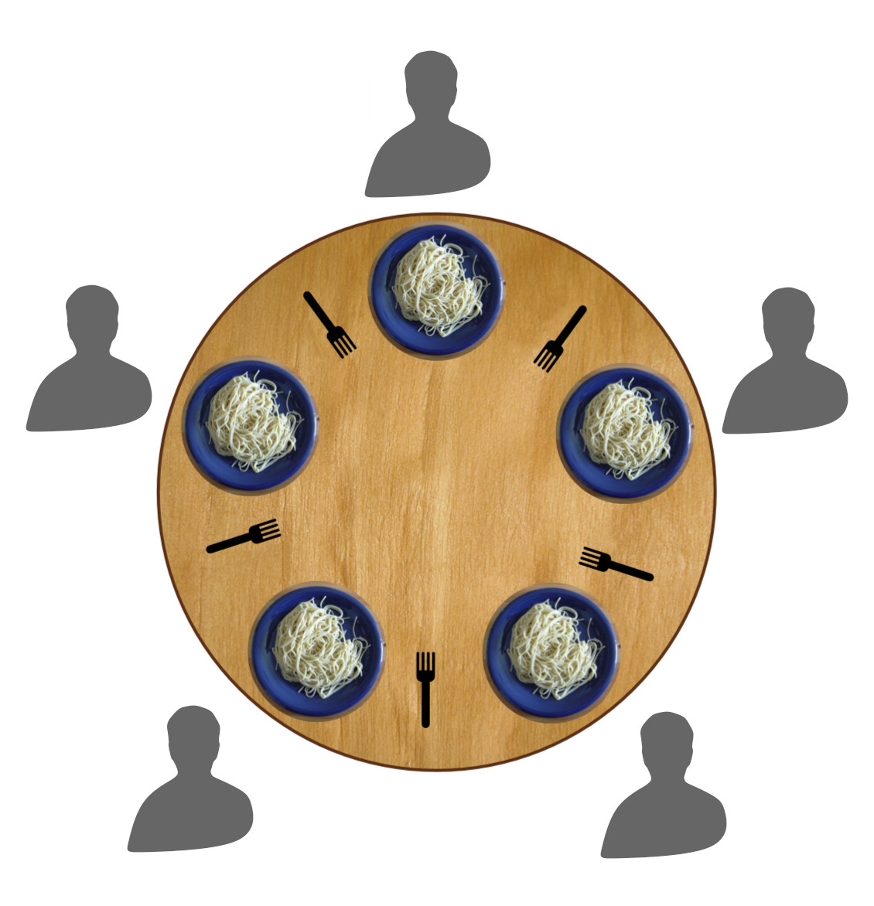
Deadlock
Dinning Philosophers: Two forks required to eat

