Slide 1

Learning Coding
With Python

Slide 2
Overview
- Empower every person to be able to code
- Material prepared on the go
- Light Material focused of demonstration and practices
- Aiming to be a live book
- Not just a Kotlin course. Concepts can be applied to any language
- Software Engineering basic concepts overviews
- Some tips about the area, interviewing and best practices
- Focused on fundamentals and essential concepts
- Skip some complex and not so common features
- Not easy, but I will simplify as much as possible
- Need to focus, review and practices
- Lots of practices, exercises and homework's
- Analogy with a gym :)

Slide 3
Course Details
URL: http://codelearn.live
Repository: https://github.com/airamez/learn-coding-python
Every Tuesdays and Thursdays at 8pm PST
Kotlin as programming language
VS Code as IDE
Focus on fundamentals and practices
Light material and heavy on demos and explanations
Goal is to cover all content necessary to prepare a Junior Computer Programmer
At least 600 hours to cover the basics: 300 hours of class + 300 hours of practices

Slide 4
Ongoing course in Portuguese
I already have a coding course
Playlist: http://codando.live
Repository: https://github.com/airamez/IntroToCode_CSharp01
C# as programming language
VS Code as IDE
I speak in Portuguese

Slide 5
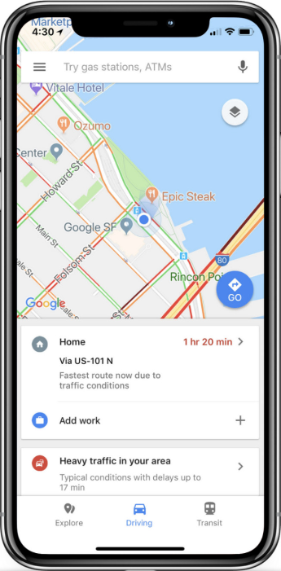
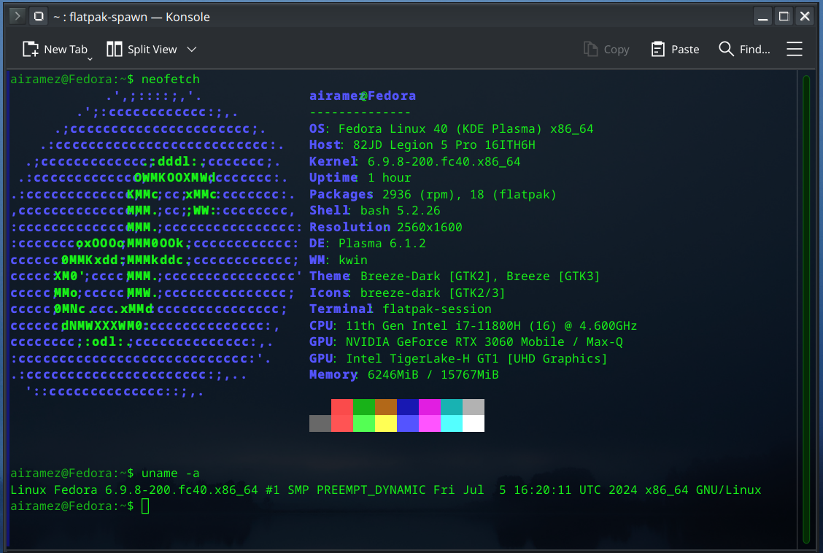
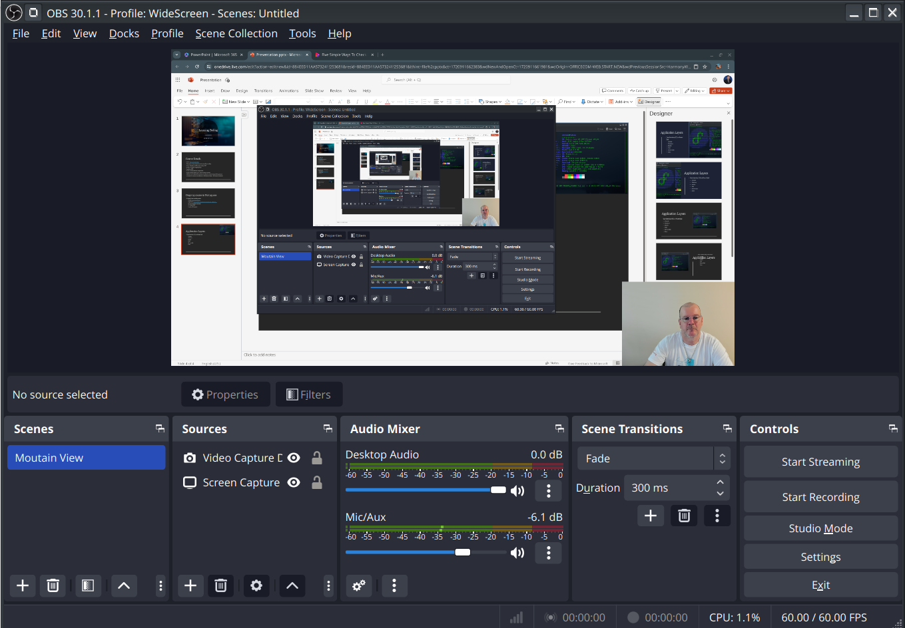

Application Layers
User Interface (UI) or Front-End
Console
Desktop
Mobile
Web
Server-Side
Data

Slide 6
Data Processing Model
Input (data)
Processing
Output (information)

Slide 7
Algorithm x Program
Algorithm: An algorithm is a step-by-step procedure or a set of rules to solve a specific problem or accomplish a certain task in computing. It’s like a recipe that describes the exact steps needed for a computer to solve a problem or reach a goal.
Program: A program, also known as software, is a set of instructions written in a programming language that is used to control the behavior of a machine, often a computer. In essence, a program tells the computer what to do and how to do it.
A program has to be translate before it can be executed
Program source => Compiler => Executable code (machine language)

Slide 8
Finding the maximum number in a list
Algorithm
Set the maximum to the first number in the list.
For each number in the list:
If the current number is greater than the maximum, update the maximum with the current number.
The maximum is the largest number in the list.
List: 50, 30, 10, 55, 15, 80, 75, 35, 40, 90, 15, 10
Max:?

Slide 9
Python
Kotlin
def find_maximum(numbers): maximum = numbers[0] for num in numbers: if num > maximum: maximum = num return maximum
numbers = [50,30,10,55,15,80,75,35,40,90,15,10] print(find_maximum(numbers))
fun findMaximum(numbers: List<Int>): Int {
var maximum = numbers[0]
for (num in numbers) {
if (num > maximum) {
maximum = num
}
}
return maximum
}
fun main() {
val numbers = listOf(50,30,10,55,15,80,75,35,40,90,15,10)
println(findMaximum(numbers)) // Output: 9
}

Slide 10
C#
Java
public class Program {
static int findMaximum(int[] numbers) {
int maximum = numbers[0];
for (int num : numbers) {
if (num > maximum) {
maximum = num;
}
}
return maximum;
}
public static void main(String[] args) {
int[] numbers = {50,30,10,55,15,80,75,35,40,90,15,10};
System.out.println(findMaximum(numbers));
}
}
public class Program {
static int FindMaximum(int[] numbers) {
int maximum = numbers[0];
foreach (int num in numbers) {
if (num > maximum) {
maximum = num;
}
}
return maximum;
}
public static void Main() {
int[] numbers ={50,30,10,55,15,80,75,35,40,90,15,10};
Console.WriteLine(FindMaximum(numbers));
}
}

Slide 11
Assembly x86
.continue:
loop .loop
; Print the maximum number
mov eax, 4
mov ebx, 1
mov ecx, maximum
mov edx, 1
int 0x80
; Exit the program
mov eax, 1
xor ebx, ebx
int 0x80
section .data
numbers db 50,30,10,55,15,80,75,35,40,90,15,10
size equ $-numbers
maximum db 0
section .text
global _start
_start:
; Initialize maximum to the first number
mov al, [numbers]
mov [maximum], al
; Loop through each number in the array
mov ecx, size
mov esi, numbers
.loop:
lodsb
cmp al, [maximum]
jle .continue
mov [maximum], al

Slide 12
Machine language
01010100 01101111 01110010 01101001 00101101 01100001 01101110 01100100 01101111 00101101 01110011 01101111 01101110 01100101 00101101 01101111 01101110 01100101 00101101 01101111 01101110 01100101 00101101 01101111 01101110 01100101 00101101 01101111 01101110 01100101 01101111 01101110 01100101 00101101 01101111 01101110 01100101 00101101 01101111 01101110 01100101 00101101 01101111 01101110 01100101 01101111 01101110 01100101 00101101 01101111 01101110 01100101 00101101 01101111 01101110 01100101 00101101 01101111 01101110 01100101 01101111 01101110 01100101 00101101 01101111 01101110 01100101 00101101 01101111 01101110
01100101 00101101 01101111 01101110 01100101 01101111 01101110 01100101 00101101 01101111 01101110 01100101 00101101 01101111 01101110 01100101 00101101 01101111 01101110 01100101 01101111 01101110 01100101 00101101 01101111 01101110 01100101 00101101 01101111 01101110 01100101 00101101 01101111 01101110 01100101 01101111 01101110 01100101 00101101 01101111 01101110 01100101 00101101 01101111 01101110 01100101 00101101 01101111 01101110 01100101 01101111 01101110 01100101 00101101 01101111 01101110 01100101 00101101 01101111 01101110

