Slide 1
Analyzing Multi-Head Self-Attention: Specialized Heads Do the Heavy Lifting, the Rest Can Be Pruned
Jagruti Airao (202211031)
Pranshu Parate(202211063)
Naila Nausin(202211064)

Slide 2
Motivation
The authors aim to investigate the importance of individual attention heads in encoder to the overall performance of the model and analyze the roles played by them.
Performance of the model with 8 heads is almost 1 BLEU point higher than that of a model of the same size with single-head attention
Previous analysis of multi-head attention considered the average of attention weights over all heads at a given position or focused only on the maximum attention weights

Slide 3
Problem Formulation
Analyzing the role and significance of different attention heads in multi-head self-attention mechanisms.
The authors investigate the attention matrices of the heads and categorize them into three types: positional heads, syntactic heads, and heads that point to rare words in the sentence.
The goal is to understand the contribution of different attention heads and determine if some heads can be pruned without significantly affecting the performance of the model.

Slide 4
Approach: 1. Identifying Important Heads:
“Confidence” of head is defined as the average of its maximum attention weight excluding the end of sentence symbol, where average is taken over tokens in a set of sentences used for evaluation (development set).
LRP to evaluate the degree to which different heads at each layer contribute to the top-1 logit predicted by the model.

Slide 5
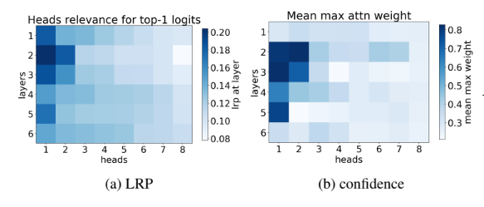

Slide 6
2. Characterizing Heads
Positional Head: A head is referred as “positional” if at least 90% of the time its maximum attention weight is assigned to a specific relative position (in practice either -1 or +1, i.e. attention to adjacent tokens).
Syntactic Heads: the Transformer’s encoder may be responsible for disambiguating the syntactic structure of the source sentence. We therefore wish to know whether a head attends to tokens corresponding to any of the major syntactic relations in a sentence. The evaluation metric used is referred to as "accuracy." For each attention head, the accuracy is calculated based on how often it assigns its maximum attention weight to a token involved in a specific dependency relation. The evaluation considers both directions of the dependency relation. a head is “syntactic” if its accuracy is at least 10% higher than the baseline that looks at the most frequent relative position for this dependency relation.

Slide 7
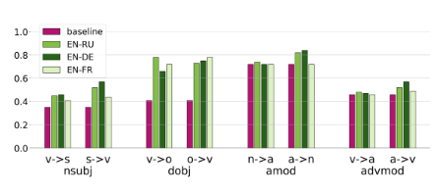

Slide 8
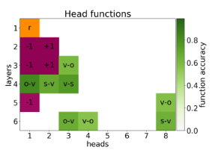
3. Rare words
One head in the first layer is judged to be much more important to the model’s predictions than any other heads in this layer.
This head points to the least frequent tokens in a sentence.

Slide 9



3. Pruning Attention Heads
gi are parameters specific to heads and are independent of the input (i.e. the sentence).
The Hard Concrete distributions is a parameterized family of mixed discrete-continuous distributions over the closed interval [0, 1]. The distributions have non-zero probability mass at 0 and 1, P(gi = 0|φi) and P(gi = 1|φi), where φi are the distribution parameters.

Slide 10
Dataset Description:
WMT Parallel Multilingual Corpus
Overview: Transformer machine translation models are trained using a carefully selected set of parallel sentence pairs called the WMT Multilingual Parallel Corpus. It comprises translations into three target languages—French, German, and Russian—with an emphasis on English as the source language.
Contents:
Languages:
[Source] English
(Target) Russian
(Target) German
(Target) French
For every language combination, there are 2.5 million parallel phrase pairs in the data.
An extra fifty thousand English sentences for assessment (WMT EN-FR).

Slide 11
Dataset Description:
A sizable compilation of television and film subtitles from the OpenSubtitles platform is known as the OpenSubtitles 2018 corpus. A service called OpenSubtitles offers multilingual subtitles for a large selection of films and TV series. Subtitles from this platform are extracted and aggregated to build the OpenSubtitles2018 corpus.
Among the OpenSubtitles 2018 corpus salient characteristics are:
Content: It includes subtitles for a wide variety of films and TV shows. For a variety of natural language processing applications, such as machine translation, this makes it an invaluable tool.
Multilingual: The subtitles are accessible in a number of languages, which reflects the international and multilingual scope of the films and television programmes they cover.
Size: The corpus offers a significant amount of parallel text data and is quite large.

Slide 12
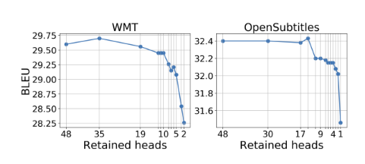
Results: Pruning Encoder Heads

Slide 13
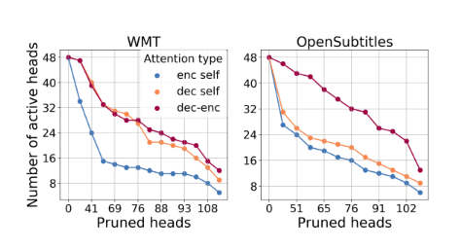
Pruning all types of attention heads

Slide 14
CONCLUSION:
• Only a small subset of heads are important for translation;
Important heads have one or more specialized and interpretable functions in the model;
• Our novel pruning method removes the vast majority of heads without seriously affecting performance.

Slide 15
References
Sebastian Bach, Alexander Binder, Grégoire Montavon, Frederick Klauschen, Klaus-Robert Müller, and Wojciech Samek. 2015. On pixel-wise explanations for non-linear classifier decisions by layer-wise relevance propagation. PloS one, 10(7):e0130140.
Anthony Bau, Yonatan Belinkov, Hassan Sajjad, Nadir Durrani, Fahim Dalvi, and James Glass. 2019. Identifying and controlling important neurons in neural machine translation. In International Conference on Learning Representations, New Orleans.
Yonatan Belinkov, Nadir Durrani, Fahim Dalvi, Hassan Sajjad, and James Glass. 2017a. What do neural machine translation models learn about morphology? In Proceedings of the 55th Annual Meeting of the Association for Computational Linguistics (Volume 1: Long Papers), pages 861–872. Association for Computational Linguistics.

Slide 16
References
Arianna Bisazza and Clara Tump. 2018. The lazy encoder: A fine-grained analysis of the role of morphology in neural machine translation. In Proceedings of the 2018 Conference on Empirical Methods in Natural Language Processing, pages 2871–2876, Brussels, Belgium. Association for Computational Linguistics.
Ondˇrej Bojar, Christian Federmann, Mark Fishel, Yvette Graham, Barry Haddow, Matthias Huck, Philipp Koehn, and Christof Monz. 2018. Findings of the 2018 conference on machine translation (wmt18). In Proceedings of the Third Conference on Machine Translation, Volume 2: Shared Task Papers, pages 272–307, Belgium, Brussels. Association for Computational Linguistics.
Fahim Dalvi, Nadir Durrani, Hassan Sajjad, Yonatan Belinkov, and Stephan Vogel. 2017. Understanding and improving morphological learning in the neural machine translation decoder. In Proceedings of the Eighth International Joint Conference on Natural Language Processing (Volume 1: Long Papers), pages 142–151. Asian Federation of Natural Language Processing

Slide 17


