Slide 1
FoodCode
Schrodinger’s Cat

Slide 2
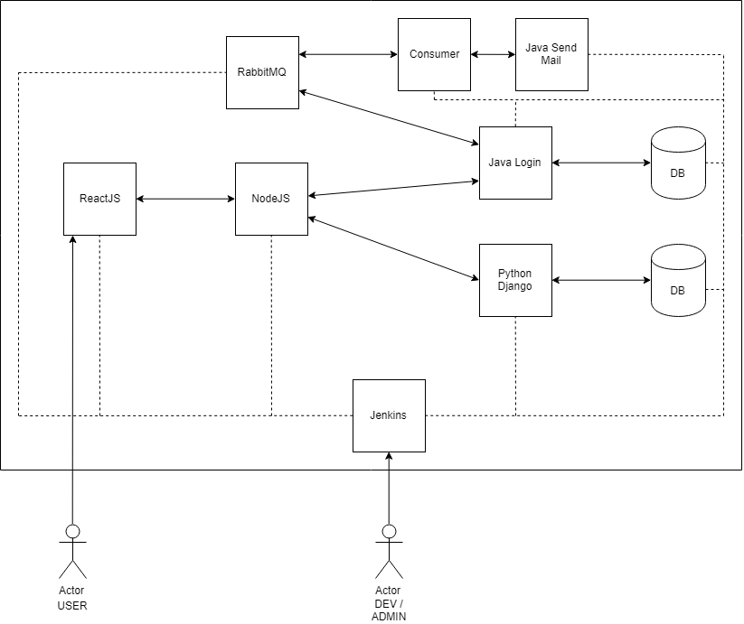
Architecture

Slide 3
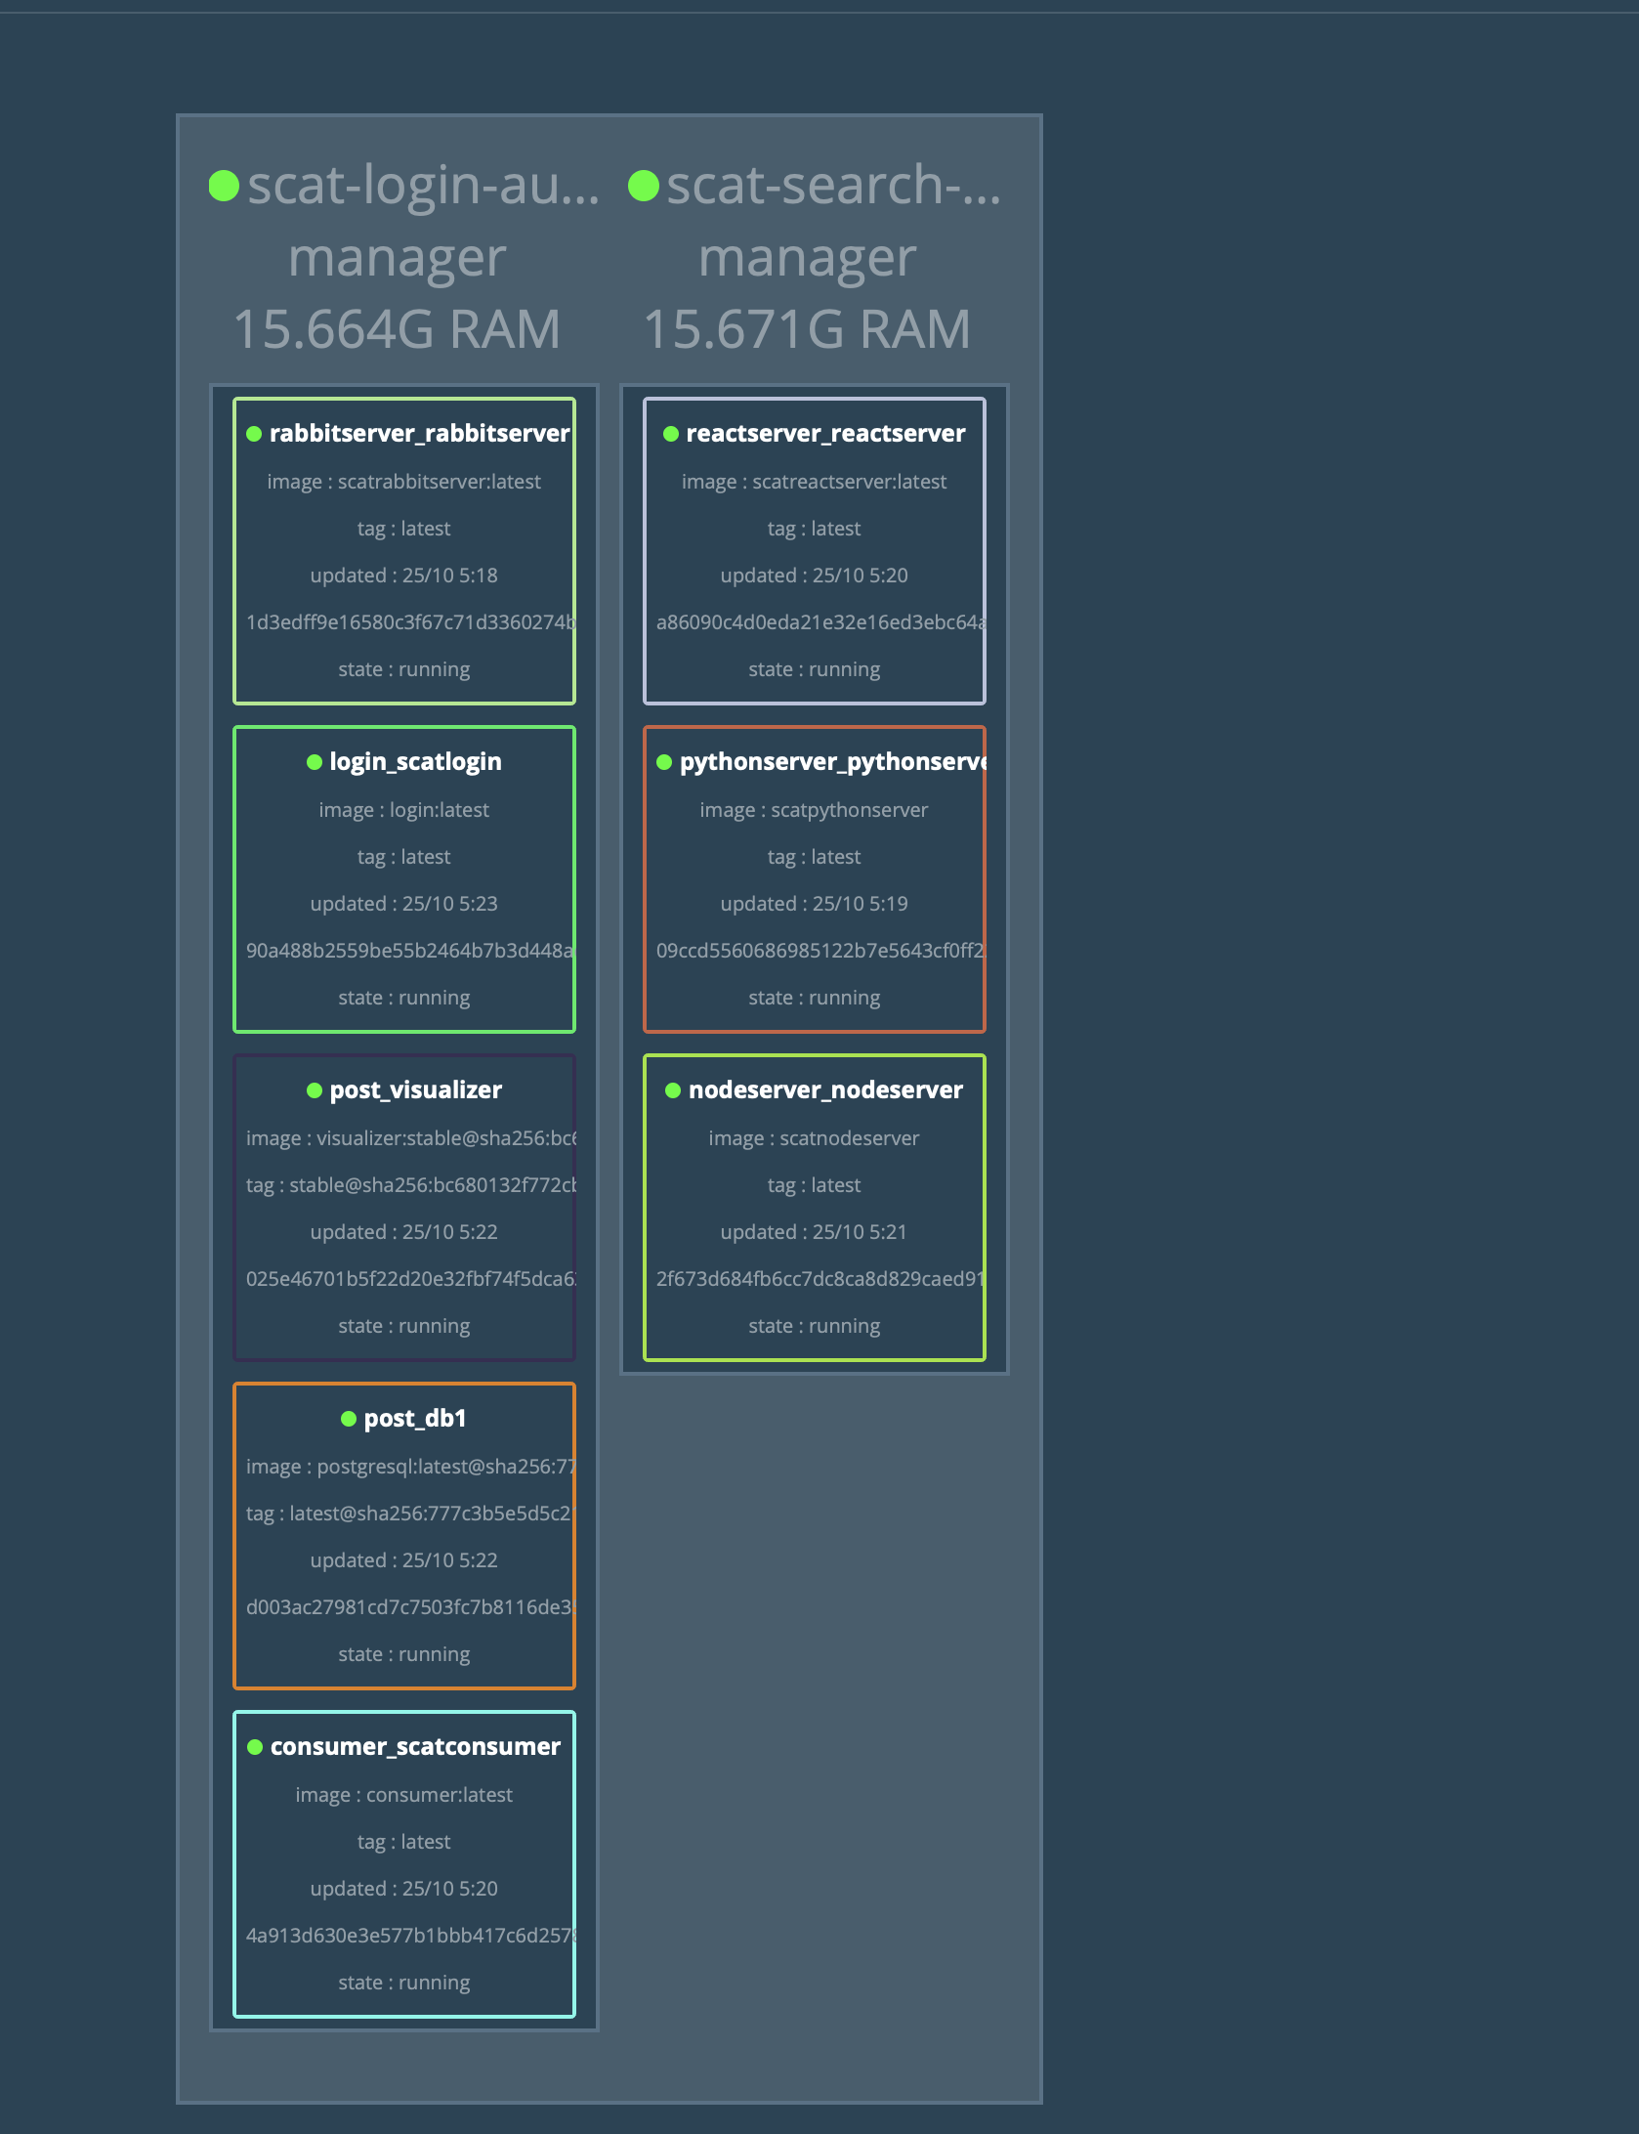
Overview of Swarm Cluster

Slide 4
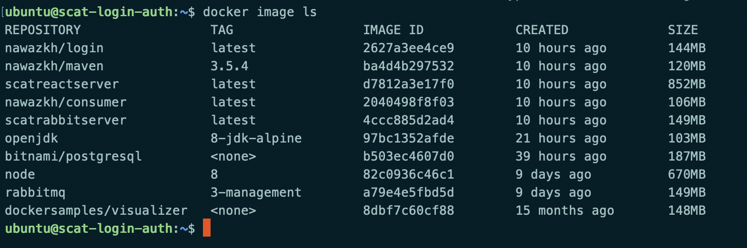
Docker Services and Images

Slide 5
Peer Review
Dependencies were not installed properly
We dockerized the application

Slide 6
Concepts Implemented
Continuous Integration
Continuous deployment
Service Discovery
Asynchronous Messaging
Containerization

Slide 7
Individual Learnings(Prashanth)
React Js
Node JS
Python/ Django
Docker and Docker Swarm
Jenkins
CI tools
RabbitMq

Slide 8
Individual Learnings (Soumya)
Maven
React
Node
Docker
Jenkins
RabbitMQ

Slide 9
Individual Learnings(Nawaz)
Java Spring boot
Java Spring Security
CI tools
Jenkins
Docker and Docker Swarm
RabbitMQ
Dockerize maven

