Slide 1
Apache Zookeeper
Hunt, P., Konar, M., Junqueira, F.P. and Reed, B., 2010, June. ZooKeeper: Wait-free Coordination for Internet-scale Systems. In USENIX Annual Technical Conference (Vol. 8, p. 9).
And other papers from http://scholar.google.com. ZK is a great example of successful open source software with strong underlying CS principles documented in scholarly articles.

Slide 2
Knowns and Unknowns in Distributed Systems
There are the known knowns
“I recognize this problem. There is a design pattern for it.”
And there are the known unknowns
“I bet there is a design pattern for this. Let’s identify it and go from there.”
And then there are the unknown unknowns…
“I thought of a great way to solve this!”
“What could possibly go wrong?”
We want to remove some of the unknown unknowns.

Slide 3

https://engineering.pinterest.com/blog/building-follower-model-scratch
Using Zookeeper to store Redis shard configuration information.
It took 1 lead developer and 2-3 part-time team members 8 weeks to go from nothing to production.
Pinterest has about ~250 million active users.

Slide 4
Classic Problems in Distributed Systems
Global Naming
Identity Management, Authentication, Authorization
Distributed Transactions
Distributed State Machines
Messaging, publish-subscribe, notification
Leader Election, primary copies, failover

Slide 5
Classic Distributed Systems Examples
Git
Versioning
Distributed File Systems
Write, not just read at scale
Global identities, groups
Replicated Databases
Primary copies, leaders, transactions
Resource Managers
Torque, SLURM, etc
Fault tolerance, process coordination

Slide 6
More Examples
REST Systems
Idempotent state
Error messages
Queuing Systems
Message order, replay, guaranteed delivery
Domain Name Servers
Naming, caching
Eventual consistency
Scaling power of hierarchies and name spaces

Slide 7
Apache Zookeeper as a Case Study
Apache Zookeeper
Some interesting design choices and assumptions
Illustrative Only
Lectures are not an endorsement
Many Others to Study
Apache Storm, Kafka, Spark, Hadoop, etc
Interesting Times
Open source software that is small enough to understand and experiment with
But cloud-native, scalable, used to run many companies
Illustrates several distributed systems concepts

Slide 8
Some General Advice
Take a class in distributed systems.
Get a book on distributed systems and read it.
Smart people have thought about these problems for a long time.
Jim Gray invented two-phase commit c. 1978, for example
CS problems often map to non-CS analogies
There are already many algorithms and design patterns for most problems that you will face.
The challenge: knowing the right prior solution for the problem at hand
The anti-pattern: reinventing something in a text book out of ignorance

Slide 9
Recall the Gateway Octopus Diagram
Browser
HTTPS
Web Interface Server
Client SDK
In micro-service arch, these need resource management and scheduling
HTTP or TCP/IP
“Super” Scheduling and Resource Management
Server SDK
Application Server
Resource Plugins
Karst: MOAB/Torque
Stampede: SLURM
Comet: SLURM
Jureca:SLURM

Slide 10
A Simplified Microservice System
Microservice 1
Microservice 1
Microservice 1
UI Server
API Gateway & Router
Microservice 2
Microservice 2
N Jobs
Microservice 2
Some questions:
Is Replica 2 of microservice 3 up and running?
Do I have at least one service running?
Microservice 3 uses Master-Worker, and the Master just failed. What do I do?
Replica 2 just came up and needs to find configuration information. How can it do that?
Microservice 3
Microservice 3
Microservice 3

Slide 11
Apache Zookeeper and Microservices
ZK can manage information in your system
IP addresses, version numbers, and other configuration information of your microservices.
This is stuff that is dynamic or otherwise doesn’t fit into a static configuration file.
The health of the microservices.
The state of a particular calculation.
Group membership

Slide 12
Apache Zookeeper Is…
A system for solving distributed coordination problems for multiple cooperating clients.
A lot like a distributed file system...
As long as the files are tiny.
And you could get notified when the file changes
And the full file pathname is meaningful to applications
A way to solve microservice management problems.
An interesting implementation of a distributed system itself.
Look under the hood AND read the papers

Slide 13
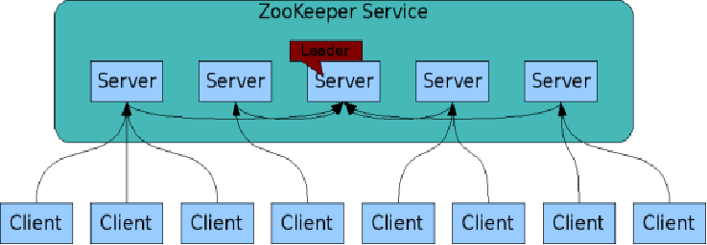
The ZooKeeper Service
Zookeeper is itself an interesting distributed system
These are your microservices
ZooKeeper Service is replicated over a set of machines
All machines store a copy of the data in memory (!)
A leader is elected on service startup
Clients only connect to a single ZooKeeper server & maintains a TCP connection.
Client can read from any Zookeeper server.
Writes go through the leader & need majority consensus.
https://cwiki.apache.org/confluence/display/ZOOKEEPER/ProjectDescription

Slide 14
Zookeeper Summary
ZooKeeper provides a simple and high performance kernel for building more complex coordination primitives.
Helps distributed components share information
Clients (your applications) contact Zookeeper services to read and write metadata.
Read from cache but writes are more complicated
Sometimes, just the existence and name of a node are enough
Tree model for organizing information into nodes.
Node names may be all you need
Lightly structured metadata stored in the nodes.
Wait-free aspects of shared registers with an event-driven mechanism similar to cache invalidations of distributed file systems
Targets simple metadata systems that read more than they write.
Small total storage

Slide 15
Zookeeper, More Briefly
Zookeeper Clients (that is, your applications) can create and discover nodes on ZK trees
Clients can put small pieces of data into the nodes and get small pieces out.
1 MB max for all data per server by default
Each node also has built-in metadata like its version number.
You could build a small DNS or an LDAP server with Zookeeper.
Can you think of ways that this would be useful?

Slide 16
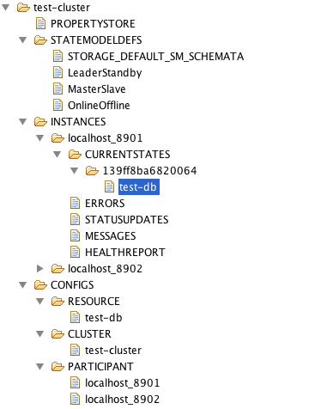
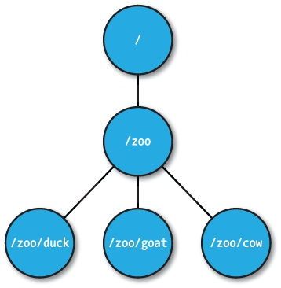
ZNodes
Maintain a stat structure with version numbers for data changes, ACL changes and timestamps.
Version numbers increases with changes
Data is read and written in its entirety

Slide 17
ZNode types
Regular
Clients create and delete explicitly
Ephemeral
Like regular znodes associated with sessions
Deleted when session expires
Both Regular and Ephemeral Nodes can be Sequential: the name name includes a universal, monotonically increasing counter

Slide 18
Zookeeper API (1/2)
create(path, data, flags): Creates a znode with path name path, stores data[] in it, and returns the name of the new znode.
flags enables a client to select the type of znode: regular, ephemeral, and set the sequential flag;
delete(path, version): Deletes the znode path if that znode is at the expected version
exists(path, watch): Returns true if the znode with path name path exists, and returns false otherwise.
Note the watch flag

Slide 19
Zookeeper API (2/2)
getData(path, watch): Returns the data and meta-data, such as version information, associated with the znode.
setData(path, data, version): Writes data[] to znode path if the version number is the current version of the znode
getChildren(path, watch): Returns the set of names of the children of a znode
sync(path): Waits for all updates pending at the start of the operation to propagate to the server that the client is connected to.

Slide 20
What Can You Do with this Simple API?
Recall earlier our classic distributed systems: DNS, Git, NFS, etc.

Slide 21
Reality Check
Zookeeper’s API is low level and can be hard to use.
Apache Curator (http://curator.apache.org/) provides a higher level API and recipes for using Zookeeper.
Easier to use and less error prone
But Java only
HashiCorp’s Consul is also a popular choice
“Next generation” after Zookeeper
Enterprise considerations like security built in

Slide 22
What Can You Do with this Simple API?
Recall earlier our classic distributed systems: DNS, Git, NFS, etc.

Slide 23
Configuration Management
All clients get their configuration information from a named znode
/root/config-me
Example: you can build a public key store with Zookeeper
Clients set watches to see if configurations change
Zookeeper doesn’t explicitly decide which clients are allowed to update the configuration.
That would be an implementation choice
Zookeeper uses leader-follower model internally, so you could model your own implementation after this.

Slide 24
The Rendezvous Problem
Classic distributed computing algorithm
Consider master-worker
Specific configurations may not be known until runtime
EX: IP addresses, port numbers
Workers and master may start in any order
Zookeeper implementation:
Create a rendezvous node: /root/rendezvous
Workers read /root/rendezvous and set a watch
If empty, use watch to detect when master posts its configuration information
Master fills in its configuration information (host, port)
Workers are notified of content change and get the configuration information

Slide 25
Locks
Familiar analogy: lock files used by Apache HTTPD and MySQL processes
Zookeeper example: who is the leader with primary copy of data?
Implementation:
Leader creates an ephemeral file: /root/leader/lockfile
Other would-be leaders place watches on the lock file
If the leader client dies or doesn’t renew the lease, clients can attempt to create a replacement lock file
Use SEQUENTIAL to solve the herd effect problem.
Create a sequence of ephemeral child nodes
Clients only watch the node immediately ahead of them in the sequence

Slide 26
Zookeeper and Science Gateways

Slide 27
Recall the Gateway Octopus Diagram
Browser
HTTPS
Web Interface Server
Client SDK
In micro-service arch, these also need scheduling
HTTP or TCP/IP
“Super” Scheduling and Resource Management
Server SDK
Application Server
Resource Plugins
Different archs, schedulers, admin domains,
…
Karst: MOAB/Torque
Stampede: SLURM
Comet: SLURM
Jureca:SLURM

Slide 28
And now let’s replicate the components.
API Server
Application Manager
Metadata Server
API Server
API Server
API Server
API Server
Application Manager
Metadata Server
Application Manager
Metadata Server
Application Manager
Metadata Server
Application Manager
Metadata Server
Application Manager
Metadata Server
Application Manager
Metadata Server

Slide 29
Why Do This?
Fault tolerance
Increased throughput, load balancing
Component versions
Not all components of the same type need to be on the same version
Backward compatibility checking
Component flavors
Application managers can serve different types of resources
Useful to separate them into separate processes if libraries conflict.

Slide 30
Configuration Management
Problem: gateway components in a distributed system need to get the correct configuration file.
Solution: Components contact Zookeeper to get configuration metadata.
Comments: this includes both the component’s own configuration file as well as configurations for other components
Rendezvous problem

Slide 31
Service Discovery
Problem: Component A needs to find instances of Component B
Solution: Use Zookeeper to find available group members instances of Component B
More: get useful metadata about Component B instances like version, domain name, port #, flavor
Comments
Useful for components that need to directly communicate but not for asynchronous communication (message queues)

Slide 32
Group Membership
Problem: a job needs to go to a specific flavor of application manager. How can this be located?
Solution: have application managers join the appropriate Zookeeper managed group when they come up.
Comments: This is useful to support scheduling

Slide 33
System State for Distributed Systems
Which servers are up and running? What versions?
Services that run for long periods could use ZK to indicate if they are busy (or under heavy load) or not.
Note overlap with our Registry
What state does the Registry manage? What state would be more appropriate for ZK?

Slide 34
Leader Election
Problem: metadata servers are replicated for read access but only the master has write privileges. The master crashes.
Solution: Use Zookeeper to elect a new metadata server leader.
Comment: this is not necessarily the best way to do this

Slide 35
Under the Zookeeper Hood

Slide 36
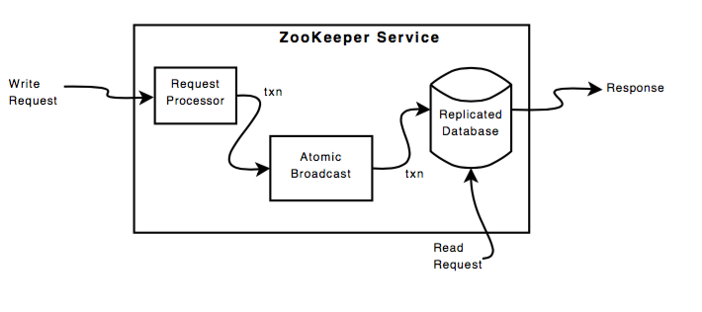
Zab Protocol
Instead of Zab, we’ll examine the simpler RAFT protocol. Both are described in academic papers

Slide 38
Zookeeper Handling of Writes
READ requests are served by any Zookeeper server
Scales linearly, although information can be stale
WRITE requests change state so are handed differently
One Zookeeper server acts as the leader
The leader executes all write requests forwarded by followers
The leader then broadcasts the changes
The update is successful if a majority of Zookeeper servers have correct state at the end of the process
Zab protocol

Slide 39
Some Zookeeper Implementation Simplifications
Uses TCP for its transport layer.
Message order is maintained by the network
The network is reliable?
Assumes reliable file system
Logging and DB checkpointing
Does write-ahead logging
Requests are first written to the log
The ZK DB is updated from the log
ZK servers can acquire correct state by reading the logs from the file system
Checkpoint reading means you don’t have to reread the entire history
Assumes a single administrator so no deep security

Slide 40
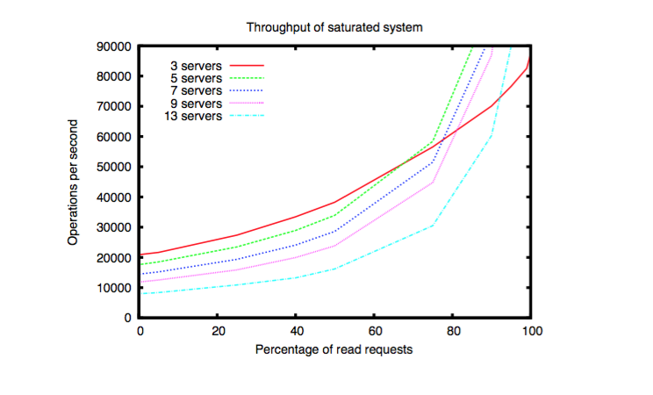
Speed isn’t everything. Having many servers increases reliability but decreases throughput as # of writes increases.

Slide 41
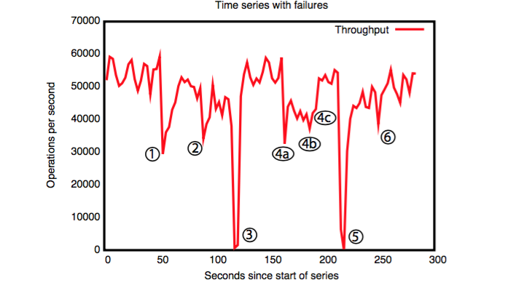
Failure and recovery of follower.
Failure and recovery of follower.
Failure of leader (200 ms to recover).
Failure of two followers (4a and 4b), recovery at 4c.
Failure of leader
Recovery of leader (?)
A cluster of 5 zookeeper instances responds to manually injected failures.

Slide 42
Final Thoughts and Cautions
Zookeeper is powerful but it is only one possible solution.
Messaging is also very powerful distributed computing concept
You could build a queuing system with Zookeeper, but you shouldn’t
https://cwiki.apache.org/confluence/display/CURATOR/TN
There are high quality queuing systems already
Highly available versus elastic, recoverable components
Zookeeper is better in the latter case
Where is the state of your system? Make one choice. Don’t have shadow states.

Slide 43
Introduction to Distributed Systems
Or, What I Have Learned Since 1998

Slide 44
Some Definitions
Distributed Systems
Distributed Computing
Examples: HTCondor, Apache Hadoop, Apache Spark, MPI, etc
Parallel Computing
Typically on a specialized resource (Big Red II, Blue Waters, etc)
Can assume tighter coupling
Science Gateways
Multiple software components that work together as a single composite entity.
Distributed components work together to perform large computations by breaking them into smaller parts.
Theme for this lecture
A special case of distributed computing
At scale are distributed systems.

Slide 45
Classic Problems in Distributed Systems
Global Naming
Identity Management, Authentication, Authorization
Distributed Transactions
Distributed State Machines
Leader Election
Messaging, publish-subscribe, notification

Slide 46
Classic Distributed Systems Examples
Git
Versioning
Distributed File Systems
Write, not just read at scale
Global identities, groups,
Replicated Databases
Primary copies, leaders, transactions
Resource Managers
Torque, SLURM, etc
Fault tolerance, process coordination

Slide 47
More Examples
REST Systems
Idempotent state
Error messages
Queuing Systems
Message order, replay, guaranteed delivery
Domain Name Servers
Scaling power of hierarchies and name spaces
Domain Name Servers
Naming, caching
Eventual consistency

Slide 48
The Fallacies of Distributed Computing
The network is reliable.
Latency is zero.
Bandwidth is infinite.
The network is secure.
Topology doesn't change.
There is one administrator.
Transport cost is zero.
The network is homogeneous.

Slide 49
Zookeeper Design Principles
For read-dominated systems
Doesn’t prescribe specific coordination primitives.
Lower level than that.
Allow clients to create their own coordination applications using the Zookeeper API
Configuration Management
Locking
Rendezvous
Group Membership

Slide 50
Zookeeper: Wait-Free Data Objects
Key design choice: wait-free data objects
Locks are not a Zookeeper primitive
You can use Zookeeper to build lock-based systems
Resembles distributed file systems
FIFO client ordering of messages
Basic idea: idempotent state changes
Components can figure out the state by looking at the change long
Operations incompatible with state throw exceptions
A good approach when systems can tolerate inconsistent data
But not E-Commerce, which needs stronger guarantees
Assumes you can order messages globally
Asynchronous messaging
DNS for example
Smaller data

Slide 51
Coordination Examples in Distributed Systems
Configuration
Basic systems just need lists of operational parameters for the system processes: IP addresses of other members
Sophisticated systems have dynamic configuration parameters.
Group Membership, Leader Election
Processes need to know which other processes are alive
Which processes are definitive sources for data (leaders)?
Locks
Implement mutually exclusive access to critical resources.
What happens if the leader is faulty?

Slide 52
Zookeeper Caches and Watches
Zookeeper clients cache data
Watches: notify listening clients when cache has changed
Watches don’t convey the content of the change.
Only work once; clients decide on the action
Why?
Centralized, top-down management doesn’t scale
Suitable for read-dominated systems
If you can tolerate inconsistencies
Networks aren’t uniform or reliable (fallacy)
Reads go to the cache

