Slide 1
Apache Zookeeper
Hunt, P., Konar, M., Junqueira, F.P. and Reed, B., 2010, June. ZooKeeper: Wait-free Coordination for Internet-scale Systems. In USENIX Annual Technical Conference (Vol. 8, p. 9).
And other papers from http://scholar.google.com. ZK is a great example of successful open source software with strong underlying CS principles documented in scholarly articles.

Slide 2
What Is Zookeeper?
In short, Zookeeper provides a way for microservices to put and get small pieces of information that they need to share.
Zookeeper allows clients to organize information into tree structures.
Like a file system, DNS, or LDAP
Zookeeper lets you keep the information ordered across a distributed set of ZK servers.
Each message sent by a client is considered to be a state change.

Slide 3
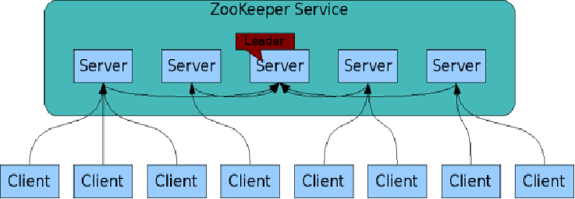
The ZooKeeper Service
Zookeeper is itself an interesting distributed system
These are your microservices
ZooKeeper Service is replicated over a set of machines
All machines store a copy of the data in memory (!)
A leader is elected on service startup
Clients only connect to a single ZooKeeper server & maintains a TCP connection.
Client can read from any Zookeeper server.
Writes go through the leader & need majority consensus.
https://cwiki.apache.org/confluence/display/ZOOKEEPER/ProjectDescription

Slide 4
Recall the Gateway Octopus Diagram
Browser
HTTPS
Web Interface Server
Client SDK
In micro-service arch, these need resource management and scheduling
HTTP or TCP/IP
“Super” Scheduling and Resource Management
Server SDK
Application Server
Resource Plugins
Karst: MOAB/Torque
Stampede: SLURM
Comet: SLURM
Jureca:SLURM

Slide 5
A Simplified Microservice System
Microservice 1
Microservice 1
Microservice 1
UI Server
API Gateway
Microservice 2
N Jobs
Message Broker
Microservice 2
Microservice 2
Some questions:
Is Replica 2 of microservice 3 up and running?
Do I have at least one service running?
Microservice 3 uses Master-Worker, and the Master just failed. What do I do?
Replica 2 needs to find configuration information. How can it do that?
Microservice 3
Microservice 3
Microservice 3

Slide 6
Apache Zookeeper and Microservices
ZK can manage information in your system
IP addresses, version numbers, and other configuration information of your microservices.
The health of the microservices.
The state of a particular calculation.
Group membership

Slide 7
Apache Zookeeper Is…
A system for solving distributed coordination problems for multiple cooperating clients.
A lot like a distributed file system...
As long as the files are tiny.
And you could get notified when the file changes
And the full file pathname is meaningful to applications
A way to solve microservice management problems.
An interesting implementation of a distributed system itself.
Look under the hood AND read the papers

Slide 8
Zookeeper, More Briefly
Zookeeper Clients (that is, your applications) can create and discover nodes on ZK trees
Clients can put small pieces of data into the nodes and get small pieces out.
1 MB max for all data per server by default
Each node also has built-in metadata like its version number.
You could build a small DNS with Zookeeper.
Some simple analogies
Lock files and .pid files on Linux systems.
Let’s next look at ZK’s data structure and its API

Slide 9
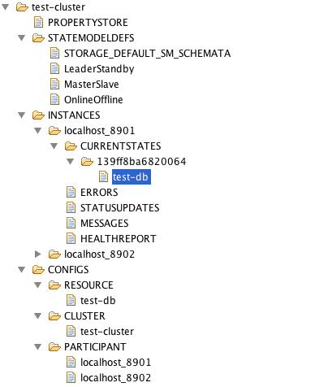
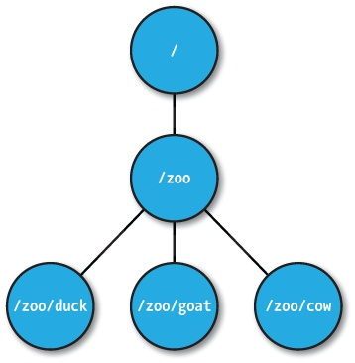
ZNodes
Maintain a stat structure with version numbers for data changes, ACL changes and timestamps.
Version numbers increases with changes
Data is read and written in its entirety

Slide 10
ZNode types
Regular
Clients create and delete explicitly
Ephemeral
Like regular znodes associated with sessions
Deleted when session expires
Sequential
Property of regular and ephemeral znodes
Has a universal, monotonically increasing counter appended to the name

Slide 11
Zookeeper API (1/2)
create(path, data, flags): Creates a znode with path name path, stores data[] in it, and returns the name of the new znode.
flags enables a client to select the type of znode: regular, ephemeral, and set the sequential flag;
delete(path, version): Deletes the znode path if that znode is at the expected version
exists(path, watch): Returns true if the znode with path name path exists, and returns false otherwise.
Note the watch flag

Slide 12
Zookeeper API (2/2)
getData(path, watch): Returns the data and meta-data, such as version information, associated with the znode.
setData(path, data, version): Writes data[] to znode path if the version number is the current version of the znode
getChildren(path, watch): Returns the set of names of the children of a znode
sync(path): Waits for all updates pending at the start of the operation to propagate to the server that the client is connected to.

Slide 13
What Can You Do with this Simple API?
Recall classic distributed systems: DNS, Git, NFS, etc.

Slide 14
Configuration Management
All clients get their configuration information from a named znode
/root/config-me
Example: you can build a public key store with Zookeeper
Clients set watches to see if configurations change
Zookeeper doesn’t explicitly decide which clients are allowed to update the configuration.
That would be an implementation choice
Zookeeper uses leader-follower model internally, so you could model your own implementation after this.

Slide 15
The Rendezvous Problem
Classic distributed computing algorithm
Consider master-worker
Specific configurations may not be known until runtime
EX: IP addresses, port numbers
Workers and master may start in any order
Zookeeper implementation:
Create a rendezvous node: /root/rendezvous
Workers read /root/rendezvous and set a watch
If empty, use watch to detect when master posts its configuration information
Master fills in its configuration information (host, port)
Workers are notified of content change and get the configuration information

Slide 16
Locks
Familiar analogy: lock files used by Apache HTTPD and MySQL processes
Zookeeper example: who is the leader with primary copy of data?
Implementation:
Leader creates an ephemeral file: /root/leader/lockfile
Other would-be leaders place watches on the lock file
If the leader client dies or doesn’t renew the lease, clients can attempt to create a replacement lock file
Use SEQUENTIAL to solve the herd effect problem.
Create a sequence of ephemeral child nodes
Clients only watch the node immediately ahead of them in the sequence

Slide 17
Configuration Management
Problem: gateway components in a distributed system need to get the correct configuration file.
Solution: Components contact Zookeeper to get configuration metadata.
Comments: this includes both the component’s own configuration file as well as configurations for other components
Rendezvous problem

Slide 18
Service Discovery
Problem: Component A needs to find instances of Component B
Solution: Use Zookeeper to find available group members instances of Component B
More: get useful metadata about Component B instances like version, domain name, port #, flavor
Comments
Useful for components that need to directly communicate but not for asynchronous communication (message queues)

Slide 19
Group Membership
Problem: a job needs to go to a specific flavor of application manager. How can this be located?
Solution: have application managers join the appropriate Zookeeper managed group when they come up.
Comments: This is useful to support scheduling

Slide 20
System State for Distributed Systems
Which servers are up and running? What versions?
Services that run for long periods could use ZK to indicate if they are busy (or under heavy load) or not.
Note overlap with our Registry
What state does the Registry manage? What state would be more appropriate for ZK?

Slide 21
Leader Election
Problem: metadata servers are replicated for read access but only the master has write privileges. The master crashes.
Solution: Use Zookeeper to elect a new metadata server leader.
Comment: this is not necessarily the best way to do this

