Slide 1
Microservices, Messaging and Science Gateways
Review microservices for science gateways and then discuss messaging systems.

Slide 2
Micro-Services
DevOps
Distributed Systems

Slide 3
The Gateway Octopus Diagram
Browser
HTTPS
Web Interface Server
Client SDK
HTTP or TCP/IP
We will focus on this piece
Server SDK
Application Server
Resource Plugins
Jobs sent to supercomputers have a nontrivial lifecycle
Karst: MOAB/Torque
Stampede2: SLURM
Comet: SLURM
Jureca: SLURM

Slide 4
State in Science Gateways
Scientific applications running on supercomputers have lifecycles
Queued
Executing
Completed
Gateways may add additional states
Created (but not yet queued)
Archived
The lifecycle of an executing job may be several minutes, hours, days, or even longer
Analogous to ordering a physical object delivered via Amazon.
State management is an important concept in gateways.
It guides component (microservice) design and implementation
It governs messaging patterns
Simple Blocking Request-Response Mechanisms Are Not Adequate

Slide 5
Basic Components of the Gateway App Server Become Microservices
API Server
Server SDK
Application Server
Application Manager
Metadata Server
Resource Plugins
For now, we will not depict the communication connections between the microservices on the left. These are over-the-wire and need to be non-blocking in many cases.

Slide 6
Replicate the Microservices
API Server
Communication patterns and system state are important
Application Manager
Metadata Server
API Server
API Server
API Server
Application Manager
Metadata Server
Application Manager
Metadata Server
Application Manager
Metadata Server
Application Manager
Metadata Server
Application Manager
Metadata Server
Application Manager
Metadata Server

Slide 7
Messaging in Distributed Systems
Examining messaging in distributed systems though Advanced Message Queuing Protocol (AMQP) and RabbitMQ overviews

Slide 8
Basic Components of the Gateway App Server
API Server
How do these services communicate?
Application Manager
Metadata Server

Slide 9
Each service actually needs to be replicated.
API Server
Application Manager
Metadata Server
API Server
API Server
API Server
API Server
Application Manager
Metadata Server
Application Manager
Metadata Server
Application Manager
Metadata Server
Application Manager
Metadata Server
Application Manager
Metadata Server
Application Manager
Metadata Server

Slide 10
Point to Point Communication Is Brittle
API Server
Combinatorial problems when you have > 3 services
How do you manage load balancing and service instance discovery?
How do rewire communications when you need to add more services?
What if multiple logical services need to receive the same message?
Application Manager
Metadata Server

Slide 11
Messaging Systems Solve Many of These Problems
API Server
Application Manager
Message Broker
Metadata Server

Slide 12
They Work Well with Service Replication
API Server
API Server
API Server
Application Manager
Application Manager
Application Manager
Message Broker
Metadata Server
Metadata Server
Metadata Server

Slide 13
Messaging Summary
Review RabbitMQ’s wonderful set of tutorials for several programming languages.
https://www.rabbitmq.com/getstarted.html
RabbitMQ implements some basic AMQP patterns out of the box.
You don’t need to understand the full power and flexibility of AMQP-based systems to use messaging.
We’ll introduce some of the main concepts

Slide 14
AMQP: Network Protocol and Architecture, Not An API
“Programmable” by endpoints
Can create and manage their own queues, exchanges, etc.
The broker manager does not need to configure these things.
Many Implementations
RabbitMQ, Apache ActiveMQ, Apache Qpid, SwiftMQ, ...
I’ll focus on Version 0-9-1 and RabbitMQ
RabbitMQ and Apache Zookeeper
Similar philosophy: provide “primitive” operations that can be combined to support more complicated scenarios.
This is not an AMQP tutorial

Slide 15
Value of Message Queuing Systems, Generally
They are queues for messages....
Even if you are doing point-to-point routing, messaging systems remove the need for publishers and consumers to know each other’s IP addresses.
Publishers and consumers just need to know how to connect to the message broker.
The network locations and specific instances of the publishers and consumers can change over time.
But logical instances persist
Synchronous and asynchronous messages natively supported.
Multiplex multiple channels of communication over a single TCP/IP connection

Slide 16
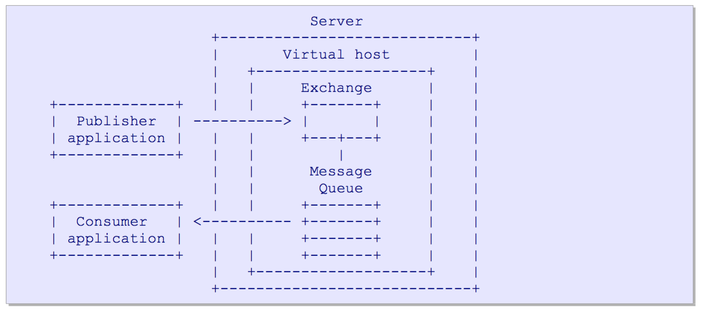
Basic Concepts

Slide 17
An AMQP Server (or Broker)
Exchange
Accepts producer messages
Sends to 0 or more Message Queues using routing keys
Message Queue
Routes messages to different consumers depending on arbitrary criteria
Buffers messages when consumers are not able to accept them fast enough.

Slide 18
Producers and Consumers
Producers only interact with Exchanges
Consumers interact with Message Queues
Consumers aren’t passive
Can create and destroy message queues
The same application can act as both a publisher and a consumer
You can implement Request-Response with AMQP
Except the publisher doesn’t block
Ex: your application may want an ACK or NACK when it publishes
This is a reply queue

Slide 19
The Exchange
Receives messages
Inspects a message header, body, and properties
Routes messages to appropriate message queues
Routing usually done with routing keys in the message payload
For point-to-point messages, the routing key is the name of the message queue
For pub-sub routing, the routing key is the name of the topic
Topics can be hierarchical

Slide 20
Message Queue Properties and Examples
Basic queue properties:
Private or shared
Durable or temporary
Client-named or server- named, etc.
Combine these to make all kinds of queues, such as
Store-and-forward queue: holds messages and distributes these between consumers on a round-robin basis.
Durable and shared between multiple consumers.
Private reply queue: holds messages and forwards these to a single consumer.
Reply queues are typically temporary, server-named, and private to one consumer.
Private subscription queue: holds messages collected from various "subscribed" sources, and forwards these to a single consumer.
Temporary, server-named, and private

Slide 21
Consumers and Message Queues
AMQP Consumers can create their own queues and bind them to Exchanges
Queues can have more than one attached consumer
AMQP queues are FIFO
AMQP allows only one consumer per queue to receive the message.
Use round-robin delivery if > 1 attached consumer.
If you need > 1 consumer to receive a message, you can give each consumer their own queue.
Each Queue can attach to the same Exchange, or you can use topic matching.

Slide 22
Publish-Subscribe Patterns
Useful for many-to-many messaging
In microservice-based systems, several different types of components may want to receive the same message
But take different actions
Ex: you can always add a logger service
You can always do this with explicitly named routing keys.
You may also want to use hierarchical (name space) key names and pattern matching.
gateway.jobs.jobtype.gromacs
gateway.jobs.jobtype.*

Slide 23
The Message Payload
Read the specification for more details.
In general AMQP follows the header-body format
The message body payload is binary
AMQP assumes the body content is handled by consumers
The message body is opaque to the AMQP server.
You could serialize your content with JSON or Thrift and deserialize it to directly send objects.

Slide 24
Message Exchange Patterns

Slide 25
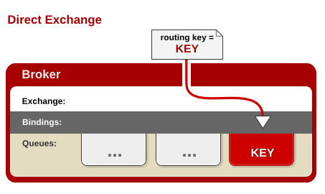
Direct Exchange
A publisher sends a message to an exchange with a specific routing key.
The exchange routes this to the message queue bound to the routing key.
A consumer receives the messages if listening to the queue.
Default: round-robin queuing to deliver to multiple subscribers of same queue
Queue.Declare queue=app.svc01
Basic.Consume queue=app.svc01
Basic.Publish routing-key=app.svc01

Slide 26
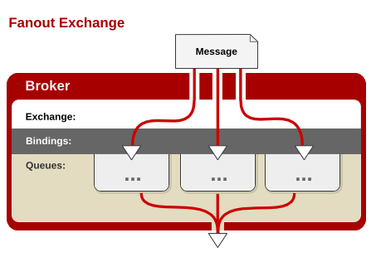
Fanout Exchange
Message Queue binds to an Exchange with no argument
Publisher sends a message to the Exchange
The Exchange sends the message to the Message Queue
All consumers listening to all Message Queues associated with an Exchange get the message

Slide 27
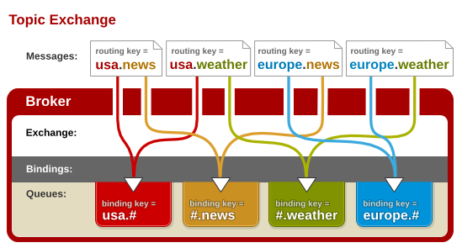
Topic Exchange
Message Queues bind using routing patterns instead of routing keys.
A Publisher sends a message with a routing key.
Exchange will route to all Message Queues that match the routing key’s pattern

Slide 28
More Examples
RabbitMQ Tutorial
https://www.rabbitmq.com/getstarted.html
What It Omits
Many publishers
Has several nice examples of classic message exchange patterns.
Absolute and partial event ordering are hard problems
Broker failure and recovery

Slide 29
Some Useful Capabilities of Messaging Systems for Microservices
Overarching Requirement: It should support your system’s distributed state machine
Let’s brainstorm some

Slide 30
Useful Capabilities: My List (1/2)
Supports both push and pull messaging
Deliver messages in order
Successfully delivered messages are delivered exactly once
OK to have multiple recipients
Deliver messages to one or more listeners based on pre-defined topics.
Store messages persistently
There are no active recipients.
All recipients are busy
Determine if critical messages were delivered correctly

Slide 31
Useful Capabilities: My List (2/2)
Redeliver messages that weren’t correctly received
Corrupted messages, no recipients, etc
Recipient can change
Redeliver messages on request
Helps clients resynch their states
Allow other components to inspect message delivery metadata.
Supports elasticity, fault tolerance
Priority messaging?
Qualities of Service
Security, fault tolerance

Slide 32
Which Messaging Software to Choose?
AMQP does not cover all the capabilities listed above.
It can be extended to cover these in many cases
AMQP messaging system implementations are not necessarily cloud-ready
They have to be configured as highly available services.
Primary + failover
No fancy leader elections, etc as used in Zookeeper + Zab or Apache Kafka
Have scaling limitations, although these may not matter at our scales.
Other messaging systems (Kafka, HedWig) are alternatives

Slide 33
Some Applications

Slide 34
Simple Work Queue
Queue up work to be done.
Publisher: pushes a request for work into the queue
Queue should be a simple Direct Exchange
Message Queue should implement “only deliver message once to once consumer”.
Round-robin scheduling.
RabbitMQ does this out of the box
Consumer: Sends an ACK after completing the task
If a Queue-Client closes before an ACK, resend message to a new consumer.
RabbitMQ detects these types of failures.

Slide 35
Simple Work Queue
AppMan Worker
MSG 1
Gateway API Server
Broker
ACK
AppMan Worker
MSG1, 2, 3
MSG 2
ACK
ACK
3 Job requests come to the API Server
API Server publishes to Broker (Exchange + Message Queue)
Broker sends to workers in round-robin
Workers send ACKs when done
If Broker detects a closed connection before an ACK, sends MSG to a different worker
MSG 3
AppMan Worker

Slide 36
What Could Possibly Go Wrong?
Jobs take a long time to finish, so ACKs may not come for hours.
Durable connections needed between Consumers and Message Queues
Alternatively, the ACK could come from a different process
Jobs may actually get launched on the external supercomputer, so you don’t want to launch twice just because of a missing ACK
Clients have to implement their own queues
Could get another work request while doing work.

Slide 37
Work Queue, Take Two
Orchestrator pushes work into a queue.
Have workers request work when they are not busy.
RabbitMQ supports this as “prefetchCount”
Use round-robin but don’t send work to busy workers with outstanding ACKs.
Workers do not receive work requests when they are busy.
Worker sends ACK after successfully submitting the job.
This only means the job has been submitted
Worker can take more work
A separate process handles the state changes on the supercomputer
Publishes ”queued”, “executing”, ”completed” or “failed” messages
When job is done, Orchestrator creates a “cleanup” job
Any worker available can take this.

Slide 38
Work Queue, Take 2
AppMan Worker
2. RunJob
1a. Ready
3. ACK
Orchestrator
Broker
Job Monitoror
0. RunJob
5. Done
7. Cleanup
9. ACK
1b. Ready
Experiment Metadata Manager
AppMan Worker
4., 6., 10. Job Status
8. CleanUp

Slide 39
What Could Possibly Go Wrong?
A Worker may not be able to submit the job
Remote supercomputer is unreachable, for example
We need a NACK
The Orchestrator and Experiment Metadata components are also consumers.
Should send ACKs to make sure messages are delivered.
Orchestrator and Experiment Metadata Manager may also die and get replaced.
Unlike AppMan workers, Orchestrator and EMM may need a leader-follower implementation
Broker crashes
RabbitMQ provides some durability for restarting
Possible to lose cached messages that haven’t gone to persistent storage

Slide 40
What Else Could Go Wrong?
Lots of things.
How do you debug unexpected errors?
Logs
A logger like LogStash should be one of your consumers
No one-to-one messages any more.
Everything has at least 2 subscribers
Your log service
The main target
Or you could use Fanout

Slide 41
Summary
Message systems provide an abstract system for routing communications between distributed entities.
You don’t need to know the physical addresses
Support multiple messaging patterns out of the box.
You don’t have to implement them.
Queues are a powerful concept within distributed systems.
Entities can save messages in order and deliver/accept them at a desirable rate.
Queues are a “primitive” (foundational) concept that you can use to build more sophisticated systems.

