Slide 1

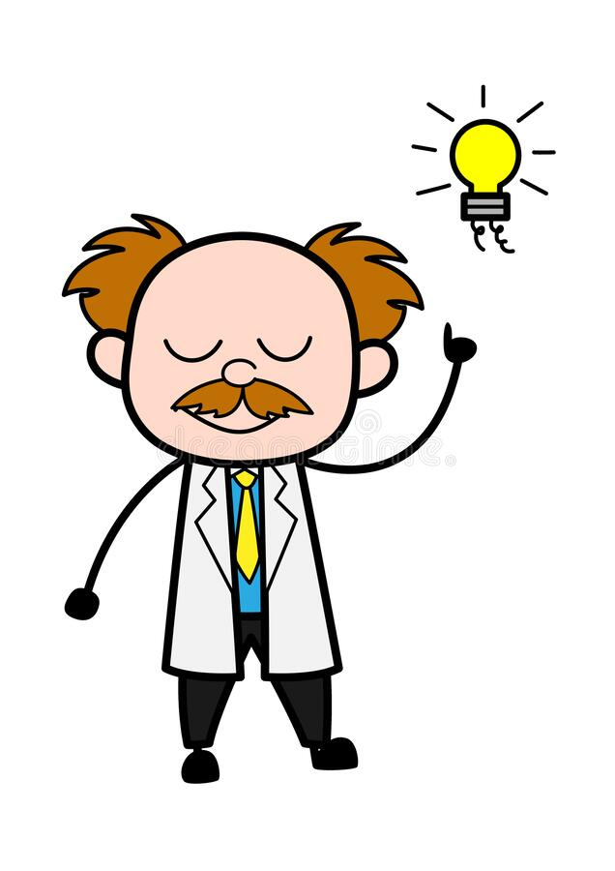
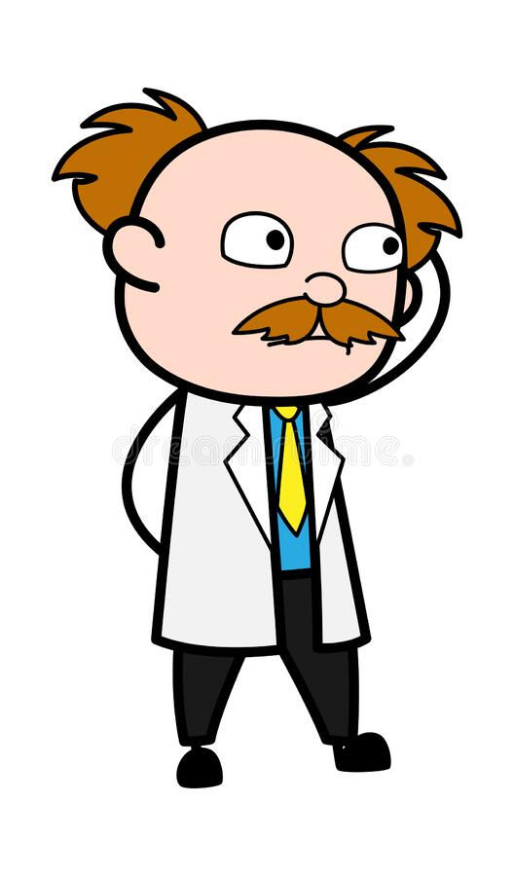
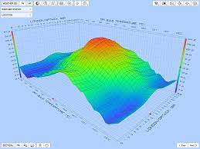
Aha!! Got the information. Time to Work on the prediction models with the data
I need the weather data of Bloomington
to work on a predication model. Let me ask the Weather Forecast App
Weather Forecast Application

