Slide 1
QuickFix
Kevin Benton, Pablo Calix, Derek Morris Jr., John Senegal II

Slide 2
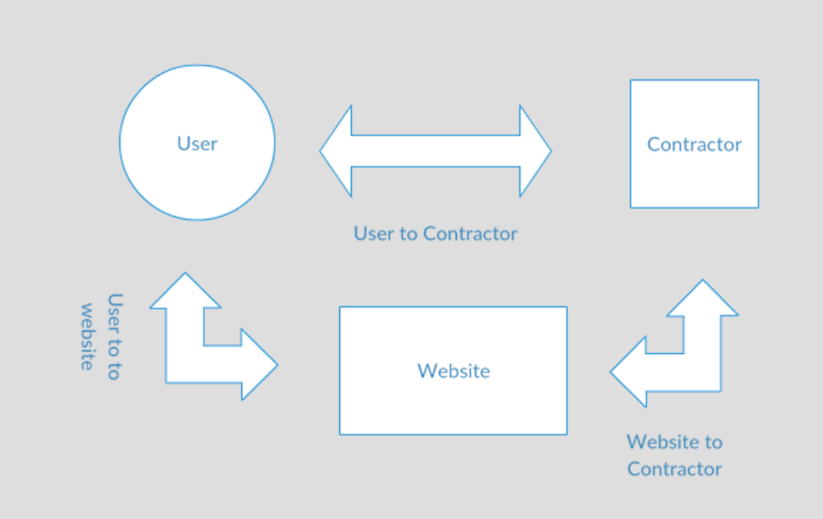
Napkin Drawing

Slide 3
Our Idea
QuickFix is meant the one and only job aggregate for contractors.
Contractors are usually in a word of mouth business and are dominated by contracting organizations
This will give them a place to compete using their competitive prices to get jobs

