Slide 1
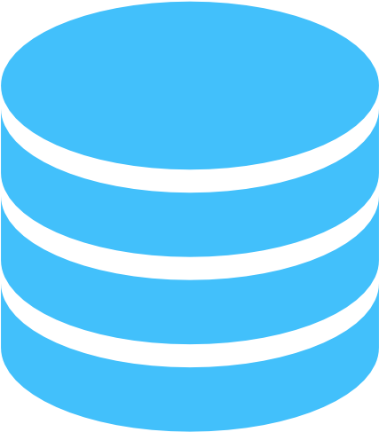


Database Communicator microservice
API
Gateway
Service
Local DB for Authentication
User Interface
(React)
S3 data accessing
microservice
Database Communicator
Microservice-II
Cache hit
Local DB for Cache/audit
Cache miss
AWS S3

