Slide 1
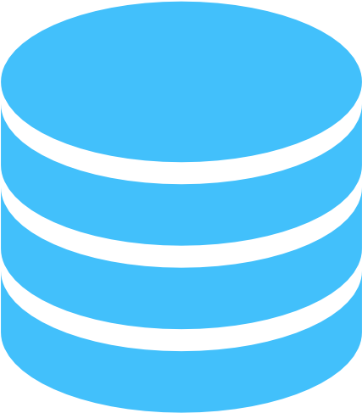


Database Communicator microservice
API
Gateway
Service
Local DB for Authentication
User Interface
(React)
S3 data accessing
microservice
Database Communicator
Microservice-II
Cache hit
Local DB for Cache/audit
Cache miss
AWS S3

Slide 2
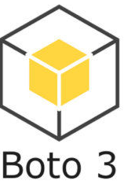



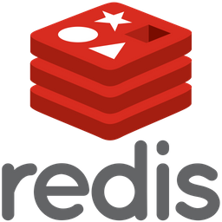
API GATEWAY
AUDIT SAVE/FETCH MICROSERVICE
DATABASE CONNECTION MICROSERVICE
LOCAL
MONGODB
NEXRAD AWS DATA FETCH, PROCESS, AND VISUALIZE
FRONT END (CLIENT)
NEXRAD data
AWS S3
CACHE CHECKER SERVICE
MERRA DATA PROCESSOR
NASA MERRA data
Hyrax server

Slide 3

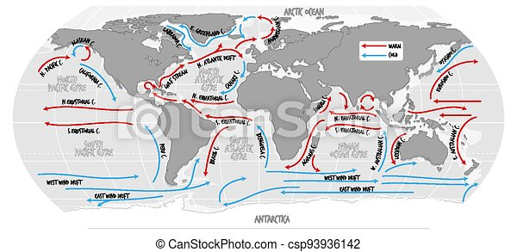

OCEAN CURRENTS
What caused this?

Slide 4
OCEAN CURRENTS
What caused this?

Slide 5
OCEAN CURRENTS
What caused this?

Slide 6

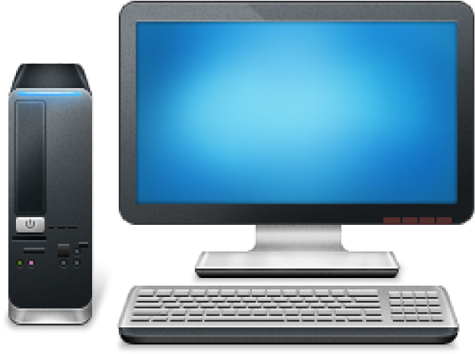
OCEAN CURRENTS
What caused this?

Slide 7
OCEAN CURRENTS
What caused this?

Slide 8


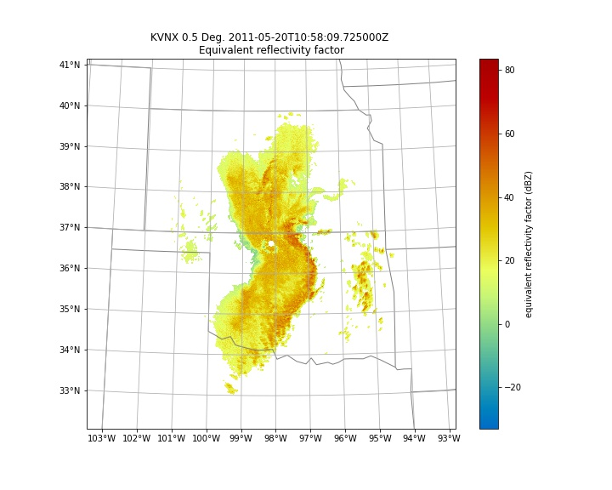
OCEAN CURRENTS

Slide 9
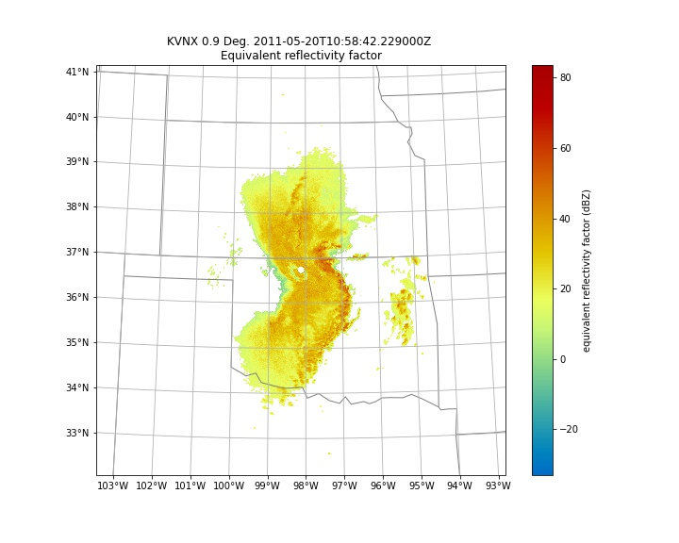
OCEAN CURRENTS

Slide 10
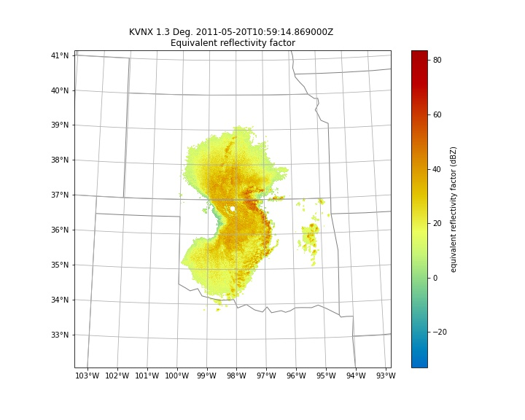
OCEAN CURRENTS

Slide 11
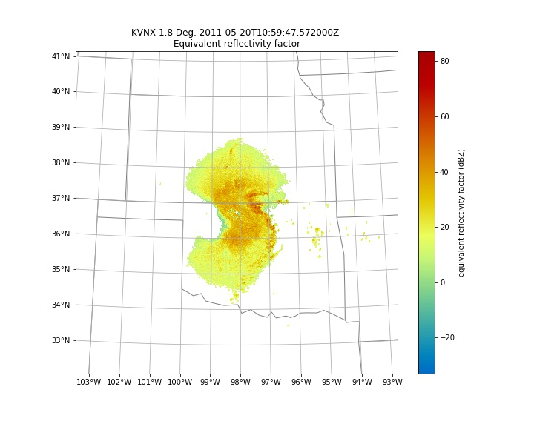
OCEAN CURRENTS

Slide 12
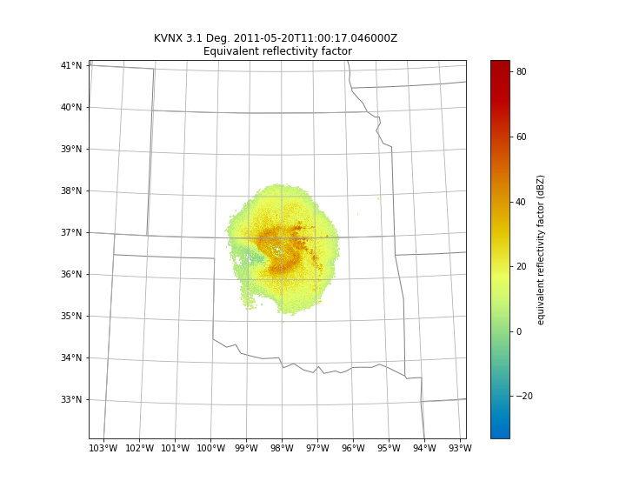
OCEAN CURRENTS

Slide 13
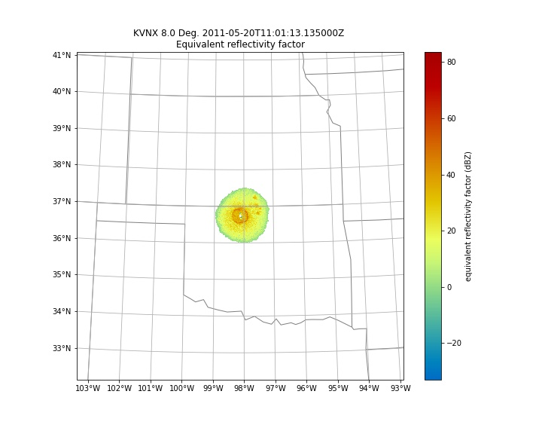
OCEAN CURRENTS

Slide 14
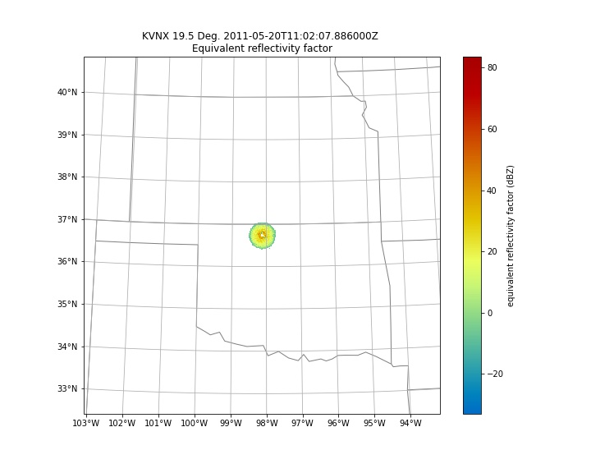
OCEAN CURRENTS

