Slide 1
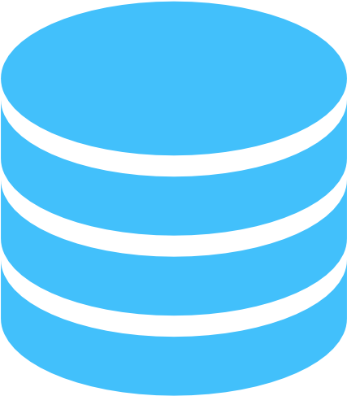
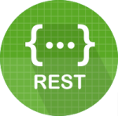

Database Communicator microservice
API
Gateway
Service
Local DB for Authentication
User Interface
(React)
S3 data accessing
microservice
Database Communicator
Microservice-II
Cache hit
Local DB for Cache/audit
Cache miss
AWS S3

Slide 2

DATABASE CONNECTION MICROSERVICE
AUTHENTICATION MICROSERVICE
API GATEWAY
AUDIT SAVE/FETCH MICROSERVICE
LOCAL
MONGODB
FRONT END (CLIENT)
INITIAL STATION DATA FETCH
NEXRAD AWS DATA FETCH AND PROCESS
REST
Webclient
AWS S3
Apache Kafka

Slide 3

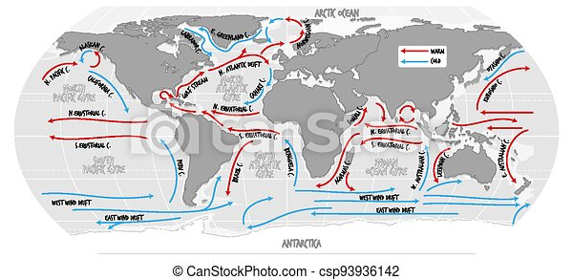

OCEAN CURRENTS
What caused this?

Slide 4
OCEAN CURRENTS
What caused this?

Slide 5
OCEAN CURRENTS
What caused this?

Slide 6

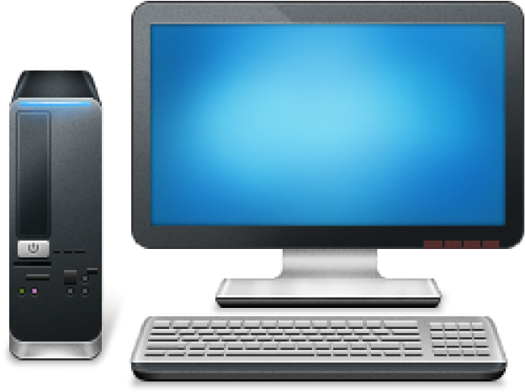
OCEAN CURRENTS
What caused this?

Slide 7
OCEAN CURRENTS
What caused this?

Slide 8


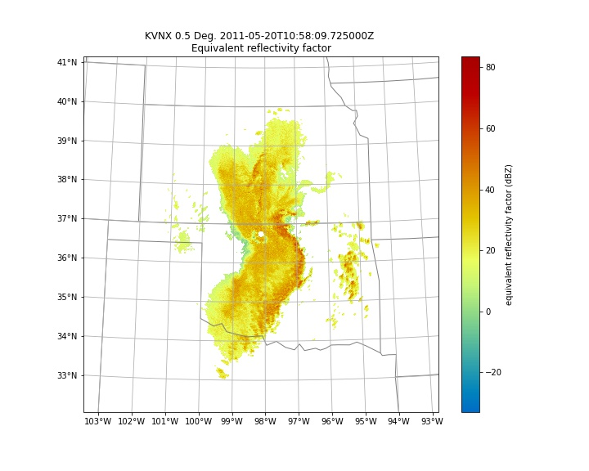
OCEAN CURRENTS

Slide 9
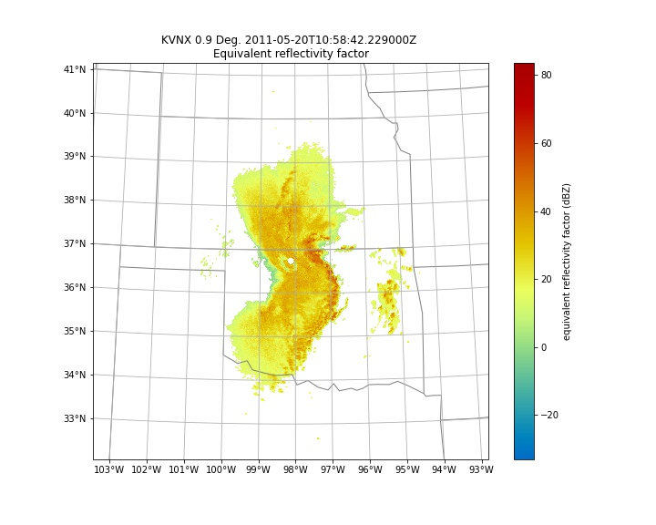
OCEAN CURRENTS

Slide 10
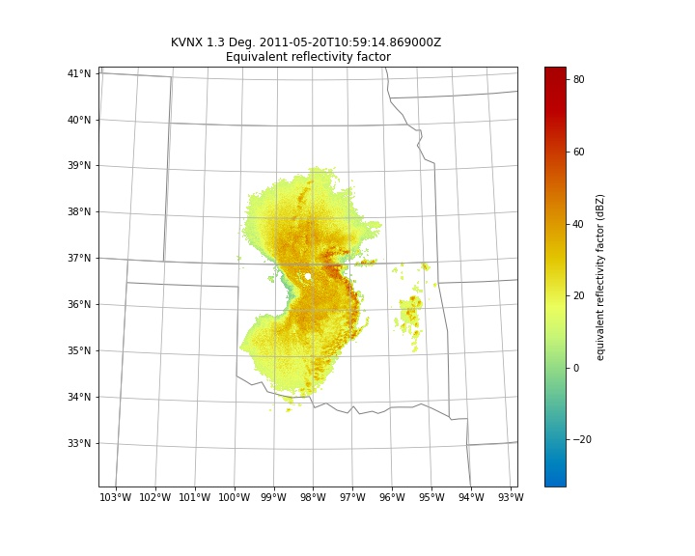
OCEAN CURRENTS

Slide 11
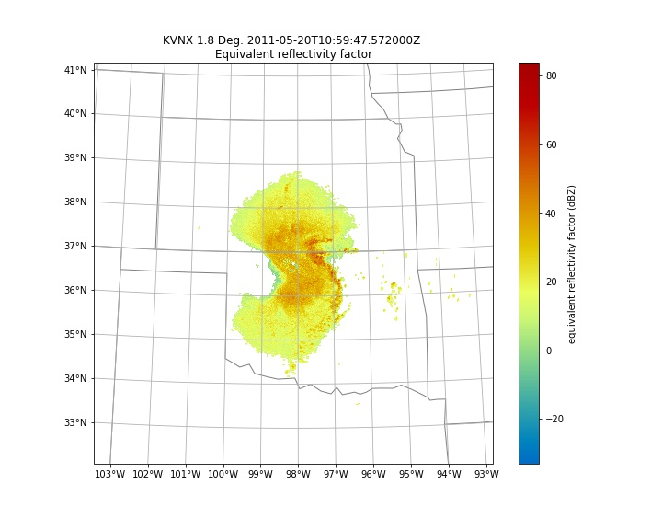
OCEAN CURRENTS

Slide 12
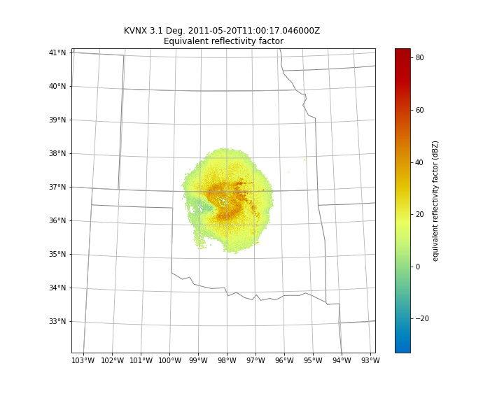
OCEAN CURRENTS

Slide 13
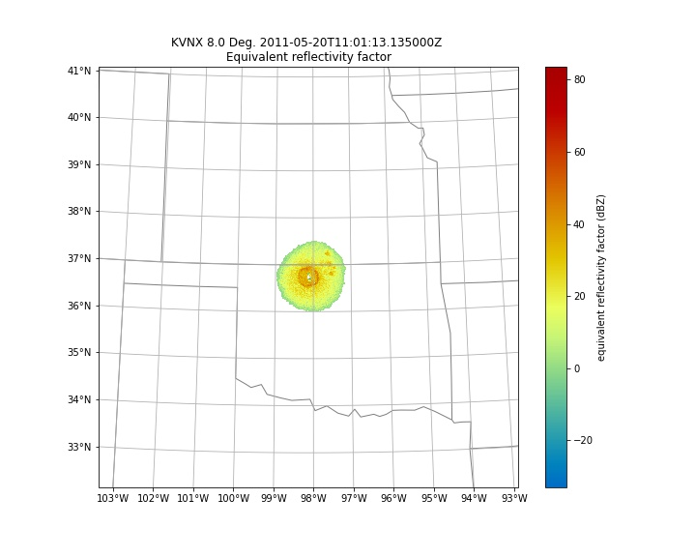
OCEAN CURRENTS

Slide 14
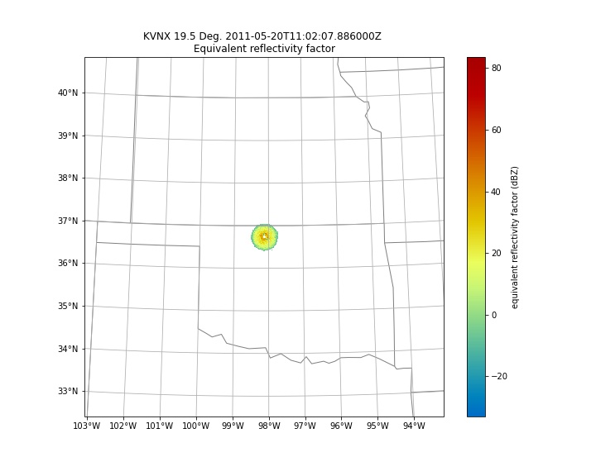
OCEAN CURRENTS

