Slide 1



Theoretical Statistic Project - Football Analysis
By Raviv Herrera & Eyal Stolov
Bar-Ilan University

Slide 2

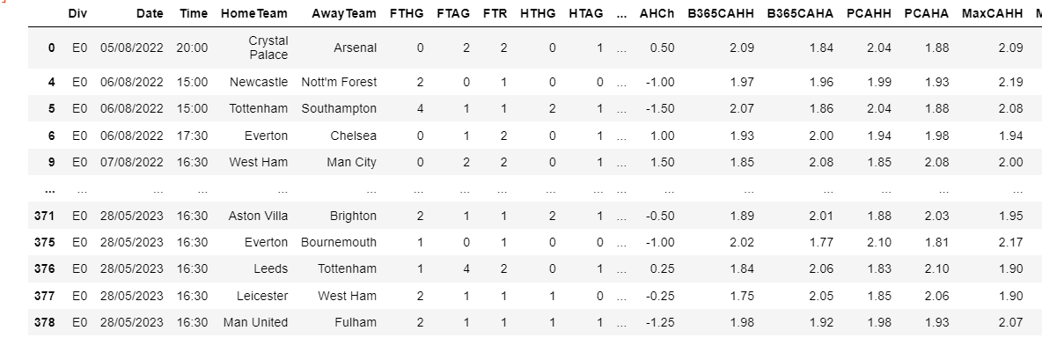
The Data
The last 20 years data of the English Premier League (2003 – 2023)

Slide 3
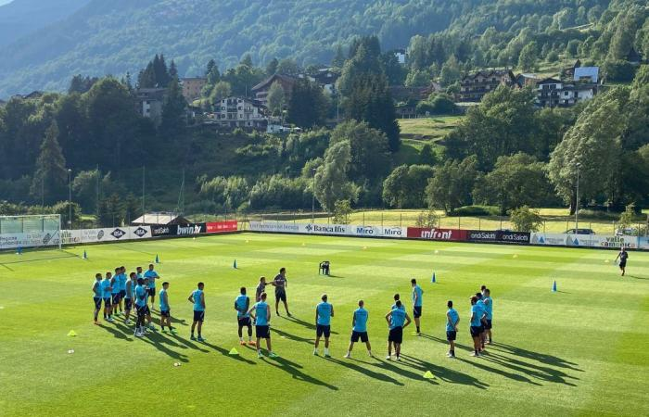
hypotheses
There exist some interesting hypotheses we have thought about
1) Game Time vs Total Number of Goals – this hypothesis suggests to analyze whether the Time of the game does affect the number of total goals in the game, or it doesn’t
2) Red cards vs Decreasing victory chances – this hypothesis suggests to analyze whether having a red card for a certain team does decrease its chances to win the game or it doesn’t.
3) Team’s Total Strength leads to victory - this hypothesis suggests to analyze whether a team’s strength (based on defined metrics) increases victory odds or not.
4) Christmas Time - this hypothesis suggests to analyze whether the Christmas time does affect the team’s performance or not

Slide 4

Features
1) Red Cards
2) Total number of Goals per team
3) Time of the matches
4) Number of shots per team

Slide 5
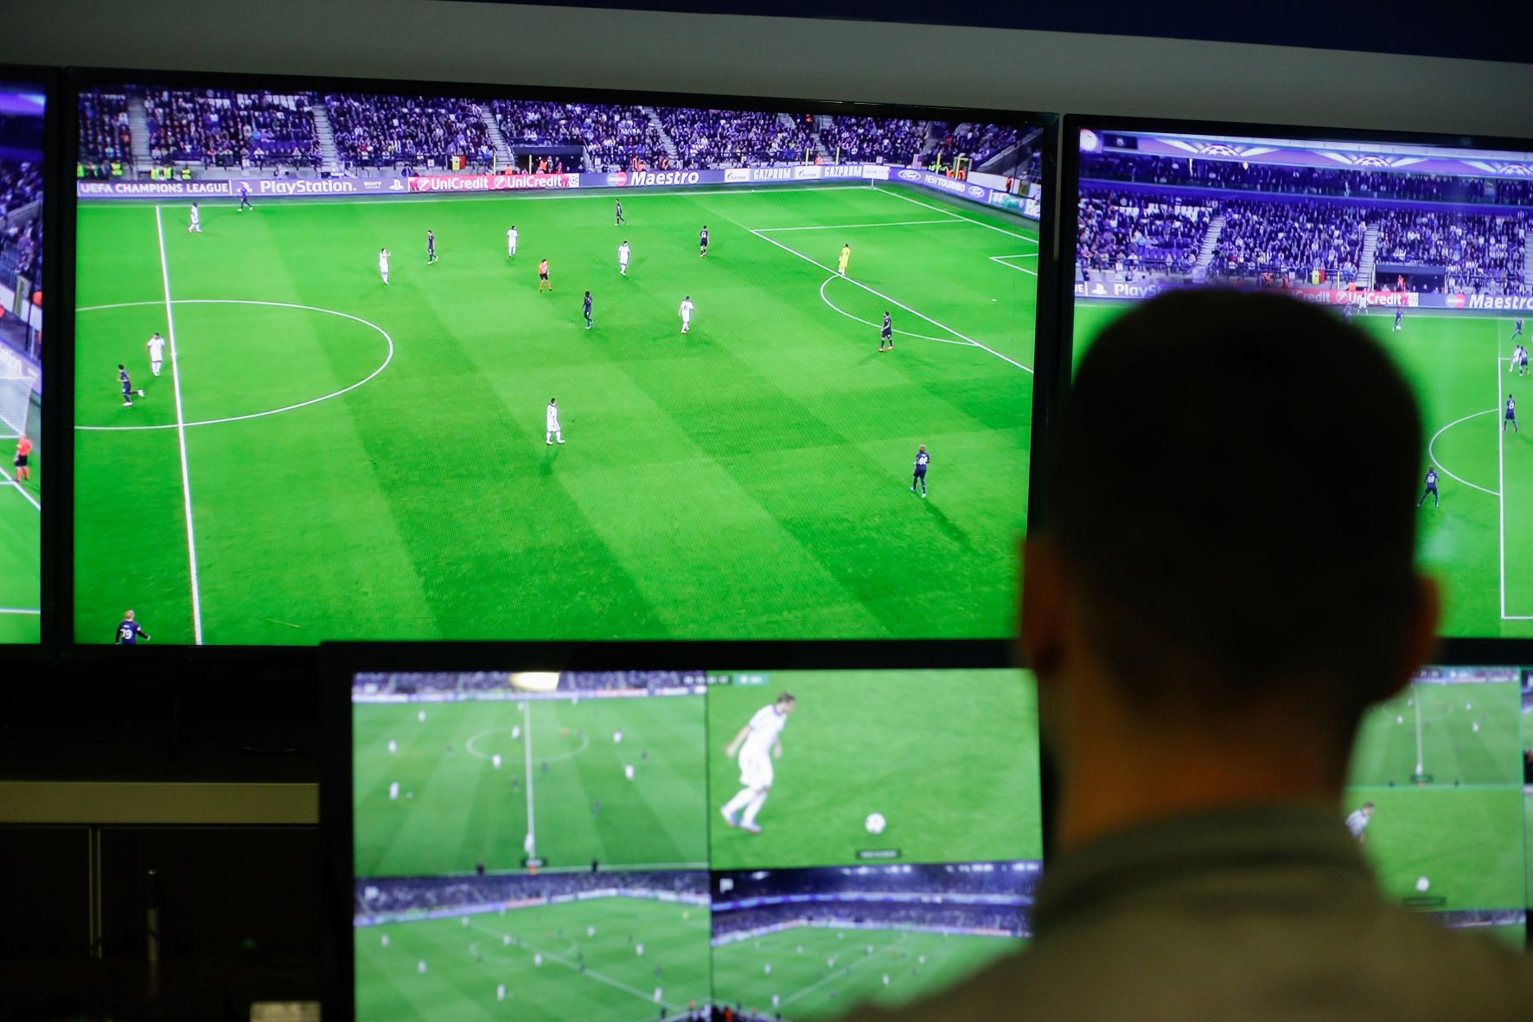
Preliminary Analysis

Slide 6
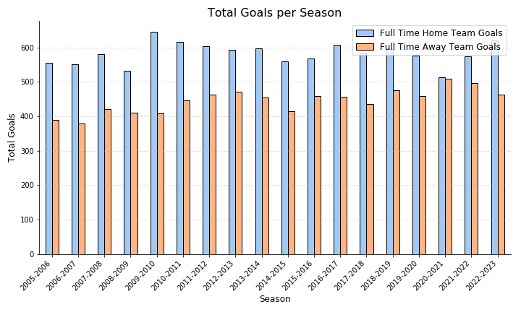
Toal Goals Per Season
We can see that a team outperforms in home matches.
It might be due the fact that in away matches the team has less fans which psychology speaking leads to insecure.
We must refer to the fact that like any other sport branch, football involves psychology within itself.
hence there is a huge key rule for the players mentality.

Slide 7
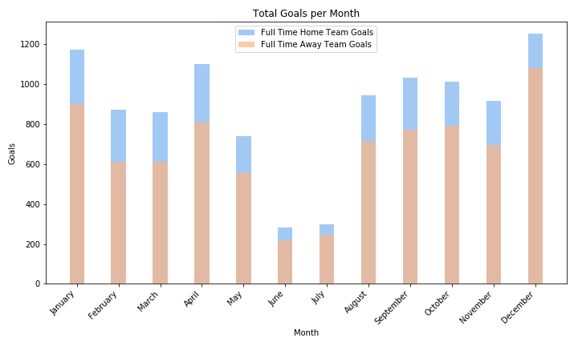
Total Goals Per Month
We can see that in the summer we find ourselves with almost no goals, due to lack of matches.
Typically, the summer is a sort of transition period between seasons.
But in the other hand, the winter is the most productive period for goals, since this is a Christmas time where each team in the Premier League has 3-4 matches within a week !
(instead of 1 match per week)

Slide 8
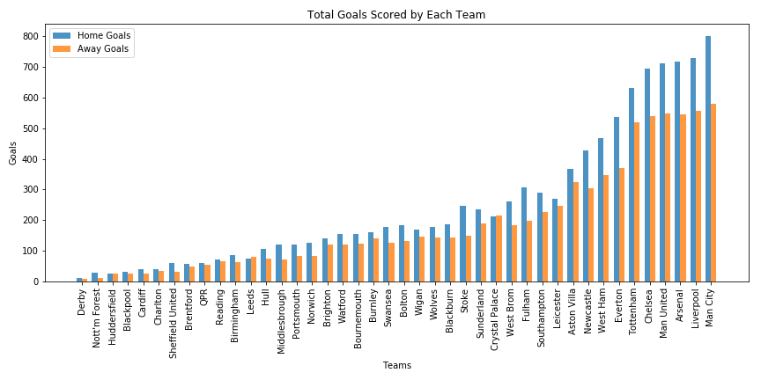
Total Goals Scored By Each Team
One of the things that makes the PL to the most attractive football league in Europe is the amount of well-perform teams that participate it the league.
Since the PL have such a big amount of well-preform teams, each season almost 4 different teams qualify to the UEFA Champions League.
Here in the figure, we can see the teams which scores the biggest number of goals during the last 20 years.
Are they really the best teams ?

Slide 9
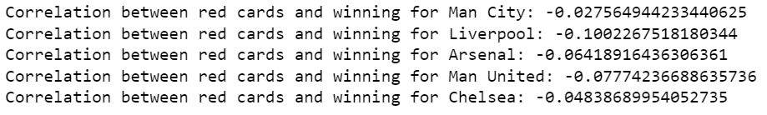
Total Goals Scored By Each Team
It sounds reasonable that if a team receives a red card, automatically it becomes a devastated act for the team and can lead the team to lose the game.
Here we can see the total correlation for all the teams and with Pierson correlation we can see that there is no correlation between receiving a red card and winning\loosing the game.
The last 5 correlations are for the 5 best teams from the previous figure.

Slide 10

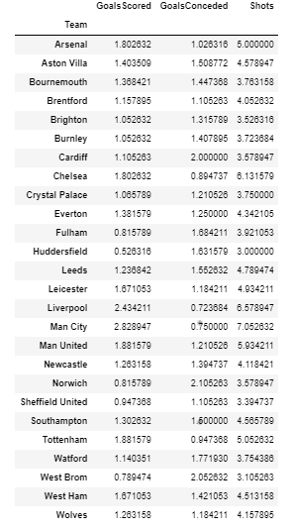
Preliminary Performance Analysis

Slide 11
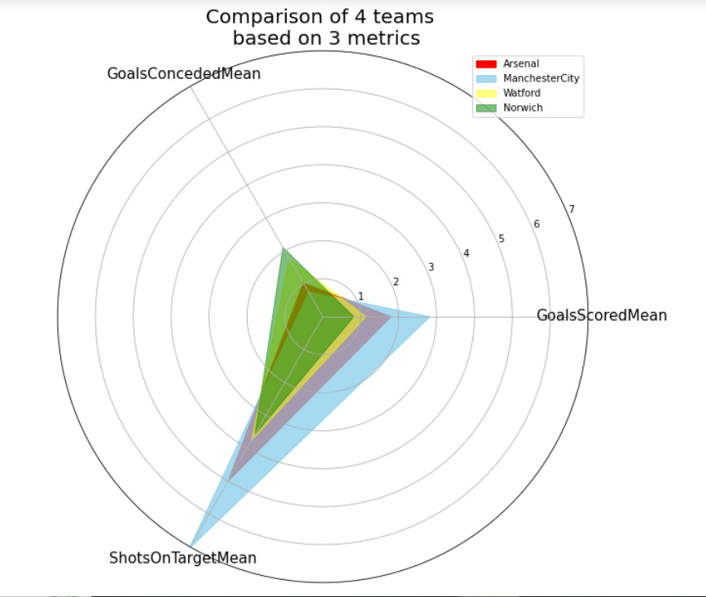
Performance spider plot
Here we see a spider plot that compares the performance of 4 different teams in the PL by 3 metrics.
We can observe the noticeable differences among the teams.
We can see that Manchester-City outperforms the other teams.
In the opposite direction, Norwich seems like it should think about substituting its manager or bringing any new players to strengthen the team.

Slide 12
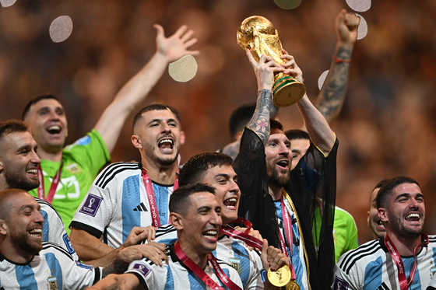
THE END

