Slide 1
XMLHttpRequest

Slide 2
Table of Contents
how http work
補充
另一個解決辦法

Slide 3
how http work

Slide 4
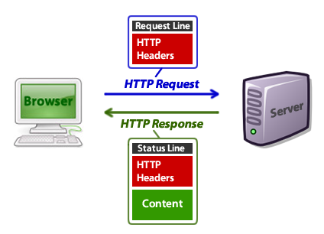
request 有三種方法：Get,post,head
這裡利用javascript示範GET request和response

Slide 5
var xhr = new XMLHttpRequest();
xhr.open('GET', "http://ipinfo.io/json", true); //true-> async
xhr.send();
xhr.onreadystatechange = processRequest;
function processRequest(e) {
if (xhr.readyState == 4 && xhr.status == 200) {
var response = JSON.parse(xhr.responseText);
alert(response.ip);
}
}

Slide 6
<script>
function httpGetAsync(theUrl, callback)
{
var xmlHttp = new XMLHttpRequest();
xmlHttp.onreadystatechange = function() {
if (xmlHttp.readyState == 4 && xmlHttp.status == 200)
callback(xmlHttp.responseText);
}
xmlHttp.open("GET", theUrl, true); // true for asynchronous
xmlHttp.send(null);
}
var doit = function (data)
{
var x=data;
console.log(x);
}
</script>

Slide 7
var HttpClient = function() {
this.get = function(aUrl, aCallback) {
var anHttpRequest = new XMLHttpRequest();
anHttpRequest.onreadystatechange = function() {
if (anHttpRequest.readyState == 4 && anHttpRequest.status == 200)
aCallback(anHttpRequest.responseText);
}
anHttpRequest.open( "GET", aUrl, true );
anHttpRequest.send( null );
}
}
var client = new HttpClient();
//client.get('http://www.nkfust.edu.tw/bin/home.php', doit); //ok
client.get('http://ipinfo.io/json', doit); //ok
//httpGetAsync('http://www.nkfust.edu.tw/bin/home.php',doit);

Slide 8
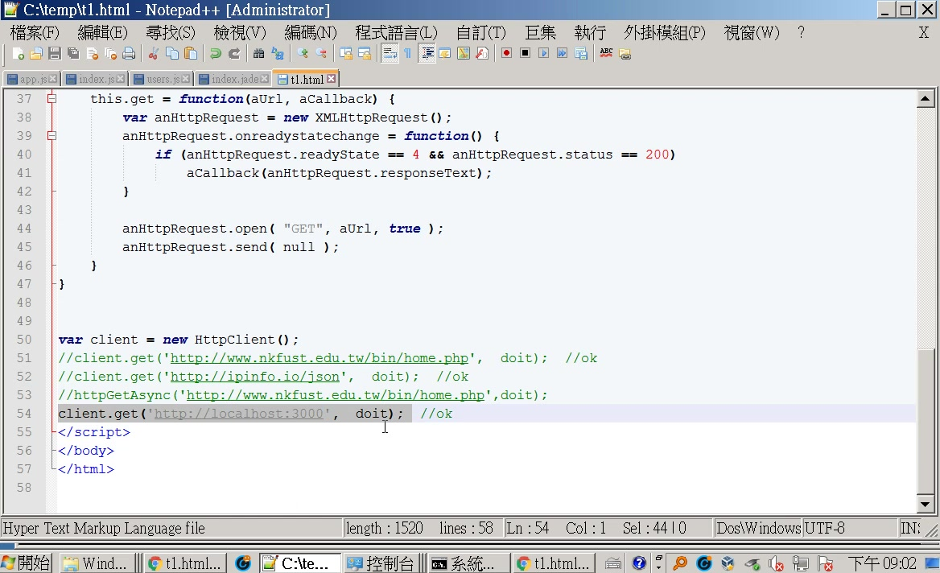

Slide 9
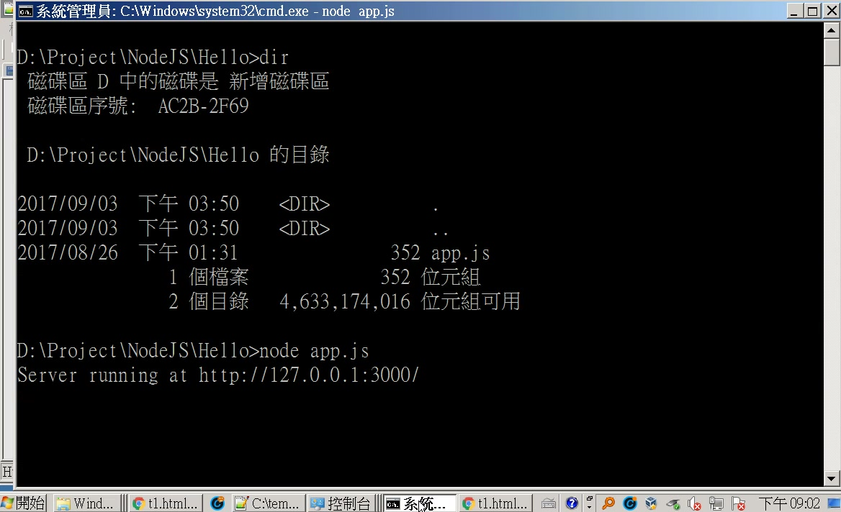
server 端

Slide 10
app.js
const http = require('http');
const hostname = '127.0.0.1';
const port = 3000;
const server = http.createServer((req, res) => {
res.statusCode = 200;
res.setHeader('Content-Type', 'text/plain');
res.end('Hello World\n');
});
server.listen(port, hostname, () => {
console.log(`Server running at http://${hostname}:${port}/`);
});

Slide 11
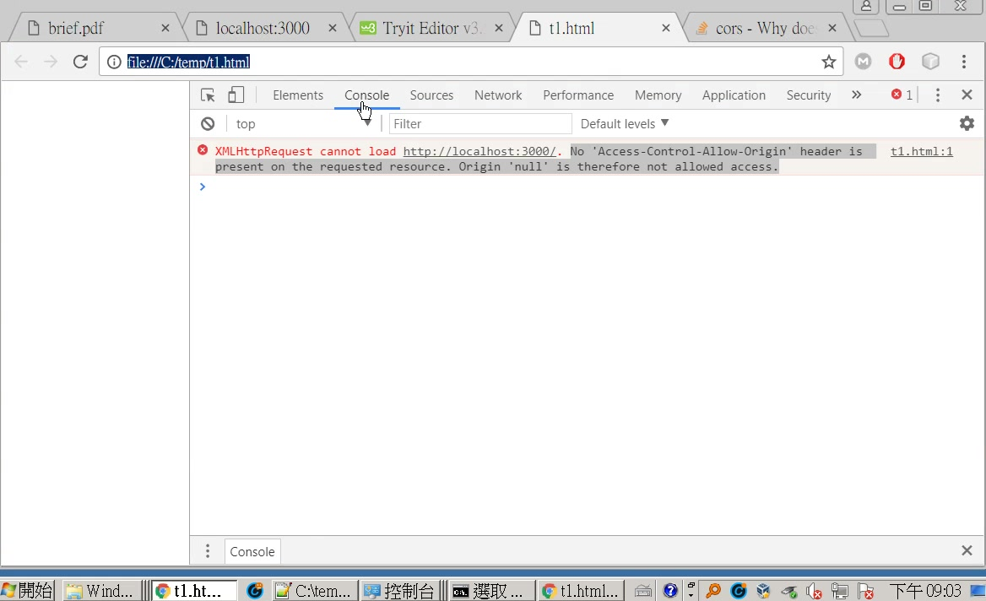
檔案：t1.html
<script>
var HttpClient = function() {
this.get = function(aUrl, aCallback) {
var anHttpRequest = new XMLHttpRequest();
anHttpRequest.onreadystatechange = function() {
if (anHttpRequest.readyState == 4 && anHttpRequest.status == 200)
aCallback(anHttpRequest.responseText);
}
anHttpRequest.open( "GET", aUrl, true );
anHttpRequest.send( null );
}
}
var client = new HttpClient();
client.get('http://localhost:3000', doit); //ok
</script>

Slide 12
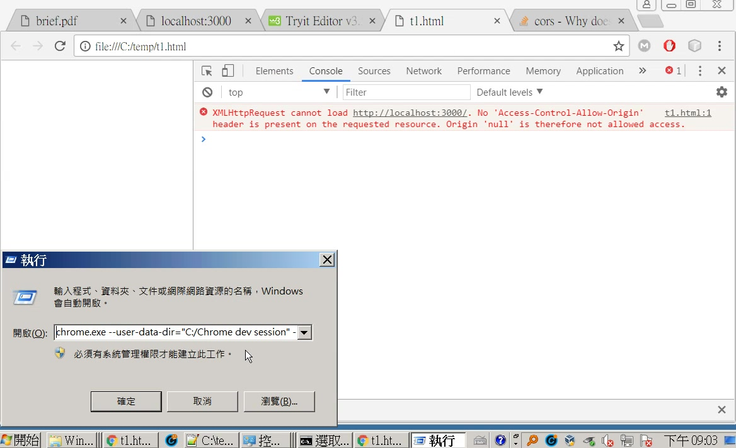
參考<這裡>
chrome.exe --user-data-dir="C:/Chrome dev session" --disable-web-security

Slide 13
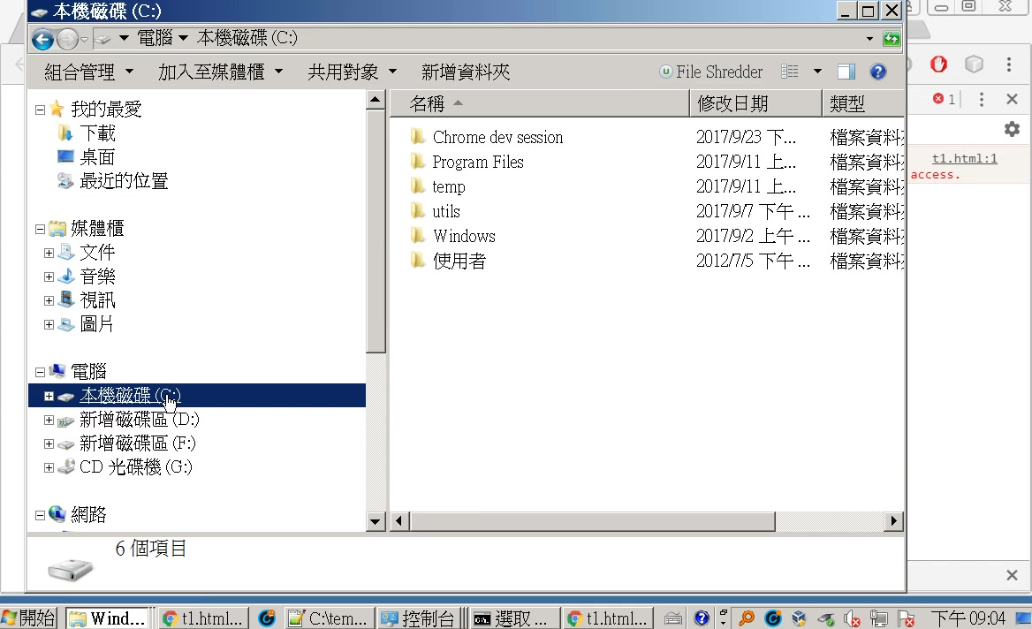

Slide 14
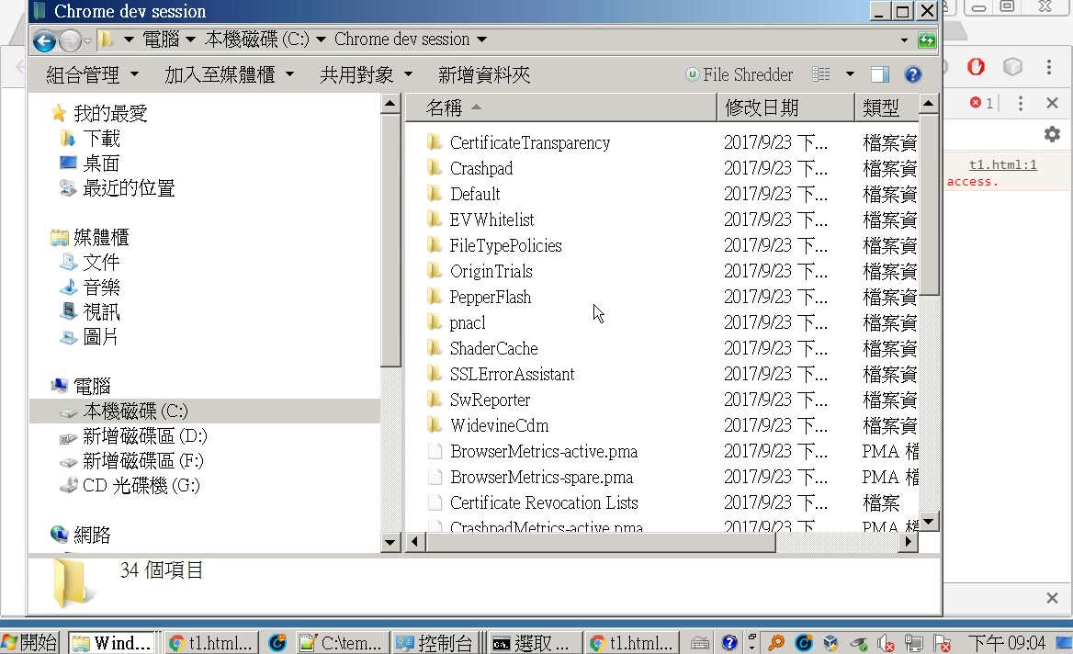

Slide 15
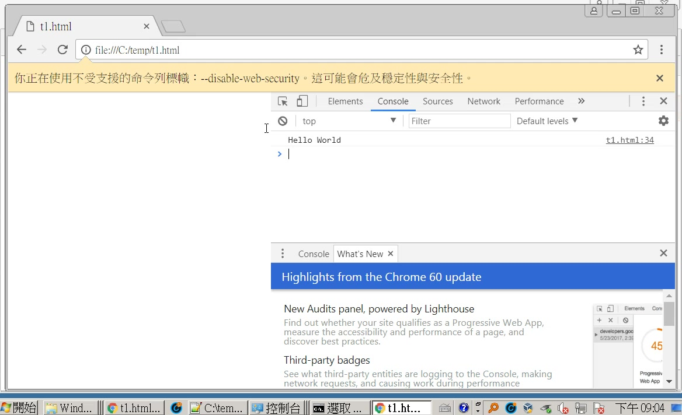

Slide 16
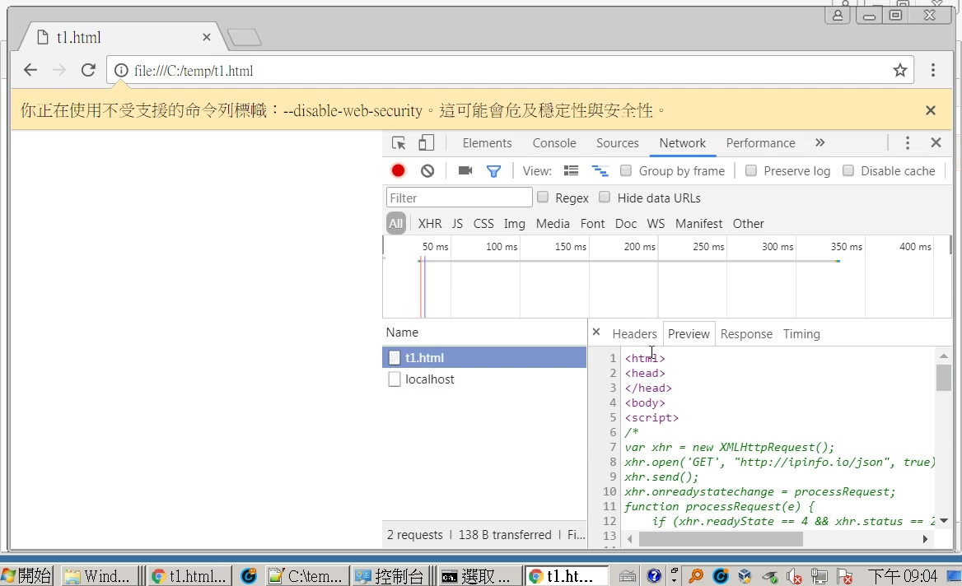

Slide 17
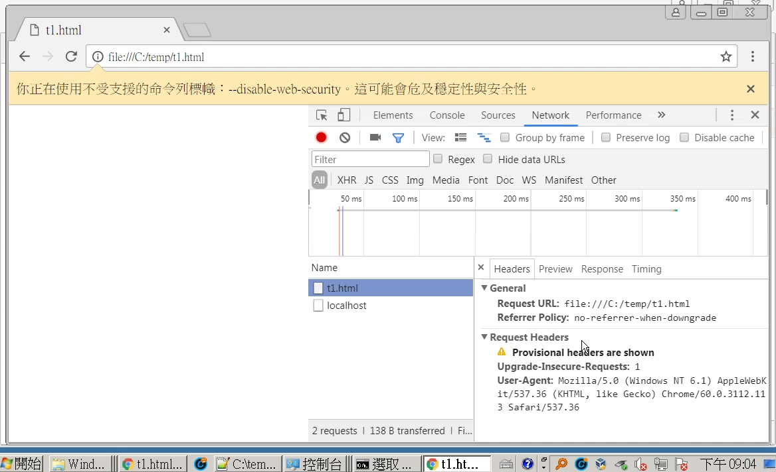

Slide 18
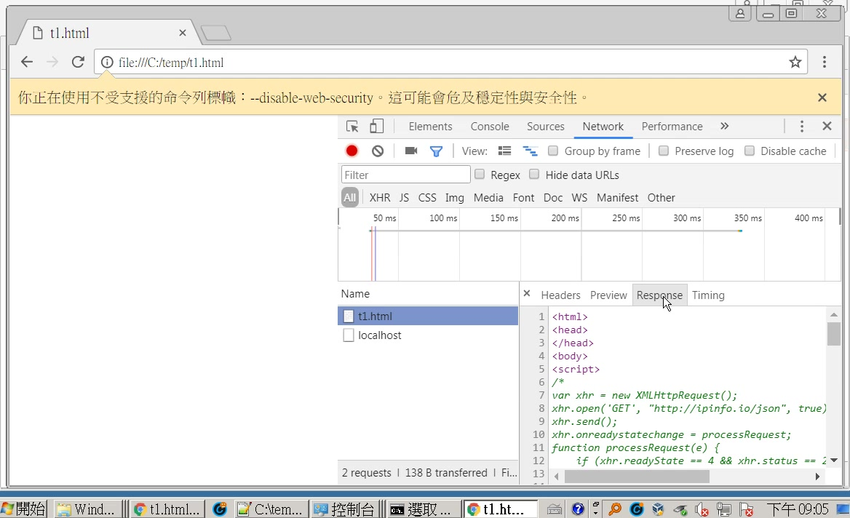

Slide 19
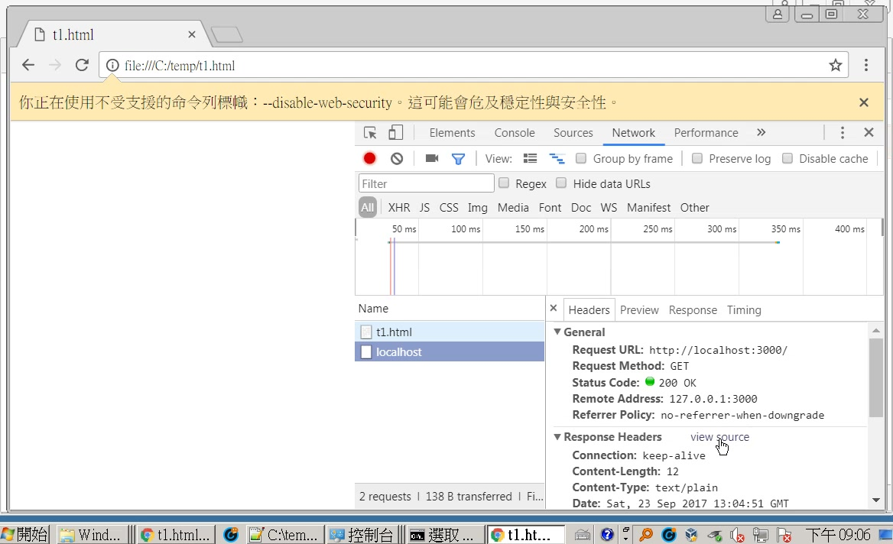

Slide 20
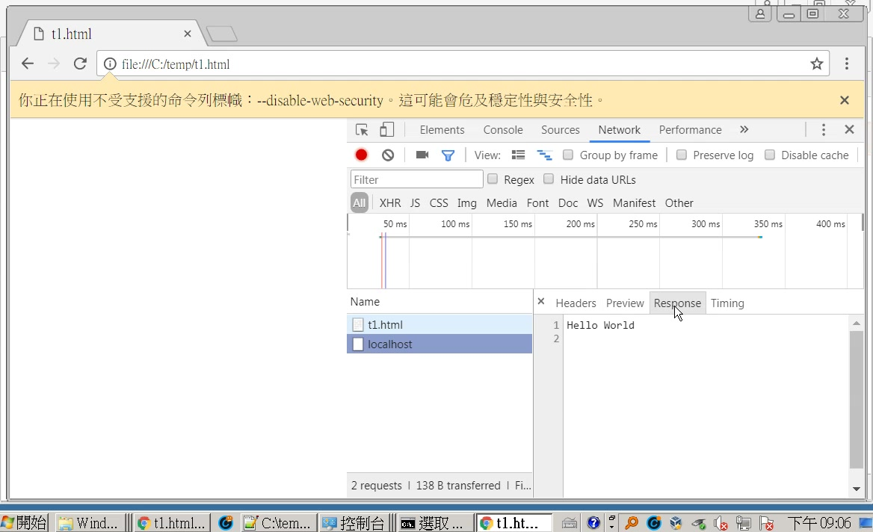

Slide 21
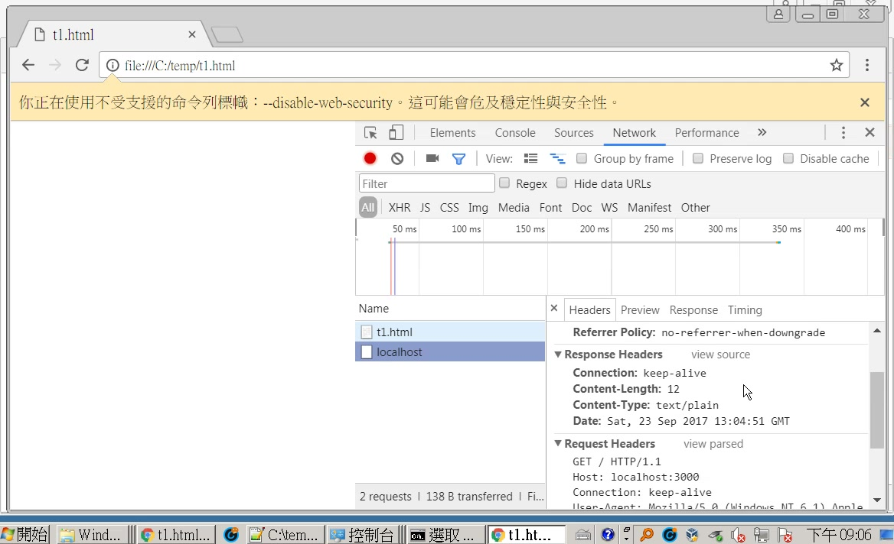
response headers

Slide 22
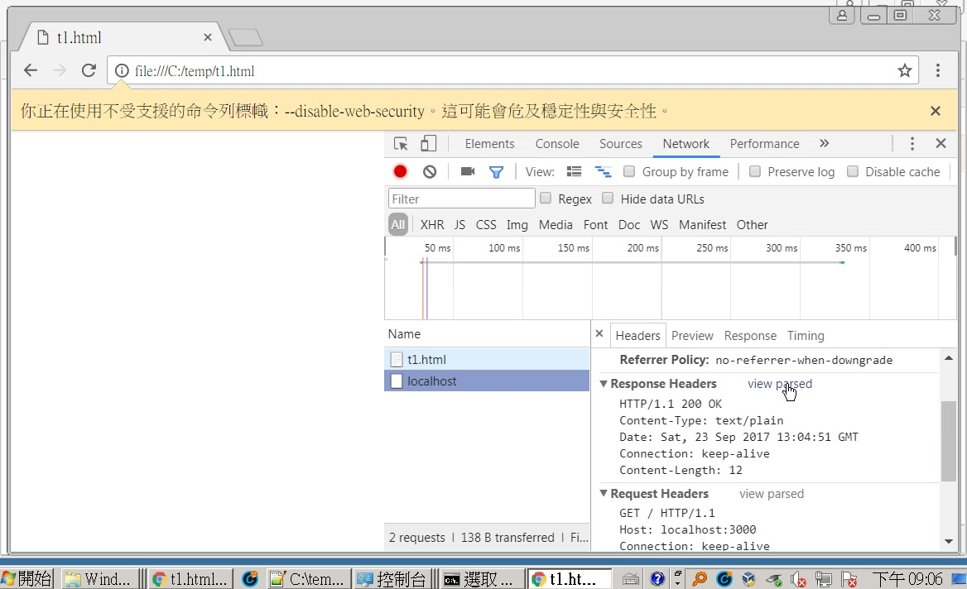

Slide 23


Slide 24
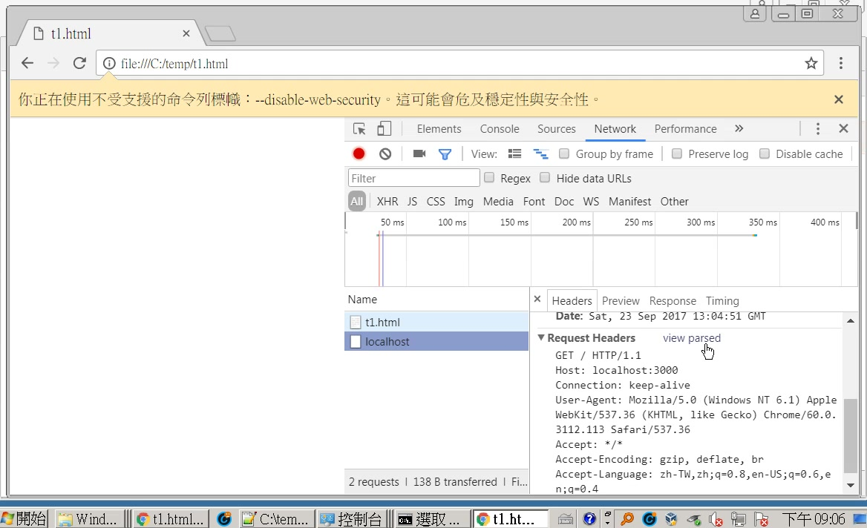
request headers

Slide 25
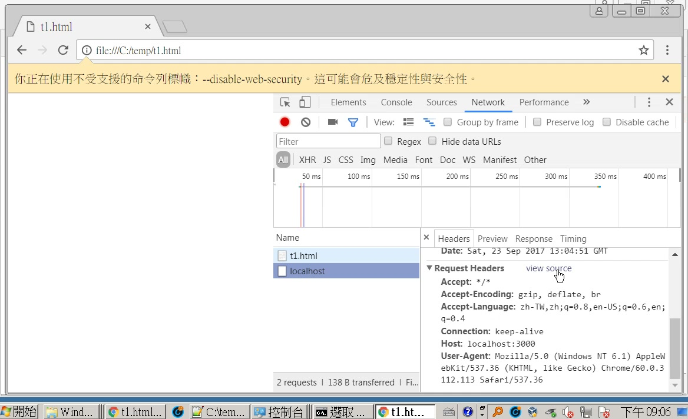

Slide 26
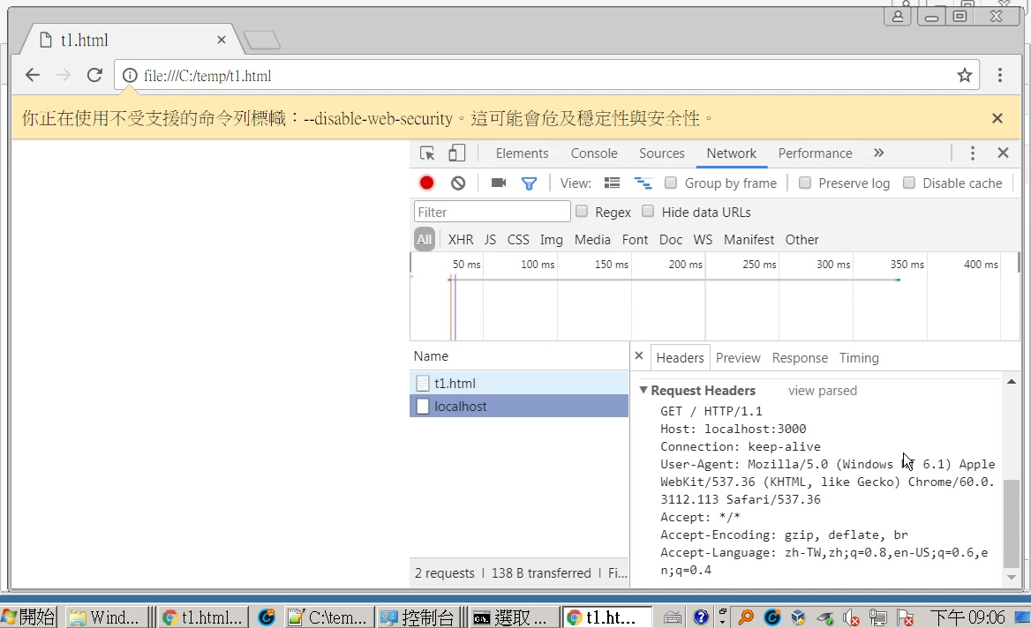

Slide 27
補充

Slide 28
利用dom導向另外一個URL
window.location.href = '...';
如果不想讓瀏覽器記錄在歷史中，則：
window.location.replace('...');

Slide 29
另一個解決辦法
修改server端的Header response

Slide 30
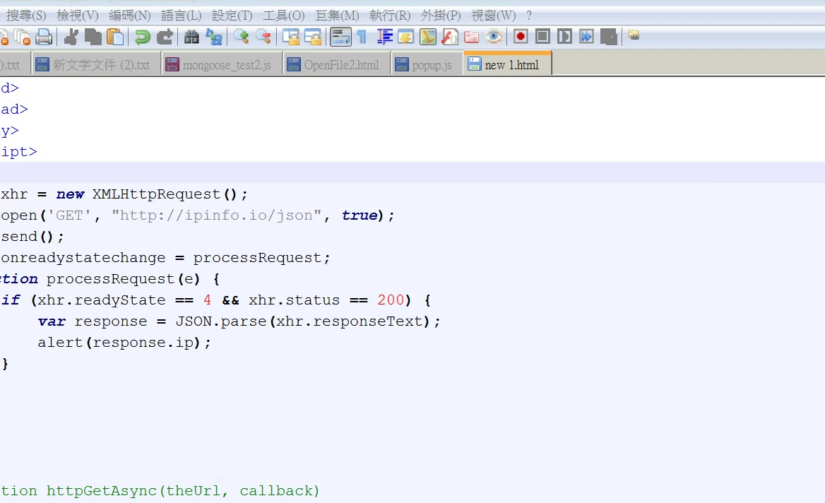
var xhr = new XMLHttpRequest();
xhr.open('GET', "http://ipinfo.io/json", true); //true-> async
xhr.send();
xhr.onreadystatechange = processRequest;
function processRequest(e) {
if (xhr.readyState == 4 && xhr.status == 200) {
var response = JSON.parse(xhr.responseText);
alert(response.ip);
}
}

Slide 31
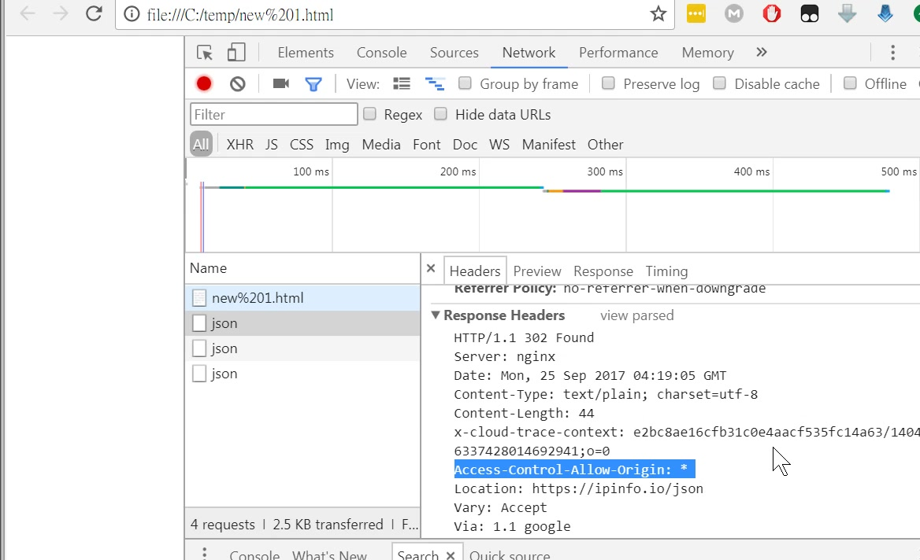

Slide 32
檔案：new 1.html
var xhr = new XMLHttpRequest();
xhr.open('GET', "http://ipinfo.io/json", true); //true-> async
xhr.send();
xhr.onreadystatechange = processRequest;
function processRequest(e) {
if (xhr.readyState == 4 && xhr.status == 200) {
var response = JSON.parse(xhr.responseText);
alert(response.ip);
}
}

Slide 33
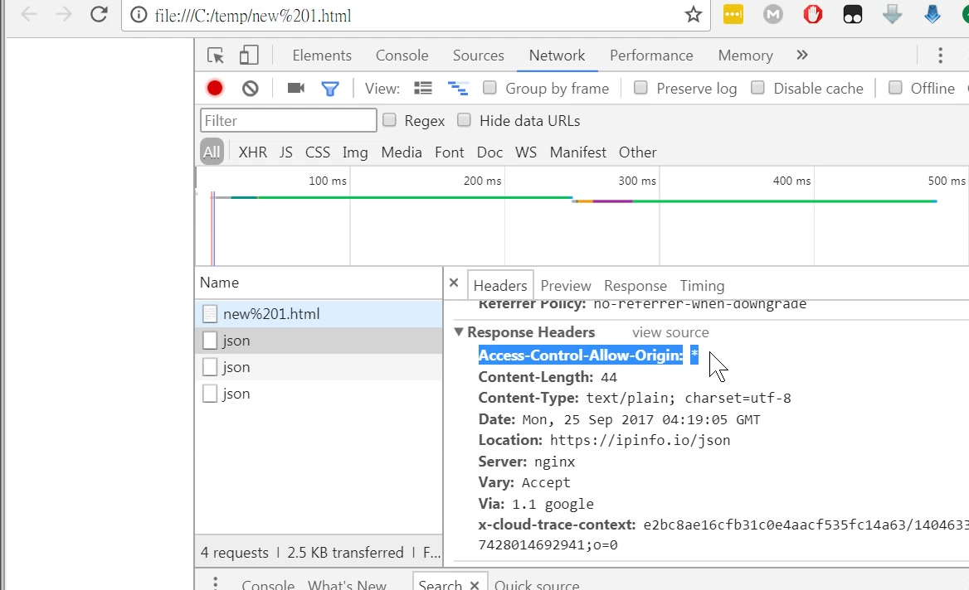

Slide 35
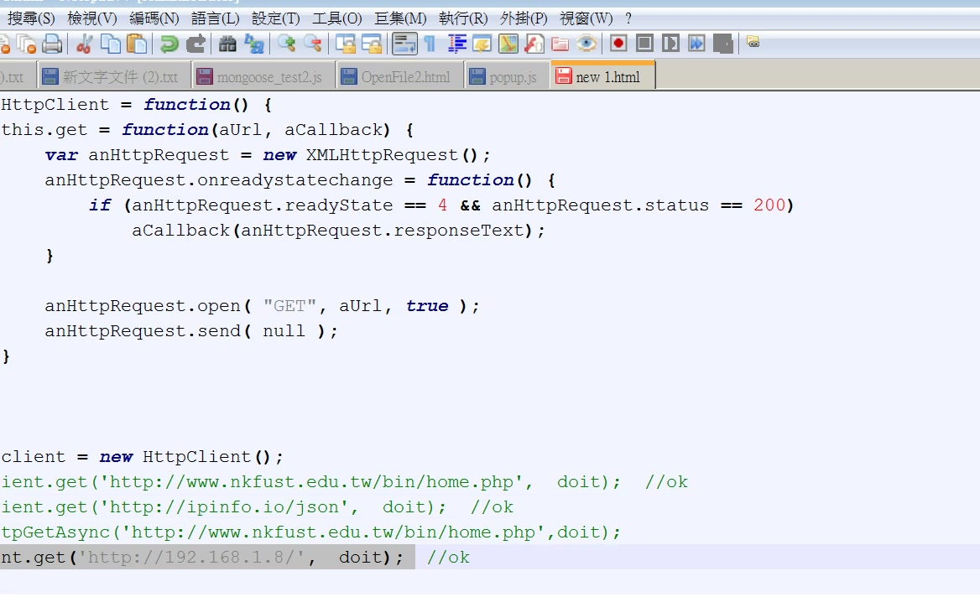
var doit = function (data)
{
console.log(data);
}
var HttpClient = function() {
this.get = function(aUrl, aCallback) {
var anHttpRequest = new XMLHttpRequest();
anHttpRequest.onreadystatechange = function() {
if (anHttpRequest.readyState == 4 &&
anHttpRequest.status == 200)
aCallback(anHttpRequest.responseText);
}
anHttpRequest.open( "GET", aUrl, true );
anHttpRequest.send( null );
}
}
var client = new HttpClient();
client.get('http://192.168.1.8/', doit); //ok
</script>

Slide 36
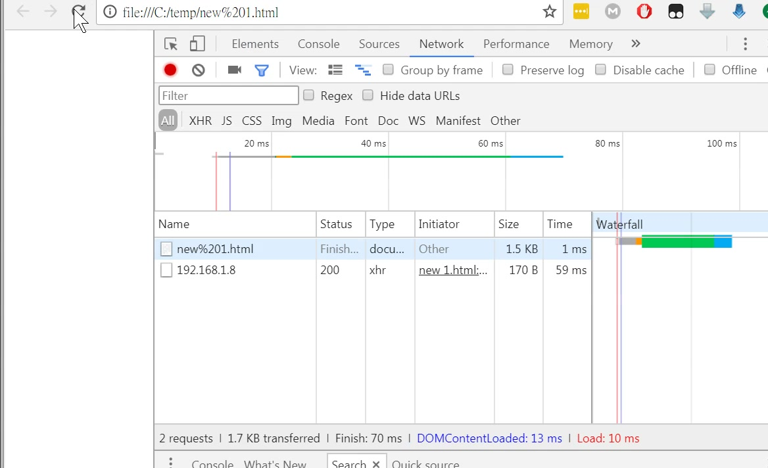

Slide 37
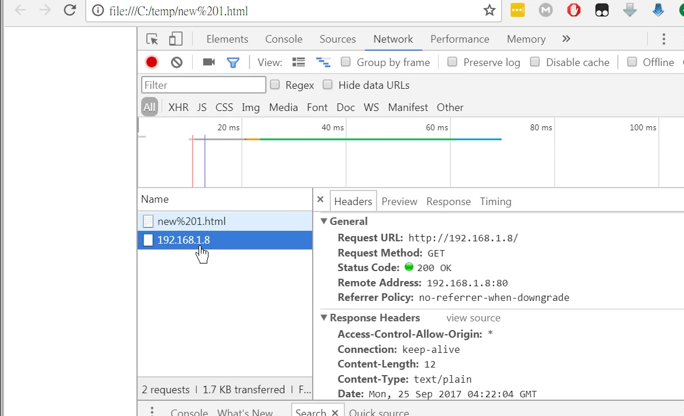

Slide 38
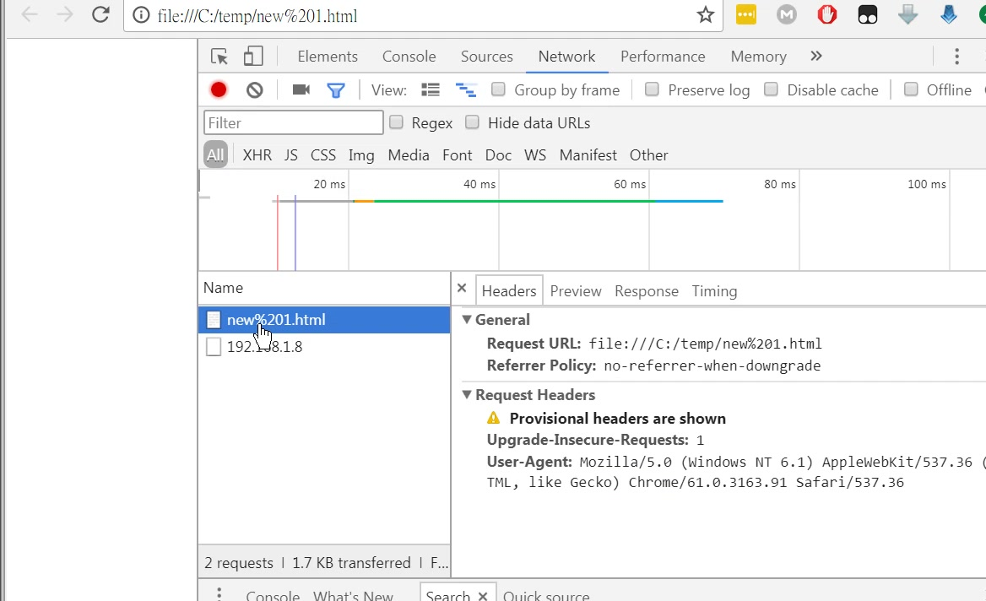

Slide 39
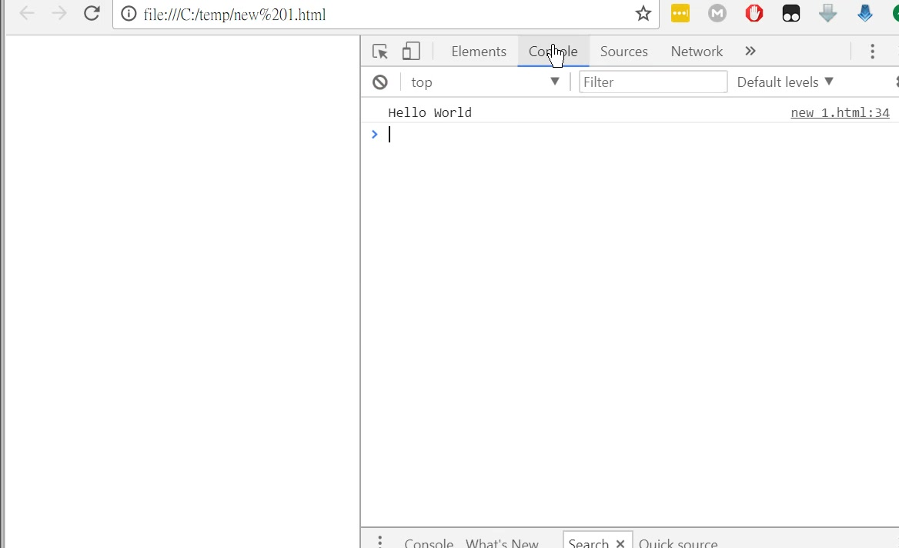

Slide 40
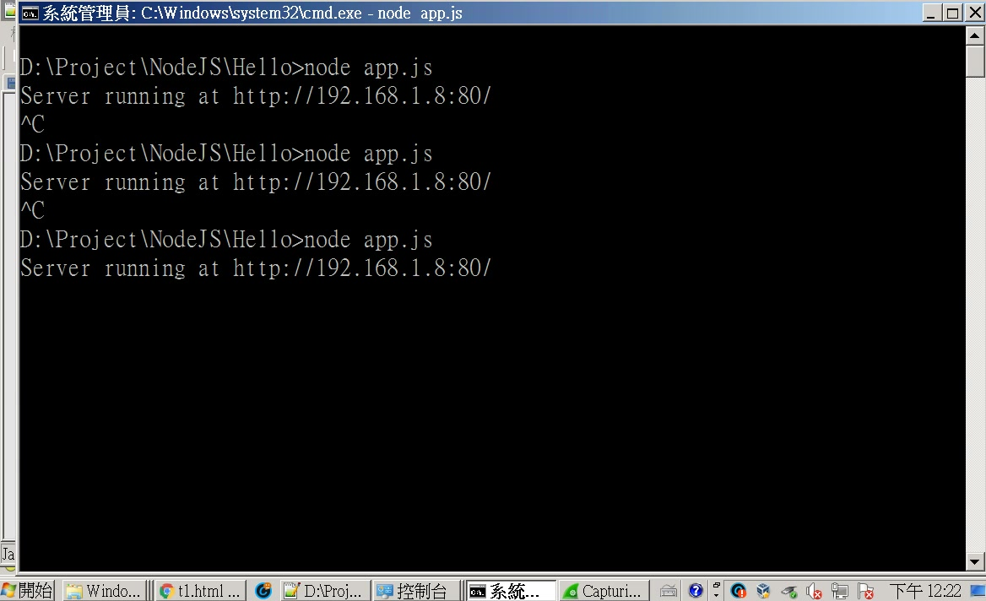

Slide 41
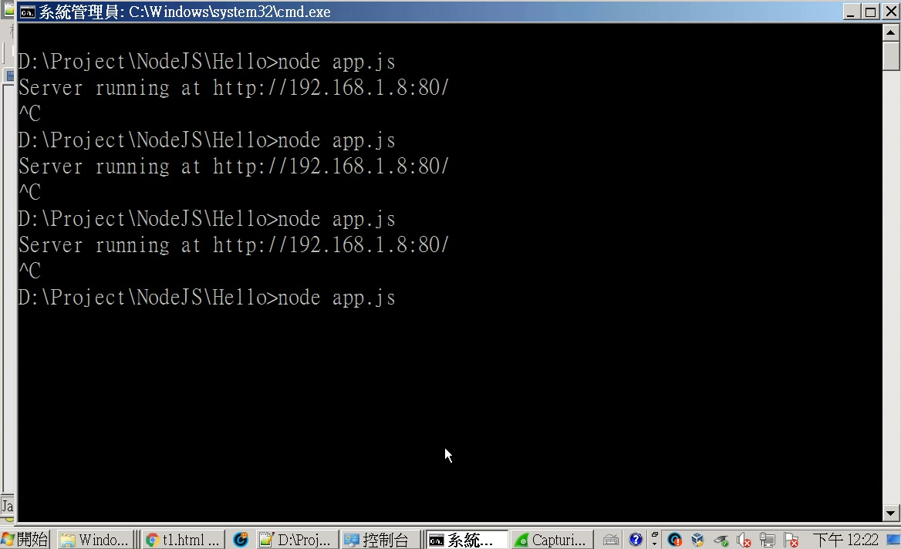
const http = require('http');
const hostname = '192.168.1.8';//'127.0.0.1';
const port = 80;//3000;
const server = http.createServer((req, res) => {
res.statusCode = 200;
res.setHeader('Content-Type', 'text/plain');
res.setHeader('Access-Control-Allow-Origin','*');
res.end('Hello World\n');
});
server.listen(port, hostname, () => {
console.log(`Server running at http://${hostname}:${port}/`);
});

Slide 42
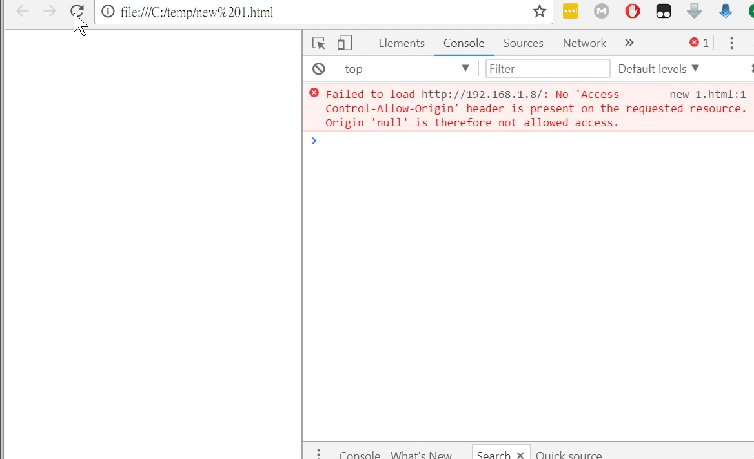
const http = require('http');
const hostname = '192.168.1.8';//'127.0.0.1';
const port = 80;//3000;
const server = http.createServer((req, res) => {
res.statusCode = 200;
res.setHeader('Content-Type', 'text/plain');
res.setHeader('Access-Control-Allow-Origin','*');
res.end('Hello World\n');
});
server.listen(port, hostname, () => {
console.log(`Server running at http://${hostname}:${port}/`);
});
沒有這行會有錯誤

