Slide 1
BRONCO PROPULSION LABORATORY | AIAA WMU
Software & Data Acquisition (DAQ)
Preliminary Design Review (PDR) — Static Test Stand
Software Subteam: Tyler Howard, Sarah Marcinkiewicz, Sofia Martinez
Team Lead: Olivia Perez | Faculty Advisor: Dr. O'Connell

Slide 2
PRELIMINARY DESIGN REVIEW (PDR)
1.0 Overview: Purpose & Subsystem Requirements
Subsystem Purpose
• Record force and temperature during 1.5 to 2.5 second motor burns.
• Provide a live screen at the laptop bunker so the team can monitor tests safely.
• Save every data point locally on the rig so we never lose data if wireless drops.
• Process raw test numbers into clean engineering graphs for our reports.
• Compare our real test curves directly against manufacturer motor specs.
Key Requirements
• Sampling Speed: 200 readings per second (200 Hz / 5ms intervals).
• Force Precision: 24-bit ADC for clear thrust resolution on the 250 lb load cell.
• Dual Storage: High-speed MicroSD card on the stand + live Wi-Fi stream to laptop.
• Auto-Tare: Software automatically zeroes out the scale weight right before ignition.
• Turnaround: Instant graph generation (< 1 second) once data is downloaded.
• Cost: $0.00 spent on software licenses (all built on Python and Arduino).

Slide 3
PRELIMINARY DESIGN REVIEW (PDR)
2.0 References: Senior Design Data & Rocketry Standards
Previous Senior Design Files
• Reviewed the 2024-2025 WMU Senior Design test logs (J1799, J425, L2200 runs).
• Found that the old Arduino Uno dropped data samples whenever it tried to write to storage.
• Upgraded to an ESP32-S3 chip with two CPU cores to separate sensor reading from file writing.
• Adopted the same physical load cell calibration techniques (using 25 lb weights).
Standards & Guidelines
• NASA-STD-5005D ground support instrumentation guidelines.
• NFPA 1125 / 1127 safety codes for rocket motor ground testing.
• NAR / TRA rocket motor letter class definitions (A through M).
• Safety perimeter rule: software operates wirelessly from >100 feet away.
Commercial Test Motors
• Aerotech J425R: 102 lbs peak force, 139 N-sec total push, 1.6s burn time.
• Aerotech J435WS: 156.5 lbs peak force, 174 N-sec total push, 1.7s burn time.
• Aerotech J450DM: 125 lbs peak force, 247 N-sec total push, 2.4s burn time.
• These specs are pre-loaded in our software so we can overlay them on real data.

Slide 4
PRELIMINARY DESIGN REVIEW (PDR)
3.0 Proposed Solution: Software Architecture
1. Rig Firmware (ESP32-S3)
• Dual-Core task split:
• • Core 1: Listens to the ADC interrupt at 200 Hz and grabs raw load cell numbers instantly.
• • Core 0: Writes data chunks to the MicroSD card and sends Wi-Fi packets.
• Keeps sensor timing steady so disk writes never freeze or drop a reading.
2. Ground Station (Laptop)
• Runs on the bunker laptop.
• Receives live Wi-Fi UDP packets from the stand.
• Displays live status in real time:
• • Current force (lbs)
• • Peak force seen so far
• • Motor casing & nozzle temperatures
• Saves a backup copy of all data as it arrives.
3. Data Processor (Python)
• Automated post-test analysis tool (processor.py).
• Takes raw CSV log files from the test.
• Zeroes resting weight and isolates the exact burn window.
• Calculates peak force, average force, burn time, and total impulse.
• Exports clean charts for our engineering reports.

Slide 5
PRELIMINARY DESIGN REVIEW (PDR)
3.1 Proposed Solution: Hardware Wiring & Simulator
Wiring Pinout (Matches KiCad Rev 2)
• Microcontroller: ESP32-S3 N16R8 (16MB Flash, 8MB PSRAM)
• Load Cell ADC (TI ADS1256 on SPI bus 2):
• • CS: GPIO 10 | MOSI: GPIO 11 | SCLK: GPIO 12 | MISO: GPIO 13
• • Data Ready (DRDY): GPIO 14 (Hardware interrupt on Core 1)
• 3x Thermocouple Amplifiers (MAX31856 on SPI bus 3):
• • Shared lines: Clock (GPIO 4), MISO (GPIO 5), MOSI (GPIO 6)
• • Select pins: Casing (GPIO 7), Ambient (GPIO 15), Nozzle (GPIO 16)
• MicroSD Card Slot:
• • 4-bit high-speed SDMMC: GPIOs 38, 39, 40, 41, 42, 2
Testing Harness (simulator.py)
• Built a fake data generator to test our code before the stand is built.
• Simulates realistic physics:
• • Ignition spike & combustion noise
• • Propellant burn profile over time
• • Thermocouple heating curves
• Lets the software team verify all calculations and charts right now on our laptops.

Slide 6
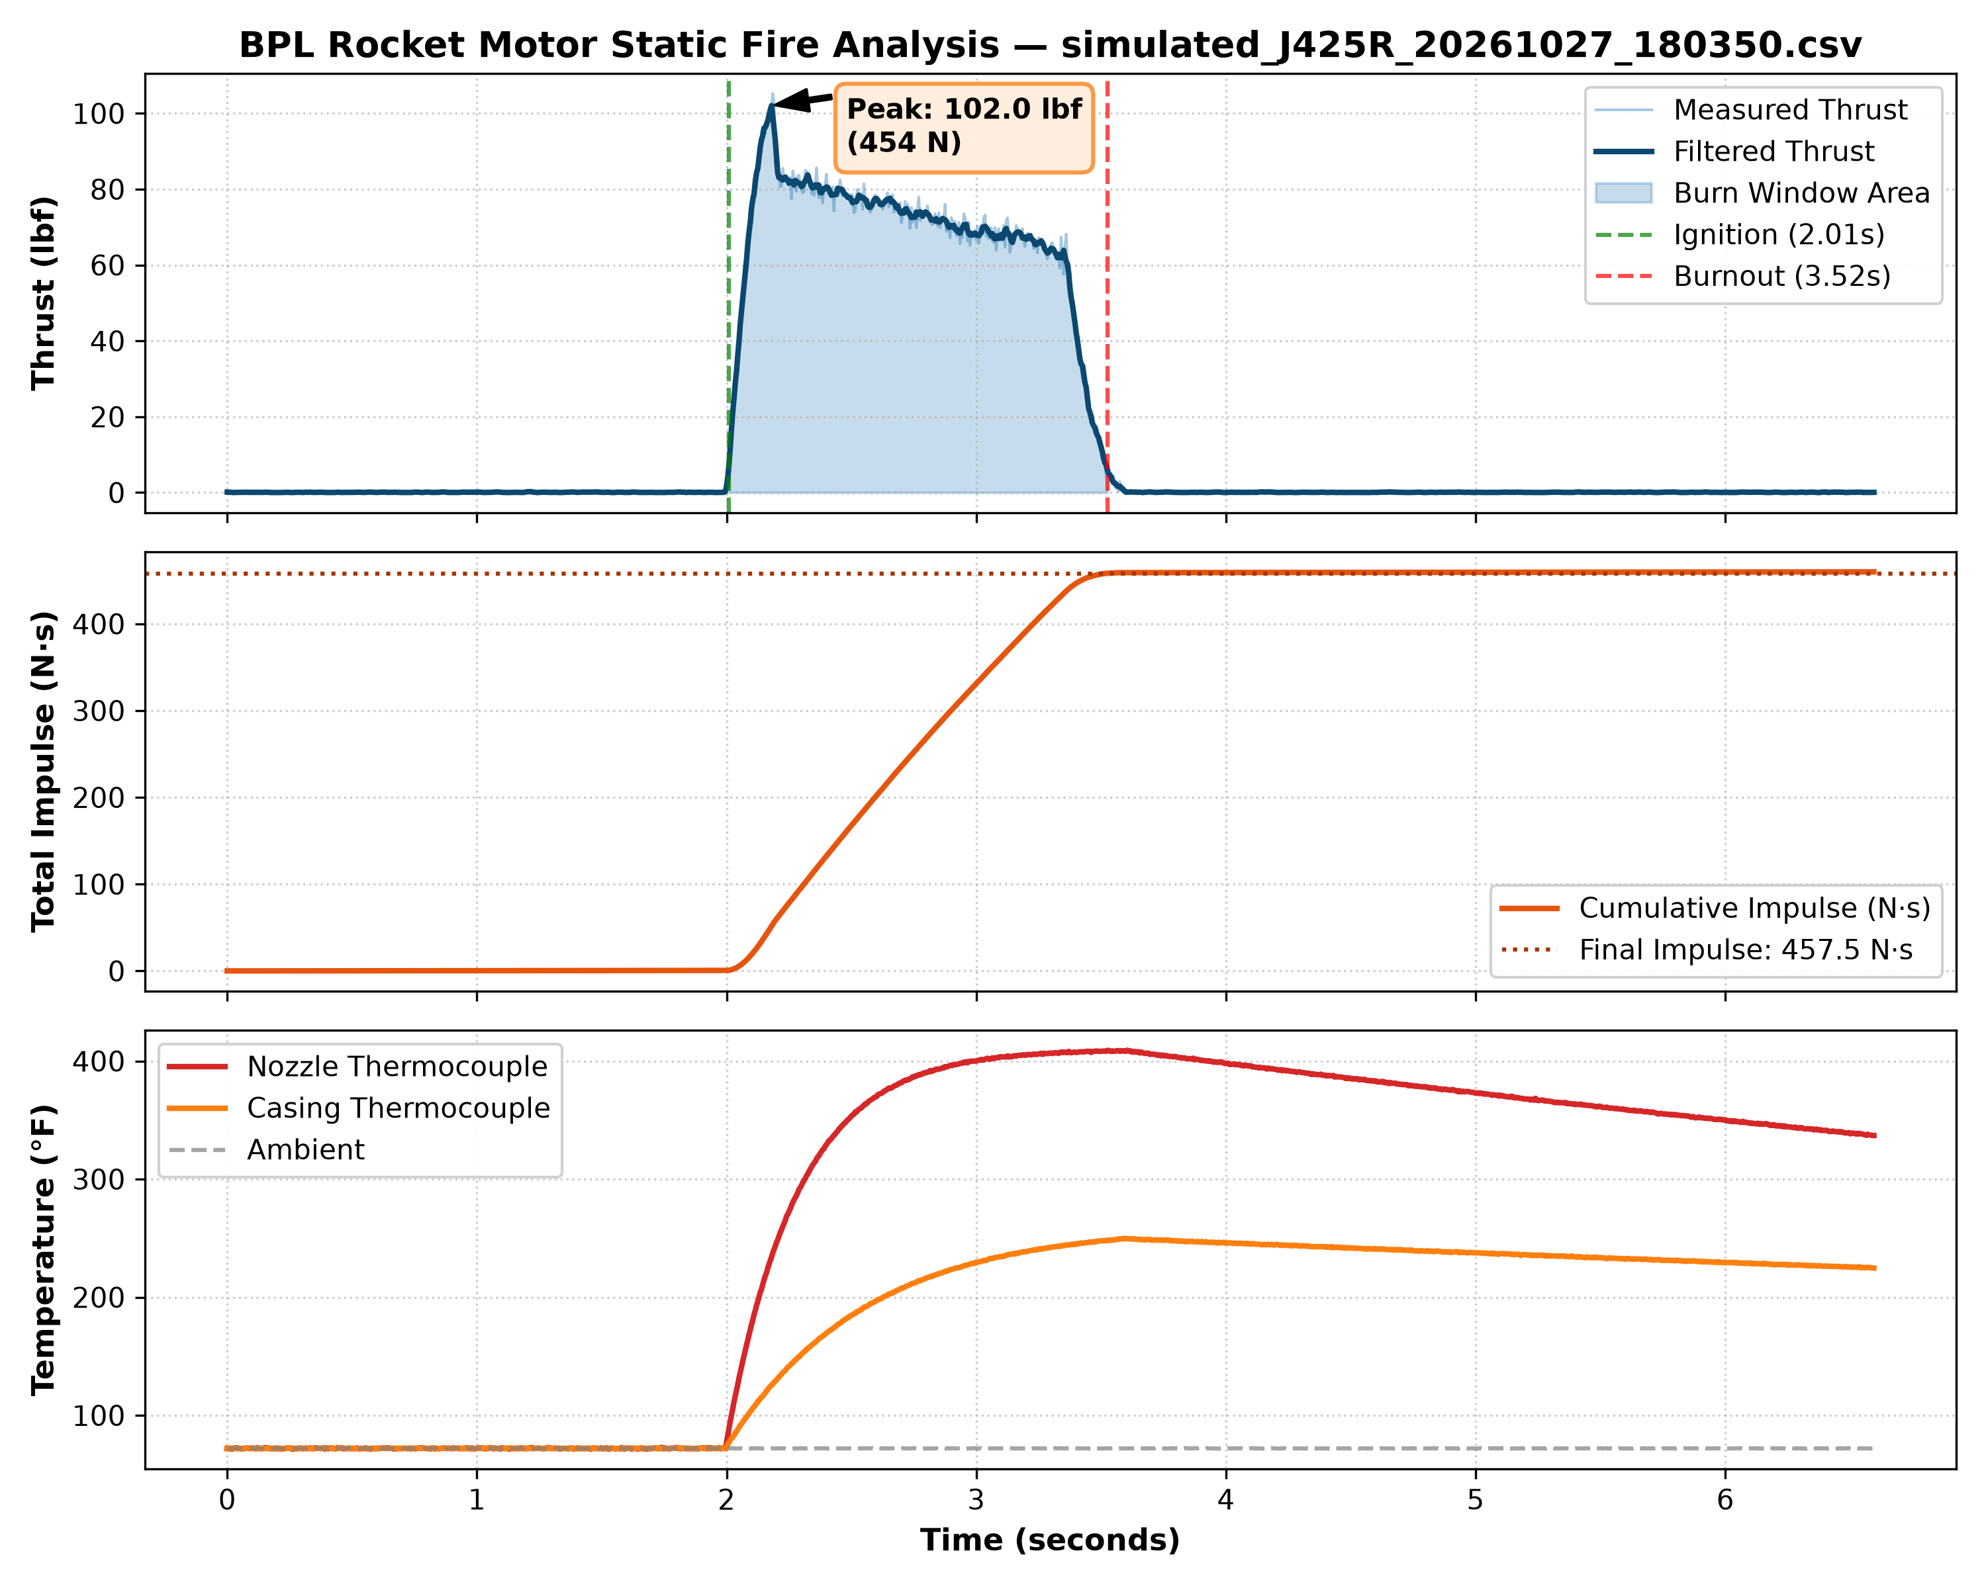
PRELIMINARY DESIGN REVIEW (PDR)
4.0 Analysis: Software Verification on Aerotech J425R Data
Calculated Results vs Spec
• Motor: Aerotech J425R (Redline)
• Sampling: 1,320 points @ 200 Hz
• Burn Time: 1.515 sec (Spec: 1.6 sec)
• Peak Force: 102.04 lbs (Spec: 102.0 lbs) [Exact match]
• Average Force: 67.68 lbs (301.1 Newtons)
• Total Impulse: 457.5 N-sec (Class I rating)
• Heating Results:
• • Casing Temp: Reached 249.8 °F (+177.9 °F rise)
• • Nozzle Temp: Reached 409.1 °F (+337.2 °F rise)
• Result: The code cleanly filters noise, finds ignition/burnout, and calculates accurate metrics.

Slide 7
PRELIMINARY DESIGN REVIEW (PDR)
5.0 Risks, Mitigations & Next Steps
Technical Risks & How We Solve Them
• Risk 1: Wi-Fi drops out during a static fire.
• -> Solution: The MicroSD card on the stand records independently. Wi-Fi is only for live viewing; all test data is stored locally on flash memory.
• Risk 2: Electrical noise from igniters or wires.
• -> Solution: 24-bit delta-sigma hardware filtering + moving average smoothing in our software.
• Risk 3: Scale zero-point drifting before fire.
• -> Solution: Software automatically takes a 500ms tare average right before ignition.
Action Items Ahead of TRR
• 1. Range Test at Field: Verify laptop Wi-Fi reception at 150 ft distance with the stand.
• 2. Scale Calibration: Run test code with standard 25 lb cinderblocks on the sensor to lock in exact calibration factor.
• 3. Mission Control Polish: Finalize live terminal display layout with Systems subteam.

Slide 8
PRELIMINARY DESIGN REVIEW (PDR)
6.0 Budget & Upcoming Milestones
Software Subteam Budget
• Total Software Expenses: $0.00
• • Python 3: Open-source (Free)
• • Libraries (pandas, numpy, matplotlib): Free
• • VS Code & Git: Free
• • Arduino IDE: Free
• No recurring fees or proprietary software costs.
• Leaves 100% of club funds ($4,401) for metal, motors, and hardware.
Key Dates
• Oct 28: Preliminary Design Review (PDR).
• Nov 1-15: Connect ESP32 to Electronics PCB.
• Nov 20: Bench test load cell calibration with weights.
• Dec 2: Test Readiness Review (TRR).
• Dec 5: Static Fire at Michiana site with commercial motors.
• Dec 10: Final test report and thrust curves.

