Slide 1

The Unavoidable Pain
Of Backups
—
Security Deep-Dive Into
The Internals Of NetBackup
Nicolas Devillers, Jean-Romain Garnier
@AirbusSecLab – Hexacon 2022

Slide 2

1
INTRODUCTION
2
LET’S MEET NETBACKUP
Target Overview: Key Technical Aspects
3
HOW WE DUG INTO NETBACKUP
The Approach, The Challenges And How We Tackled Them
4
FINDINGS
Overview Of Vulnerabilities And Attack Paths
5
TAKEAWAYS

Slide 3





WHO ARE WE?
Airbus Security Lab
SPEAKERS
CO-AUTHORS
Nicolas Devillers (@nikaiw)
10+ years in offensive security
Focus on vulnerability research and red teaming
Member of Airbus security lab
Mouad Abouhali (@_m00dy_)
Security evaluator
Benoît Camredon (@ben64_)
Security evaluator
Jean-Romain Garnier (@JRomainG)
Security evaluator for 2 years
Focus on reverse engineering and low-level security
Member of Airbus security lab
Anaïs Gantet
Security evaluator
Missions include:
As an internal offensive team, evaluating products that Airbus uses
(or intends to) or sells to increase the company’s overall security
Performing red teaming, vulnerability research, tooling development…
Checkout https://airbus-seclab.github.io and @AirbusSecLab
Notes:
=> We work to find vulnerabilities to increase company security

Slide 4
MOTIVATIONS
Why Backup Software?
BUSINESS PERSPECTIVE
Proper backup deployment paramount for resilience
Specialized software required for large-scale infrastructure
Often considered as “last line of defense”
RED TEAM PERSPECTIVE
Widely deployed across infrastructure with high privileges
Potential access to sensitive/critical data
Ability to move large amounts of data

Slide 5
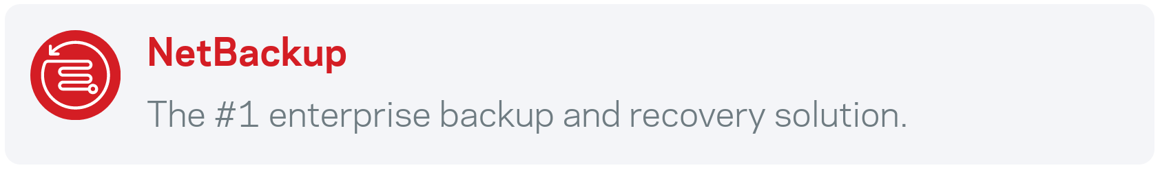


MOTIVATIONS
Why NetBackup?
Source: veritas.com/protection/netbackup
⋅⋅⋅
1987
Chrysler
1990
AWBUS
1993
BackupPlus
& NetBackup
1997
Veritas
2005
Symantec
2016
Veritas
BeeRumP Paris 2016, APT Cyber-Numérique Sur Sauvegardiciel Connecté – Émilien Girault
Full Disclosure 2017 – Sven Blumenstein, Xiaoran Wang and Andrew Griffiths from Google Security
Notes:
Some binaries start with “bp as in BackupPlus”; this give an idea on when the binaries were made
Quickly explain Google + Emilien findings
Mention we’ll now share our technical work, lessons learned and more

Slide 6
1
INTRODUCTION
2
LET’S MEET NETBACKUP
Target Overview: Key Technical Aspects
3
HOW WE DUG INTO NETBACKUP
The Approach, The Challenges And How We Tackled Them
4
FINDINGS
Overview Of Vulnerabilities And Attack Paths
5
TAKEAWAYS
Notes:
idées pour l'oral: dire que cette partie est là pour présenter les grandes lignes du vocabulaire fonctionnel des composants principaux de nbu pour embarquer l'auditoire pour la suite de l'histoire ; ainsi que les questions de sécurité que l'on se pose initialement en découvrant le fonctionnement de la solution
=> Préciser que l’objectif de la conf c’est pas de détailler toutes les vulns, parce que c’est pas intéressant en fait !

Slide 7
LET’S MEET NETBACKUP
NetBackup Architecture Overview
¹ Formerly “Master Server”
² To be replaced by “NetBackup IT Analytics”
OpsCenter
²
Domain A
Domain B
Media Server
Media Server
Primary Server
Primary Server
¹
Media Server
Media Server
Client
Client
Client
Client
Client
Client
Notes:
“User story” about setting up a NetBackup infrastructure: put yourself in the head of your worst nemesis for a second: the sysadmin
=> think about what your need is, how each component addresses that need, and how new needs appear:
Need to backup hosts -> Client, need to orchestrate backups -> Primary, need to handle storage -> media, need to segregate networks / hosts -> domains, need to manage domains -> Ops

Slide 8
LET’S MEET NETBACKUP
More About NetBackup Clients
CLIENT DEPLOYMENT OPTIONS
Domain A
Bare-metal
Cloud
Virtualized
Database
Media Server
OPERATING SYSTEM
…
Primary Server
Windows
Red Hat
IBM AIX
HP-UX
Media Server
CONFIGURATION
://
…
Client-side Encryption
Secure communication
HTTP Tunneling
Client
Client
Client
Notes:
Secure communication is a feature that has been added after the work presented at beerrump to have authentication of computers instead of identification
Client role: perform backups
=> Focus on wide integration (infra + OS) and many features, thus many possible configurations

Slide 9
LET’S MEET NETBACKUP
More About NetBackup Primary Servers
PRIMARY SERVER DEPLOYMENT OPTIONS
Domain A
…
Cluster
Media
Appliance
Media Server
BACKUP COMPONENTS
…
Primary Server
Policies
Catalog
API
Web UI
Media Server
SECURITY CONFIGURATION
…
Secure communication
Client
Client
Client
Notes:
Primary server role: defining element of domain; backup and archive policy management, job monitoring and reporting, hosting catalog databases, executing backups, archives, and restores
=> Focus a bit on backup policies and mostly on catalog: contains conf, correspondence between client and backup location, storage devices used by which media server, etc; paramount for data recovery (actually 2 databases + files)
=> Secure Comm: feature to move from identification to certificate authentication

Slide 10
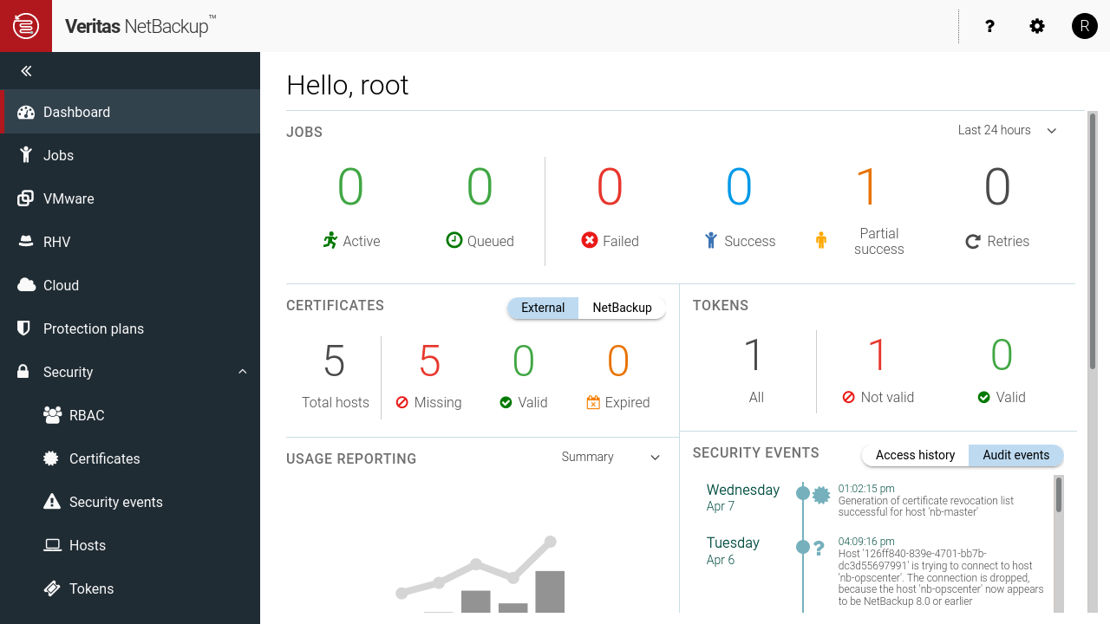
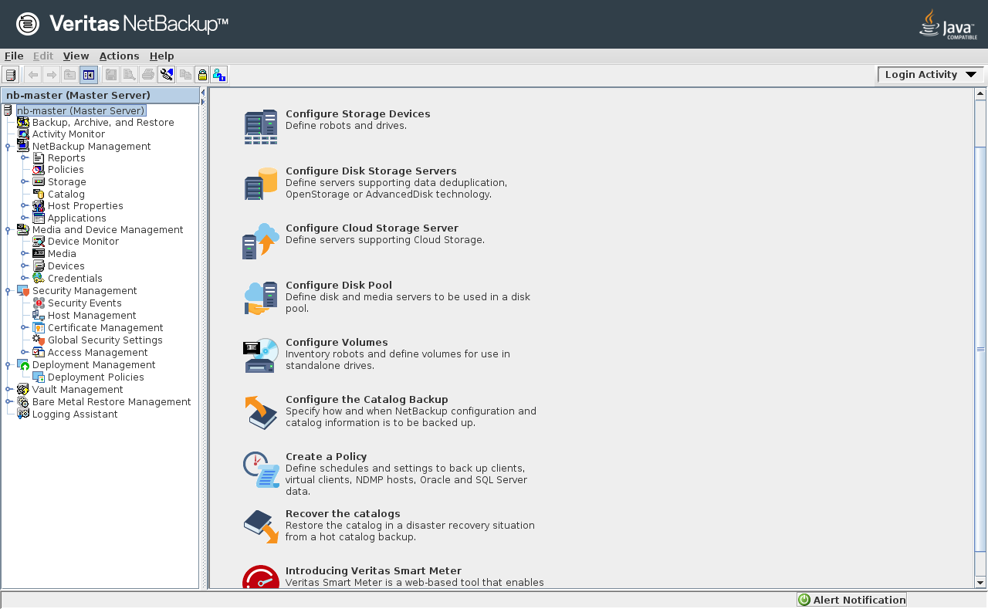
LET’S MEET NETBACKUP
More About NetBackup Primary Servers
Domain A
Media Server
Primary Server
Media Server
Client
Client
Client
Notes:
Here’s what managing a Primary server looks like: a Web UI and and Java console

Slide 11
LET’S MEET NETBACKUP
More About NetBackup Media Servers
MEDIA SERVER DEPLOYMENT OPTIONS
Domain A
Disk pool
Tape library
Appliance
Media Server
STORAGE CONFIGURATION
…
Primary Server
Deduplication
Catalog
Media Server
STORAGE SECURITY
…
Data encryption
Offline
storage
WORM
Client
Client
Client
Notes:
Media Server role: control storage interaction (reads/writes data to/from storage), has access to NetBackup clients of the domain only
Notes anais : parler du chiffrement des backups par ici

Slide 12
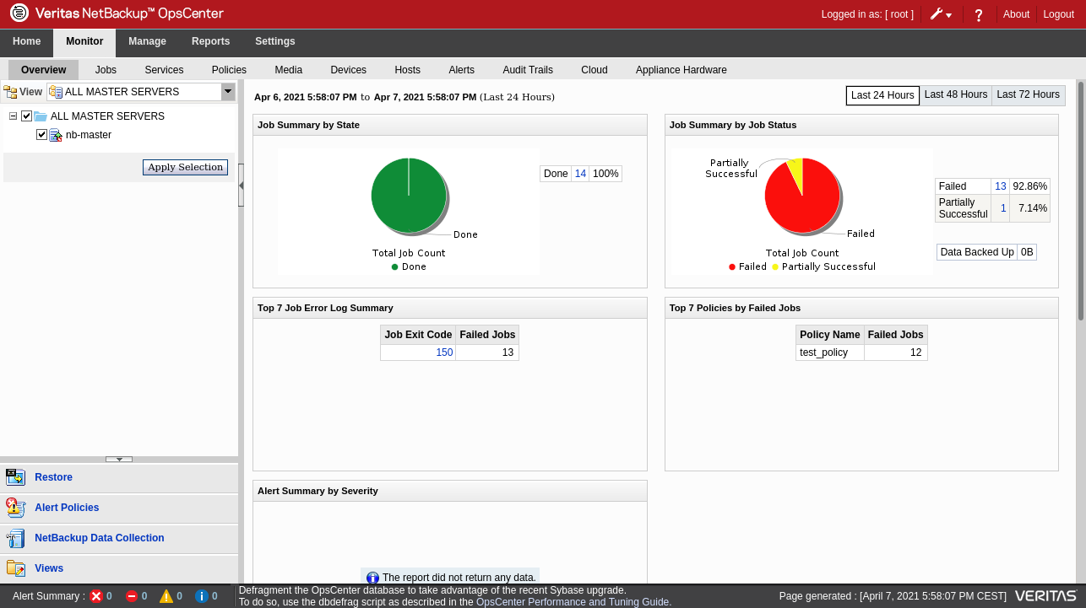
LET’S MEET NETBACKUP
More About The NetBackup OpsCenter
OPSCENTER ROLES
OpsCenter
Domain A
Media Server
Monitor
Manage
Report
Primary Server
Media Server
Client
Client
Client

Slide 13
LET’S MEET NETBACKUP
NetBackup Trust Model
Caption
A
B
A is trusted by B
OpsCenter
Primary Server
Client
Client
Media Server

Slide 14
1
INTRODUCTION
2
LET’S MEET NETBACKUP
Target Overview: Key Technical Aspects
3
HOW WE DUG INTO NETBACKUP
The Approach, The Challenges And How We Tackled Them
4
FINDINGS
Overview Of Vulnerabilities And Attack Paths
5
TAKEAWAYS

Slide 15
HOW WE DUG INTO NETBACKUP
Starting Point: Asking Security Questions (And Quick Spoilers)
1. What would it take for an attacker to exploit NetBackup?
⇒ Specific tooling & workflow knowledge, not out of reach of motivated attackers
2. Can a Primary Server be compromised from a NetBackup client?
⇒ Yes, and more:
CVE-2022-36948, CVE-2022-36949, CVE-2022-36950, CVE-2022-36951, CVE-2022-36953, CVE-2022-36954, CVE-2022-36955, CVE-2022-36984, CVE-2022-36985, CVE-2022-36986, CVE-2022-36987, CVE-2022-36988, CVE-2022-36989, CVE-2022-36990, CVE-2022-36991, CVE-2022-36992, CVE-2022-36993, CVE-2022-36994, CVE-2022-36995, CVE-2022-36996, CVE-2022-36997, CVE-2022-36998, CVE-2022-36999, CVE-2022-37000, CVE-2022-42299, CVE-2022-42300, CVE-2022-42301, CVE-2022-42302, CVE-2022-42303, CVE-2022-42304, CVE-2022-42305, CVE-2022-42306, CVE-2022-42307, CVE-2022-42308
3. Could the NetBackup system be used as a pivot to attack other interconnected systems?
⇒ Follow along for a full-chain demo!
4. Which data could an attacker target to prevent NetBackup recovery?
⇒ Backup data or backup metadata, more details later on
Notes:
Answers we reached through our evaluation
Specific understanding about backup workflow + nbu commands etc.
=> How did we reach them? Follow along for our methodology & detailed answers
=> Reminder: we won’t detail vulns as they’re not all interesting, not the goal of the presentation

Slide 16
HOW WE DUG INTO NETBACKUP
Our Approach To Discover What’s Under The Hood
Find a team of motivated people
⇒ 5 evaluators over the course of several months
Read some documentation
⇒ Learn about main components & concepts
Setup some labs
⇒ Use customer installers (8.2–9.1), apply & check understanding, find questions
Talk with architects
⇒ Get practical knowledge, understand risks & ask questions
Read more documentation
⇒ Don’t forget about security & administrator guides
Play with our labs
⇒ Don’t forget to go back to previous steps
Notes:
NetBackup public documentation + NetBackup installers for each component (v 8.2 to 9.1, focus on 8.2) + demos of features from IT teams who use and manage this product in our company
Lab: Custom infrastructure w/ basic NBU configuration (at least 1 VM per component with debug means)

Slide 17
HOW WE DUG INTO NETBACKUP
Our Approach To Discover What’s Under The Hood
Play with our labs?
⇒ What does it even mean?
First naive questions
What processes are running on each component?
How do components communicate with each other?
What services are exposed remotely? Locally?
Notes:
What does “play with our labs” actually mean?
=> Try to answer some practical questions

Slide 18
HOW WE DUG INTO NETBACKUP
Too Many Binaries, Too Little Time: $ ps To The Rescue
Java Web Server
ops_atd
OpsCenterDBd
OpsCenterServerd
pbx_exchange
bpcd bpcompatd bpdbm bpjobd bprd | Java Web Server ltid nbars nbatd nbaudit | nbazd nbdisco nbemm nbevtmgr nbim | nbjm nbkms nbpem nbproxy nbrb
 |  | nbrmms nbsl nbstserv nbsvcmon nbvault | NB_dbsrv pbx_exchange vmd vnetd
bpcd
nbdisco
nbrmms
nbsl
nbsvcmon
pbx_exchange
vmd
vnetd
avrd bmrbd bmrd bmrpxeserver bpinetd | nbostpxy PXEMTFTP spoold spad
avrd | bpinetd nbcssc | nbostpxy nbrntd
bpcd bpbkar nbdisco | pbx_exchange vnetd
Daemons run as root / SYSTEM; newer versions have an option to change user on some components
Notes:
Story-telling: discovery of the landscape of binaries (daemons) -> showcase once again the complexity and illustrate the question “where do we even start?”
=> Only daemons are listed, there are plenty of other binaries; and we probably haven’t found all of them
=> Ok, there is way too much stuff, let’s have a look at what’s exposed

Slide 19
HOW WE DUG INTO NETBACKUP
Too Many Daemons, Too Little Time: $ ss To The Rescue
Java Web Server
OpsCenterDBd
pbx_exchange
bpcd bpdbm bpjobd bprd | Java Web Server nbatd | nbazd
 |  | nbsl | NB_dbsrv pbx_exchange vmd vnetd
bpcd
pbx_exchange
vmd
vnetd
bpcd | pbx_exchange vnetd
Notes:
Plenty of daemons listening, but also plenty don’t => what are they for?

Slide 20
HOW WE DUG INTO NETBACKUP
Too Many Daemons, Too Little Time: $ ss To The Rescue
Client
OpsCenter
Primary
Media
Binary name
Address:Port
OpsCenterDBd
Java Web Server
pbx_exchange
vnetd
bpcd
vmd
bprd
bpdbm
nbazd
bpjobd
nbatd
NB_dbsrv
nbsl
127.0.0.1:13786
0.0.0.0:8443
0.0.0.0:1556
0.0.0.0:13724
0.0.0.0:13782
0.0.0.0:13701
0.0.0.0:13720
0.0.0.0:13721
0.0.0.0:13722
0.0.0.0:13723
0.0.0.0:13783
0.0.0.0:13785
127.0.0.1:9284

Slide 21
HOW WE DUG INTO NETBACKUP
Too Many Daemons, Too Little Time: $ ss To The Rescue
Client
OpsCenter
Primary
Media
Binary name
Address:Port
OpsCenterDBd
Java Web Server
pbx_exchange
vnetd
bpcd
vmd
bprd
bpdbm
nbazd
bpjobd
nbatd
NB_dbsrv
nbsl
127.0.0.1:13786
0.0.0.0:8443
0.0.0.0:1556
0.0.0.0:13724
0.0.0.0:13782
0.0.0.0:13701
0.0.0.0:13720
0.0.0.0:13721
0.0.0.0:13722
0.0.0.0:13723
0.0.0.0:13783
0.0.0.0:13785
127.0.0.1:9284
legacy ports

Slide 22
HOW WE DUG INTO NETBACKUP
How To Navigate An Ocean Of Binaries To Understand What’s Under The Hood
java
bpcompatd
bpdbm
bprd
nbemm
ops_atd
bpcd
nbsvcmon
nbatd
OpsCenterDBd
C/C++
nbdisco
nbvault
nbrmms
nbars
OpsCenterServerd
Java
vnetd
nbazd
nbsl
ltid
How to keep going on
nbaudit
pbx_exchange
bpbkar
nbsvcmon
nbstserv
CORBA
Read more documentation
Play real use cases and observe
Choose binaries of interest
nbevtmgr
bpjobd
NB_dbsrv
nbkms
nbpem
nbim
vmd
nbrb
nbproxy
Sybase
nbjm

Slide 23
HOW WE DUG INTO NETBACKUP
Understanding A (Simplified) Workflow: The Use Case Of A Client Backup
Primary Server
bprd
Scheduled backup
pbx_exchange/vnetd
Backup metadata
1
bpcompatd
2
pbx_exchange/vnetd
Backup request
Media Server
Client
bpcd
5
bpbkar
4
Backup data
pbx_exchange/vnetd
Backup request / Backup data
bptm
bpbrm
3
bpcd
Storage
Notes:
Could imagine several infrastructures (push / pull), NetBackup uses a mix of both: all components both listen AND connect
First part of answer to security question 1: “this is what we mean when we say specific workflow knowledge: root is ‘not enough’, you need command knowledge and understand component interactions”

Slide 24
HOW WE DUG INTO NETBACKUP
Understanding The Workflow Of Some Edge Cases: The Use Case Of Dmz Clients
Primary Server
Media Server
LAN
Internal Firewall
HTTP Proxy
Client
Demilitarized Zone
External Firewall

Slide 25
HOW WE DUG INTO NETBACKUP
Our Covered Attack Surface
Client
OpsCenter
Primary
Media
Binary name
Acronym meaning
ops_atd
OpsCenterServerd
pbx_exchange
vnetd
bpcd
nbsl
bprd
nbatd
NB_dbsrv
OpsCenter Authentication Daemon
OpsCenter Server Daemon
Private Branch Exchange Service
NetBackup Network Communications Service Daemon
NetBackup Client Service Daemon
NetBackup Service Layer
NetBackup Request Daemon
NetBackup Authentication Daemon
NetBackup Relational Database Manager
Notes:
ops_atd == nbatd
Emphasis on pbx_exchange as we’ll talk about it just after

Slide 26
HOW WE DUG INTO NETBACKUP
Going Back To A More Standard Approach
Component-specific documentation
⇒ Veritas knowledge base
Static analysis
⇒ Linux & Windows
Process debugging
⇒ perf-tools (ebpf), GDB / x64dbg, function hooking
Network traffic analysis
⇒ Wireshark, MITM (pynet), TLS decryption
Custom tooling
⇒ Scripts, plugins, etc.
Follow logs
⇒ Debug level contains a lot of very useful information
⇒ inotify, Git to track modified files
Notes:
A lot of logs -> flooded with information -> inotify + bpftrace + git dying
Root on the host, but not easy: too much stuff (concepts, certificates, etc.)

Slide 27
HOW WE DUG INTO NETBACKUP
The Role Of pbx_exchange
> pbx_exchange
> The Private Branch Exchange (PBX) service provides single-port access to clients outside
> the firewall that connect to Veritas product services
Primary Server
bprd
Scheduled backup
bpcompatd
pbx_exchange/vnetd
Backup metadata
1
2
pbx_exchange/vnetd
Backup request
Media Server
Client
bpcd
5
bpbkar
Backup
data
pbx_exchange/vnetd
Backup request / Backup data
bptm
4
3
bpcd
bpbrm
Storage
Notes:
We presented a whole lot of attack surface, but then focus on pbx_exchange because it’s the entrypoint to all this attack surface

Slide 28
HOW WE DUG INTO NETBACKUP
The Role Of pbx_exchange
> pbx_exchange
> The Private Branch Exchange (PBX) service provides single-port access to clients outside
> the firewall that connect to Veritas product services
# ss | grep pbx_exchange
127.0.0.1:42437 pbx_exchange
127.0.0.1:33075 pbx_exchange
127.0.0.1:1557 pbx_exchange
0.0.0.0:1556 pbx_exchange
# ss | grep pbx_exchange
127.0.0.1:36493 pbx_exchange
127.0.0.1:35003 pbx_exchange
127.0.0.1:1557 pbx_exchange
0.0.0.0:1556 pbx_exchange
# ss | grep pbx_exchange
127.0.0.1:41011 pbx_exchange
127.0.0.1:32841 pbx_exchange
127.0.0.1:1557 pbx_exchange
0.0.0.0:1556 pbx_exchange
# ss | grep pbx_exchange
127.0.0.1:36227 pbx_exchange
127.0.0.1:33765 pbx_exchange
127.0.0.1:1557 pbx_exchange
0.0.0.0:1556 pbx_exchange

Slide 29
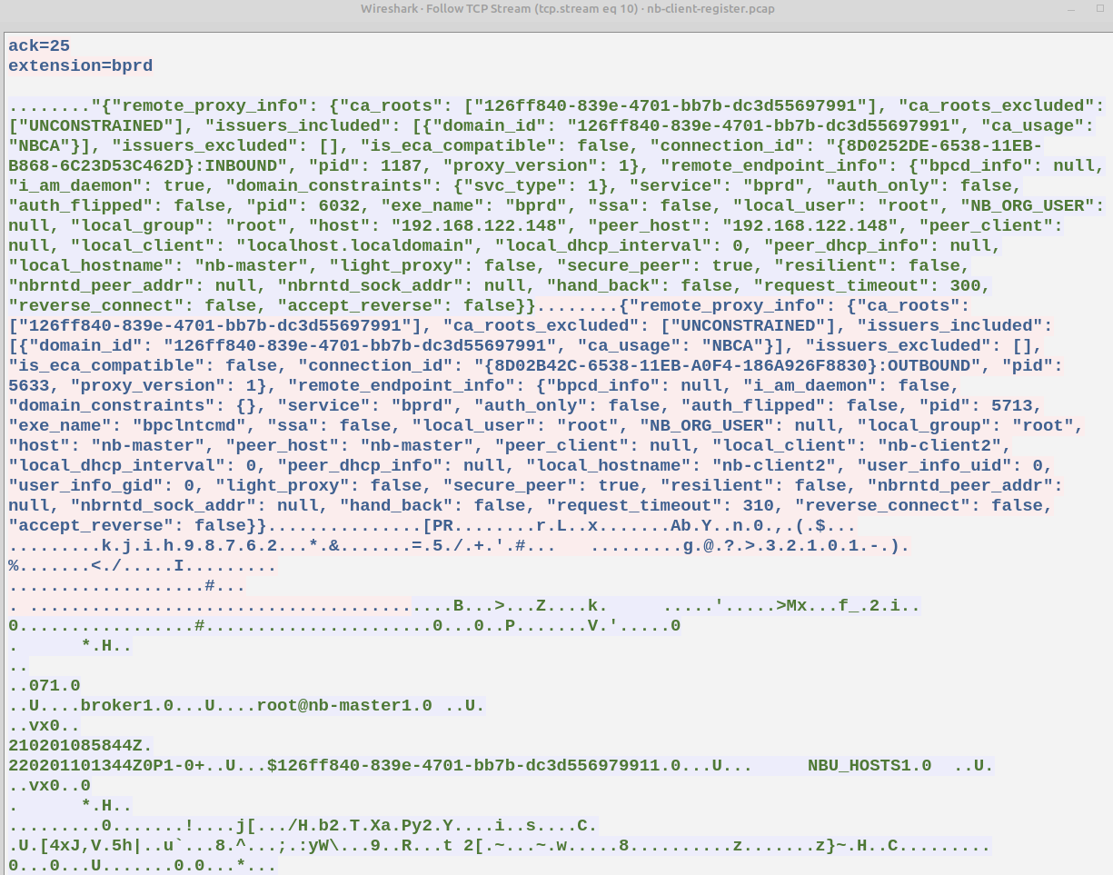
HOW WE DUG INTO NETBACKUP
The Role Of pbx_exchange
pbx init
secure comm init
pbx_exchange
TLS handshake

Slide 30
HOW WE DUG INTO NETBACKUP
Component Communication With pbx_exchange: Example Of nbatd
Primary Server
Caption
pbx_
exchange
1556
cnx
nbatd
TCP
1556
port number P
UNIX socket
P
cnx
Client
cnx
1556
P
UNIX path U
S
U
connect
U
socket descriptor S
communication
S
Notes:
From the perspective of the client, cnx and comm are the same connection, it’s transparent

Slide 31
HOW WE DUG INTO NETBACKUP
Component Communication With pbx_exchange: MITM-ing nbatd
Primary Server
Caption
pbx_
exchange
1556
cnx
proxy
1557
cnx
nbatd
TCP
1556
port P
1557
port P’
UNIX socket
P
cnx
P’
cnx
Client
cnx
1556
P
UNIX path U
P’
UNIX path U’
S
U
connect
cnx
U’
connect
U
socket S
bind
S’
U’
socket S’
communication
S
communication
S’
Notes:
Goal: perform a HITM between the client and nbatd
Difficulties: listen on the same port as an already binded process + intercept and modify a socket descriptor on a unix socket
Note: LD_PRELOAD to change port 1556 to 1557 by replacing call to connect with content of environment variable

Slide 32
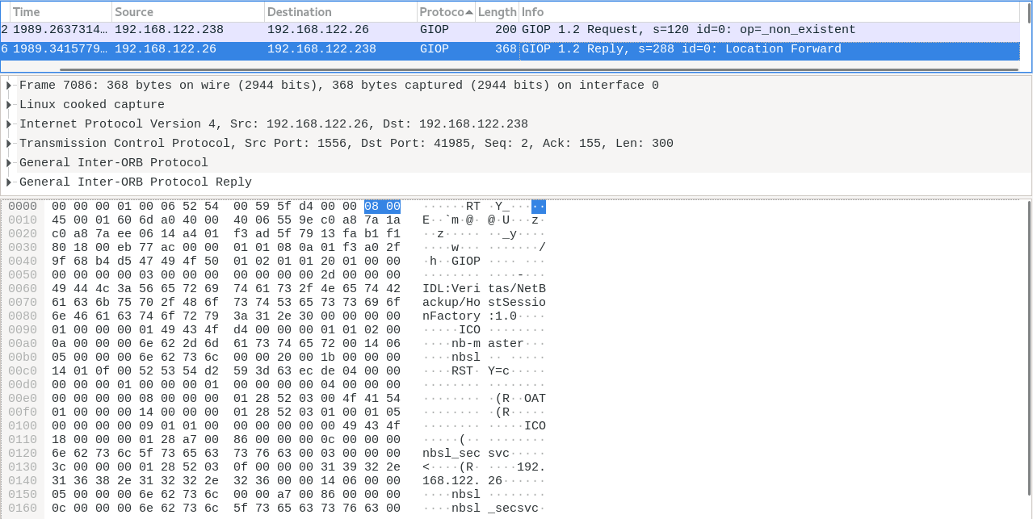
HOW WE DUG INTO NETBACKUP
Remote Procedure Call: Example Of CORBA
BeeRumP Paris 2016: APT Cyber-Numerique Sur Sauvegardiciel Connecté – Émilien Girault
⇒ CORBA with proprietary layer (PBXIOP) in C++ binaries
Notes:
What goes into the pipes after the pbx_exchange connection?
=> One example: CORBA
=> According to BeeRumP prez: implemented in C++ binaries

Slide 33
HOW WE DUG INTO NETBACKUP
Remote Procedure Call: find To The Rescue
[root@nb-opscenter ~]# find / -iname "*orb*.jar" -o -iname "*iop*.jar" 2>/dev/null
/opt/SYMCOpsCenterServer/lib/pbxiop2.jar
/opt/SYMCOpsCenterServer/lib/corbaservice.jar
/opt/SYMCOpsCenterServer/lib/nbu_corba.jar
/opt/SYMCOpsCenterServer/lib/corbaservice_idl.jar
/opt/SYMCOpsCenterServer/lib/jacorb-omgapi.jar
/opt/SYMCOpsCenterServer/lib/jacorb-services.jar
/opt/SYMCOpsCenterServer/lib/jacorb.jar
/opt/SYMCOpsCenterServer/lib/vxssiop2.jar
/opt/SYMCOpsCenterGUI/webserver/webapps/opscenter/WEB-INF/lib/corbaservice_idl.jar
/opt/SYMCOpsCenterGUI/webserver/webapps/opscenter/WEB-INF/lib/jacorb-omgapi.jar
/opt/SYMCOpsCenterGUI/webserver/webapps/opscenter/WEB-INF/lib/jacorb-services.jar
/opt/SYMCOpsCenterGUI/webserver/webapps/opscenter/WEB-INF/lib/jacorb.jar
/opt/SYMCOpsCenterGUI/webserver/webapps/opscenter/WEB-INF/lib/nbu_corba.jar
/opt/SYMCOpsCenterGUI/webserver/webapps/opscenter/WEB-INF/lib/pbxiop2.jar
/opt/SYMCOpsCenterGUI/webserver/webapps/opscenter/WEB-INF/lib/vxssiop2.jar
Notes:
We’re lucky: no C++ for us!
=> Find Java classes with implementation, all we have to do is import .jar files and call endpoints

Slide 34
HOW WE DUG INTO NETBACKUP
Remote Procedure Call: (Not) Learning CORBA
public static synchronized DiscoveryService getDiscoveryService(String serverHostname) {
String servantName = "DiscoveryService";
String pbxServiceName = "DiscoveryService";
org.omg.CORBA.ORB localOrb = makeLocalOrb(servantName, pbxServiceName);
String corbaloc = OrbUtil.createPBXCorbaLoc(serverHostname, 1556, pbxServiceName, servantName, false);
org.omg.CORBA.Object remoteObject = localOrb.string_to_object(corbaloc);
return DiscoveryServiceHelper.narrow(remoteObject);
}
public static synchronized void testDiscoSvc(String serverHostname) {
DiscoveryService service = getDiscoveryService(serverHostname);
service.registerExplorer("A", "B", "C", "D", AuthorityType.AT_ANYANDALL, (short)10);
}
public static void main(String[] args) {
String serverHostname = "192.168.1.100";
testDiscoSvc(serverHostname);
}
Notes:
Use this to write our own code
=> Easy tooling to test huge attack surface
Second part of answer to security question 1: specific tooling (pbx client + CORBA) in addition to just an exploit, + tooling to deploy malware through NetBackup

Slide 35
HOW WE DUG INTO NETBACKUP
Summary
1. Learned about the target
Scratched the surface to avoid falling too deep
2. Tried to keep head out of the water
Took step back when lost: relied on documentation & architects
3. Dove deeper into ~8 binaries
Focused on (our understanding of) critical components
⇒ ~30 CVEs published
⇒ Only the top of the iceberg has been studied!

Slide 36
1
INTRODUCTION
2
LET’S MEET NETBACKUP
Target Overview: Key Technical Aspects
3
HOW WE DUG INTO NETBACKUP
The Approach, The Challenges And How We Tackled Them
4
FINDINGS
Overview Of Vulnerabilities And Attack Paths
5
TAKEAWAYS

Slide 37
FINDINGS
Disclaimer
(usual)
DISCLAIMER
Coordinated disclosure with Veritas
  Disclosed vulnerabilities
  Patches are available to customers
  Veritas published CVEs & security advisories
Present our understanding
  We are in no way NetBackup experts
  Did not study every configuration option
  Focused on version 8.2

Slide 38
FINDINGS
Quick Overview Of Discovered Vulnerabilities
Binary name
Vulnerabilities
bpcd | LPE
bprd | Authenticated RCE, arbitrary file read/write, arbitrary transversal file write, DoS, info leak, arbitrary directory creation
nbatd | Pre-auth DoS
nbsl | Authenticated RCE
ops_atd | Pre-auth DoS
pbx_exchange | Arbitrary file deletion, XXE, DoS
OpsCenterServerd | Unauthenticated RCE, unauthorized account creation, LPE, info leak
Ops Java Web Server | Unauthenticated RCE, web UI authentication bypass
bpdgclone | Local command injection
nbars | XXE, DoS
DiscoveryService | SQLi, DoS, XML injection, path traversal, DOM XSS
Severity: Critical, High, Medium, Low
Notes:
Approximate list of our findings => too many to cover them all, will focus on a few interesting examples

Slide 39
FINDINGS
Example: Exploiting The Trust Chain With Secure Communication And NBAC
OpsCenter
Primary Server
OpsCenter
Primary Server
Caption
A
B
Client
Client
Media Server
A is trusted by B
Client
Client
Notes:
Only valid if VxSS (NBAC) is enabled

Slide 40
FINDINGS
Example: Understanding The Practical Trust Chain With NBAC
⇒ Access to authenticated endpoints (CORBA)
OpsCenter
Primary Server
UserImpl user = new UserImpl();
user.uniqueIdentifier = "backdoor";
// ...
SecurityMemberImpl member = new SecurityMemberImpl();
member.uniqueId = "backdoor";
member.password = "password";
// ...
manager.createUser(user, member, true, viewList);
Client
Client

Slide 41
FINDINGS
Example: A Tale Of CORBA On Windows Primary Servers - Attacking From The LAN
Approach:
Attempted to open CORBA connection to all known pbx_exchange services
  Checked for NO_PERMISSION / OBJECT_NOT_EXIST / COMM_FAILURE errors
Discovered services with unauthenticated CORBA endpoints:
  DiscoveryService (DiscoveryService)
  nbevtmgr (Event.EventMgr)
  NBFSMCLIENT (FSM.ClientClusterMgr)
Found a variety of vulnerabilities, some more interesting than others
⇒ Let’s talk about a couple of them!

Slide 42
FINDINGS
Example: A Tale Of CORBA On Windows Primary Servers – SQL injection (CVE-2022-42302)
ClientClusterMgr manager = getClientClusterMgr(serverHostname);
manager.updateActiveAppClusters("injection');--", new String[0], false);
SELECT A.MachineKey, A.MachineID, A.FQMachineName, [...]
FROM EMM_Machine A
left outer join EMM_Machine X ON A.ParentKey = X.MachineKey
[...]
WHERE UPPER(EMM_MachineAlias.MachineAliasName)
= UPPER('injection');-- ) AND EMM_MachineAlias.MachineNbuType [...]

Slide 43
FINDINGS
Example: A Tale Of CORBA On Windows Primary Servers – Dead End?
Permissions:
SQLAnywhere runs as root / SYSTEM
EMM_MAIN database user has access to list of hosts, disks, jobs, some credentials…
Limitations:
Requests are not stackable
Blind injection
Many functions are undefined (e.g. xp_cmdshell)
EMM_MAIN user doesn’t have permission to read / write files
Valid NetBackup hosts require a database entry + a file
No interesting data found in our lab in these tables

Slide 44
FINDINGS
Example: A Tale Of CORBA On Windows Primary Servers – Digging Around
Where to go from there?
Requests are stackable in newer versions
SQLAnywhere allows INSERT in SELECT statement!
Second order SQLi can be triggered in JOBD_MAIN database (CVE-2022-42303)
Still no RCE in sight…
⇒ What if we abuse NetBackup features and logic?

Slide 45
FINDINGS
Example: A Tale Of CORBA On Windows Primary Servers – Path Traversal (CVE-2022-42305)
service.registerExplorer(
"A", "B", "C", "../D", AuthorityType.AT_ANYANDALL, (short)10
);
Unable to open /usr/openv/netbackup/db/discovery/4 ../d c.xml Failed to persist discovery record.

Slide 46
FINDINGS
Example: A Tale Of CORBA On Windows Primary Servers – URL encoding / decoding
service.registerExplorer(
"A", "B", "/C1\\\0\0blahblah", "\\plopiplop\0\01234",
AuthorityType.AT_ANYANDALL, (short)10
);
-rw-r--r-- 1 root root 181 '4 \plopiplop %252fc1%255c.dat'
-rw-r--r-- 1 root root 325 '4 \plopiplop %252fc1%255c.xml'
decoded
encoded

Slide 47
FINDINGS
Example: A Tale Of CORBA On Windows Primary Servers – Path Traversal + Alternate Data Stream
service.registerExplorer(
"A", "B", "C", "/../../../../../../../Temp/win%3a",
AuthorityType.AT_ANYANDALL, (short)10
);
(Ab)use special NetBackup files to bypass authentication:
/usr/openv/var/bprd/remote_ops/<hostname>
/usr/openv/var/vxss/credentials/dhcp_cred
/usr/openv/var/vxss/credentials/match_required.txt
/usr/openv/var/vxss/credentials/no_match_required.txt

Slide 48
FINDINGS
Example: A Tale Of CORBA On Windows Primary Servers – Full Chain
1. Path traversal (CVE-2022-42305)
⇒ Create ../../../var/bprd/remote_ops/<hostname>
Authentication bypass
2. SQL injection (CVE-2022-42302)
⇒ Add host as “known” NetBackup client in EMM_MAIN database
3. Authenticated RCE (e.g. CVE-2022-36989)
⇒ Execute arbitrary code from NetBackup client to Primary Server
4. Let’s see a demo!
⇒ Exploit full chain of vulnerabilities

Slide 49
DEMO
CVE-2022-36989, CVE-2022-42302, CVE-2022-42305

Slide 50


Slide 51
FINDINGS
Playing Out Attack Scenarios
?
?
Media Server
Primary Server
OpsCenter
?
?
?
Client
LAN device

Slide 52
FINDINGS
Attacking From An OpsCenter
¹CVE-2022-36949
LPE¹
²CVE-2022-36988
OpsCenter
Domain A
Domain B
RCE²
RCE²
Media Server
Media Server
Media Server
Media Server
RCE²
Primary Server
Primary Server
Primary Server
Primary Server
Media Server
Media Server
Media Server
Media Server
Client
Client
Client
Client
Client
Client

Slide 53
FINDINGS
Attacking From A Primary Server
¹CVE-2022-36985
²CVE-2022-36988
³by design
OpsCenter
Domain A
Domain B
Media Server
Media Server
Media Server
RCE²
LPE¹
Primary Server
Primary Server
Media Server
File read/write³
Media Server
Media Server
Client
Client
Client
Client
Client
Client
Client
Client
Client
Notes:
Note: If the OpsCenter is a client, RCE as well!

Slide 54
FINDINGS
Attacking From A Media Server
¹CVE-2022-36988
OpsCenter
Domain A
Domain B
Media Server
Media Server
RCE¹
Primary Server
Primary Server
Primary Server
Media Server
Media Server
Client
Client
Client
Client
Client
Client
Notes:
TODO: Il y a pas arbitrary file read/write sur le primary avec la même vuln que depuis le client ?
RCE via vnetd+bpdgclone+bpdr C_REMOTE_WRITE ?

Slide 55
FINDINGS
Attacking From A Client
¹CVE-2022-36955
²CVE-2022-{36987,36989,36991,36992,36993}
³CVE-2022-{36990,36999,37000}
OpsCenter
Domain A
Domain B
Media Server
Media Server
RCE²
Primary Server
Primary Server
Primary Server
Media Server
File Read/Write³
Media Server
LPE¹
Client
Client
Client
Client
Client
Client
Client
Client

Slide 56
FINDINGS
Attacking From The LAN
¹CVE-2022-{36950,36951}
²CVE-2022-{42302,42305}
RCE¹
OpsCenter
OpsCenter
Domain A
Media Server
RCE on Windows²
Primary Server
Primary Server
LAN device
Media Server
Client
Client
Client

Slide 57
FINDINGS
Example Real World Scenario
DMZ
LAN
Domain A
Domain B

Slide 58
DEMO
CVE-2022-36951, CVE-2022-36988, CVE-2022-36989

Slide 59
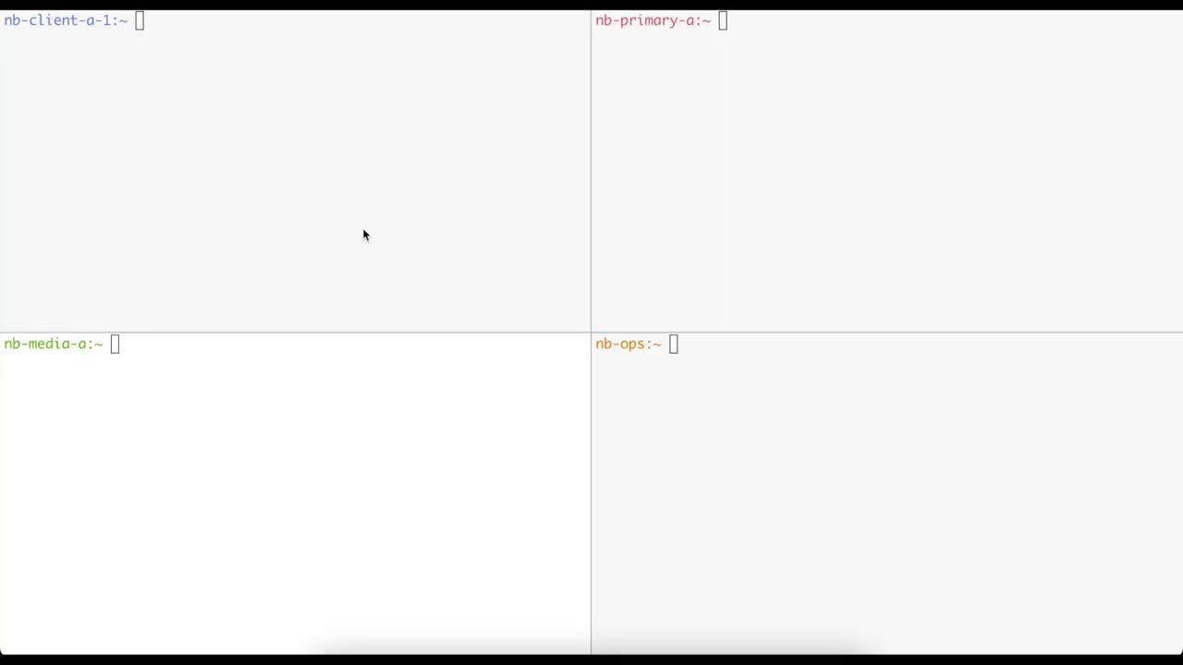

Slide 60
FINDINGS
Reviewing Security Questions
1. What would it take for an attacker to exploit NetBackup?
⇒ Specific tooling & workflow knowledge, not out of reach of motivated attackers
⇒ pbx_exchange, backup policies, trust model, NetBackup commands, etc.
2. Can a Primary Server be compromised from a NetBackup client?
⇒ Yes, and much more
3. Could the NetBackup system be used as a pivot to attack other interconnected systems?
⇒ Yes, as shown in our demo
4. Which data could an attacker target to prevent NetBackup recovery?
⇒ Let’s take a step back

Slide 61
FINDINGS
Minimal Requirements To Restore A NetBackup Infrastructure
Backup data (obviously)
⇒ To restore clients’ files
Primary server catalog
⇒ To know where to find clients’ data
Media server deduplication catalog (if enabled)
⇒ To rebuild full backups
Encryption secret(s) (if enabled)
⇒ To decrypt stored data
Disaster recovery file (optional)
⇒ To automate some recovery steps
Notes:
DR file not required, it’s only to save some time

Slide 62
FINDINGS
Reviewing Security Questions
1. What would it take for an attacker to exploit NetBackup?
⇒ Specific tooling & workflow knowledge, not out of reach of motivated attackers
⇒ pbx_exchange, backup policies, trust model, NetBackup commands, etc.
2. Can a Primary Server be compromised from a NetBackup client?
⇒ Yes, and much more
3. Could the NetBackup system be used as a pivot to attack other interconnected systems?
⇒ Yes, as shown in our demo
4. Which data could an attacker target to prevent NetBackup recovery?
⇒ Backup data, catalogs, encryption secrets, disaster recover file

Slide 63
FINDINGS
Disclosure Timeline
FIRST VULNERABILITY REPORT
2021-10-13: SecLab sent first report to Veritas.
2021-11-22: Veritas acknowledged the report and ask some more details.
2021-12-13: SecLab provided answer to Veritas and a reminder about the 90 days policy.
2022-01-26: Veritas answered with the expected timeline of patch for the different component.
2022-02-28: Veritas provided patches of NetBackup OpsCenter to SecLab for review.
2022-05-10: First patch for NetBackup Primary Server, Media Servers released.
2022-07-13: Veritas released patches and a security advisory for NetBackup OpsCenter: VTS22-009.
2022-07-18: Veritas released a security advisory for NetBackup Clients, Primary Server, Media Server: VTS22-004 , VTS22-008.
2022-09-21: Veritas released hotfix patches for Clients related to VTS22-008.
SECOND VULNERABILITY REPORT
2022-04-11: SecLab sent a 2nd report to Veritas with more findings.
2022-04-11: Veritas acknowledged the 2nd report.
2022-08-01: Veritas released patch for NetBackup Clients (VTS22-010).
2022-08-29: Veritas released patch for NetBackup Primary Server, Media Server. (VTS22-011)
2022-09-23: Veritas released hotfix patches for NetBackup Primary Server, Media Server. (VTS22-010, VTS22-011)
2022-09-26: New advisories released VTS22-010; VTS22-011; VTS22-012; VTS22-013.

Slide 64
1
INTRODUCTION
2
LET’S MEET NETBACKUP
Target Overview: Key Technical Aspects
3
HOW WE DUG INTO NETBACKUP
The Approach, The Challenges And How We Tackled Them
4
FINDINGS
Overview Of Vulnerabilities And Attack Paths
5
TAKEAWAYS

Slide 65
TAKEAWAYS
1. Discovered vulnerabilities illustrate wide attack surface & security impact
~30 CVEs attributed to Airbus Security Lab, official patches available
Presented attack paths showcase possible impact & complexity
2. Work presented only scratches the surface
Plenty of attack surface not yet studied: there’s a lot of room for more work!
Your work is needed and there are plenty of uncharted waters for you to have fun
3. Your favorite enterprise backup software can be broken / better protected
Consider this a gift to convince your employers to let you have an offensive / defensive deep dive!
Skilling-up on such software can help red teaming, pentesting, detecting, etc.
4. The unavoidable pain of backups
Backups are a pain, but French people eat pain for breakfast! 🥖
Notes:
Deploying backup software can add an unforeseen attack surface to your information system. Though it may protect you against unintended data loss, it is a highly integrated and privileged solution that is an ideal target for attackers
Asymmetry between defenders' and attackers' hurdles when it comes to such a complex solution: securing its setup is an order of magnitude more difficult than exploiting it
All software will have vulnerabilities, including security products. In the case of backups, if they are your last line of defense, combine them with other security guarantees (such as WORM), and challenge the implementation to avoid relying on a single prohibitively complex product

Slide 66
Thank you for your attention!
Any questions?
https://airbus-seclab.github.io
@AirbusSecLab
airbus-seclab
Some icons by Ahmad Roaayala, alimasykurm, Alzam, Andi Nur Abdillah, Anil, Anthony Ledoux, Arthur Shlain, Bernar Novalyi, Candy Design, Cazier Visual, Daniel T., Edwin PM, Eko Purnomo, Flatart, Fulloption, Hat-Tech, heisen, Iconspace, Lars Meiertoberens, Mada Creative, Mask Icon, Maxicons, mungang kim, Nithinan Tatah, ochre7, Phonlaphat Thongsriphong, rex, Sadewo, Setyo Ari Wibowo, Shocho, Siddharth Dasari, throwaway icons, TkBt, Umer Younas, Vectors Market, Vectorstall, WEBTECHOPS LLP, Xinh Studio, YANDI RS, YUDHI RESTU PEBRIYANTO from Noun Project, by Simple Icons, and by Icon Fonts

