Slide 1


SereneDB challenge · SchubKI Hackathon 2026
5 M
Making Sense
of Logs
log lines
3
roles
Ask your logs a question. Get the answer your role needs, with proof.
2
commands to set up
Amirali & Konark
Notes:
We built an assistant that answers questions about millions of log lines for three people who need different things: the engineer who fixes, the team lead who plans, the manager who decides. Every number it says can be checked.

Slide 2



THE PROBLEM
Logs hold the answers. Nobody reads them.
Engineer
Team lead
Manager
“What failed?”
“What keeps coming back?”
“What do we fix first?”
Millions of lines don't fit in a prompt, and an AI that guesses numbers can't be trusted.
Making Sense of Logs · Problem
2
Notes:
Three people ask about the same logs. Engineers grep for hours during an outage, team leads count in spreadsheets, managers decide by gut. And you cannot just hand the logs to an AI: they don't fit, and a model that makes up numbers is dangerous.

Slide 3
THE PROBLEM
Raw logs mislead
855,501
1 / 10
69.6 %
FATAL lines, but only 36,714 bursts of problems
real alerts in the top 10 when ranked by log level
of claims correct when an AI greps the raw files (pilot)
Making Sense of Logs · Problem
3
Notes:
Even when you can read them, raw logs mislead. BGL has 855 thousand FATAL lines, but they come from far fewer recurring problems. Rank by severity and only one of the top ten is a real alert. And plain Claude Code grepping the raw files got 70 percent of its claims right in our pilot.

Slide 4




THE SOLUTION
The database counts, the AI explains
Ask
SereneDB
Jev
Answer
in plain words
searches and counts every line
knows which messages are real faults
for your role, with proof
docker compose up -d · claude · “Load the base corpus”
Making Sense of Logs · Solution
4
Notes:
Our solution splits the work. You ask in plain words. SereneDB searches and counts every line. Jev already knows which kinds of messages are real faults. Claude only picks the tools and writes the answer for your role, with every number linked to its query. Setup is two commands and one sentence.

Slide 5
DEMO
One problem, three answers
Engineer
Team lead
Manager
1,024 nodes hit by a new fault
31 bursts, owner disputed
Rank 1 of 133 problems
Next: check host 172.16.96.116
Next: two teams triage together
Next: name one owner now
Making Sense of Logs · Solution
5
Notes:
LIVE DEMO in Claude Code: /mcp__logs__worked_investigation, topic 'what deserves attention in November 2005'. The top problem in BGL, November 2005, is a new fault: 'Link has been severed', 12,996 lines on 1,024 nodes. The engineer gets the first burst and what happened 21 minutes before; the lead gets 31 recurrences and an owner disputed between two teams; the manager gets rank 1 of 133 and a decision. Different evidence, not different lengths. Backup: docs/investigation/report.html.

Slide 6
WHY IT'S BETTER
More accurate and faster
62 / 62
13 – 2
13 s
numbers traced to a query
wins vs the reference design (blind judge)
per answer, vs 71 s for an AI grepping raw files (pilot)
Making Sense of Logs · Solution
6
Notes:
More accurate: every number comes from the database. In the worked investigation, 62 of 62 numbers trace to a query, and Verify re-runs each one. On 50 questions with known answers, a blind judge preferred us 13 to 2 on the brief's data, with fewer wrong claims, 53 vs 69. Faster: in our pilot, Claude Code with our server answered in 13 seconds; grepping the raw files took 71, with 94 vs 70 percent of claims correct.

Slide 7



HOW IT FITS THE COMPANY
It plugs into routines that already exist
On-call
Weekly review
Monthly planning
the engineer, during an incident
the lead, recurring problems by team
the manager, a computed ranking
Their tools
Claude Code / any MCP client
Their data
stays on their machine
Their logs
any file format
Their teams
access per team
Making Sense of Logs · Company
7
Notes:
It fits three routines a company already has: the incident, the weekly review, the monthly planning. It uses the tools people already have, keeps logs on their own machine, reads their own log formats, and maps problems to their teams, with access per team enforced by the database itself.

Slide 8
CHEAPER THAN THE ALTERNATIVES
Judge once, not every line
An LLM reads every line
Jev judges 1,126 patterns
≈ 177 M tokens
$0.02 · 20 s
every time (estimate)
once, reused by every answer
real alerts in the top 10: 1 → 5
Making Sense of Logs · Cost
8
Notes:
Why it's cheaper. Reading all of BGL with a large model is around 177 million tokens, every time you ask; that is an estimate from the file size. Jev, a small model for typed judgments, runs inside SereneDB and judges each kind of message once: 1,126 patterns in 20 seconds for about two cents, stored and reused by every answer. That single step moved real alerts in the top ten from one to five. An answer with Claude plus our server cost about 7 cents in the pilot.

Slide 9





LOADING
One sentence loads your logs
›
›
›
›
›
Stream
Detect format
Parse
Patterns
Jev judges
Index
72 s
1.6 s
76
base corpus, 5 M lines
a new 21 k-line file
log formats detected
Making Sense of Logs · Loading
9
Notes:
Loading. One sentence to Claude starts it, and every step runs inside SereneDB: the file is streamed in with COPY, its format detected from 76 known formats, parsed with SQL into typed columns, reduced to kinds of message, judged once by Jev in SQL, and indexed. The base corpus is ready in 72 seconds, a new 21 thousand line file in 1.6. The expensive work happens once, so every later answer is fast and cheap.

Slide 10
PERFORMANCE
Built on SereneDB's search-analytics engine
Inverted index
Term dictionary
SQL-native load
7 ms
3–39 ms
18 s
full-text count, 4.7 M lines
group-bys without scanning
4.7 M lines parsed
ASOF · ROLLUP · PIVOT
Remote Parquet
On-demand index
< 100 ms
2.8 s
0.94 ms
timelines and rankings
1 B rows on S3, in place
vs 281 ms scan
Making Sense of Logs · Performance
10
Notes:
Performance comes from SereneDB's engine. The inverted index counts a full-text search over 4.7 million lines in 7 milliseconds; group-bys come straight from the term dictionary without scanning rows. Data loads inside the database. Timelines use ASOF joins, rankings use ROLLUP and PIVOT. Remote Parquet on S3 is read in place, and an on-demand index pays for itself after four searches. The database takes under a second per answer; most of the time is the AI writing.

Slide 11




TECHNICAL · MCP
One MCP server, four ways to use it
44 tools
5 prompts
6 resources
Completions
just ask
type /
type @
press Tab
Making Sense of Logs · Technical
11
Notes:
Now the technical part. MCP is how Claude discovers and calls our functions. Our server offers all four kinds: 44 tools Claude picks from their descriptions, 5 prompts as slash commands, 6 resources you attach with @, and completions that suggest real values from your data.

Slide 12
TECHNICAL · TOOLS
44 tools, grouped by the question
Find
Count
Recurring
search_logs · get_context
count_by · trend · rollup
top_patterns · pattern_history
Explain
Decide
Set up
burst_timeline · precursors
priority_table · owner_of
load_logs · use_dataset
Every result: its SQL, the exact total, and a flag if cut to 50 rows
Making Sense of Logs · Technical
12
Notes:
Forty-four tools grouped by the question they answer: find, count, recurring, explain, decide, set up. You never name a tool; Claude picks it from its description, which says when to use it, when not to, what it returns and what comes next. Every result carries the SQL that ran, the exact total, and a flag if rows were cut to 50. Full list in docs/TOOLS.md.

Slide 13
TECHNICAL · PROMPTS AND RESOURCES
Shortcuts in Claude Code
Prompts /
Resources @
investigate_failure
review_recurring_problems
set_priorities
worked_investigation
whole_corpus_counts
logs://datasets
logs://glossary
logs://field-guide/{dataset}
logs://ownership/{dataset}
logs://session/latest
Making Sense of Logs · Technical
13
Notes:
Prompts are slash commands: one playbook per role, a three-role worked investigation, and the whole-corpus counts the brief asks for. Resources attach context with @: the loaded datasets, the glossary, what each field means, the ownership table, and the full evidence of the session, beyond the 50-row tool limit. Arguments complete with real values from the data.

Slide 14





WOW
Beyond what the brief asked for
Your own logs
Verify button
1 B remote rows
Access per team
Blind evaluation
Judged once
Making Sense of Logs · Wow
14
Notes:
What goes beyond the brief: load your own log files with no code; a Verify button that re-runs the query behind any number; a billion OpenTelemetry rows queried in place on S3; access per team enforced by the database, not the prompt; our own blind evaluation with 50 answer keys; and AI judgments computed once inside the database.

Slide 15
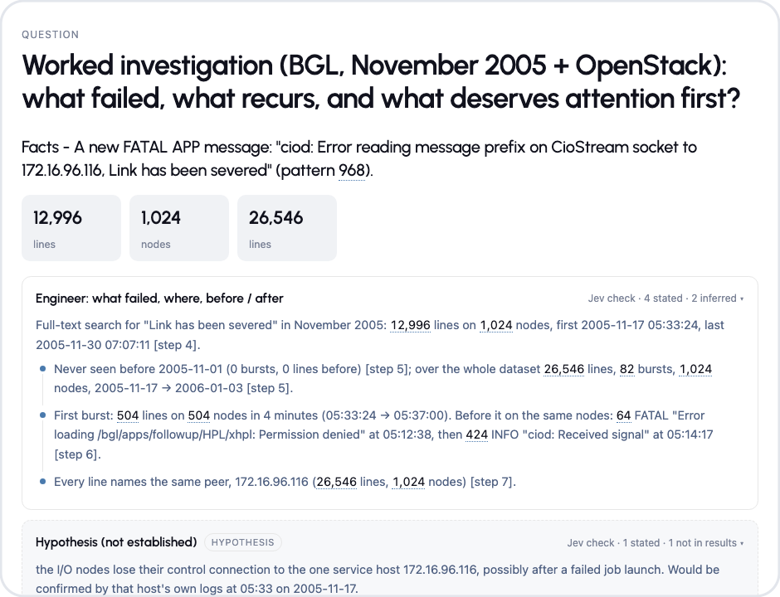
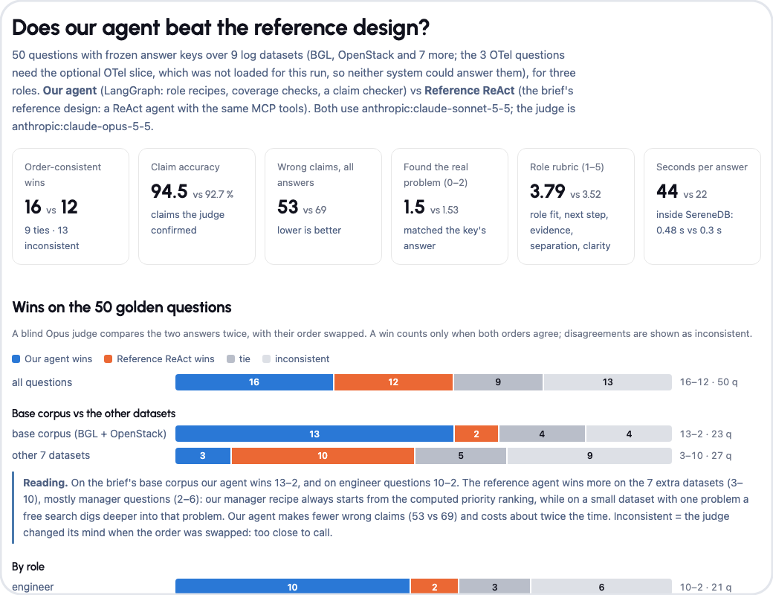
WOW
Every answer comes with its proof
Session report
Eval dashboard
Making Sense of Logs · Wow
15
Notes:
Every answer comes with its proof. On the left, the session report: each number links to the query behind it, and Verify re-runs it. On the right, the evaluation dashboard: 50 questions, both answers, the judge's reasons, and how to re-run it. Both open offline from the repo.

Slide 16




SCALE
Where it goes next
Mittelstand
Other industries
A product
production and IT logs
anything that writes logs
a self-hosted log copilot
10
11.2 M
1 B
log types, no code change
lines loaded in 47 s
remote rows, in place
Making Sense of Logs · Scale
16
Notes:
Nothing in the code is specific to one dataset: ten log types load without code changes, eleven million HDFS lines load in 47 seconds, and a billion remote rows are queried in place. That makes it a product: a self-hosted log copilot for Mittelstand production and IT, and any industry that writes logs.

Slide 17

Try it in two commands
docker compose up -d
claude
> Load the base corpus
github.com/aircode610/making-sense-of-logs-schubki-ai-hackathon
Notes:
Two commands and one sentence, and your logs answer back. The worked investigation, the dashboard and every tool are documented in the repo. Thank you.

