Slide 1


Slide 2

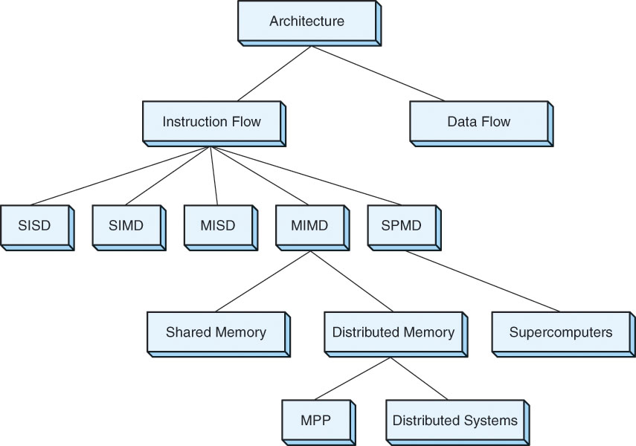
In this course, we concentrate on single processor systems
But there are many other breeds of architectures:
  RISC vs. CISC
  SIMD
  MIMD
  Supercomputers
  Dataflow machines
  Neural networks
  We will briefly look at the differences in the top 3 of this list
NOTE: we do not use MISD machines

Slide 3

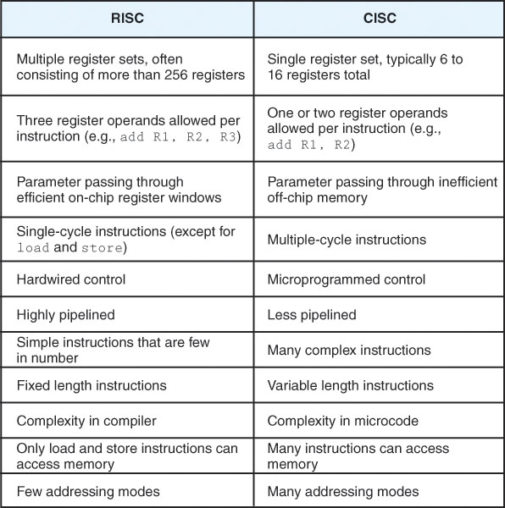
We will describe the difference between these two architectures
  in chapters 4 and 5
Here is a specific list of features
  Recall that the RISC approach is all based around efficient pipelining and parallelism, the CISC approach is mostly based on power
    each instruction should do as much as possible

Slide 4

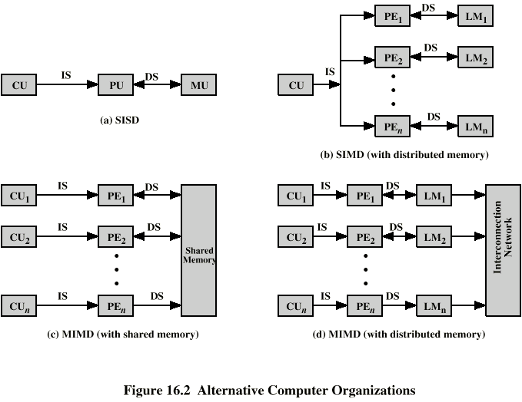
Our traditional computer is SISD:
  A single instruction is executed on a single datum during each fetch-execute cycle
One form of parallelism is SIMD:
  Single instruction executed on multiple data
  This allows us to perform vector or matrix operations with single instructions
    We can reduce the time it takes for image processing, speech recognition, weather forecasting, etc
  There are also useful parallel algorithms that can be executed on SIMD for searching and sorting (we cover some of these in 464)
1 control unit
1 processing unit (ALU)
1 pathway to datum (memory)
1 control unit
1 processing unit for each datum
Direct connection from each
processor to each datum
  Two forms of SIMD architectures are:
    Vector processors (each processor operates on 1 datum of a 1-D array)
    Matrix processors (each processor operations on 1 datum of a 2-D array)

Slide 5

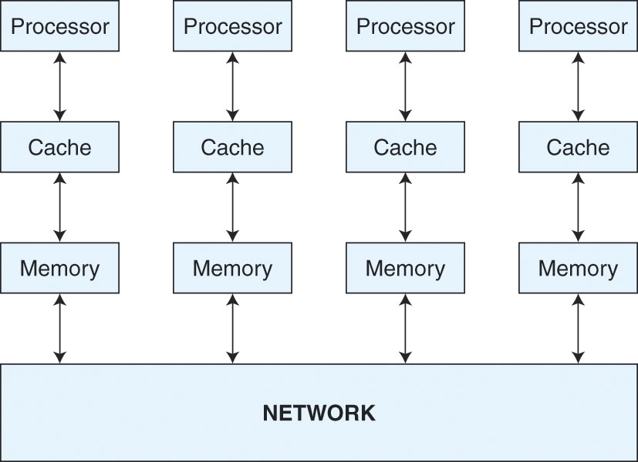
Two forms:
  Tightly coupled – all processors connect to a single shared main memory, communication is through shared variables in memory
    This form is commonly used to run parallel programs
  Loosely coupled – each processor has its own main memory, communication between processors is through an interconnection network (ICN)
    This is like a network of computers, but all resources are located within one box
We do not use MISD (Multiple instructions on a single datum) but we do use MIMD (multiple instructions on multiple data)
  MIMD are true parallel processors
    each unit is a full processor (control unit, ALU, cache)

Slide 6

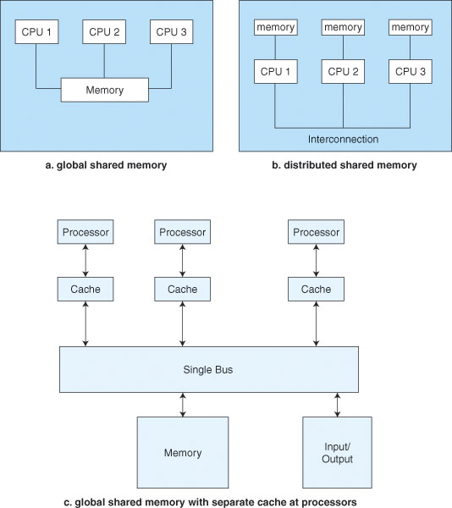
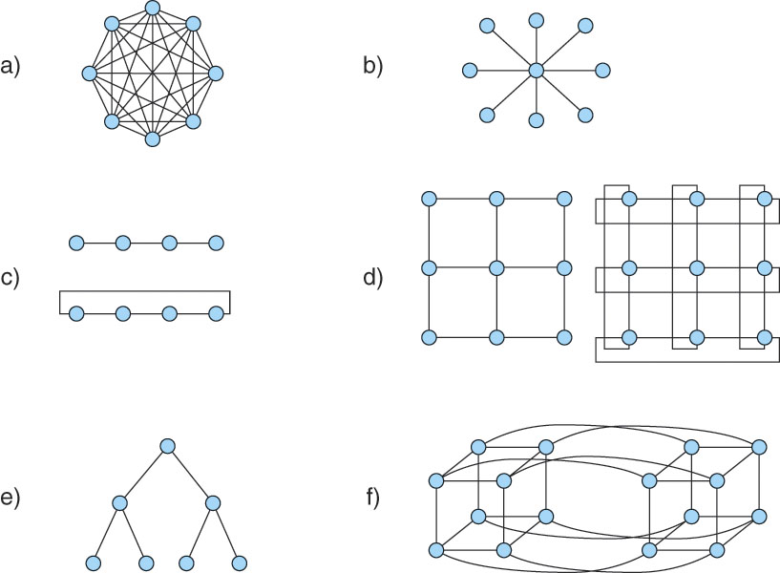
How do the various processors connect together?
  This is the role of the ICN
    Different shapes of ICN are used to solve different types of problems
      The tree network is often used for parallel tournament algorithms and the hypercube is used in other parallel algorithms
d and f (on the left) represent nearest
neighbor, f in particular is known as
a hypercube network (of degree 3)
Notes:
Static Network Topologies
a. Completely Connected
b. Star
c. Linear and Ring
d. Mesh and Mesh Ring
e. Tree
f. Three-Dimensional Hypercube

Slide 7

With affordable networks, the question now becomes:
  How can we use all of these resources efficiently?
  Parallel processors are expensive, but at night, how many computers on the Internet sit idle?
    Let’s use them!
Distributed computing is the ability to launch processes across the network to other machines
  This requires that each machine be able to transmit and accept remote procedure calls (RPCs)
  One machine must keep track of the progress of the processes running on the various processors and there must be adequate communication between the machines (the local-area network will hopefully serve us here)
    SETI uses this idea by running processes on volunteers’ machine across the Internet

