Slide 1
CSCI 162 Topics in Computing Science Prolog

Slide 2
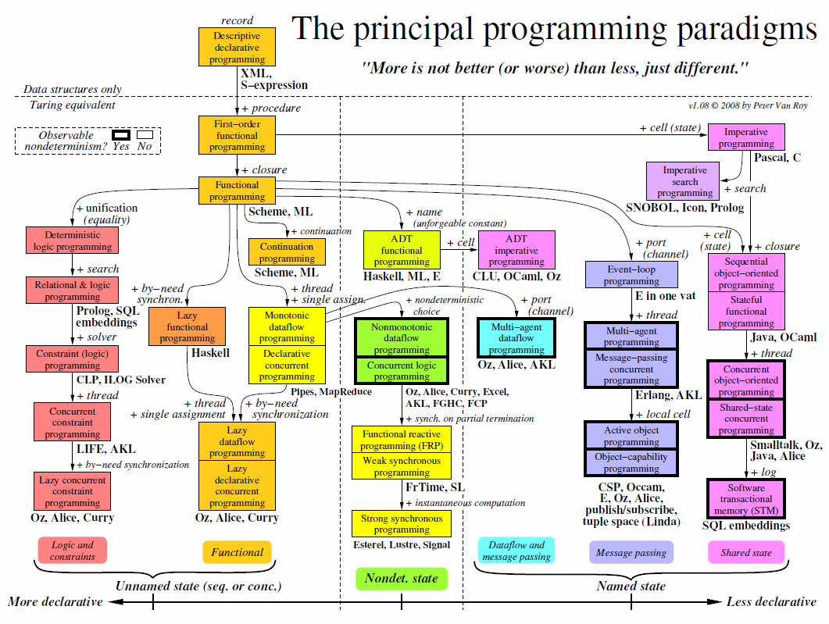
Notes:
The chart classifies programming paradigms according to their kernel languages (the small core language in which all the paradigm’s abstractions can be defined). Kernel languages are ordered according to the creative extension principle: a new concept is added when it cannot be encoded with only local transformations.
Two languages that implement the same paradigm can nevertheless have very different "flavors" for the programmer, because they make different choices about what programming techniques and styles to facilitate.
When a language is mentioned under a paradigm, it means that part of the language is intended (by its designers) to support the paradigm without interference from other paradigms.
It does not mean that there is a perfect fit between the language and the paradigm. It is not enough that libraries have been written in the language to support the paradigm.
The language’s kernel language should support the paradigm.
When there is a family of related languages, usually only one member of the family is mentioned to avoid clutter.
The absence of a language does not imply any kind of value judgment.
State is the ability to remember information, or more precisely, to store a sequence of values in time.
Its expressive power is strongly influenced by the paradigm that contains it.
We distinguish four levels of expressiveness, which differ in whether the state is unnamed or named, deterministic or nondeterministic, and sequential or concurrent.
The least expressive is functional programming (threaded state, e.g., DCGs and monads:unnamed, deterministic, and sequential).
Adding concurrency gives declarative concurrent programming (e.g., synchrocells: unnamed, deterministic, and concurrent). Adding nondeterministic choice gives concurrent logic programming (which uses stream mergers: unnamed, nondeterministic, and concurrent).
Adding ports or cells, respectively, gives message passing or shared state (both are named, nondeterministic, and concurrent).
Nondeterminism is important for real−world interaction (e.g., client/server).
Named state is important for modularity.
Axes orthogonal to this chart are typing, aspects, and domain−specificity.
Typing is not completely orthogonal: it has some effect on expressiveness.
Aspects should be completely orthogonal, since they are part of a program’s specification.
A domain−specific language should be definable in any paradigm (except when the domain needs a particular concept).
Metaprogramming is another way to increase the expressiveness of a language.
The term covers many different approaches, from higher−order programming, syntactic extensibility (e.g., macros), to higher−order programming combined with syntactic support (e.g., meta−object protocols and generics), to full−fledged tinkering with the kernel language (introspection and reflection).
Syntactic extensibility and kernel language tinkering in particular are orthogonal to this chart.
Some languages, such as Scheme, are flexible enough to implement many paradigms in almost native fashion.
This flexibility is not shown in the chart.

Slide 3
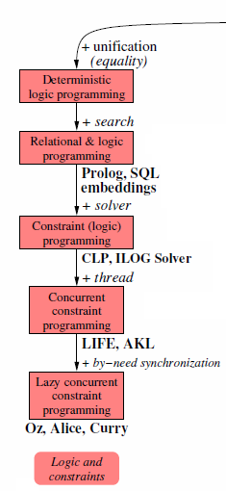
Logic Programming
Good for:
searching (expert systems, graph & tree searching ...)
symbolic interpretation
Bad for:
debugging
modularity

Slide 4
Outline
What is Prolog?
Language syntax
Rules
Questions
Backtracking
Conclusions

Slide 5
What Is Prolog?
Prolog is a logic language that is particularly suited to programs that involve symbolic or non-numeric computation.
For this reason it is a frequently used language in Artificial Intelligence where manipulation of symbols and inference about them is a common task.
Prolog consists of a series of rules and facts.
A program is run by presenting some query and seeing if this can be proved against these known rules and facts.

Slide 6
Syntax
.pl files contain lists of clauses
Clauses can be either facts or rules
male(bob).
male(harry).
child(bob,harry).
son(X,Y):-
male(X),child(X,Y).
Predicate, arity 1 (male/1)
Terminates a clause
Argument to predicate
Indicates a rule
“and”

Slide 7
Rules
Rules combine facts to increase knowledge of the system
son(X,Y):-
male(X),child(X,Y).
X is a son of Y if X is male and X is a child of Y

Slide 8
Questions
Ask the Prolog virtual machine questions
Composed at the ?- prompt
Returns values of bound variables and yes or no
?- son(bob, harry).
yes
?- king(bob, france).
no

Slide 9
Questions [cont’d]
Can bind answers to questions to variables
Who is bob the son of? (X=harry)
?- son(bob, X).
Who is male? (X=bob, harry)
?- male(X).
Is bob the son of someone? (yes)
?- son(bob, _).
No variables bound in this case!

Slide 10
Backtracking
How are questions resolved?
?- son(X,harry).
Recall the rule:
son(X,Y):-
male(X),child(X,Y).

Slide 11
Backtracking [cont’d]
Y is bound to the atom “harry” by the question.
male(X) child(X,Y)
X=harry
Y=harry
child(harry,harry)?
no
X=bob
Y=harry
child(bob,harry)?
yes - succeeds

Slide 12
Applications
Intelligent systems
Complicated knowledge databases
Natural language processing
Logic data analysis

Slide 13
Conclusions
Strengths:
Strong ties to formal logic
Many algorithms become trivially simple to implement
Weaknesses:
Complicated syntax
Difficult to understand programs at first sight

Slide 14
Issues
What applications can Prolog excel at?
Is Prolog suited for large applications?
Would binding the Prolog engine to another language be a good idea?

