Slide 1
CSCI 162 Abstract Data Types
A quick introduction to abstract data types and recursion.

Slide 2
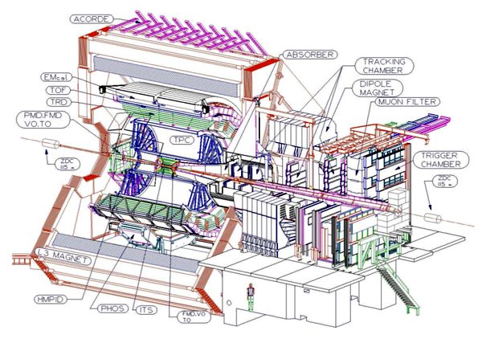


What is an Abstract Data Type?
An ADT is a mathematical model which may be used to capture the essentials of a problem domain in order to translate it into a computer program.
Built on the idea of encapsulation
No Breaching Encapsulation!
Interface
Abstract Data Type Implementation
What is going on in here?
Implementation

Slide 3
ADT Examples
Examples of ADTs
Stacks
Queues
Lists
Trees
Graphs
Sets
The idea of objects came from ADTs

Slide 4
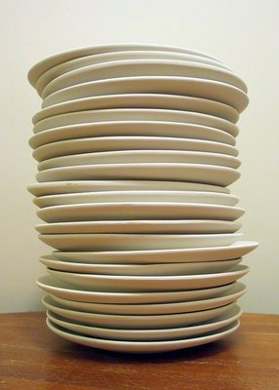
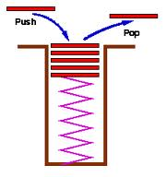
Stack: A.K.A. LIFO
Think of a stack of dishes in the cafeteria.
Wash a plate → put it on top
Need a plate → Take the top one.
Only interact with the top plate
Defining Operations
Push – Put a new item on the top
Pop – Take the last element off
Other operations:
Empty?
Top

Slide 5

Queue: A.K.A. FIFO
Think of a line for a movie.
Line up at the back.
When you reach the front, buy a ticket.
Only add to the end
Only remove from the front
Defining Operations
Push – Put a new item at the end
Pop – Take the first element out
Other operations:
Empty?
Front
Size

Slide 6
List
Think of a snake who’s tail forms a new head each time you cut it off.
Add/Remove anywhere
Defining Operations
Head – The first element in a list
Tail – The rest of the list
List.tail().head()
Other operations:
Insert
Remove
Empty
Size

Slide 7
MyLinkedList.h in C++
// MyLinkedList.h
// Author: Sheldon Cooper
// This file implements a linked list.
#ifndef MY_LINKEDLIST_H
#define MY_LINKEDLIST_H
#include <cstdlib>
#include <iostream>
using namespace std;
class MyLinkedList; // needed for friend line below
#endif // MY_LINKEDLIST_H
Next 2 slides go here.

Slide 8
MyLinkedList.h in C++
class ListElement
{
private:
int datum;
ListElement* next;
public:
ListElement (int, ListElement*);
int getDatum () const;
ListElement const* getNext () const;
friend class LinkedList; // gives LinkedList access to datum and next
};
datum
next

Slide 9
MyLinkedList.h in C++
class MyLinkedList
{
private:
ListElement* head;
public:
LinkedList (); // Constructor
int size();
int getItem(int where);
void insertAt (int item, int where)
void insertItem (int);
void makeList ();
void appendItem (int);
void deleteItem (int where);
void printList ();
};

Slide 10
Stack.h in C++ (Using MyLinkedList)
// MyLinkedList.h
// Author: Sheldon Cooper
// This file implements a linked list.
#ifndef MY_STACK_H
#define MY_STACK_H
#include "MyLinkedList.h"
#include <iostream>
using namespace std;
#endif // MY_STACK_H
Next slide goes here.

Slide 11
MyStack.h in C++
class MyStack
{
private:
LinkedList myData;
public:
MyStack(); // Constructor
void Push(int);
int Pop();
};

Slide 12
MyStack.cpp
LinkedList myData;
int getItem(int where);
void insertAt (int item, int where);
void deleteItem (int where);
#include "MyStack.h"
using namespace std;
void MyStack::Push(int data)
{
myData.insertAt(data,0);
}
int MyStack::Pop()
{
myData.getItem(0);
myData.deleteItem(0);
}

Slide 13
Recursion
Recursion

Slide 14
Recursion
Recursion
Sometimes, the best way to solve a problem is by solving a smaller version of the exact same problem first
Recursion is a technique that solves a problem by solving a smaller problem of the same type
A procedure that is defined in terms of itself
When you turn that into a program, you end up with functions that call themselves:
Recursive Functions

Slide 15
Mystery Function
What does this function return?
int mystery (int n)
{
if (n < 3 )
return (1);
else
return(mystery(n-2)
+ mystery(n-1));
}
Stopping case
Recursive calls to mystery
Finds the nth Fibonacci number

Slide 16
Recursion
Recursion
What’s does this function do?
public int f(int a){
if (a==1)
return(1);
else
return(a * f( a-1));
}
It computes f! (factorial)

Slide 17
Factorial
Factorial:
Note:
Remember:
...split up the problem into a smaller problem of the same type...
*
a! = 1 * 2 * 3 * ... * (a-1) * a
a! = a * (a-1)!
a!
a
(a-1)!

Slide 18
Tracing the example
public int factorial(int a){
if (a==0)
return(1);
else
return(a * factorial( a-1));
}
RECURSION !

Slide 19
Tracing the example
public int factorial(int a){
if (a==0)
return(1);
else
return(a * factorial( a-1));
}
5!
5!
5*24=120 is returned
5 * 4!
5 * 4!
4*6=24 is returned
4 * 3!
4 * 3!
3*2=6 is returned
3 * 2!
3 * 2!
2*1=2 is returned
2 * 1!
2 * 1!
1*1=1 is returned
1 * 0!
1 * 0!
1 is returned
1
1

Slide 20
Watching the Stack
public int factorial(int a){
if (a==1)
return(1);
else
return(a * factorial( a-1));
}
a = 1
Return to L4
a = 2
Return to L4
a = 3
Return to L4
a = 4
a = 4
Return to L4
…
Return to L4
a = 5
a = 5
a = 5
Initial
After 1 recursion
After 4th recursion
Every call to the method creates a new set of local variables !

Slide 21
Watching the Stack
public int factorial(int a){
if (a==1)
return(1);
else
return(a * factorial( a-1));
}
a = 1
Return to L4
a = 2
a = 2*1 = 2
Return to L4
Return to L4
a = 3
a = 3
a = 3*2 = 6
Return to L4
Return to L4
Return to L4
a = 4
a = 4
a = 4
a = 4*6 = 24
Return to L4
Return to L4
Return to L4
Return to L4
a = 5
a = 5
a = 5
a = 5
a = 5*24 = 120
After 4th recursion
Result

Slide 22
Properties of Recursive Functions
Problems that can be solved by recursion have these characteristics:
One or more stopping cases have a simple, nonrecursive solution
The other cases of the problem can be reduced (using recursion) to problems that are closer to stopping cases
Eventually the problem can be reduced to only stopping cases, which are relatively easy to solve
Follow these steps to solve a recursive problem:
Try to express the problem as a simpler version of itself
Determine the stopping cases
Determine the recursive steps

Slide 23
Solution
The recursive algorithms we write generally consist of an if statement:
IF
the stopping case is reached solve it
ELSE
split the problem into simpler cases using recursion
Solution on stack
Solution on stack
Solution on stack

Slide 24
Common Programming Error
Recursion does not terminate properly: Stack Overflow !

Slide 25
Exercise
Define a recursive solution for the following function:
f(x) = x
n
int Power(int base, int exp)
{
if(exp == 0)
return 1
else
return(base * Power(base, exp-1)
}

Slide 26
Recursion vs. Iteration
You could have written the power-function iteratively, i.e. using a loop construction
What‘s the difference ?

Slide 27
Recursion vs. Iteration
Iteration can be used in place of recursion
An iterative algorithm uses a looping construct
A recursive algorithm uses a branching structure
Recursive solutions are often less efficient, in terms of both time and space, than iterative solutions
Recursion can simplify the solution of a problem, often resulting in shorter, more easily understood source code
(Nearly) every recursively defined problem can be solved iteratively.
Iterative optimization can be implemented after recursive design

Slide 28
Deciding whether to use a Recursive Function
When the depth of recursive calls is relatively “shallow”
The recursive version does about the same amount of work as the nonrecursive version
The recursive version is shorter and simpler than the nonrecursive solution

Slide 29
Examples: Fractal Tree
http://id.mind.net/~zona/mmts/geometrySection/fractals/tree/treeFractal.html

Slide 30
Examples: The 8 Queens Problem
http://mossie.cs.und.ac.za/~murrellh/javademos/queens/queens.html
Eight queens are to be placed on a chess board
in such a way that no queen checks against
any other queen

Slide 31
Recursive String Methods
Write a recursive method that will print the characters in a string recursively, one character at a time.
public static void printString (String s)
{
if ( s.length() == 0)
return;
else
{ System.out.println ( s.charAt(0) );
printString ( s.substring (1) );
}
}

Slide 32
Recursive String Methods
Write a recursive method that will print a String in reverse order one character at a time.
public static void printReverse ( String s )
{
if ( s.length() > 0 )
{ printReverse ( s.substring ( 1 ) );
System.out.println ( s.charAt ( 0 ) );
}
}
Many recursive solutions involve breaking a sequential structure, such as a string or an array, into its head and tail. An operation is performed on the head, and the algorithm recurses on the tail.

Slide 33
Recursive String Methods
Write a recursive method that will count the number of occurrences of the character ch in the String s.
public static int countChar (String s, char ch)
{
if ( s.length() == 0 )
return 0;
else if ( s.charAt ( 0 ) == ch)
return 1 + countChar ( s.substring (1), ch);
else
return 0 + countChar ( s.substring (1), ch);
}

Slide 34
Recursive String Methods
Write a recursive method to convert a String representing a binary number to its decimal equivalent. For example, binTodecimal (“101011”) should return the int 43.
public static int binTodecimal (String s)
{
if ( s.length() == 1)
return Integer.parseInt (s);
else
return Integer.parseInt (s.substring (s.length() - 1)) +
2 * binTodecimal (s.substring (0, s.length() - 1);
}

Slide 35
Recursive Array Methods
Write a recursive method that will do a sequential search on an array.
public static int rSearch (int[] arr, int head, int key )
{
if ( head == arr.length )
return –1;
else if ( arr[head] == key )
return head;
else
return rSearch ( arr, head + 1, key );
}

