Slide 1
CSCI 162 Topics in Computing Science Programming Languages An introduction to functional programming

Slide 2
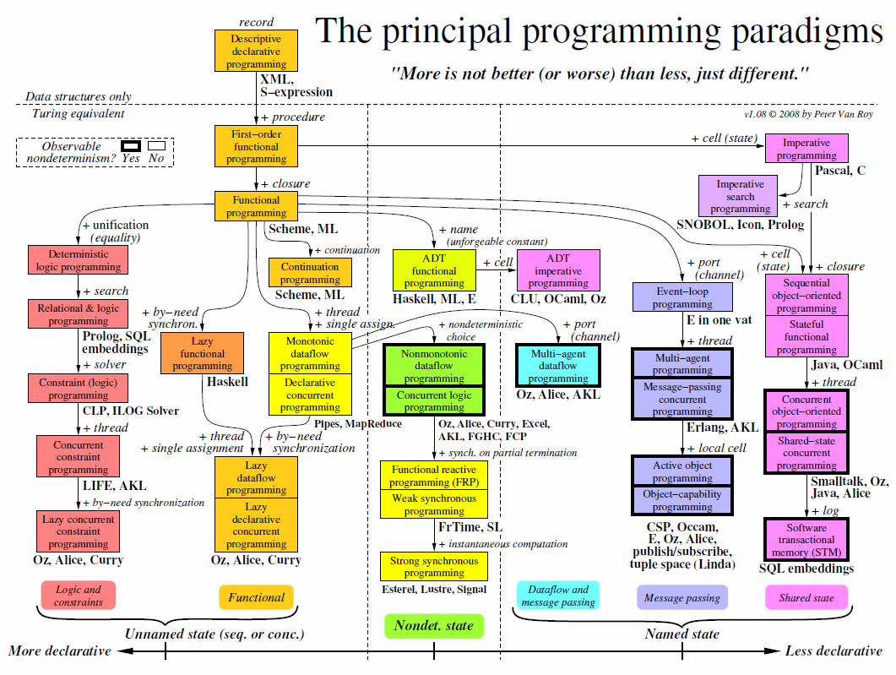
Notes:
The chart classifies programming paradigms according to their kernel languages (the small core language in which all the paradigm’s abstractions can be defined). Kernel languages are ordered according to the creative extension principle: a new concept is added when it cannot be encoded with only local transformations.
Two languages that implement the same paradigm can nevertheless have very different "flavors" for the programmer, because they make different choices about what programming techniques and styles to facilitate.
When a language is mentioned under a paradigm, it means that part of the language is intended (by its designers) to support the paradigm without interference from other paradigms.
It does not mean that there is a perfect fit between the language and the paradigm. It is not enough that libraries have been written in the language to support the paradigm.
The language’s kernel language should support the paradigm.
When there is a family of related languages, usually only one member of the family is mentioned to avoid clutter.
The absence of a language does not imply any kind of value judgment.
State is the ability to remember information, or more precisely, to store a sequence of values in time.
Its expressive power is strongly influenced by the paradigm that contains it.
We distinguish four levels of expressiveness, which differ in whether the state is unnamed or named, deterministic or nondeterministic, and sequential or concurrent.
The least expressive is functional programming (threaded state, e.g., DCGs and monads:unnamed, deterministic, and sequential).
Adding concurrency gives declarative concurrent programming (e.g., synchrocells: unnamed, deterministic, and concurrent). Adding nondeterministic choice gives concurrent logic programming (which uses stream mergers: unnamed, nondeterministic, and concurrent).
Adding ports or cells, respectively, gives message passing or shared state (both are named, nondeterministic, and concurrent).
Nondeterminism is important for real−world interaction (e.g., client/server).
Named state is important for modularity.
Axes orthogonal to this chart are typing, aspects, and domain−specificity.
Typing is not completely orthogonal: it has some effect on expressiveness.
Aspects should be completely orthogonal, since they are part of a program’s specification.
A domain−specific language should be definable in any paradigm (except when the domain needs a particular concept).
Metaprogramming is another way to increase the expressiveness of a language.
The term covers many different approaches, from higher−order programming, syntactic extensibility (e.g., macros), to higher−order programming combined with syntactic support (e.g., meta−object protocols and generics), to full−fledged tinkering with the kernel language (introspection and reflection).
Syntactic extensibility and kernel language tinkering in particular are orthogonal to this chart.
Some languages, such as Scheme, are flexible enough to implement many paradigms in almost native fashion.
This flexibility is not shown in the chart.

Slide 3
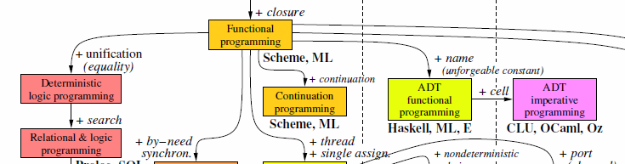
Functional Languages
Good for:
equational reasoning
declarative programming
Bad for:
OOP
explicit concurrency
run-time efficiency (although constantly improving)

Slide 4
Functional Vs. Imperative Programming
Imperative (Procedural) Programming
FORTRAN, COBOL, Pascal, C, BASIC, Ada, etc.
emphasizes changes in state
Functional Programming
evaluation of mathematical functions
emphasizes the application of functions
Roots in λ calculus (Lambda calculus)
Notes:
Having taken the prerequisites for this course:
CSCI 162 - Topics in Computing Science (fourth generation languages)
CSCI 260 - Data Structures
CSCI 261 - Computer Architecture & Assembly Language
CSCI 265 - Software Engineering
You have been introduced to a number of imperative or procedural languages even if you were not told that is what they are called.
[Click ] - imperative programming is a programming paradigm that describes computation in terms of statements that change a program state. In much the same way that imperative mood in natural languages expresses commands to take action
Procedural programming is imperative programming in which the program is built from one or more procedures (also known as subroutines or functions). The terms are often used as synonyms, but the use of procedures has a dramatic effect on how imperative programs appear and how they are constructed. Heavily procedural programming, in which state changes are localized to procedures or restricted to explicit arguments and returns from procedures, is known as structured programming.
[Click ] - In computer science, functional programming is a programming paradigm that treats computation as the evaluation of mathematical functions and avoids state and mutable data.
[Click ] - in sharp contrast to the imperative programming style, which emphasizes changes in state.
Functional Programming emphasizes the application of functions,
[Click ] - Functional programming has its roots in lambda calculus, a formal system developed in the 1930s to investigate function definition, function application, and recursion. Many functional programming languages can be viewed as elaborations on the lambda calculus.
In practice, the difference between a mathematical function and the notion of a "function" used in imperative programming is that imperative functions can have side effects, changing the value of program state. Because of this they lack referential transparency, which means the same language expression can result in different values at different times depending on the state of the executing program.

Slide 5
Referential transparency
Definition: An expression is said to be referentially transparent if it can be replaced with its value without changing the program.
Depends only on its arguments (No global variables)
Has no side effects
If all functions involved in the expression are pure functions, then the expression is referentially transparent.
Notes:
An expression is said to be referentially transparent if it can be replaced with its value without changing the program (in other words, yielding a program that has the same effects and output on the same input). The opposite term is referentially opaque.
[Click ] - functional code is referentially transparent so the output value of a function depends only on the arguments that are input to the function, so calling a function f twice with the same value for an argument x will produce the same result f(x) both times. Eliminating side effects can make it much easier to understand and predict the behaviour of a program, which is one of the key motivations for the development of functional programming.
[Click ] - If all functions involved in the expression are pure functions, then the expression is referentially transparent.

Slide 6
Pure Functions
In computer programming, a function may be described as pure if both these statements about the function hold:
The function always evaluates the same result value given the same argument value(s).
Evaluation of the result does not cause any semantically observable side effect or output.
Notes:
In computer programming, a function may be described as pure if both these statements about the function hold:
1. The function always evaluates the same result value given the same argument value(s). The function result value cannot depend on any hidden information or state that may change as program execution proceeds or between different executions of the program, nor can it depend on any external input from I/O devices.
2. Evaluation of the result does not cause any semantically observable side effect or output, such as mutation of mutable objects or output to I/O devices.
The result value need not depend on all (or any) of the argument values. However, it must depend on nothing other than the argument values. The function may return multiple result values and these conditions must apply to all returned values for the function to be considered pure. If an argument is call by reference it is considered to be a combination of one argument and one return value and so the argument will get overwritten; because of this call by reference will make an expression impure even if the function called is pure.

Slide 7
Pure Functions
Pure functions
SQRT(x) – Square root of X
Length(s) – Length of a string s
Impure functions
Random() – It is designed to return a different value each time.
Printf() – causes output to an I/O device.
Next() – Returns the next element in a linked list.
Notes:
Pure functions
sin(x), returning the sine of a number x
length(s), returning the size of a string s
encrypt(k,d), running an encryption algorithm on a piece of data d using a key k
Impure functions
A hypothetical function today() that returns the current day of the week is impure because at different times it will yield different results—it refers to some global state. Similarly, any function that uses global state or a static variable is potentially impure.
random() is impure because each call potentially yields a different value. (This is because pseudorandom generators use and update a global "seed" state. If we modify it to take the seed as an argument, i.e. random(seed); then random becomes pure, because multiple calls with the same seed value return the same random number.)
printf() is impure because it causes output to an I/O device as a side effect.
It is possible for a pure expression to yield an impure function (or more generally a value which contains one or more impure functions).
It is also possible for an expression to be pure even if one or more of the argument subexpressions yields an impure function (or a value which contains one or more impure functions). In this case the impure function(s) in the argument must not be applied during evaluation (but may be incorporated in the result somehow). However, dealing with programs that allow impure and pure functions to be mixed like this can be quite difficult in practice, thus purely functional programming languages do not allow impure functions to be defined.

Slide 8
Functional programming languages
Pure Functional Programming Languages
Charity
Clean
Curry
Haskell
Miranda
Many functional languages are "impure", containing imperative features
Lisp
Scheme
Notes:
Functional languages
Functional languages include:
Pure
Charity
Clean
Curry
Haskell
Miranda
[Click ] assignments for this course will be in Haskell, a standardized, general-purpose purely functional programming language, with non-strict semantics and strong static typing.
[Click ] - Many so-called functional languages are "impure", containing imperative features. Not surprisingly, many of these languages are tied to mathematical calculation tools. There are many of them, but the most ubiquitous one is Lisp
Impure
APL
Curl
Erlang
F#
FPr
CAL
Hop
J
Joy
Kite
Lisp
Clojure
Common Lisp
Dylan
eLisp Emacs Lisp
Little b
Logo
Scheme
Racket (used to be Scheme)
Tea
Lush
Mathematica
ML
Standard ML
Alice
Ocaml
Mythryl
Nemerle
Opal
OPS5
Poplog
Q (equational programming language)
Q (programming language from Kx Systems)
R
REFAL
Russell
Scala
Spreadsheets

Slide 9
Why be referentially transparent?
One advantage of writing code in a referentially transparent style is that given an intelligent compiler, static code analysis is easier and better code-improving transformations are possible automatically.
The primary disadvantage of languages which enforce referential transparency is that it makes the expression of operations that naturally fit a sequence-of-steps imperative programming style more awkward and less concise.
Notes:
One advantage of writing code in a referentially transparent style is that given an intelligent compiler, static code analysis is easier and better code-improving transformations are possible automatically. For example, when programming in C, there will be a performance penalty for including a call to an expensive function inside a loop, even if the function call could be moved outside of the loop without changing the results of the program. The programmer would be forced to perform manual code motion of the call, possibly at the expense of source code readability. However, if the compiler is able to determine that the function call is referentially transparent, it can perform this transformation automatically.
-----------------------------------------------------------------------------------
Blackboard Example
int plusOneRTransparent(x) {
return (x + 1);
}
int plusOneROpaque(x) {
x++;
return (x);
}
Consider the following expressions:
Int result = plusOneRTransparent(x) + plusOneRTransparent(y) *(plusOneRTransparent(x) - plusOneRTransparent(x))
Can reduce to
Int result = plusOneRTransparent(x)
But this can not!!!
Int result = plusOneRTransparent(x) + plusOneRTransparent(y) *(plusOneROpaque(x) - plusOneROpaque(x))
mathematical identities such as x − x = 0 no longer hold.
Such mathematical identities will hold for referentially-transparent functions
-----------------------------------------------------------------------------------
The primary disadvantage of languages which enforce referential transparency is that it makes the expression of operations that naturally fit a sequence-of-steps imperative programming style more awkward and less concise. Such languages often incorporate mechanisms to make these tasks easier while retaining the purely functional quality of the language, such as definite clause grammars and monads.
With referential transparency, no difference is made or recognized between a reference to a thing and the corresponding thing itself. Without referential transparency, such difference can be easily made and utilized in programs.

Slide 10
λ Calculus
It is the foundation of programming languages in general and functional programming in particular.
It introduces the most basic form of computation, functional evaluation by reduction.
Since the names of functions are largely a convenience, the lambda calculus has no means of naming a function.
Since all functions expecting more than one input can be transformed into equivalent functions accepting a single input (via Currying), the lambda calculus has no means for creating a function that accepts more than one argument.
Notes:
Just read this slide.
We will discuss currying in later classes.
The lambda calculus consists of lambda terms and some extra operations.
Since the names of functions are largely a convenience, the lambda calculus has no means of naming a function. Since all functions expecting more than one input can be transformed into equivalent functions accepting a single input (via Currying), the lambda calculus has no means for creating a function that accepts more than one argument. Since the names of arguments are largely irrelevant, the native notion of equality on lambda terms is alpha-equivalence (see below), which codifies this principle.
Currying may be best grasped intuitively through the use of an example. Compare the function (x, y) ↦ x*x + y*y with its curried form, x ↦ (y ↦ x*x + y*y). Given two arguments, we have: ((x, y) ↦ x*x + y*y)(5, 2) = 5*5 + 2*2 = 29. However, using currying, we have: ((x ↦ (y ↦ x*x + y*y))(5))(2) = (y ↦ 5*5 + y*y)(2) = 5*5 + 2*2 = 29 and we see the uncurried and curried forms compute the same result. Notice that x*x has become a constant.

Slide 11
λ Calculus Syntax
< λ-exp> ::= <vars> | <abstraction> | <application> | ‘(‘< λ-exp>’)’
<abstraction> ::= ‘λ’ <var> ‘.’ < λ-exp>
Conceptually and abstraction is an “Unnamed function”
Note: All functions take a single parameter/argument.)
<application> ::= < λ-exp> < λ-exp>
An application is a function invocation
Notes:
For example, these are λ-expressions:
x a Variable
λx.x an Abstraction
λf.(λx.fx) and abstraction inside another abstraction
(x y) an Application
Abstraction:
Conceptually and abstraction is an “Unnamed function”;
λx.<body>
Denotes a function where ‘x’ is it parameter
Application
An application is a function invocation
(λx.<body>)<argument>
Denotes a function evaluation/call where the variable ‘x’ has <argument> as its value in <body>
In other words, every “bound” occurrence of x in <body> is replaced by <argument>

Slide 12
λ Calculus Syntax
A variable ‘x’ is bound if it is inside λx.< λ -exp> otherwise it is free.
x x is free
(x y) x,y are free
λx.x x is bound
(λx.x) x
Free
Bound
Notes:
Examples: On board
(λx.xy)f becomes ?? Answer: f y
↑_ Bound
(λf.fy)(λx.x) becomes ?? Answer: (λx.x)y
↑_ Bound
((λx.λy.xyy)u)v becomes
((λx.λy.xyy)u)v – Step 1
(λy.uyy)v
uvv (Normal form)

Slide 13
Quick Quiz
Imperative Programming emphasizes ____ _ ___ while Functional Programming emphasizes the _______ _ ______
An expression is said to be ________ _______if it can be replaced with its value without changing the program
Which of these functions are impure?
What is (((λc.λa.λt.cat)d)o)g _____ in normal form
changes in state
application of functions
referentially transparent
Sin(x)
IncrementGlobalVariableBy(x)
PopStack()
Printf(“Hello World”)
dog

Slide 14
Imperative Programming
emphasizes changes in state
Functional Programming
emphasizes the application of functions
evaluation of mathematical functions
Lambda
Logic Programming
Concurrent Programming
Notes:
In computer science, functional programming is a programming paradigm that treats computation as the evaluation of mathematical functions and avoids state and mutable data. It emphasizes the application of functions, in contrast to the imperative programming style, which emphasizes changes in state.^{[1]} Functional programming has its roots in lambda calculus, a formal system developed in the 1930s to investigate function definition, function application, and recursion. Many functional programming languages can be viewed as elaborations on the lambda calculus.^{[1]}
In practice, the difference between a mathematical function and the notion of a "function" used in imperative programming is that imperative functions can have side effects, changing the value of program state. Because of this they lack referential transparency, i.e. the same language expression can result in different values at different times depending on the state of the executing program. Conversely, in functional code, the output value of a function depends only on the arguments that are input to the function, so calling a function f twice with the same value for an argument x will produce the same result f(x) both times. Eliminating side effects can make it much easier to understand and predict the behavior of a program, which is one of the key motivations for the development of functional programming.^{[1]}

Slide 15
Resources
Free online books
Understanding Programming Languages (by M. Ben-Ari)

